Slide 1
Increasing Biofuel Deployment through Renewable Super Premium
for the
Energy Future Coalition
March 24, 2015
Tim Theiss, ORNL
Bob McCormick, NREL
Michael Wang, ANL
Notes:
----- Meeting Notes (3/19/15 11:01) -----
Introduce co-workers

Slide 2
Outline of Presentation
Background & motivation
Project overview
Technical highlights
  Dedicated RSP Vehicle Demonstration – ORNL
  Infrastructure assessment for RSP – NREL & ORNL
  Market assessment of RSP – NREL & ORNL
  Well-to-wheel greenhouse gas (GHG) & energy analysis – ANL
Summary
Q & A

Slide 3

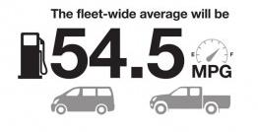

Transportation Industry Faces Unprecedented Challenges
Renewable Fuel Standard
Fuel Economy Standards
Emissions Regulations
36 billion gallons by 2022
(EISA 2007)
2025 CAFE Standards
(U.S. EPA and U.S. NHTSA standards)
70% NO_{x} & PM, 85% NMOG
< 10 ppm sulfur in gasoline
(U.S. EPA Tier 3 regulations)
Renewable Super Premium (RSP) can create additional demand for large amounts of ethanol & enable improved fuel economy in dedicated vehicles (supports biofuels & automobile industries)
Existing project is “scoping study” to address barriers, quantify benefits and determine if additional R&D is warranted

Slide 4




















The Team … a 3-Lab Collaboration
Shean Huff
Mike Kass
Paul Leiby
‘Debo Oladosu
Jim Szybist
Jeongwoo Han, Amgad Elgowainy & Michael Wang
Tim Theiss
Teresa Alleman
Aaron Brooker
John Thomas
Gina Chupka
Caley Johnson
Bob McCormick
Kristi Moriarty
Emily Newes
Brian West
Rocio Uria-Martinez

Slide 5
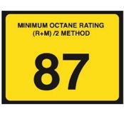
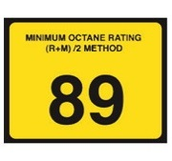
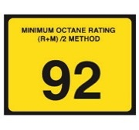
Background on Fuel Octane Number
RENEWABLE SUPER PREMIUM *
REGULAR
PLUS
PREMIUM
MINIMUM OCTANE RATING
(R+M)/2 METHOD
95
RON 91
RON 93
RON 95
RON 100
Octane is measured by RON (research octane number); MON (motor octane number) and AKI (anti-knock index) which is the average of RON + MON
  Isooctane has an AKI, RON and MON of 100
For modern technology engines, RON is the better measure of knock prevention
Fuel octane number can be changed by using different octane petroleum or ethanol concentration
Higher octane number allows for more aggressive engine design, which can improve efficiency

Slide 6
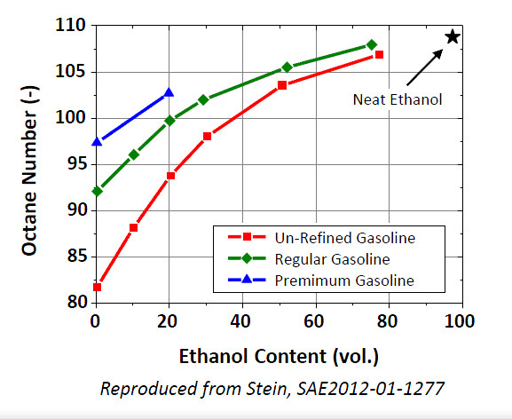
Motivation for High-Octane, Mid-Level Ethanol Blends
Ethanol has 2/3 energy density of gasoline but high octane
Non-linear influence of ethanol content → most benefit at lower levels
Efficiency gains have been demonstrated in research studies at ORNL, Ford & others
Optimum blend likely 20-40% ethanol → non-linear benefit of higher octane vs. linear decrease in energy density
RSP
Low-Octane BOB
Regular Gasoline
Premium Gasoline
Define “Renewable Super Premium” as RON ~ 100 with 25-40% ethanol

Slide 7
Considering the Viability of Renewable Super Premium
Stakeholder Engagement
Existing Flex-Fuel Vehicles
Refinery Impact
Knock Resistance
Existing
Infrastructure
Low-Cost
Blendstocks
Barriers & Opportunities
Dedicated RSP Vehicle Efficiency
Market Assessment
Well to Wheels Environmental Performance
Information for Decision-Makers

Slide 8
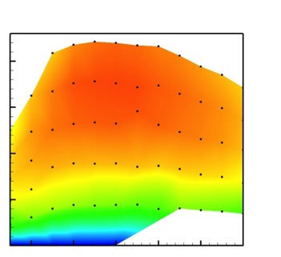
Higher Octane Fuel Enables Both Engine and Vehicle Efficiency Gains
Many drive cycles do not coincide with engine’s most efficient operating range
Engine based technologies can improve the maximum efficiency
Vehicle based technologies can shift engine drive-cycle demands to higher efficiency region
  Down-speeding and down-sizing
New technologies can help promote operation in the high efficiency plateau
These technologies are being applied in real engines – leveraging projects from Bioenergy and Vehicle Technologies Offices
4.5% efficiency gain has been demonstrated in turbo-charged GDI vehicle on high load driving cycle
Efficiency Contours for Light-Duty Engine
Peak BTE region of speed/load map
Engine Load
Light-duty drive cycle
Engine Speed
High fuel efficiency region of current passenger vehicle production engines is small and does not intersect light-duty drive cycle speed/load requirements.

Slide 9
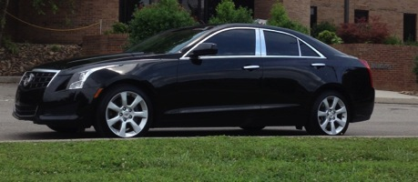
High-Octane Efficiency Benefits Demonstrated at the Vehicle Level
Acquired vehicle suitable as “dedicated RSP vehicle”
  Currently conducting baseline tests on range of fuels with factory pistons/calibration
  Fuel blends will span various octane levels with different sources of octane number (e.g., Regular, Premium, E10-100 RON, E25-100 RON, E40-100 RON)
  GM ATS Vehicle with 2.0 Turbo GDI Engine
Key Assumption/Goal:
Volumetric Fuel Economy Parity
E25 – 5% efficiency gain
E40 – 10% efficiency gain (stretch)
Implement engine and vehicle based tools to improve efficiency
Will be able to demonstrate possible efficiency gains with “dedicated” RSP vehicle
  Compare high octane from ethanol and gasoline
  Will not universally apply to all vehicles or conditions
Notes:
Objective is to demonstrate FE improvement on vehicle platform.
Complementary to ongoing engine projects in VTO
Same Engine as new VTO FOA/CRC Project
Manual Transmission will readily enable downspeeding
Currently conducting baseline tests on range of fuels with factory pistons/calibration
Change to high compression ratio, revise calibration
Fuel blends will span various octane levels with different sources of octane number
Work supported by DOE Bioenergy Technologies Office, GM technical support (vehicle uses same engine as DOE FOA project [CRC AVFL-26])

Slide 10
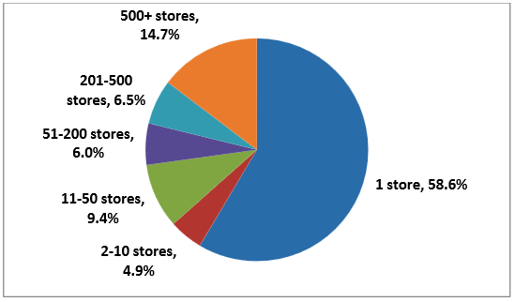
Is the Retail Infrastructure the “showstopper” to RSP?
Determined costs to upgrade stations for E25 and E25+
Identified compatible equipment by manufacturer and model
Technically E25/E25+ is possible. Marketwise, E25 is less costly and more acceptable to retailers
Most materials used are compatible
Identified issue: refueling stations are not required to keep equipment records - a challenge for determining compatibility
Estimate that ~ 20% of stations have to carry new fuel for it to be “widely available”
Infrastructure barrier has been overstated!
Most retail stations are small businesses

Slide 11
Market Assessment Study Examined Eight RSPV Adoption Scenarios
Mandated deployment of RSP/RSPV (all vehicles starting in MY18 and largest 20% of stations)
Replace mid-grade with RSP and convert premium fuel vehicles to RSP-vehicles (RSPV), then highest performance next – saves stations money
Price-driven adoption of RSPV (switch most efficient vehicles first) and station subsidies (40% & 80% of incremental cost to upgrade to RSP)
Eliminate high altitude gas and introduce ethanol-tolerant, premium-optimized vehicles, mandate all new refueling equipment
E85 becomes 51% ethanol (currently a legal fuel), utilize FFV infrastructure; E51 is back-up fuel for RSPV until RSP is available
Require all new dispensers to be blender pumps (capable of RSP), vehicles are market-driven adoption
Deploy RSP Regionally (Midwest, CA), build up from existing FFV infrastructure
Expensive - new UST and dispensers, $455 incremental cost for vehicles; 20% largest stations must sell RSP by 2023
Rapid deployment bookend - mandate fuel, retail dispensing, and vehicles
Manufacturers proactively convert car models to RSPVs
Considered multiple policies to investigate impact of the assumptions – not predict “correct” scenario
Manufacturers proactively convert car models to RSPVs
Consumer choice/CAFE drivers - but mandate to optimize new vehicles to 98 RON and ethanol-tolerant
Less Aggressive Policies
Consumer choice/CAFE drivers
Slow deployment bookend - E40, new UST and dispenser, high vehicle cost
Notes:
Note that scenarios are not intended to be predictive but rather to demonstrate what factors are important and how these factors interact

Slide 12
Ethanol Demand from Supply Chain Simulation- Preliminary
Feedstock availability and cost do not limit deployment of RSP
In all scenarios, dedicated RSPs make up more than a third of vehicle fleet by 2030
Actual ethanol usage is limited by biorefinery construction rate for:
  Rapid deployment scenario, E40 case throughout the simulation
  Scenarios where only RSP refueling equipment is available drive a rapid increase in demand such that biorefinery construction is limiting in initial years (2020-2023)
In scenarios with significant cost for RSP refueling equipment, RSP availability at retail limits actual demand
Preliminary results show potential ethanol consumption in 2035 ranging from 28 to 58 billion gal/yr for the E40 rapid deployment scenario and 18 to 32 billion gal/yr for the E25 price driven scenario
Range is based on different assumptions for vehicle fleet mix and vehicle fuel economy
Both vehicle market penetration and ethanol demand sensitive to how RSP is treated for CAFE

Slide 13
Environmental Analysis of High Octane Fuel are Being Conducted
Expanded definition: High Octane Fuel (HOF) = RON 100 (RSP or E10)
Estimate well-to-wheels (WTW) energy and green house gas (GHG) emissions benefits of RSP/HOF with different ethanol blending levels
  Conduct petroleum refinery modeling of producing HOF with different ethanol blending levels
  Update upstream crude production and cellulosic and corn ethanol production
Estimate WTW GHG emissions benefits of HOF
  Assess vehicle efficiency gains by HOF
  Analyze refinery challenges for meeting RON and RVP requirements with different ethanol blending levels without the 1 psi waiver for E10+
  Estimate GHG benefits of corn and cellulosic ethanol blending for HOF production

Slide 14
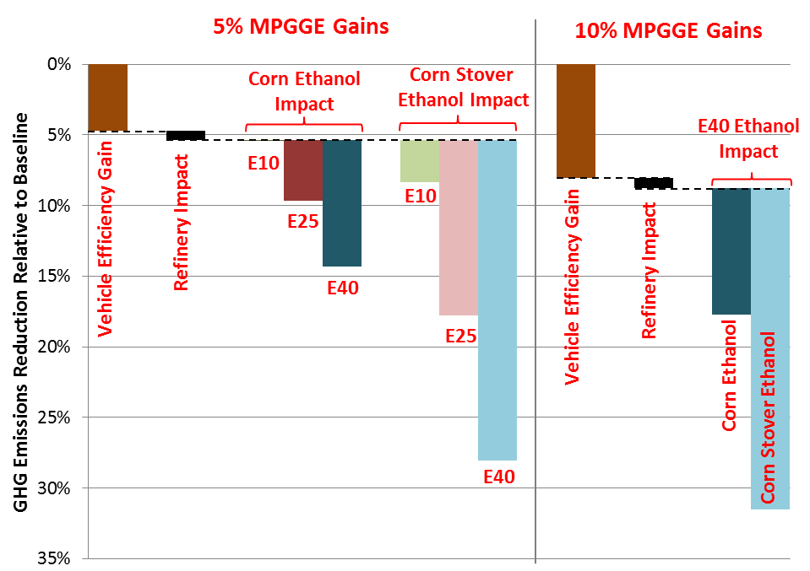
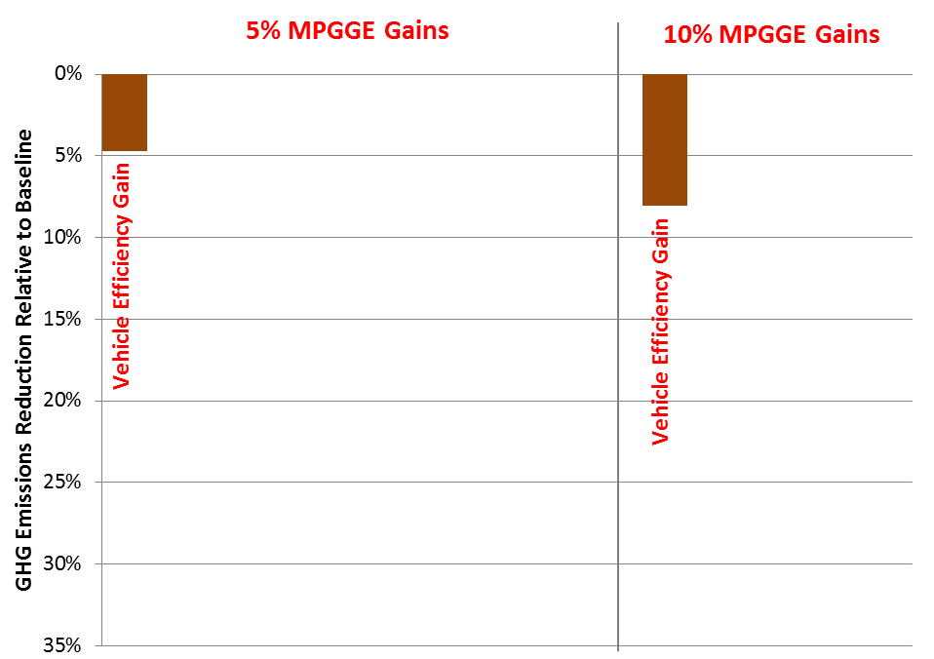
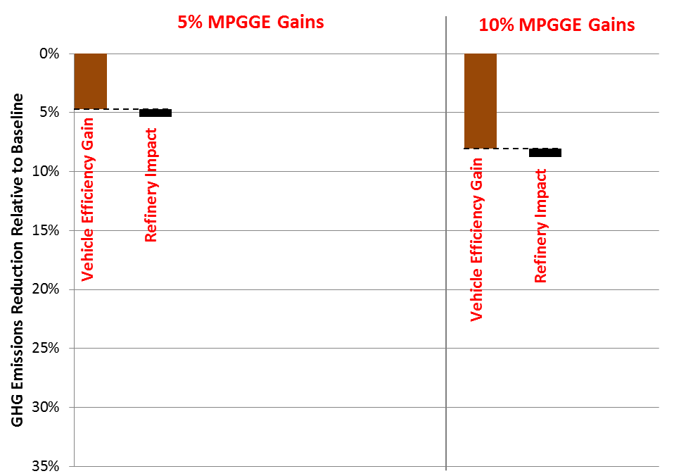
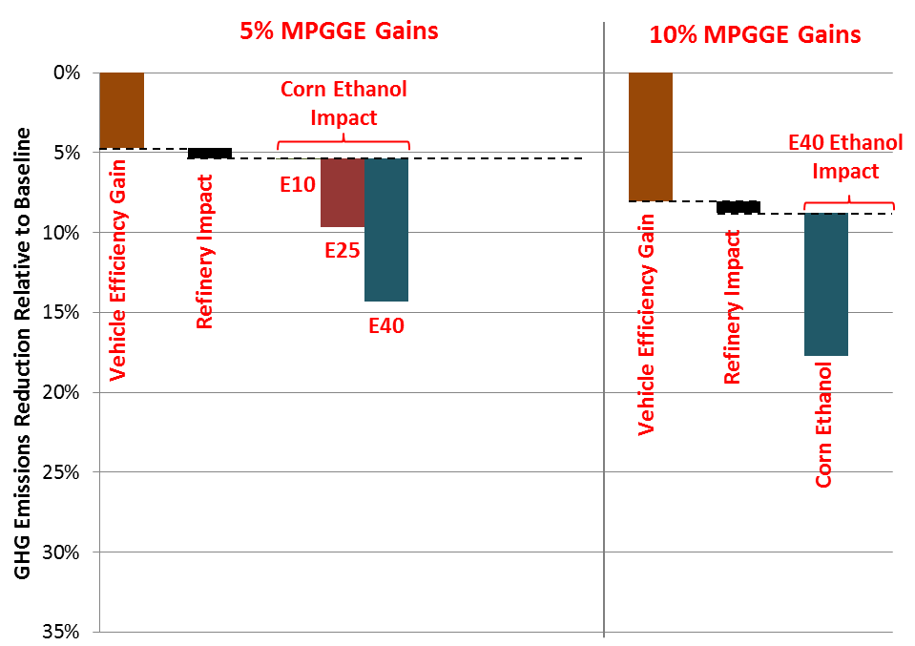
RSP Reduces WTW GHG Emissions
(Only for HOF E40)
30% reduction
GHG reductions due to efficiency gains: 5-9% respectively
Minimal refinery Impact: <1%
Additional GHG reductions for ethanol impact depends on ethanol source
Efficiency-ethanol combined GHG reductions ~ 30% for cellulosic ethanol with E40!
Notes:
This slide is animated.

Slide 15
Provisional Results To Date Are Encouraging …
Ethanol is a significant enabler for high octane fuels
Potential vehicle efficiency gains significant (5-10% feasible)
Significant reductions in GHG (~30% with cellulosic ethanol)
Little decrease in overall US refinery efficiency, even at very high demands
Ethanol offers higher volume of HOF and additional GHG benefits not achievable with E10 HOF
Provides opportunities for refineries to export gasoline products
Immediately usable in legacy FFVs (17M)
Reasonable path forward in infrastructure
Significant market share for dedicated RSP vehicles using different market scenarios
Significant increase in ethanol demand (~18-58 BGY ethanol)
With equal decreases in petroleum!

Slide 16
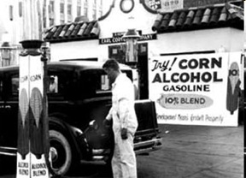
Thank you for this opportunity
Questions?

Slide 17
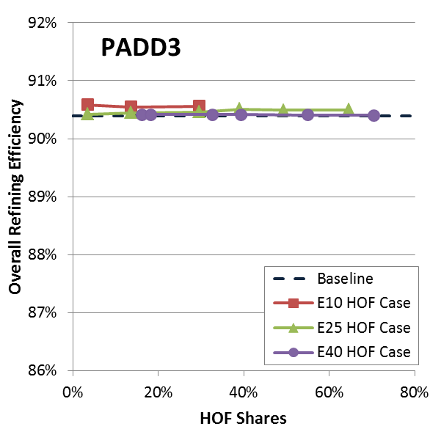
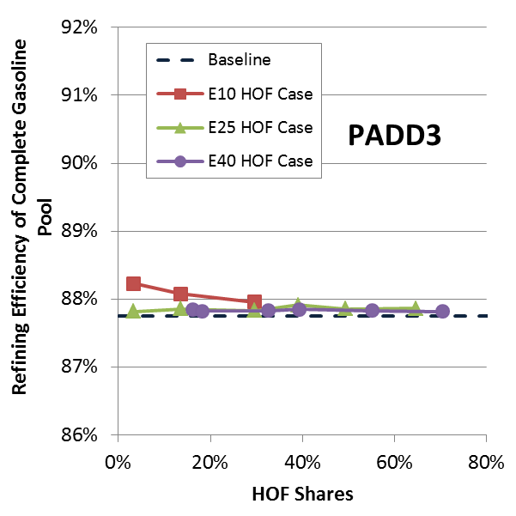
Accomplishment: Overall Refinery and Gasoline BOB Efficiencies Are Changed Little with Ethanol Blending Level and HOF Share
BOB: Blendstock for Oxygenate Blending; BOB + Ethanol = Finished Gasoline
E10 HOF is feasible only up to ~25% of gasoline market share
  A result of no new capital investment assumption
PADD2 shows similar trends
Notes:
PADD2 results are provided in backup: Overall refinery and gasoline efficiencies are fairly unchanged with blending level and HOF shares
No significant efficiency penalty by HOF
Limited market share of E10 HOF and no new capital investment assumption
Larger fuel gas yield: E10 HOF → More reformate → Larger fuel gas yield → Less purchased NG → Slightly higher efficiency
At expense of lower gasoline yield and loss of profit

Slide 18
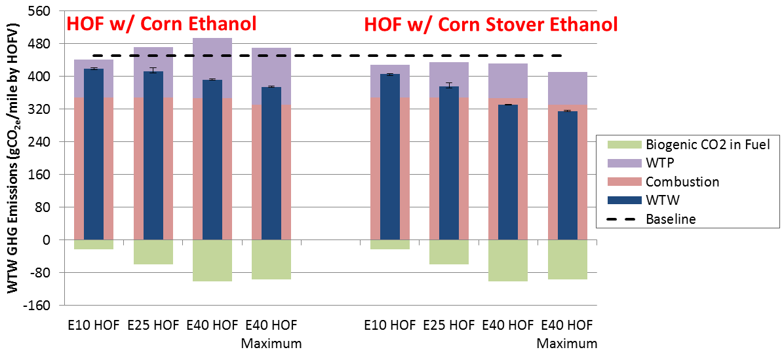
Vehicle Fuel Economy Gains Provides Additional WTW GHG Emissions Reductions (per mile result, PADD3)
E10, E25 and E40 HOF → 5% MPGGE gain (volumetric fuel parity at E25)
E40 HOF Maximum → 10% MPGGE gain (Volumetric fuel parity at E40)
Notes:
PADD2 results are provided in backup: Vehicle fuel economy gains provides additional WTW GHG emissions reduction (per mile basis, PADD2)

Slide 19
Objective and Approach: Market Assessment
Objective: Assess the feasibility, economics, and logistics of adopting RSP by drivers, vehicle makers, fuel retailers, and fuel producers
Approach:
Identify benefits of RSP to key participants
Define hurdles to RSP adoption
Propose resolutions to hurdles
Model vehicle adoption rates for various
scenarios (consumer preference model)
Model biofuel production supply chain
Based on literature review and discussion with industry representatives/stakeholders
Scenarios are resolutions grouped by compatibility and synergies
Industry and Stakeholder Interactions
Drivers | Vehicle Makers | Fuel Retailers | Fuel Producers
AAA | General Motors | National Association of Convenience Stores | Renewable Fuels Association
National Association of Fleet Administrators | Honda |  | Poet
National Automobile Dealers Association | Ford |  | ICM Inc. and Ethanol Across America
 | Mercedes |  | Magellan Midstream Partners
 | USCAR Fuels WG |  | BP
Notes:
10 is the FY15 work

Slide 20
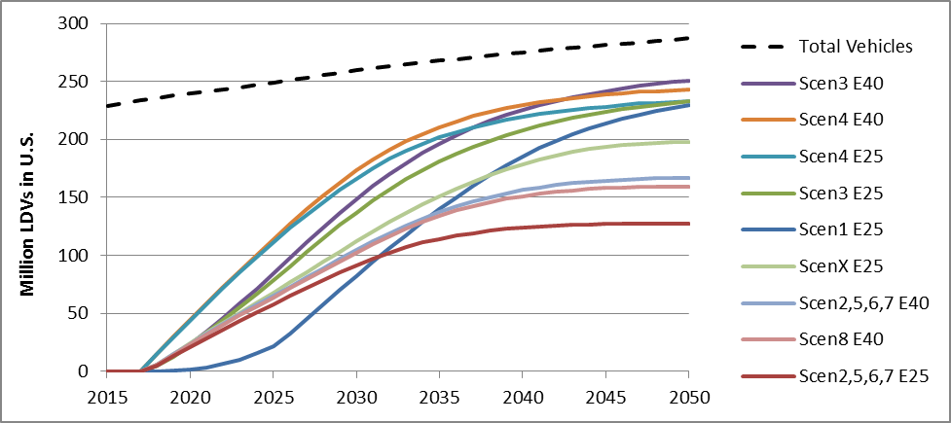
Vehicle Market Penetration Simulation Results - Preliminary
All scenarios achieved a substantial percentage (44%−87%) of the light-duty vehicle stock by 2050
More RSPVs are adopted if RSP is E40 because they offer greater fuel cost savings and more CAFE benefit than if RSP was E25
$2,500 purchase incentive boosted 2050 penetration by 55% in consumer choice driven scenarios
“Performance vehicles first” conversion was the slowest to gain momentum
High gasoline prices had little effect on the rate of RSPV adoption because high gasoline prices enabled CAFÉ compliance through more efficient vehicles
Total Vehicles
Price driven adoption E40
Mandated deployment bookend E40
Mandated deployment bookend E25
Price driven adoption E25
Replace mid-grade with E25/RSP performance cars
Consumer choice+CAFE+$2500 RSPV incentive E25
Consumer choice+CAFE E40
Slow deployment bookend (E40 only)
Consumer choice+CAFE E25

Slide 21
Increased Efficiency with High Octane Fuels Has Been Demonstrated
Results with standard factory pistons
RON Increasing
Higher octane increases maximum efficiency & high efficiency plateau of engines

