Slide 1
Fixing Weaknesses in the Feedstock Regulatory Landscape
Pre-Processing, Follow-the-Crop, Depot, Dandelion Model— Taking a New Look at the Definition of Feedstock Material at a Biofuels Production Facility
Advanced Bioeconomy Feedstocks Conference June 9, 2015

Slide 2
Advocates for the adoption of advanced biofuels as an
energy security,
military flexibility,
economic development
climate change mitigation
pollution control
solution.
Advanced Biofuels USA
501(c)3 Nonprofit
Educational Organization
Founded April 2008
Website:
www.AdvancedBiofuelsUSA.org
Frederick, MD
Notes:
Advanced Biofuels USA, a nonprofit educational organization advocates for the adoption of advanced biofuels as an energy security, military flexibility, economic development and climate change mitigation/pollution control solution. Our key tool for accomplishing this is our web site, www.AdvancedBiofuelsUSA.org, a resource for everyone from opinion-leaders, decision-makers and legislators to industry professionals, investors, feedstock growers and researchers; as well as journalists, teachers and students.
In addition, we prepare technology assessments, present briefing documents to Congressional staff, participate in international conferences on renewable fuels, provide both background and attributed interviews for a wide range of journalists and broadcast reporters, consult with international conference organizers, conduct presentations and lectures for civic and school groups, and provide general assistance to those interested in any facet of the world of advanced biofuels.

Slide 3
Advanced Bioeconomy Feedstocks Conference June 9, 2015
Notes:
Thanks to ACORE for organizing the working group that pulled together this paper.

Slide 4
Contributing Authors
Notes:
Which included these people and companies. Those who are here will be happy to answer specific questions you have about an important problem with the RFS that I’m going to describe.

Slide 5
Renewable Fuel Standard
Notes:
So, to start with the RFS.
The idea is to increase advanced biofuels in the marketplace over time.

Slide 6
Renewable Fuel Standard: Facility
“means all of the activities and equipment associated with the production of renewable fuel starting from the point of delivery of feedstock material to the point of final storage of the end product, which are located on one property, and are under the control of the same person (or persons under common control.” (40 CFR 80.1401)
Notes:
To start out, if you want to make a fuel that is counted toward achieving the RFS goals, you have to make it in a facility that meets this definition which pretty much reflects how a corn-ethanol plant operates.

Slide 7
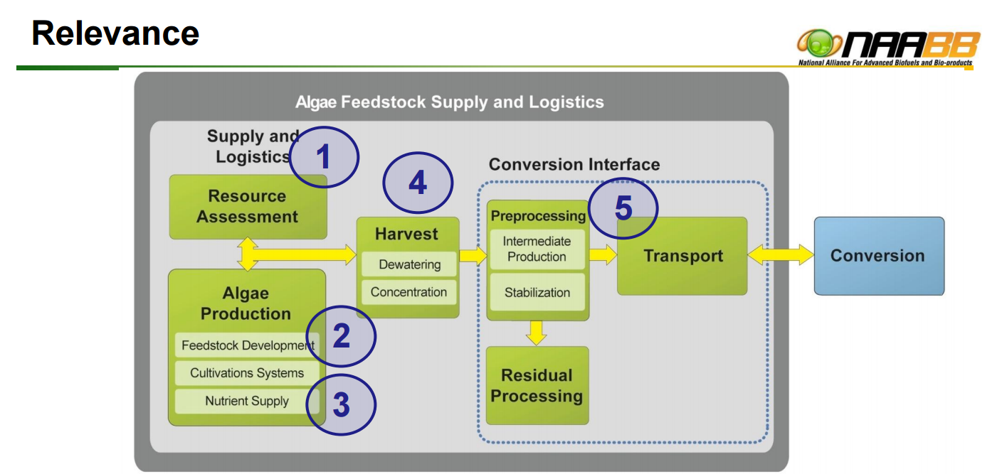
But … How does it really work for many advanced biofuels?
Notes:
However, as advanced biofuels have been developed, that “everything happens in one location” model doesn’t apply.
It looks more like this with production of intermediates or pre-processing taking place close to the growing and harvesting site or food processing location -- with pre-processed feedstock then being transported to another location for final conversion into fuels.

Slide 8
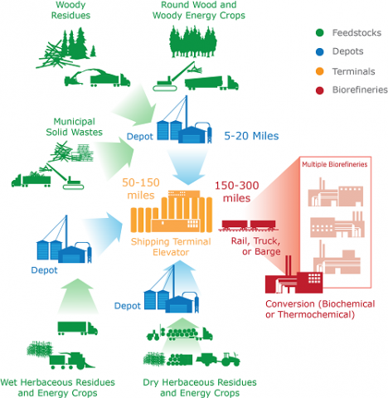
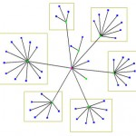
Pre-Processing, Intermediates, Dandelion Model, Follow-the-Crop, Regional Biomass Processing Depots
The Dandelion Model: Two-step biofuels technologies and the emergence of super-refineries Biofuels Digest October 24, 2012
DOE EERE Biomass Feedstocks website page
Notes:
http://www.energy.gov/eere/bioenergy/biomass-feedstocks
http://www.biofuelsdigest.com/bdigest/2012/10/24/the-dandelion-model-two-step-biofuels-technologies-and-the-emergence-of-super-refineries/
A number of people and organizations have described this phenomena.
Jim Lane calls it the dandelion model
Bruce Dale at Michigan State calls it a depot system
Bob Kozak at Atlantic Biomass refers to a “Follow-the-Crop” system
The US Department of Energy has this graphic on the EERE Biomass Feedstocks website.
All clearly anticipate that raw material will be partially converted (to oils, sugars, etc.) and then transported for final refining.
Much like the oil extracted from wells, tar sands, etc., is partially processed before shipping to large scale petroleum refineries.

Slide 9
How RINs Work Part A
Renewable fuel produced
Fuel sold to obligated party with RIN attached
Obligated Party gives RINs to EPA to prove use in market
Fuel sold without RINs has less value.
Notes:
So what?
RINs.
If renewable fuel doesn’t have a RIN attached, it is worth less in the marketplace.
At it’s most basic, this is how Renewable Identification Numbers are used to prove that the objectives of the RFS are being met.
Renewable fuel that does not have a RIN attached has less value because it doesn’t help the obligated party prove to EPA that it has put renewable fuel into the market.

Slide 10
How RINs Work Part B
Terminal Operator/Blender or Obligated Party has extra RINs
Sells RINs in open market
RIN-needy Obligated Party buys RINS to give to EPA to prove use in market
Speculator buys RINs to keep for future sale
Fuel sold without RINs has less value.
Notes:
Fuel with RINs attached also has added value because RINs can be traded and sold.
Here’s how it usually works.
Obligated parties are usually refiners; however the renewable fuel is usually delivered to the blender. The blender then sells or trades the RINs to the refiners; and can also sell them to speculators who bet on the price of the RINs going up and down.
So, again, renewable fuel without RINs is at a disadvantage.

Slide 11
But … How does it really work for many advanced biofuels?
Notes:
Because, EPA is interpreting this system that includes transportation from a pre-processing site to a final refinery to not meet the definition of “facility” that we looked at before.
The White Paper explains that EPA should re-think how it interprets the term “feedstock material” in that definition, so that it accommodates the reality of advanced biofuels production.

Slide 12
Federal Government Support--Consortium funded by DOE
National Advanced Biofuels Consortium (NABC).
three intermediates to be further processed in standard refinery operations:
bio-crudes for co-processing with crude oil;
refinery-ready intermediates substantial downstream processing; and
near-finished fuels or blendstocks.
National Alliance for Advanced Biofuels and Bioproducts (NAABB).
Goal: to reduce the cost of producing algae-based “biocrude” as an intermediate that could be processed into hydrocarbon fuels at a refinery location.
Notes:
The government should harmonize the work by DOE, USDA that has encouraged development of advanced biofuels using this model with its interpretation of “feedstock material” to include these intermediates.
For one, government-supported organizations have developed advanced biofuels using the pre-processing/intermediate model.

Slide 13
Federal Government Support--Technologies investments by DOE, USDA, FAA, DOE
DOE Integrated Biorefineries.
Solazyme
Algenol
DoDAlgal-derived Jet Fuel.
DARPA awarded to General Atomics
Dynamic Fuels
Solazyme
Alcohol-to-Jet (ATJ).
LanzaTech
Pacific Northwest National Lab
Swedish Biofuels
Notes:
In addition to the agencies listed, the Department of Defense, particularly the Navy, has been testing fuels made using the pre-processing/intermediate model.

Slide 14
How to Fix the Problem?
Doesn’t need an Act of Congress
EPA can address by
Clarify interpretation of feedstock material in the definition of facility in the RFS consistent with government research, investment and practice
Notes:
The government should harmonize the work by DOE, USDA that has encouraged development of advanced biofuels using this model with its interpretation of “feedstock material” to include these intermediates.

Slide 15
How to Fix the Problem?
EPA should clarify that For the purposes of section 80.1401 it understands, within the definition of facility,
“feedstock material means
any material that arrives at the facility that is processed into the end renewable fuel product. “
Notes:
Here’s the clarification that we suggest EPA adopt.

Slide 16
Addressing Compliance Concerns
Doesn’t need an Act of Congress
EPA can address by
Reporting and Recordkeeping Requirements
Strengthening the Quality Assurance Program (QAP)
Improving Testing
Notes:
If there are any concerns about compliance, the responsibility would still be with the final fuel producer, the one that generates the RINs.
The White Paper goes into more detail about the specifics of compliance assurance.
Here’s a quick overview.

Slide 17
Addressing Compliance Concerns
Reporting and Recordkeeping Requirements
The generator of RINs would be responsible for compliance with requirements of the appropriate pathways.
The RFS rules already provide for the tracking and accounting for the integrity of “renewable biomass” pre-processing at a location different from fuel production.

Slide 18
Addressing Compliance Concerns
Strengthening the Quality Assurance Program (QAP)
Third-party site visits,
Mass and energy balance that include pre-processing,
Appropriate documentation,
Technical methods of measuring the renewable energy content of a finished product.

Slide 19
Addressing Compliance Concerns
Improving Testing
Gauge biogenic fuel content through isotope testing methods
Accelerator Mass Spectrometer (AMS)
Liquid Scintillation Counter (LSC),

Slide 20
Questions?
LINK TO ACORE WHITE PAPER:
http://www.acore.org/images/uploads/ACORE%20EPA%20Co-Location%20White%20Paper.pdf
Joanne Ivancic 301-644-1395 info @ AdvancedBiofuelsUSA.org
Jeramy Shays , (202) 507-4629 shays @ acore.org
Advanced Bioeconomy Feedstocks Conference June 9, 2015

