Slide 1
Advanced Biofuels A Truly Sustainable Renewable Future
Advanced Biofuels USA
www.AdvancedBiofuelsUSA.org
301-644-1395

Slide 2
Advocates for the adoption of advanced biofuels as an
energy security,
military flexibility,
economic development
climate change mitigation
pollution control
solution.
Advanced Biofuels USA
501(c)3 Nonprofit
Educational Organization
Founded April 2008
Website:
www.AdvancedBiofuelsUSA.org
Frederick, MD
Notes:
Advanced Biofuels USA, a nonprofit educational organization advocates for the adoption of advanced biofuels as an energy security, military flexibility, economic development and climate change mitigation/pollution control solution. Our key tool for accomplishing this is our web site, www.AdvancedBiofuelsUSA.org, a resource for everyone from opinion-leaders, decision-makers and legislators to industry professionals, investors, feedstock growers and researchers; as well as journalists, teachers and students.
In addition, we prepare technology assessments, present briefing documents to Congressional staff, participate in international conferences on renewable fuels, provide both background and attributed interviews for a wide range of journalists and broadcast reporters, consult with international conference organizers, conduct presentations and lectures for civic and school groups, and provide general assistance to those interested in any facet of the world of advanced biofuels.

Slide 3
What Are Advanced Biofuels?
What are they?
What are they used for?
How are they made?
Why are they important?
Policy Considerations
Notes:
Introduction
This is what we are going to talk about
At the end of the presentation, you should be able to answer these questions. At least a little bit.
Before we do anything else, “What does the word ‘biofuel’ mean to you? What do you think of when you hear the word ‘biofuel’?”

Slide 4
What Are Advanced Biofuels?
What are they?
What are they used for?
How are they made?
Why are they important?
Policy Considerations
Markets
Notes:
Introduction
This is what we are going to talk about
At the end of the presentation, you should be able to answer these questions. At least a little bit.
Before we do anything else, “What does the word ‘biofuel’ mean to you? What do you think of when you hear the word ‘biofuel’?”

Slide 5
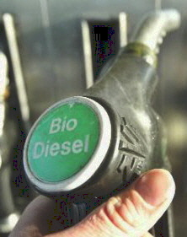
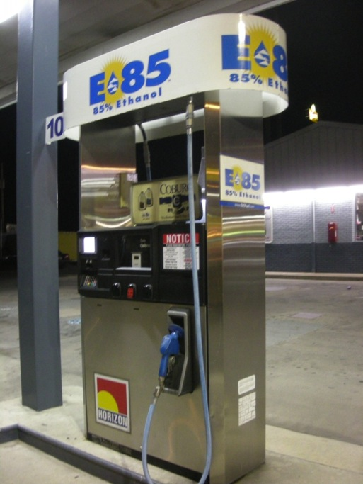
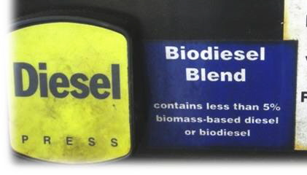
Ethanol is a biofuel, not the only biofuel. Biodiesel Renewable Diesel Biojet Bio-isobutanol Drop-in hydrocarbons
What Are Advanced Biofuels?
Notes:
Many people don’t realize that the ethanol that we talk about with regard to fuel is the same molecule as the ethanol or alcohol in wine, beer, whiskey—and that corn ethanol has long been nick-named moonshine.
Important note: as soon as the ethanol is distilled and ready for transport from a biorefinery, some gasoline is added to “poison” it so that it will not be drinkable, and will not be diverted to beverage purposes.
Photos are an old crusher and presser which might be used for grapes (similar ones for apples and other fruit); and the distillery at Mount Vernon, VA, a re-creation of the distillery operated by George Washington on his plantation.
If you want to add a history lesson, or integrate this with lessons in the history department, you can talk about how corn was converted to liquid (moonshine) to both increase its value and make it easier to move large volumes across the Appalachian mountains in the early days of the United States. The Whiskey Rebellion is also a relevant topic.
You can point out the parallels in the problems that people have today moving large volumes of raw biomass to biorefineries.
Ethanol for use as a transportation fuel must be highly distilled

Slide 6
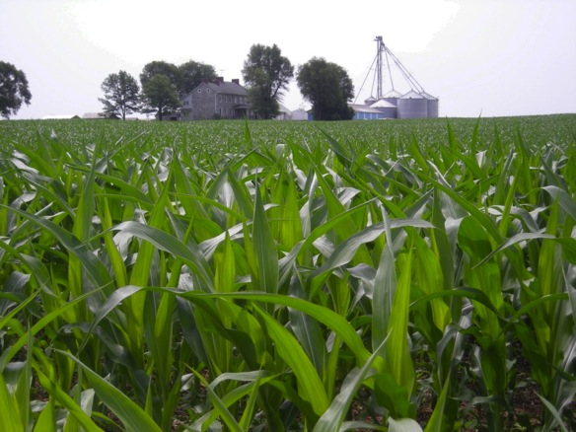
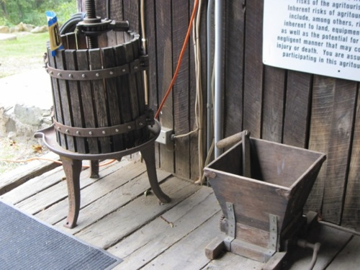
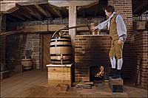
Corn-based ethanol (nearly 200 proof moonshine or 100% ethanol) is one of the few currently commercially available biofuels you can buy for vehicles today. Replaces MTBE as an octane enhancer.
And the ethanol molecule is part of many other things too.
Wine
Beer
Whiskey
Notes:
Many people don’t realize that the ethanol that we talk about with regard to fuel is the same molecule as the ethanol or alcohol in wine, beer, whiskey—and that corn ethanol has long been nick-named moonshine.
Important note: as soon as the ethanol is distilled and ready for transport from a biorefinery, some gasoline is added to “poison” it so that it will not be drinkable, and will not be diverted to beverage purposes.
Photos are an old crusher and presser which might be used for grapes (similar ones for apples and other fruit); and the distillery at Mount Vernon, VA, a re-creation of the distillery operated by George Washington on his plantation.
If you want to add a history lesson, or integrate this with lessons in the history department, you can talk about how corn was converted to liquid (moonshine) to both increase its value and make it easier to move large volumes across the Appalachian mountains in the early days of the United States. The Whiskey Rebellion is also a relevant topic.
You can point out the parallels in the problems that people have today moving large volumes of raw biomass to biorefineries.
Ethanol for use as a transportation fuel must be highly distilled

Slide 7
What Are Advanced Biofuels?
How are they made?
What are they used for?
Why are they important?
Policy Considerations
Markets
Notes:
Introduction
This is what we are going to talk about
At the end of the presentation, you should be able to answer these questions. At least a little bit.
Before we do anything else, “What does the word ‘biofuel’ mean to you? What do you think of when you hear the word ‘biofuel’?”

Slide 8
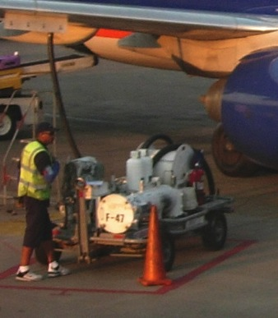
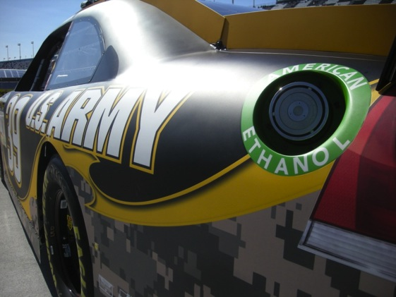
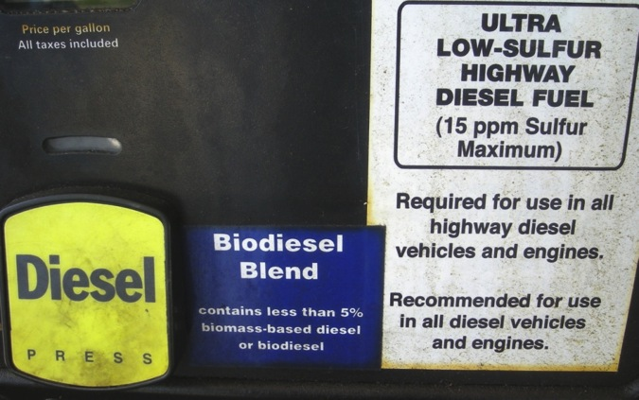
What Are Advanced Biofuels Used For? Today
Fueling Cars and Trucks
Fueling Aircraft
Notes:
Today, biofuels are used in your cars and trucks. You can buy biofuels at the “gas” station. Around the Washington DC area, almost all the regular gasoline is E10—or 10% ethanol, a biofuel; so 10% biofuel. You can also buy biodiesel blends. Usually 2-5% is biodiesel; but some people use 100% biodiesel, sometimes in farm equipment or in specially adapted cars and trucks.
Race cars use biofuel—IndyCars use E98—almost 100% ethanol. Do you know why they can’t use 100%? Because someone might drink it; so they have to poison it with gasoline molecules so that it is used just for the cars; not for people. Next year IndyCar will use E85, to develop engines and fuels that are closer to what is used on the street.
NASCAR uses 15% ethanol this year. They may increase the amount of ethanol that they use in the future.
In the American Le Mans Series, some cars use bio-isobutanol (Butamax); some use E85; some use E10. Some use diesel; maybe they’ll use renewable diesel some day.
And some flights in Spain, Netherlands, Germany and Mexico use blends of biofuel and regular fuel; and commercial flights are starting in the US with Alaska Airlines and United/Continental being the first.
So, you do use biofuels today—just not so much advanced biofuels.

Slide 9
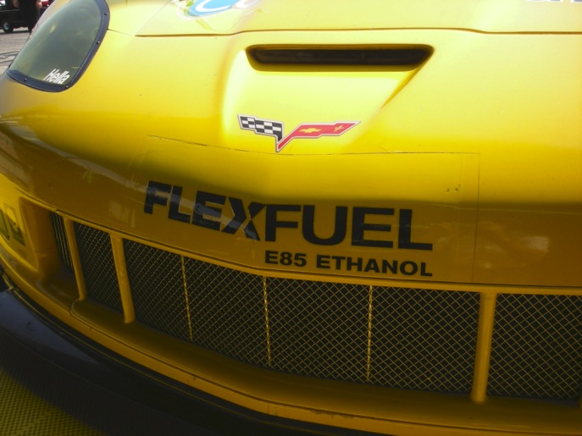
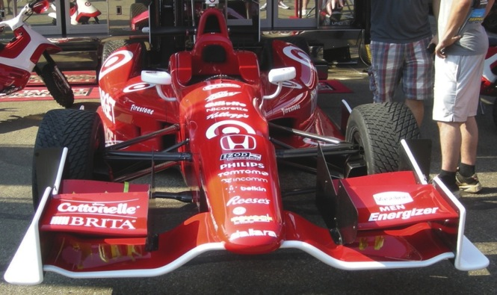
What Will Advanced Biofuels Be Used For Tomorrow?
High octane “Designer” fuels for high mileage vehicles
Hydrogen Carriers for Fuel Cells
Notes:
Gasoline substitutes
(Grassoline; Green Crude)
Biodiesel or renewable diesel from non-food feedstocks
Jet fuel made from biomass or algae
(JP-8; Commercial Aviation fuels)
“Designer” fuels tailored to obtain the most efficient, most powerful performance from specific engines
Hydrogen Carriers for Fuel Cells
Tier 3 and E30 certification fuels

Slide 10
What Will Advanced Biofuels Be Used For Tomorrow?
Military Aviation Fuels
Military Marine Fuels
Notes:
On March 25, 2010, the Air Force successfully conducted
the first flight test of an aircraft powered by a 50-50
camelina-based biofuel blend. As of mid-2011, 99
percent of the Air Force fleet has been certified to fly on
biofuel blends.15 The Air Force expects to complete all
flight testing by February 2012 and all certifications by
December 2012.
The Navy also is actively engaged in testing and certifying
advanced biofuels for planes and ships—flying the
“Green Hornet” on a camelina-based jet fuel and floating
Riverine Command Boat-Experimental (RCB-X) on a
biofuel derived from algae.16
The Navy is planning to demonstrate a carrier strike group
powered solely by alternative fuels in 2012. Dubbed the
Great Green Fleet, the ships and planes are expected to
conduct an extended mission in 2016, and all energy
provided to operational platforms is to be 50 percent
alternative by 2020.

Slide 11
What Will Advanced Biofuels Be Used For Tomorrow?
The Great Green Fleet
Notes:
On March 25, 2010, the Air Force successfully conducted
the first flight test of an aircraft powered by a 50-50
camelina-based biofuel blend. As of mid-2011, 99
percent of the Air Force fleet has been certified to fly on
biofuel blends.15 The Air Force expects to complete all
flight testing by February 2012 and all certifications by
December 2012.
The Navy also is actively engaged in testing and certifying
advanced biofuels for planes and ships—flying the
“Green Hornet” on a camelina-based jet fuel and floating
Riverine Command Boat-Experimental (RCB-X) on a
biofuel derived from algae.16
The Navy demonstrated a carrier strike group
powered solely by alternative fuels in 2012. Dubbed the
Great Green Fleet, the ships and planes are expected to
conduct an extended mission in 2016, and all energy
provided to operational platforms is to be 50 percent
alternative by 2020.

Slide 12
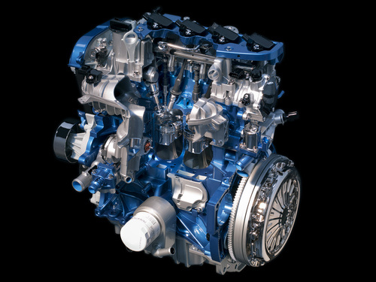
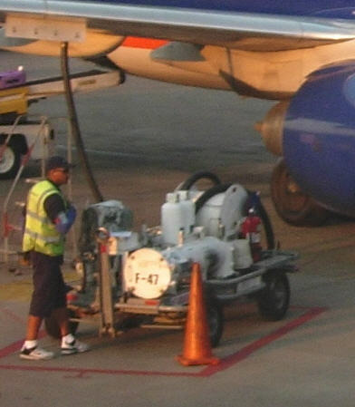
What Will Advanced Biofuels Be Used For Tomorrow?
Optimized Flex-Fuel Vehicles
E85
E30
Drop-In Petroleum Fuel Replacements
Renewable Diesel
Jetfuel (ASTM standards)
The Rest of the Gallon
Notes:
On March 25, 2010, the Air Force successfully conducted
the first flight test of an aircraft powered by a 50-50
camelina-based biofuel blend. As of mid-2011, 99
percent of the Air Force fleet has been certified to fly on
biofuel blends.15 The Air Force expects to complete all
flight testing by February 2012 and all certifications by
December 2012.
The Navy also is actively engaged in testing and certifying
advanced biofuels for planes and ships—flying the
“Green Hornet” on a camelina-based jet fuel and floating
Riverine Command Boat-Experimental (RCB-X) on a
biofuel derived from algae.16
The Navy is planning to demonstrate a carrier strike group
powered solely by alternative fuels in 2012. Dubbed the
Great Green Fleet, the ships and planes are expected to
conduct an extended mission in 2016, and all energy
provided to operational platforms is to be 50 percent
alternative by 2020.

Slide 13
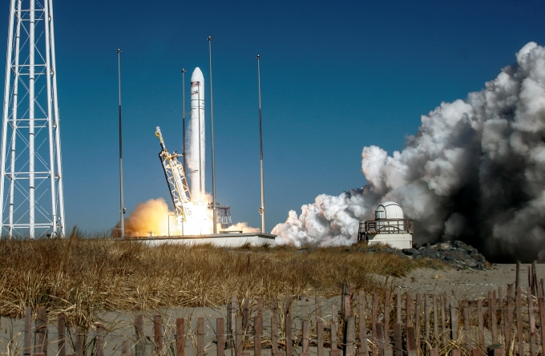
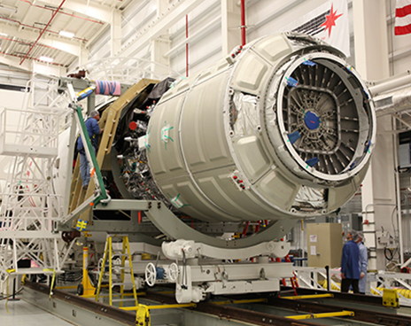
What Will Advanced Biofuels Be Used For Tomorrow?
Rocket Fuel: Resupply Missions to the International Space Station
Notes:
Orbital Completes First Operational Cargo Mission to International Space Station for NASA-- Cygnus Cargo Logistics Spacecraft Reenters Earth’s Atmosphere Over Pacific Ocean --
-- Company’s Next CRS Mission to ISS to Take Place in Early May --
(Dulles, VA 19 February 2014) – Orbital Sciences Corporation (NYSE: ORB), one of the world’s leading space technology companies, today announced the successful completion of the first of eight CygnusTM operational cargo logistics spacecraft missions to the International Space Station (ISS) as part of the company’s $1.9 billion Commercial Resupply Services (CRS) contract with NASA. The Cygnus spacecraft unberthed from the ISS yesterday morning at 6:41 a.m. (EST), completing a 37-day stay at the orbiting laboratory. Today, Cygnus reentered Earth’s atmosphere over the Pacific Ocean east of New Zealand at approximately 1:20 p.m. (EST).
“We are very proud to have a second flawless cargo mission to the space station brought to a successful conclusion this afternoon,” said Mr. David W. Thompson, Orbital’s Chairman and Chief Executive Officer. “Following Cygnus’ successful demonstration mission in late 2013 conducted under our COTS research and development partnership with NASA, the picture-perfect execution of the first operational mission is a great way to start the CRS contract. We are looking forward to the next Antares launch and Cygnus cargo delivery mission currently scheduled for early May.”
The CRS-1 mission began on January 9, 2014 when Orbital’s AntaresTM rocket launched Cygnus into orbit from the Mid-Atlantic Regional Spaceport (MARS) located at NASA’s Wallops Flight Facility in eastern Virginia. Cygnus, which carried 2,780 lbs. (1,260 kg.) of cargo and science payloads, rendezvoused and berthed with the ISS three days later on January 12. Prior to its departure from the station, the astronauts loaded the cargo module with approximately 3,250 lbs. (1,477 kg.) of unneeded items for disposal.
Under the CRS contract with NASA, Orbital is using Antares and Cygnus to deliver up to 44,000 lbs. (20,000 kg.) of cargo to the ISS over eight missions, including the CRS-1 flight just completed, through late 2016. For these missions, NASA will manifest a variety of essential items based on ISS program needs, including food, clothing, crew supplies, spare parts and equipment, and scientific experiments.
Preparations are already well advanced for the next Cygnus cargo delivery flight, the CRS-2 mission, scheduled to take place in early May. The Antares rocket for the mission is now undergoing final assembly at Wallops Island, while the Cygnus spacecraft is being prepared for shipment to the Wallops launch site in mid-March. The CRS-2 flight is expected to deliver about 3,630 lbs. (1,650 kg.) of cargo to the Space Station.
About Antares The Antares medium-class launch vehicle represents a major increase in the payload launch capability that Orbital can provide to NASA, the U.S. Air Force and commercial customers compared to its heritage small-class space launch vehicles such as Pegasus, Taurus and Minotaur. The Antares rocket can launch spacecraft weighing up to 14,000 lbs. (6,400 kg.) into low-Earth orbit, as well as lighter-weight payloads into higher-energy orbits. Orbital’s newest launcher has completed three successful missions and is currently on-ramped to both the NASA Launch Services-2 and the U.S. Air Force’s Orbital/Suborbital Program-3 contracts, enabling the two largest U.S. government space launch customers to order Antares for “right-size and right-price” launch services for medium-class spacecraft. For more information on Antares, visit http://www.orbital.com/SpaceLaunch/Antares/.
About Cygnus Orbital developed the Cygnus cargo spacecraft as part of its Commercial Orbital Transportation Services (COTS) joint research and development initiative with NASA. Cygnus consists of a common Service Module (SM) designed and built by Orbital at its Dulles, VA manufacturing facilities, and a Pressurized Cargo Module (PCM), built by Thales Alenia Space under a subcontract from Orbital. The SM incorporates avionics, power and propulsion systems already successfully flown aboard dozens of Orbital’s LEOStar™ and GEOStar™ satellite products. The PCM is based on the Multi-Purpose Logistics Module (MPLM) used with the Space Shuttle. For more information on Cygnus, visit http://www.orbital.com/NewsInfo/Publications/Cygnus_fact.pdf.
About Orbital Orbital develops and manufactures small- and medium-class rockets and space systems for commercial, military and civil government customers. The company’s primary products are satellites and launch vehicles, including low-Earth orbit, geosynchronous-Earth orbit and planetary exploration spacecraft for communications, remote sensing, scientific and defense missions; human-rated space systems for Earth-orbit, lunar and other missions; ground- and air-launched rockets that deliver satellites into orbit; and missile defense systems that are used as interceptor and target vehicles. Orbital also provides satellite subsystems and space-related technical services to U.S. Government agencies and laboratories. More information about Orbital can be found at http://www.orbital.com. Follow the company on Twitter @OrbitalSciences.
# # # http://www.orbital.com/NewsInfo/release.asp?prid=1887

Slide 14
What Are Advanced Biofuels?
How are they made?
Feedstock
Logistics
Technology
Notes:
There are three parts to making advanced biofuels: feedstock—the stuff that goes into the recipe; logistics—how do you get the feedstock from where it grows or is produced to the biorefinery; and the technology—how do you convert the feedstock into fuels.
For example, how do you release the energy of the sun that has been captured in plants so that it can be productively used to move a car, truck, train or plane?

Slide 15
Agriculture: The Foundation of the Bioeconomy
Feedstocks
Logistics
Technology
Notes:
There are three parts to making advanced biofuels: feedstock—the stuff that goes into the recipe; logistics—how do you get the feedstock from where it grows or is produced to the biorefinery; and the technology—how do you convert the feedstock into fuels.
For example, how do you release the energy of the sun that has been captured in plants so that it can be productively used to move a car, truck, train or plane?

Slide 16
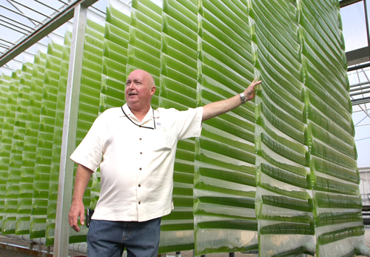
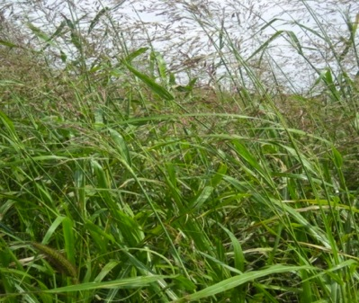
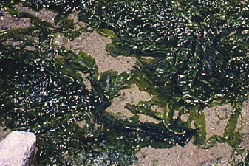
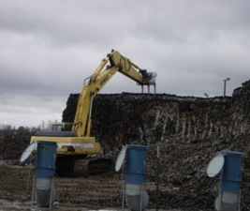
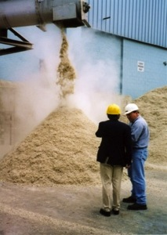
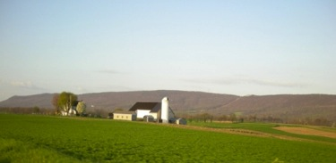
Feedstocks:
Sugars, Starches
Oil seed crops
Grasses
Trees and Forest Waste
Agricultural Residues
Algae
Food/Animal Processing Residues
Energy Crops
Thin Air
Copyright 2010Advanced Biofuels USA
16
Notes:
We’re just going to look at some pictures of the many things that could become advanced biofuels.

Slide 17
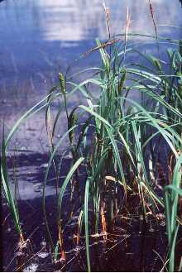
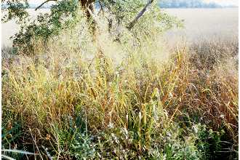
Examples of Potential Feedstocks or Energy Crops
Algae
Corn stover
Corn cobs
Energy cane
Sorghum
Forestry waste
Municipal waste
Sawdust
Chicken manure
Agricultural residues
Grasses such as
Switchgrass
Miscanthus
Sugar beets
Coffee grounds
Jatropha
Camelina
Paper/pulp mill waste
Halophytes…
Copyright 2010Advanced Biofuels USA
17
Notes:
University of Maryland Center for Environmental Science
($324,439) Feng Chen, associate professor, Institute of Marine & Environmental Technology, works with Dayton-based HY-TEK Bio LLC to develop a system for extracting nutrients from chicken manure to speed the growth of microalgae, which HY-TEK Bio uses in its photobioreactor-based systems to mitigate greenhouse gas emissions on an industrial scale, and develop a bacteria-based process that will separate algae from water that will make harvesting algae fast and inexpensive.
- See more at: http://www.mtech.umd.edu/news/press_releases/mips_r52_release.html#sthash.1Zj3gA4S.dpuf

Slide 18
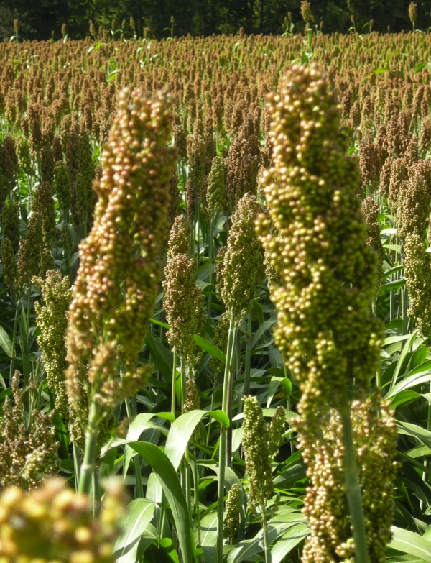
Examples of potential crops/plants which can be used for production of biofuels
Sweet Sorghum
Copyright 2010Advanced Biofuels USA
18
Notes:
Shiv with sweet sorghum stalk

Slide 19
Examples of potential crops/plants which can be used for production of biofuels
Sunflower or Jerusalem Artichoke
Copyright 2010Advanced Biofuels USA
19
Notes:
Photos from the Penn State Energy Crop Library fields

Slide 20
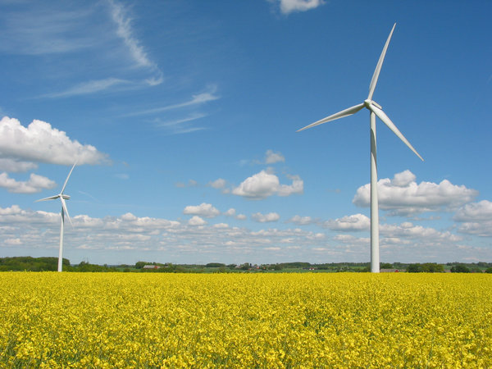
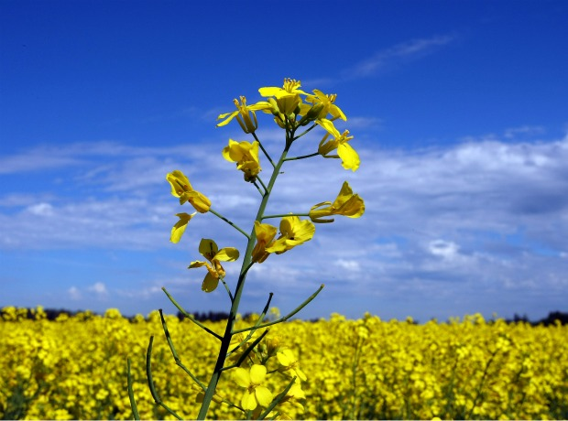
Examples of potential crops/plants which can be used for production of biofuels
Canola
Copyright 2010Advanced Biofuels USA
20
Notes:
canola

Slide 21
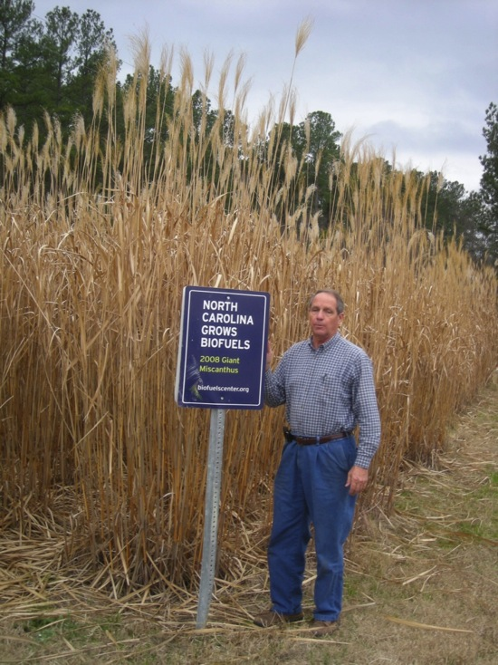
Examples of potential crops/plants which can be used for production of biofuels
ENERGY GRASSES
Miscanthus
Arundo or Giant Reed
Copyright 2010Advanced Biofuels USA
21
Notes:
Grasses that grow as high as houses.
Clarinet reeds are made out of giant reed plants.
In the US this is considered an invasive species. No federal funds are available to research using this as an energy crop in the US.

Slide 22
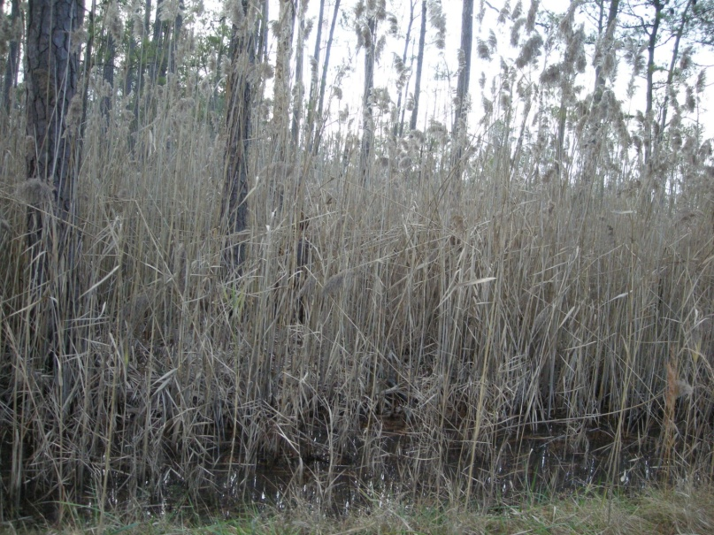
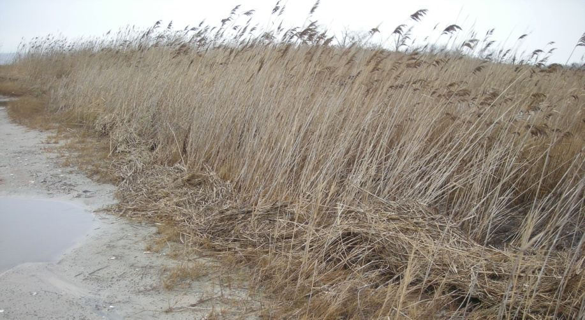
Examples of potential crops/plants which can be used for production of biofuels
ENERGY GRASSES
Phragmites
Copyright 2010Advanced Biofuels USA
Notes:
Grasses that grow as high as houses.
Clarinet reeds are made out of giant reed plants.
In the US this is considered an invasive species. No federal funds are available to research using this as an energy crop in the US.

Slide 23
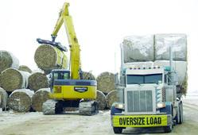
Examples of potential crops/plants which can be used for production of biofuels
AGRICULTURAL RESIDUES
Corn Stover, Cobs
Copyright 2010Advanced Biofuels USA
23

Slide 24
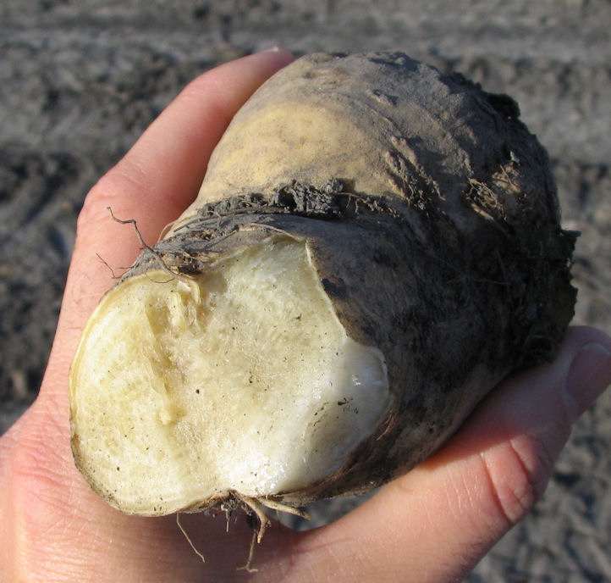
Examples of potential crops/plants which can be used for production of biofuels
Sugar Beet/Sugar Beet Pulp
Copyright 2010Advanced Biofuels USA
24
Notes:
This is a small sugar beet. Many get as big as soccer balls. During harvest, people in the area know to drive far behind the trucks full of sugar beets as some bounce out of the truck and hit and break windshields.

Slide 25
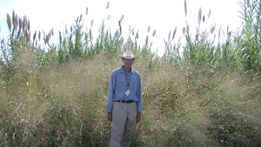
Examples of potential crops/plants which can be used for production of biofuels
Switchgrass
Copyright 2010Advanced Biofuels USA
25
Notes:
Not only is the grass growing higher than the height of the man, but the root system of the grass grows even longer than that. So, when you talk about sustainability; places that need soil erosion control might be good candidates for growing switchgrass as an energy crop.

Slide 26
Examples of potential crops/plants which can be used for production of biofuels
26
Copyright 2010Advanced Biofuels USA

Slide 27
Examples of potential crops/plants which can be used for production of biofuels
Kenaf
27
Copyright 2010Advanced Biofuels USA

Slide 28
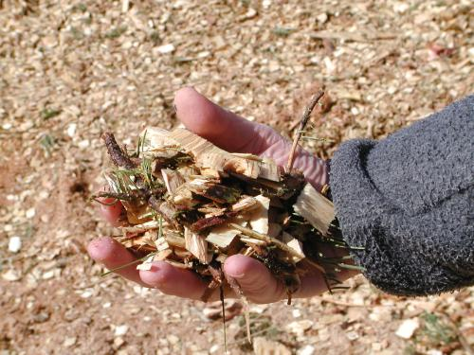
Examples of potential other things which can be used for production of biofuels
Woody Biomass
Copyright 2010Advanced Biofuels USA
28
Notes:
Wood chips might be left-overs or residues of other forest products processes. For example from sawmills. Or from slash and waste at forest harvest sites—materials that would otherwise be burned int the open. But then you have a logistics issue—getting the waste wood from the forest to the biorefinery for an economical price.
You might also have purpose-grown wood, just as you have for some pulp/paper mills; especially when those have gone out of business.

Slide 29
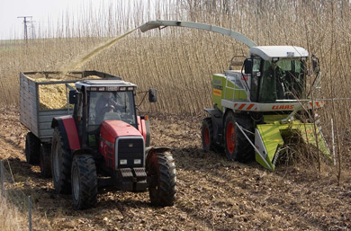
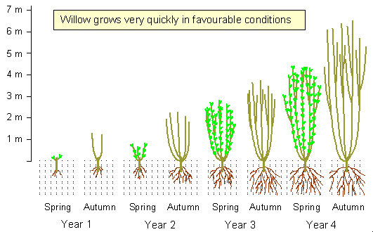
Examples of potential crops/plants which can be used for production of biofuels
Short Rotation Coppice Willow
Poplar
29
Copyright 2010Advanced Biofuels USA
Notes:
http://www.crops4energy.co.uk/short-rotation-coppice-src/

Slide 30
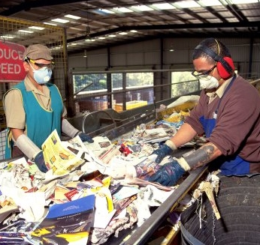
Examples of potential other things which can be used for production of biofuels
Sorted Municipal Solid Waste
Copyright 2010Advanced Biofuels USA
30

Slide 31
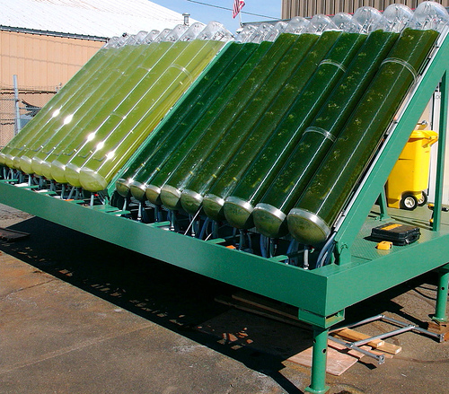
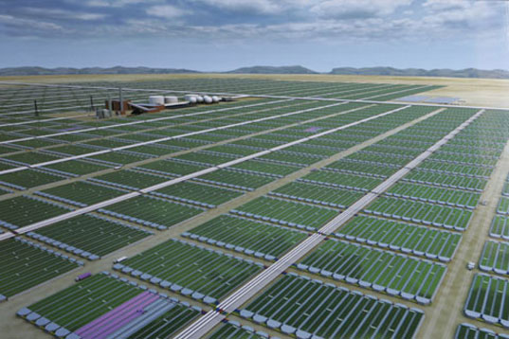
Examples of potential other things which can be used for production of biofuels
Algae
Copyright 2010Advanced Biofuels USA
31
Notes:
There are lots of different ways to grow algae.

Slide 32
Agriculture: The Foundation of the Bioeconomy
Feedstocks
Jobs Related to Feedstocks?
Notes:
There are three parts to making advanced biofuels: feedstock—the stuff that goes into the recipe; logistics—how do you get the feedstock from where it grows or is produced to the biorefinery; and the technology—how do you convert the feedstock into fuels.
For example, how do you release the energy of the sun that has been captured in plants so that it can be productively used to move a car, truck, train or plane?

Slide 33
A Few Types of Jobs Available in Advanced Biofuels Feedstock Development and Production
Agronomists
Farmers
Farm workers
Farm equipment designers
Biologists
Biologists specializing in genetic research
Biologists specializing in plant cells
Chemists
Chemical engineers
Researchers into bioenergy crop development
Agriculture/horticulture experts
Freight railroad operators, engineers, loaders, unloaders
Equipment operators, technicians
Farm product purchasers/traders
Agricultural and Forestry Supervisors
Agricultural Inspectors
Computer Software Engineers
Others?
33

Slide 34
What Are Advanced Biofuels?
How are they made?
Feedstock
Logistics
Technology
Notes:
There are three parts to making advanced biofuels: feedstock—the stuff that goes into the recipe; logistics—how do you get the feedstock from where it grows or is produced to the biorefinery; and the technology—how do you convert the feedstock into fuels.
For example, how do you release the energy of the sun that has been captured in plants so that it can be productively used to move a car, truck, train or plane?

Slide 35
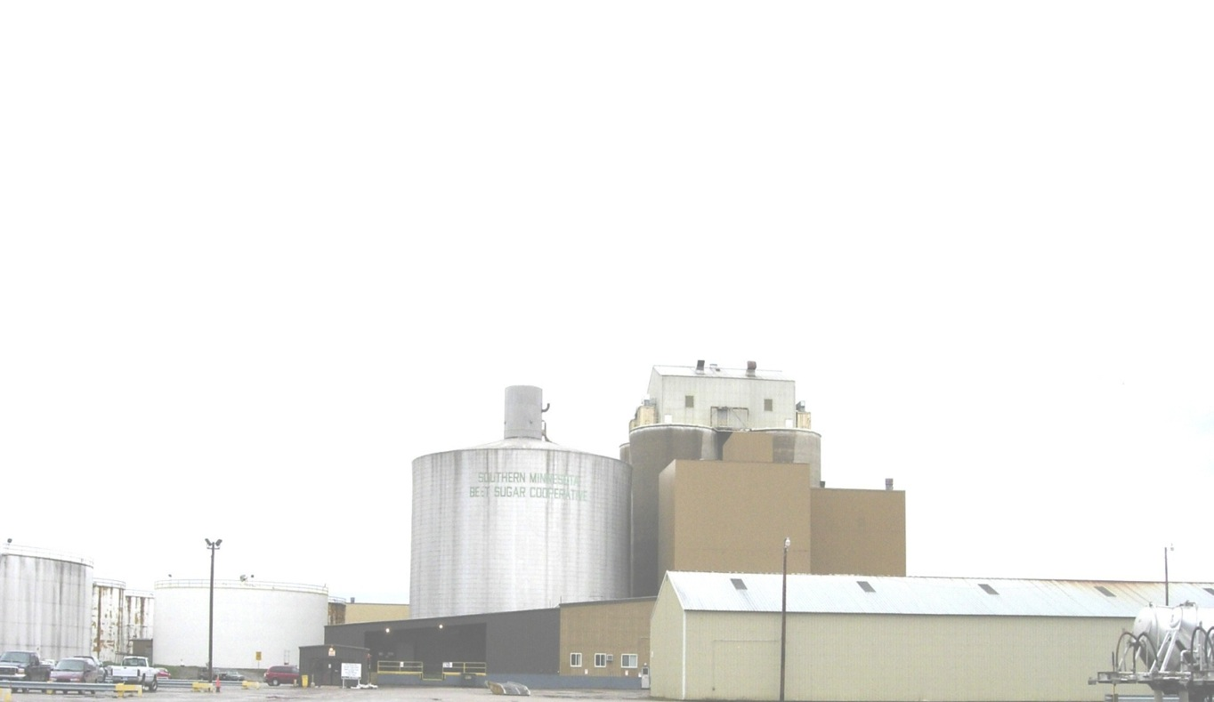
Processes
Biochemical
Thermochemical
Fermentation
Plant extraction
Transesterification
Hydrolysis
Enzymatic Catalysis
Gasification
Plasma arc gasification
Pyrolysis
Thermochemical conversion of sugars
35
Notes:
Now we get to the technology piece.
These are names of processes that take the feedstock and make it into biofuels or the building blocks for biofuels.
Explain enzymes—like the saliva in your mouth
Explain fermentation—
Explain ethanol. Ask class—what is ethanol? What in everyday life has ethanol in it? You may need to prompt by using the word “alcohol.”
Make clear that the ethanol molecules in fuel are the same chemically as the ones in beer, wine, spirits. The process for converting sugars and starches into ethanol is fermentation. The process for getting the ethanol concentrated—getting the water out—is distillation.
Especially if local history includes production of moonshine, explain that corn ethanol is the same corn ethanol currently used commercially in fuel. If time permits, can introduce the idea of the difference in value and the difference in transportation costs between dried corn kernals and processed corn into whiskey/moonshine. If a history lesson is in order, refer to the Whiskey Rebellion dealt with by George Washington.
For more detail on process technologies, word search in Advanced Biofuels USA’s web site.

Slide 36
Process Path: Biomass-to-Fuels and Products
Copyright 2008 Advanced Biofuels USA
Graphic by Zina Deretsky, National Science Foundation
Notes:
Spend some time on this slide. If you remember anything from this presentation, I hope you have in mind the stories and the photo of this page.
Tell York, PA Farm Show story.
Distributed (or decentralized)/Centralized production of precursors or intermediates at a location away from large scale integrated biorefineries.
Before we do anything else, “What does the word ‘biofuel’ mean to you? What do you think of when you hear the word ‘biofuel’?”

Slide 37
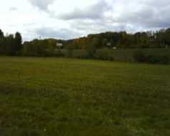
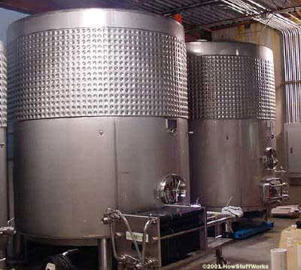
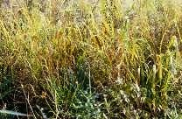
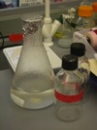
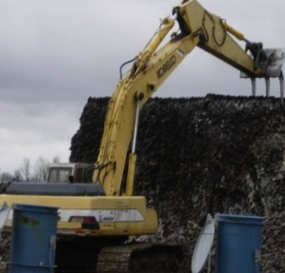
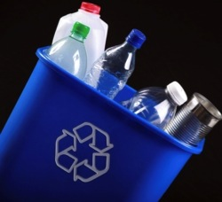
Heat
Syngas
Fischer-Tropsch
Synthesis or Fermentation
Gasification
Pyrolysis
Heat
Biocrude
Hydro treating
Deconstruction
Aqueous
phase
forming
Low heat
sugar in water
Plant Biomass: poplar,switchgrass, corn stover, woody biomass; sorted municipal solid waste and others
Catalytic Process
Jet fuel
Diesel
Transportation Fuel
Plastics
Copyright 2010Advanced Biofuels USA
37
Notes:
Here’s generally where those processes or technologies fall into the steps of getting from feedstock to fuel or other product.

Slide 38
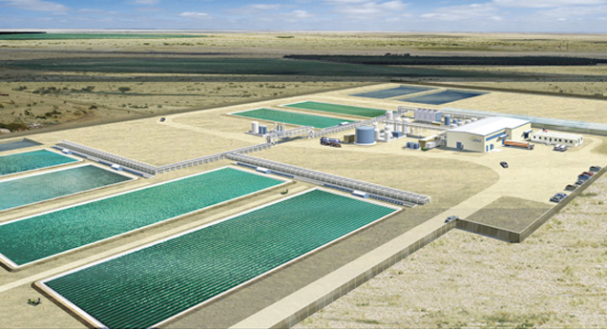
Process: 4th Generation
Direct-to-Fuel
Solar Fuels
Electrofuels
Joule Fuels (artist’s imagination)
38
Notes:
Joule Sunflow-E and Joule Sunflow-D are derived directly from sunlight and waste CO₂, without costly biomass intermediates or complex processing.
Scale: Our lack of feedstock constraints and our modular system allow rapid scale-up to meet global demand.
Efficiency: Our direct, continuous process maximizes areal efficiency, with ultimate productivity targets of 25,000 gallons of Sunflow-E and 15,000 gallons of Sunflow-D per acre annually.
Cost: At full-scale commercial production, we target costs as low as $1.28/gal Sunflow-E and $50/bbl Sunflow-D, excluding subsidies and including capital costs.
Infrastructure readiness: Our products are inherently compatible with existing fuel infrastructure without chemical processing.
Joule Sunflow-E will be commercially available in 2014, with Joule Sunflow-D to follow.
A similar example, a way to get to ethanol directly from algae—Algenol.
Direct solar fuel technologies utilize photosynthetic microorganisms to produce liquid fuels and fuel precursors directly from solar energy. In most cases, the microorganisms can work as biocatalysts to continuously produce fuels such as liquid hydrocarbons.
Direct Solar Fuels - Projects
Arizona State University: Turning Bacteria into Fuel
Iowa State University: A Genetically Tractable Microalgal Platform for Advanced Biofuel Production
Sun Catalytix: Energy from Water and Sunlight
University of Minnesota: Biofuel from Bacteria and Sunlight

Slide 39
Conversion Processes: Turning biomass and renewables into building blocks for fuels, chemicals and products
Jobs Related to Conversion Processes?
Notes:
There are three parts to making advanced biofuels: feedstock—the stuff that goes into the recipe; logistics—how do you get the feedstock from where it grows or is produced to the biorefinery; and the technology—how do you convert the feedstock into fuels.
For example, how do you release the energy of the sun that has been captured in plants so that it can be productively used to move a car, truck, train or plane?

Slide 40
A Few Types of Jobs Available in Advanced Biofuels Production
Biologists
Biologists specializing in genetic research
Biologists specializing in plant cells
Chemists
Chemical engineers
Systems engineers
Research assistants
Lab technicians
Industrial engineers
Industrial architects
Construction workers, Managers
Truck drivers
Plant operations managers
Equipment operators, technicians
Computer Software Engineers
Refinery Equipment Manufacturers
Welders
Boilermakers
Pipe Fitters
Others?
40
Notes:
And construction and startup of new advanced biofuel biorefineries are creating thousands of new jobs, many of them also union jobs, for others in different regions of the country. One new cellulosic biorefinery has had as many as 1,000 workers on site as it nears the start of production this year. That means welders, boilermakers, pipe fitters and more are finding new jobs.

Slide 41
What Are Advanced Biofuels?
How are they made?
What are they used for?
Why are they important?
Policy Considerations
Markets
Notes:
Introduction
This is what we are going to talk about
At the end of the presentation, you should be able to answer these questions. At least a little bit.
Before we do anything else, “What does the word ‘biofuel’ mean to you? What do you think of when you hear the word ‘biofuel’?”

Slide 42
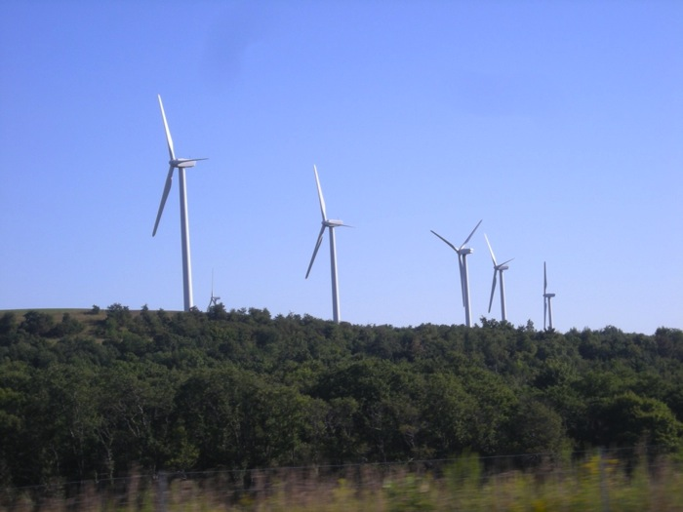
Virtually no oil is used to produce electricity in the US.
Windmills and solar
can produce electricity
but cannot power jet airplanes.
Copyright 2010Advanced Biofuels USA
42
Notes:
Why focus on transportation instead of making electrical power? If our goal is to replace imported oil and petroleum-based fossil fuels, then transportation fuel is the way to go.

Slide 43
Why Replacing Fossil-Fuel Oil With Advanced Transportation Biofuels is Important—
18.8 Million Barrels
of oil used
each day by US
TODAY
71% Used as
Transportation Fuel
Rest to produce
plastics, fiber
film, chemicals
Information from US Energy Information Administration
43
Copyright 2010Advanced Biofuels USA
Notes:
We are not just trying to put oil companies out of business. In addition to national energy security, the underlying reason for all of this is the crisis we face due to climate change.
RFS one was predicated on the idea that the oil companies would transition to become fuel companies; by forcing them to blend renewables into their product, some assumed that they would finance the development of these fuel products—diversify into renewables.
Instead, they fight tooth and nail to preserve their old market as they knew it rather than look to the future; see themselves as “oil men” rather than “fuel providers” or fuel and chemical precursor providers
All of the above; should be “all of the above ground”
Advanced Biofuels as part of an Energy Security solution.
1) Something as important to everyday life as the power to help you move from place to place.
If you put control of that power in the hands of other countries, you become vulnerable. If those other countries want to make you do something that you don’t want to do, they can just squeeze your supply of oil and make life difficult.
For examples, early 1970’s oil embargo lead to lines of cars at gas stations.
In your memory, then lines at gas stations after Hurricane Katrina knocked out a lot of gasoline production and distribution. That kind of disruption is a vulnerability. It’s better to make your fuel at home.
If we can replace a good portion of that oil that is used for transportation by making our own transportation fuels, we minimize that liability.
Energy Security
About two-thirds of U.S. petroleum demand is in the transportation sector. Approximately half of U.S. petroleum is imported. Depending heavily on foreign petroleum supplies puts the United States at risk for trade deficits, supply disruption, and price changes. The Renewable Fuels Association's 2012 Ethanol Industry Outlook(PDF) calculated that in 2011 the ethanol industry replaced the gasoline produced from more than 485 million barrels of imported oil. Ethanol represents 25% of domestically produced and refined motor fuel for gasoline engines.
http://www.afdc.energy.gov/fuels/ethanol_benefits.html US DOE Alternative Fuels Data Center
POLICY Discussion: Non-monitizable value of trying to first transition from petroleum transportation fuels: energy security, military flexibility, economic development, climate change mitigation, pollution control.
If we were not-policy directed, but rather marketing/financing directed; initial emphasis would have been on plastics, fiber, film. Greater margins, smaller scale for greater returns.
Problem has been that “fuels first” policy was articulated, but insufficiently funded.
In 2009: However, the majority of petroleum now extracted—
in the range of 85%—is used to produce fuels. Most of
these are transportation fuels such as gasoline, diesel
fuel, and jet fuel, while some, such as fuel oil, liquefied
petroleum gas, and propane, are used for heating
and power generation. Petroleum accounts for more
than 90% of transportation fuel, but only for 2% of
electricity generation. When refined, a 42-gallon barrel
of crude oil yields about 20 gallons of gasoline, 10
gallons of diesel fuel and heating oil, four gallons of
jet fuel, and smaller amounts of other products.
http://www.publichealthreports.org/userfiles/124_1/5-19.pdf
 5
Energy and Public Health:
The Challenge of Peak Petroleum
Howard Frumkin, MD, DrPHa
Jeremy Hess, MD, MPHa,b
Stephen Vindigni, MPHa,b
aNational Center for Environmental Health and Agency for Toxic Substances and Disease Registry, Centers for Disease Control and
Prevention, Atlanta, GA
bEmory Medical School, Atlanta, GA
Address correspondence to: Howard Frumkin, MD, DrPH, National Center for Environmental Health and Agency for Toxic Substances
and Disease Registry, Centers for Disease Control and Prevention, 4770 Buford Hwy., MS F-61, Atlanta, GA 30341-3717; tel. 770-488-0604;
fax 770-488-3385; e-mail <hfrumkin@cdc.gov>.
Consumption and Disposition
U.S. Petroleum Consumption18,835,000 barrels/day
U.S. Motor Gasoline Consumption8,736,000 barrels/day (377 million gallons/day)
Share of U.S. Oil Consumption for Transportation71% (2011)
U.S. Total Petroleum Exports2,924,000 barrels/day
http://www.eia.gov/energyexplained/index.cfm?page=oil_home#tab2
With the turmoil in the Middle East, it is more important than ever that, because the U.S. produced 13.9 billion gallons of ethanol last year, we used 485 million fewer barrels of imported oil. That is roughly equivalent to 13 percent of total U.S. crude oil imports, saving the American economy $49.7 billion. Without the RFS—and without ethanol production—the U.S. would have imported 52 percent of its oil last year. With the RFS—and with oil imports at 45 percent, their lowest level since 1996—the U.S. is less dependent on unstable or unfriendly regimes. http://www.ethanolproducer.com/articles/9185/the-rfs-itundefineds-not-broke-donundefinedt-fix-it
On the other hand:
Why opt look at the power of zoning. In the Digest we have written about strategic feedstock reserves. Why? Because without reserves and zoning, who is going to make $2 food or $3 fuel when one can make $7 chemicals, $12 nutraceuticals, or convert land for even more to parking lots. It is inevitable that the market will embrace the higher-value opportunities — and these markets are so titanic that it is not as easy as you think to saturate them and move down the cost curve to other products. You can build an awful lot of biorefineries before you have run out of markets for adipic acid, or ethylene.
…Regulate feedstock as the spectrum of scarce bandwidth that it is — and there will be feedstock for all products demanded by the market, and at fair prices. READ MORE

Slide 44
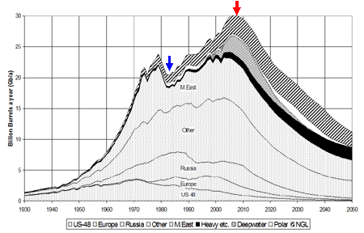
Peak Oil
44
Notes:
This is a diagram of how production of oil has peaked in the US, while our need for petroleum fuels has increased, so we have to import oil that we can’t produce ourselves. This same dynamic of oil fields being used up is going on around the world. They don’t replenish, are not renewable. When the oil is gone, the well doesn’t grow more.

Slide 45
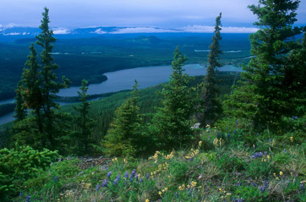
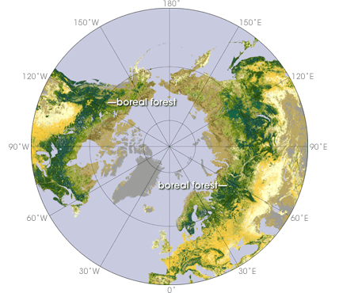
Before oil runs out, it becomes more difficult and dangerous to extract.
Copyright 2010Advanced Biofuels USA
45
Notes:
2) This oil is fossil fuel. It will run out some day. Before it runs out, it becomes very difficult, dangerous and expensive to find and to extract.
Remember the oil spill in the Gulf of Mexico in 2010—drilling for oil very, very deep wells
Also the tar sands in Canada
In Canada’s boreal forests, there are almost 3000 square miles of mineable oil sands. Getting to the oil sands means removing the forests. It means that large scale, heavy equipment moves into the landscape, removing the plants, impacting animal populations, and damaging soil, water and air. Shifting Sands documents the work in the oil sands with photos of the oil sands landscapes during and after this process. Some consider this to be a cost of oil production. Others consider this to be an environmental disaster.
http://www.decodedscience.com/the-tar-sands-fueling-controversy/4981 by Tricia Edgar is a science writer and educator from the beautiful, wet Pacific Northwest. She has a Master’s degree in Environmental Management.
Map: http://www.google.com/imgres?hl=en&sa=X&biw=1280&bih=685&tbm=isch&prmd=imvns&tbnid=YeF5QzLiRLZv9M:&imgrefurl=http://earthobservatory.nasa.gov/Study/BorealThreshold/&docid=omIRY8y0hG362M&imgurl=http://earthobservatory.nasa.gov/Features/BorealThreshold/Images/boreal_forest_map.gif&w=428&h=370&ei=CkO0TrbAJM-CsgKimNnmAw&zoom=1&iact=hc&vpx=607&vpy=226&dur=11401&hovh=209&hovw=241&tx=103&ty=113&sig=117376384788423915804&page=1&tbnh=141&tbnw=163&start=0&ndsp=18&ved=1t:429,r:8,s:0
http://www.platts.com/RSSFeedDetailedNews/RSSFeed/Oil/8662080?WT.mc_id=&WT.tsrc=Eloqua
"The challenge for producers such as the UAE is to continue producing oil and gas from existing reservoirs while, at the same time, developing new opportunities," he said. "It is no secret that the days of easy oil are coming to an end. Increasingly we are being forced to go down the route of enhanced oil recovery and developing ultra sour oil and gas from complex reservoirs." These challenges had turned the oil-rich region to become a center for development of new technologies and innovation, Hamli said, referring to the UAE's expansion into renewable energy and its decision to build the zero-carbon Masdar City in Abu Dhabi. "Our commitment to widening our domestic energy mix and promoting renewable energy does not mean that we have turned our backs to the oil industry," Hamli said. "Our growing population and fast-moving industrial developments have forced us to choose between continuing burning fossil fuels which would otherwise be exported and finding complementary energy solutions for use at home. We realized that by widening our domestic fuel mix, we could release more hydrocarbons for export," he added. The UAE has set a target of switching to nuclear power for 25% of its power generation requirements, Hamli said, adding that national peak demand for electricity was set to more than double by 2020 while demand for other forms of energy is growing. The UAE expects to have its first nuclear power station commissioned in 2017 while at the same time developing solar energy. Abu Dhabi has set a target of generating 7% of its energy needs from renewable sources including solar. "We believe that the best way of securing a sustainable economic future in a carbon constrained world is to develop a balanced portfolio of clean energy sources in which nuclear, renewable energy, oil and natural gas all have a role to play," Hamli said.

Slide 46
Before oil runs out, it becomes more difficult and dangerous to extract.
Copyright 2010Advanced Biofuels USA
46
Notes:
2) This oil is fossil fuel. It will run out some day. Before it runs out, it becomes very difficult, dangerous and expensive to find and to extract.
Remember the oil spill in the Gulf of Mexico in 2010—drilling for oil very, very deep wells
Also the tar sands in Canada
In Canada’s boreal forests, there are almost 3000 square miles of mineable oil sands. Getting to the oil sands means removing the forests. It means that large scale, heavy equipment moves into the landscape, removing the plants, impacting animal populations, and damaging soil, water and air. Shifting Sands documents the work in the oil sands with photos of the oil sands landscapes during and after this process. Some consider this to be a cost of oil production. Others consider this to be an environmental disaster.
http://www.decodedscience.com/the-tar-sands-fueling-controversy/4981 by Tricia Edgar is a science writer and educator from the beautiful, wet Pacific Northwest. She has a Master’s degree in Environmental Management.

Slide 47
47
Notes:
Advanced Biofuels as part of a Climate Change mitigation solution
. Not only will oil run out some day, but in the meantime burning hydrocarbons that used to be buried deep in the Earth releases carbon dioxide into the air. More than we need to grow plants and to sustain life. So it stays for very long time in the atmosphere causing climate change. More about carbon cycle later.
Less pollution
Fuels like ethanol burn cleaner, don’t put as many pollutants into the air.
In this country, mostly for transportation; but in other countries ethanol and biodiesel can replace wood and dung which put lots of soot into the air which also causes climate change.
Carbon neutral: use does not contribute to an increase in greenhouse gases.
Suggestion: Point out location of oil on the chart. And arrows coming from oil surface, brining stored/sequestered carbon to the sruface and releasing it; compare that to re-using/recyling carbon that is already released.

Slide 48
Zero Emissions Vehicle…?
Batteries
GHG Emissions
Rare Earth Metal Mining
Nuclear
Power Plant
GHG Emissions
Hydro
Solar
Wind
Coal Mining
Natural Gas Fracking

Slide 49
The Road to Electric Vehicles
Batteries
GHG Emissions
Rare Earth Metal Mining
Nuclear
19%
Power Plant
7.92%
GHG Emissions
Hydro
2.92%
25%
Solar
42%
0.04%
Wind
Other: Approx. 2%
Coal Mining
Natural Gas Fracking
Notes:
http://upload.wikimedia.org/wikipedia/commons/d/da/2011_US_electricity_generation_by_source.png
2011 US electricity generation by source from Electric Power Monthly February 2012

Slide 50
A Few Types of Jobs in Communicating Importance of Advanced Biofuels
Public Relations
Economic Development
Marketing/Sales
Elected Official
Federal Agency Staff
State Agency Staff
County/Local Administrative Staff
Journalists
Writers
Photographers
Broadcast Media Professionals
Teachers
Teaching Assistants
Nonprofit Organization Staff
Advocates
Lawyers
Office Administrative Staff
Book Publishers
Event Organizers
Fundraisers
Others?
50

Slide 51
Principles of Sustainability
Economic Environmental Social
51
Notes:
So, those are the reasons of why BIOFUELS in general are important; why Advanced Biofuels?
That has to do with sustainability. We’ll talk about this in more detail later and you’ll do an exercise too.
For now, what does sustainable mean?
Endurance
Lasts for a long time. Or, you can keep doing something over and over without it degrading. Or, in a way, it has continued life or existence
So, when we talk about sustainability and biofuels, we mean that they have to have economic viability over a long term; have to allow or enable the environment to be unharmed or helped; and have to have social acceptance, fit into the fabric of a culture. We’ll talk about some examples later. Just tuck that in the back of your mind for now.
Advanced biofuels are the ones that are more sustainable, do less damage to the environment, while still being economical to produce and that meet the demands of the society for social values such as the ones we talked about before—energy security, for example.
Sustainability is the capacity to endure. For humans, sustainability is the long-term maintenance of well being, which has environmental, economic, and social dimensions, and encompasses the concept of stewardship, the responsible management of resource use. In ecology, sustainability describes how biological systems remain diverse and productive over time, a necessary precondition for human well-being. Long-lived and healthy wetlands and forests are examples of sustainable biological systems (from Wikipedia)

Slide 52
Principles of Sustainability
Economic Environmental Social
52
Notes:
Now we’ll look more deeply into the concept of sustainability. Because this is, in a general sense, what makes a biofuel an advanced biofuel.

Slide 53
Sample Question: Environmental
How can
Growing crops,
Using forest products,
Growing algae, or
Using waste from food processing or municipal waste
Help or Hurt the Environment?
Copyright 2010Advanced Biofuels USA
53
Notes:
These are some of the questions that come up when thinking about sustainability from an environmental point of view.
Take each question one at a time.
First, how can growing crops help the environment? Think about the switchgrass.
How can growing crops hurt the environment? What have you heard about fertilizers and the dead zones in the Chesapeake Bay or Gulf of Mexico?
How can using forest products help the environment?
Think about preventing forest fires through good forest management
How can it hurt the environment? You may have heard of harming the rainforests by cutting them down for agriculture purposes.
Same kind of questions and thoughts for the other topics. Or you can talk about others, too.

Slide 54
Sample Question: Social
How do we use land for Food/Fuel/Feed/Fiber and Fun?
Who gets to decide how land is used?
Locally, Nationally, Internationally
Copyright 2010Advanced Biofuels USA
54
Notes:
This group gets to discuss a question dealing with social sustainability. How do advanced biofuels fit into the culture?
First, think about the ways we use land in this culture. What do we use land for?
Then think about who gets to decide how that land is used?
What about the residues from an industry? Like food processing? Who decides how those are used—or not used and thrown away?
What if you as a community wanted to change that? What would you do?
If your community has a landfill problem—the landfill is getting full and the community is discussing what to do with the waste—what might you recommend that they consider? How does that process of recommending what is considered happen?
Think about public hearings, zoning, planning commissions, protest marches, petition drives, what else? Running for office?

Slide 55
Sample Question: Economic
How Will We Economically Produce and Transport Feedstock to Biorefineries? And Fuel to Customers?
Copyright 2010Advanced Biofuels USA
55
Notes:
Break up into small groups to discuss this issue related to economic sustainability.
Remember, sustainability means endurance, long lasting; of, relating to, or being a method of harvesting or using a resource so that the resource is not depleted or permanently damaged
As well as: Sustainability is a way of working and living that balances immediate needs for commerce, living, habitation, food, transportation, energy and entertainment with future needs for these resources and systems as well as the liveliness and support of nature, natural resources and future generations.
When considering this question, think about the residues from sugar production from sugar beets; think about getting the slash from forests; the large bales of grass or corn stover and corn cobs from the field to the biorefinery.
What will you use?
What kind of costs are involved in the transportation?
Do you have to move it in the condition it is in in the field or processing plant?
If you could change it, what do you think would help make answering this question easier?
What ways is fuel moved from the refinery to the place where people put it into cars and trucks?
Any problems with that that you have heard of?

Slide 56
Principles of Sustainability
Economic Environmental Social
Everyone in the value chain needs to make a living
The operation must be financially stable
The price of the product must be competitive in its market
56
Notes:
Here are some concepts that might be considered when talking about economic aspects of sustainability. You might not have used these words, but probably included at least one of these ideas in your discussion.
The inflection point
Credit worthy feedstock supplier, 15 year terms US $50/tonne
Demonstration of technology at scale
Credit worthy offtake partner 10-15 years (tough for airlines, although they say they will buy whatever can be produce and although they seem stable, they don’t have good balance sheets from the perspective of financiers)
Parity with $80 oil, unsubsidizied on comparable BTUs
(Jim Lane, Biofuels Digest 11 1006)

Slide 57
Minimizing the Cost of Biomass Transportation The Transport Conundrum
How can we gather enough Biomass
to support a
Cost-Efficient Biorefinery?
57
Notes:
This is the logistics part of the economic question. This is where thinking about changing the biomass closer to the original location becomes an important consideration.
Then biorefineries can be built at larger scale which makes them more economical to operate (and think of social aspects of having many biorefineries in many towns—people might say—not in my backyard).
Right now, there has not been much research into conversion to intermediaries or precursors that can be transported easier and cheaper. See next slide.

Slide 58
Minimizing the Cost of Biomass Transportation The Transport Conundrum
The size of current generation of ethanol production plants is limited by the amount of crop that can be economically trucked to the plant
Production plants can not take advantage of economies of scale
Production plants may not operate year-round because of harvest patterns
Production plants may not be able to switch crops to reduce costs because of longer transport distances
58
Notes:
See: The Distributed/Centralized BioProduction Approach: Sustainable Biofuels and Bioproducts Are Possible Through the Significant Reduction of Biomass Transportation Costs
by Robert Kozak (Advanced Biofuels USA) Problem Definition: The production of biofuels in the US is at a substantial roadblock. Due to the high cost of transporting large quantities of low density, low value biomass to biorefineries, the economies of scale that allow the US petroleum industry to minimize production and transportation costs are not available to the biofuel industry.
The current biofuel production paradigm is based on the “Midwestern Model” of building relatively small, 50-100 mgy (million gallons per year) biorefineries that are supplied by a single type of crop grown within the economic transport range for freshly harvested crops. The maximum range for cost-effectively transporting these crops is about 50-75 miles.
There are two significant problems with this approach.
First, in most agricultural areas east of the Mississippi there is not enough contiguous non-food producing land within the 50-75 mile zones suitable for biorefinery siting to “feed” a biorefinery of even the small 50-100 mgy size.
Second, and even more important, the current biofuel production system cannot economically sustain the 2-5 billion gallons/year biorefineries needed to cost-effectively meet US transportation fuel demands. (The average US petroleum refinery capacity is 1.7 billion gallons/year (146 refineries) and the ten largest petroleum refineries that supply 23% of all capacity average 5.5 billion gallons/year. US DOE/EIA 2008 data.)
Solution Definition: The solution to this problem is to efficiently convert harvested field crops, slash timber, and agricultural residues at their point of production into biofuel and bioproducts precursors with sufficient value so they may be economically transported in excess of 500 miles. At the end of their journey, these precursors would arrive at large-scale biorefineries that would be designed to produce a variety of market driven bioproducts ranging from automotive fuel alcohols to structural polymers. In many cases, these large facilities would be co-located with existing petroleum refineries or would utilize mothballed industrial facilities.
The most efficient precursors that should be produced are soluble sugars or pyrolysis hydrocarbons. These slurry liquids can be transported by tank trucks, rail cars, or barges. Additionally, the composition and concentration of these slurries produce a product with enough value to justify medium to long-range transport.
Design Principles: The Decentralized/Centralized concept embraces two general concepts: Follow-the-Crop and Depot systems.
Follow-the-Crop: Developed by Atlantic Biomass Conversions, this portable system is based on the model of combines that follow the harvest season, “Follow-the-Crop” modules would be deployed nationwide as energy grasses and crops are harvested. These modules would convert the biomass into medium density soluble biofuel sugars, C-5 and C-6, using a fast, low-cost combined pretreatment and saccharification enzyme system. A byproduct would be high protein animal feed from the plant proteins. These systems would be especially beneficial to regions with non-contiguous stands, converted pasture lands, lands with regulated cropping patterns (conservation lands), or regions lacking in railheads equipped with grain elevators.
Depot: The Depot system, developed by Bruce Dale of Michigan State University, envisions a series of multi-precursor production systems co-located with existing agricultural collection points such as grain elevators. These systems would be able to produce pyrolysis hydrocarbons, as well as high protein animal feeds. These multiple crop input systems would be especially suited to regions with existing networks of agricultural collecting points with railheads since the Depots would be able to collect and process large quantities of biomass.
In either case, the benefits to overall bioproducts would be the same.
Decentralized/Centralized System Benefits: By splitting precursor production from the integrated biorefinery and placing it close to the grower, the transportation conundrum can be overcome. The result would be a sustainable biofuel and bioproducts industry. Benefits would include:
For Growers and Agricultural Communities
Multiple crops and agricultural residues could be used as biofuel feedstocks giving growers multiple economically driven options.
With biofuel feedstocks becoming non-crop specific, “energy” crops can be selected on the basis of specific environmental and agronomic factors rather than suitability for the local biofuel plant.
Farmers will be able to utilize their marginal lands and expand their selection of crops for biofuel use without the necessity of planting hundreds of contiguous acres.
Significant quantities of total energy biomass could be grown outside the Midwestern “grain-belt.”
Nationwide deployment of the Depot and Follow-the-Crop systems would provide new, year-round employment in technical and equipment maintenance jobs needed to staff the biofuel intermediate production modules.
Rural communities could retain significant biomass economic benefits from precursor production without having industrial biorefinery installations in their towns.
For the Bioproducts Industry
The Decentralized/Centralized concept would transform the American advanced biofuels and bioproducts industry into one coherent system that could respond to supply and demand market forces. Benefits to the industry would include:
Changing the feedstock of biofuel refineries from individual specialized crops into common commodities would make input pricing stable.
Providing common precursors on a year-round basis would increase the number of days of biorefinery operation. This would greatly improve the economics of biofuel production and make the industry a better investment.
Providing common precursors would reduce and simplify refinery conversion operations leading to reduced production costs.
Providing a reliable and sustainable biorefinery feedstock would encourage investments in new advanced biofuels and bioproducts.
Download “Quick Brief” PDF READ MORE (US Department of Energy) and MORE (Bruce Dale, Michigan State University)

Slide 59
Minimizing the Cost of Biomass Transportation Distributed/Centralized Precursor Processing
Separating biorefinery functions is an answer to the conundrum
Conversion of biomass to high density liquid sugars or other intermediate compounds would occur at a network of decentralized, low-capital facilities, often co-located with grain elevators
Intermediate liquids or “precursors” would be transported by truck or rail to existing refineries
59

Slide 60
Minimizing the Cost of Biomass Transportation Distributed/Centralized Precursor Processing
Existing petroleum refineries or biorefineries could be retrofitted to utilize intermediates or precursors as a feedstock alternative to crude oil
Biofuel production would be year-round, utilizing a variety of different biomass sources harvested at different times of year
Multiple biofuels and other bio-chemicals would be produced at one facility, provides market response flexibility
Copyright 2010Advanced Biofuels USA
60

Slide 61
As a prospective grower, how do you find out what bioenergy crops might grow where you live?
Ask your
local Agricultural Extension Service
local Farm Bureau members
State Land Grant University
Contact your local Agricultural Economic Development Office
Need for online grower decision-making tool
61
Notes:
Biofuel/Bioproduct Biomass Grower Decision Tool Box
Need for the Tool Box
In order to meet expanding national needs for the production of non-food crop biofuels, biomass production will have to be substantially increased without decreasing food or forest product production. In large part, this increase in biomass will have to come from perennial grasses, energy crops, and non-forest product managed stands. Specific programs proposed for increasing bioenergy biomass production include:
Intercropping,
Prairie Recovery,
Pastureland Preservation,
Grass Land Cropping, and
Forest Harvesting
Since the economic margins of growing biomass for commodity biofuels are thin, it is of prime importance that growers have a reliable source of information on the best species/strains to grow and what their expected yields would be. In most cases, yields are not only a product of macroclimate conditions, but also of microenvironmental conditions including rain fall, soil conditions, and runoff. Questions that growers need to have answered would include:
What species/strains are suitable for their land?
What is the minimum tonnage/acre needed for profitable cropping?
What is the ratio of yield to nutrient inputs?
What is the minimum acreage needed to be profitable?
Tool Box Design
Answers to these questions could be provided by a grower-oriented decision making tool box. The decision making model would be statistically based and would use a database composed of: in-field production data, USDA and state soil condition data, NOAA climatological information, and demand and price information from biofuel/bioproducts markets and technologies. Information would be presented to the grower using maps and charts. Users would have the ability to enter data for specific parameters and could choose output types. Output options would include graphs depicting ranges and what/if solutions.
Objective/Work Program for Phase 1Funding
The objective of Phase 1 funding would be to determine the data needs and the programming requirements for the Biomass Grower Decision Tool Box. In order to reduce production and maintenance costs and to maximize existing resources, the starting point for this project could be the knowledge base already existing in University of Minnesota, College of Food, Agricultural and National Resources FINBIN Farm Financial Database. On the successful completion of a Phase 1 design study, a pilot program would be developed and tested on a state or regional basis. Once that has been accomplished the program would expand to a national scope.

Slide 62
Sample Question: Environmental
How can
Growing crops,
Using forest products,
Growing algae, or
Using waste from food processing or municipal waste
Help or Hurt the Environment?
Copyright 2010Advanced Biofuels USA
62
Notes:
These are some of the questions that come up when thinking about sustainability from an environmental point of view.
Take each question one at a time.
First, how can growing crops help the environment? Think about the switchgrass.
How can growing crops hurt the environment? What have you heard about fertilizers and the dead zones in the Chesapeake Bay or Gulf of Mexico?
How can using forest products help the environment?
Think about preventing forest fires through good forest management
How can it hurt the environment? You may have heard of harming the rainforests by cutting them down for agriculture purposes.
Same kind of questions and thoughts for the other topics. Or you can talk about others, too.

Slide 63
Principles of Sustainability
Economic Environmental Social
Carbon Cycle/Climate Change
Reduce Green House Gases in
the atmosphere
Reduce our “carbon footprint”
Reduce Black carbon from
cooking fires
Reduce use of fertilizer
Reduce use of water
Grow crops that sequester carbon
63

Slide 64
64
Notes:
Carbon neutral: use does not contribute to an increase in greenhouse gases.

Slide 65
Sample Question: Social
How do we use land for Food/Fuel/Feed/Fiber and Fun?
Who gets to decide how land is used?
Locally, Nationally, Internationally
Copyright 2010Advanced Biofuels USA
65
Notes:
This group gets to discuss a question dealing with social sustainability. How do advanced biofuels fit into the culture?
First, think about the ways we use land in this culture. What do we use land for?
Then think about who gets to decide how that land is used?
What about the residues from an industry? Like food processing? Who decides how those are used—or not used and thrown away?
What if you as a community wanted to change that? What would you do?
If your community has a landfill problem—the landfill is getting full and the community is discussing what to do with the waste—what might you recommend that they consider? How does that process of recommending what is considered happen?
Think about public hearings, zoning, planning commissions, protest marches, petition drives, what else? Running for office?

Slide 66
Principles of Sustainability
Economic Environmental Social
Government
Land ownership
Transportation
Infrastructure
Education
Copyright 2010Advanced Biofuels USA
66

Slide 67
Principles of Sustainability
Economic Environmental Social
Land Use Practices
Decision-Making
Form of Government
Cultural Values and Traditions
Economic System
Market-Based
Level of Government Influence
Prestige and Aspirations
67

Slide 68
What Are Advanced Biofuels?
How are they made?
What are they used for?
Why are they important?
Policy Considerations
Notes:
Introduction
This is what we are going to talk about
At the end of the presentation, you should be able to answer these questions. At least a little bit.
Before we do anything else, “What does the word ‘biofuel’ mean to you? What do you think of when you hear the word ‘biofuel’?”

Slide 69
Why Replacing Fossil-Fuel Oil With Advanced Transportation Biofuels is Important— - Do We Really Care about Climate Change?
18.8 Million Barrels
of oil used
each day by US
TODAY
71% Used as
Transportation Fuel
Rest to produce
plastics, fiber
film, chemicals
69
Copyright 2010Advanced Biofuels USA
Notes:
We are not just trying to put oil companies out of business. In addition to national energy security, the underlying reason for all of this is the crisis we face due to climate change.
RFS one was predicated on the idea that the oil companies would transition to become fuel companies; by forcing them to blend renewables into their product, some assumed that they would finance the development of these fuel products—diversify into renewables.
Instead, they fight tooth and nail to preserve their old market as they knew it rather than look to the future; see themselves as “oil men” rather than “fuel providers” or fuel and chemical precursor providers
All of the above; should be “all of the above ground”
Advanced Biofuels as part of an Energy Security solution.
1) Something as important to everyday life as the power to help you move from place to place.
If you put control of that power in the hands of other countries, you become vulnerable. If those other countries want to make you do something that you don’t want to do, they can just squeeze your supply of oil and make life difficult.
For examples, early 1970’s oil embargo lead to lines of cars at gas stations.
In your memory, then lines at gas stations after Hurricane Katrina knocked out a lot of gasoline production and distribution. That kind of disruption is a vulnerability. It’s better to make your fuel at home.
If we can replace a good portion of that oil that is used for transportation by making our own transportation fuels, we minimize that liability.
Energy Security
About two-thirds of U.S. petroleum demand is in the transportation sector. Approximately half of U.S. petroleum is imported. Depending heavily on foreign petroleum supplies puts the United States at risk for trade deficits, supply disruption, and price changes. The Renewable Fuels Association's 2012 Ethanol Industry Outlook(PDF) calculated that in 2011 the ethanol industry replaced the gasoline produced from more than 485 million barrels of imported oil. Ethanol represents 25% of domestically produced and refined motor fuel for gasoline engines.
http://www.afdc.energy.gov/fuels/ethanol_benefits.html US DOE Alternative Fuels Data Center
POLICY Discussion: Non-monitizable value of trying to first transition from petroleum transportation fuels: energy security, military flexibility, economic development, climate change mitigation, pollution control.
If we were not-policy directed, but rather marketing/financing directed; initial emphasis would have been on plastics, fiber, film. Greater margins, smaller scale for greater returns.
Problem has been that “fuels first” policy was articulated, but insufficiently funded.
In 2009: However, the majority of petroleum now extracted—
in the range of 85%—is used to produce fuels. Most of
these are transportation fuels such as gasoline, diesel
fuel, and jet fuel, while some, such as fuel oil, liquefied
petroleum gas, and propane, are used for heating
and power generation. Petroleum accounts for more
than 90% of transportation fuel, but only for 2% of
electricity generation. When refined, a 42-gallon barrel
of crude oil yields about 20 gallons of gasoline, 10
gallons of diesel fuel and heating oil, four gallons of
jet fuel, and smaller amounts of other products.
http://www.publichealthreports.org/userfiles/124_1/5-19.pdf
 5
Energy and Public Health:
The Challenge of Peak Petroleum
Howard Frumkin, MD, DrPHa
Jeremy Hess, MD, MPHa,b
Stephen Vindigni, MPHa,b
aNational Center for Environmental Health and Agency for Toxic Substances and Disease Registry, Centers for Disease Control and
Prevention, Atlanta, GA
bEmory Medical School, Atlanta, GA
Address correspondence to: Howard Frumkin, MD, DrPH, National Center for Environmental Health and Agency for Toxic Substances
and Disease Registry, Centers for Disease Control and Prevention, 4770 Buford Hwy., MS F-61, Atlanta, GA 30341-3717; tel. 770-488-0604;
fax 770-488-3385; e-mail <hfrumkin@cdc.gov>.
Consumption and Disposition
U.S. Petroleum Consumption18,835,000 barrels/day
U.S. Motor Gasoline Consumption8,736,000 barrels/day (377 million gallons/day)
Share of U.S. Oil Consumption for Transportation71% (2011)
U.S. Total Petroleum Exports2,924,000 barrels/day
http://www.eia.gov/energyexplained/index.cfm?page=oil_home#tab2
With the turmoil in the Middle East, it is more important than ever that, because the U.S. produced 13.9 billion gallons of ethanol last year, we used 485 million fewer barrels of imported oil. That is roughly equivalent to 13 percent of total U.S. crude oil imports, saving the American economy $49.7 billion. Without the RFS—and without ethanol production—the U.S. would have imported 52 percent of its oil last year. With the RFS—and with oil imports at 45 percent, their lowest level since 1996—the U.S. is less dependent on unstable or unfriendly regimes. http://www.ethanolproducer.com/articles/9185/the-rfs-itundefineds-not-broke-donundefinedt-fix-it

Slide 70
If Climate Change Mitigation Was REALLY Important... Wouldn’t we treat it as important? Three Questions for any country…
Is the money your government puts into research to develop sustainable advanced biofuels on the same level as money spent for other national security priorities?
US: No
Annual budget for USDA and DOE
biofuel and biocrop research
about ½ the cost of one fully developed and equipped F-35 jet fighter/bomber.
=
The US military plans to buy hundreds of these aircraft each year for the next decade.
70
Copyright 2010Advanced Biofuels USA
Notes:
Is the money your government puts into research to develop sustainable advanced biofuels on the same level as money spent for other national security priorities?
US Commitment: Currently the US’s annual budget for USDA and DOE biofuel and biocrop research is about ½ the cost of one fully developed and equipped F-35 jet fighter/bomber. The US military plans to buy hundreds of these aircraft each year for the next decade.
Answer: No

Slide 71
If Climate Change Mitigation Was REALLY Important... Wouldn’t we treat it as important? 3 Questions for any country…
2. Do the economic and taxation policies of your government properly include the cost of climate change adaption, environmental restoration, and national defense in the price of non-renewable hydrocarbon fuel sources?
US : No
The US does not charge or tax for externalities--
Damages caused by mountain top removal and fracking,
Adaptation of American coast lines to rising sea levels, or for
Military protection of oil producing countries and shipping lanes.
71
Copyright 2010Advanced Biofuels USA
Notes:
Do the economic and taxation policies of your government properly include the cost of climate change adaption, environmental restoration, and national defense in the price of non-renewable hydrocarbon fuel sources?
US Commitment: The US has not enacted any “carbon tax” policies to pay for restoration of damages caused by mountain top removal and fracking, the adaption of American coast lines to rising sea levels, or for the US military’s protection of oil producing countries and shipping lanes.
Answer: No

Slide 72
If Climate Change Mitigation Was REALLY Important... Wouldn’t we treat it as important? 3 Questions for any country…
3. Does your government apply uniform environmental and sustainable production rules, including international Indirect Land Use Change analysis (ILUC), to both advanced biofuels and emerging extractive hydrocarbon technologies?
US : No
Renewable Fuel Standard (RFS2) regulations require environmental and sustainability studies, including Indirect Land Use Change, before commercial production of an advanced biofuel can be included in the RFS program
Wide-scale commercial production of natural gas fracking allowed without studying potential geological effects
vs
72
Copyright 2010Advanced Biofuels USA
Notes:
Does your government apply uniform environmental and sustainable production rules, including Indirect International Land Use (IILU), to both advanced biofuels and emerging extractive hydrocarbon technologies?
US Commitment: The US government allowed wide-scale commercial production of natural gas fracking without studying what the geological effects would be. In contrast, US EPA Renewable Fuel Standard (RFS) regulations for the production of advanced biofuels require environmental and sustainable production studies, including Indirect International Land Use (IILU), before commercial production can included in the RFS program.
Answer: No

Slide 73
Funding of “new” and “never been
done before” technologies
Private
Investors
Government
Long-term
Personal
Passion
Credit
Markets/
Banks
Federal
States
Venture
Capital
Valley
of Death
Exit Strategy
2-3 years;
20% ROI
New Ideas?
Copyright 2010Advanced Biofuels USA
73
Notes:
This illustrates a merger of the economic and social aspects of sustainability. Unless new ideas that are developed to achieve the social goals (energy security, for example) can get funded, they have no life, no endurance, no sustainability.
All of the legs of the sustainability analysis stool must be strong or the project will not survive.
The inflection point
Credit worthy feedstock supplier, 15 year terms US $50/tonne
Demonstration of technology at scale
Credit worthy offtake partner 10-15 years (tough for airlines, although they say they will buy whatever can be produce and although they seem stable, they don’t have good balance sheets from the perspective of financiers)
Parity with $80 oil, unsubsidizied on comparable BTUs
(Jim Lane, Biofuels Digest 11 1006)
1859—first oil well in US in Titusville, PA

Slide 74
2007 Renewable Fuels Standard Sec. 202 Energy Independence and Security Act of 2007 (Billion Gallons/Year)
74
Notes:
The renewable fuel standard in the 2007 EISA mandated an amount of biofuels that oil companies were required to blend with gasoline for transportation fuel. This is an example illustrating the social aspects of sustainability. The society went through a political process to suggest, promote, discuss and then pass a law that put society’s desire, as President George W. Bush put it, to get off our addition to oil. This was one way society decided to work on that social goal that grows out of the values discussed in the initial slides of this presentation—energy security, for example.

Slide 75
Barriers and Challenges
TECHNICAL CHALLENGES
FINANCING “New” & “Never Been Done Before” Technologies
POLICY ISSUES / CONTROVERSIES
75

Slide 76
Barriers and Challenges
TECHNICAL CHALLENGES
Copyright 2010Advanced Biofuels USA
76

Slide 77
Overcoming the Technical Roadblocks to Low-Cost Advanced Biofuel Production
Make all components of biomass available for biofuel production (Use the appropriate parts of specific plants)
Improve the efficiency of biomass to biofuel conversion (Do it faster, cheaper, sustainably)
Minimize the cost of biomass transportation (Move more for less)
77

Slide 78
Making Plant Biomass Available for Biofuel Production Sugar Availability in Plant Cell Walls
Additional “simple” sugars are available in plant and tree cell walls, but are in more complex forms that are not readily available for biofuel production
Plant cell walls are composed primarily of three components: cellulose, hemicellulose, and pectin
78

Slide 79
Making Plant Biomass Available for Biofuel Production Sugar Availability in Plant Cell Walls
Tree and grass cell walls have an additional component, lignin.
This is the “woody” material that gives trees great tensile strength
Cellulose, hemicellulose, and pectin are composed of monosaccharides strung together, they are called polysaccharides
Lignin is composed of polysaccharides and alcohols
79

Slide 80
Making Plant Biomass Available for Biofuel Production Biomass Recalcitrance
Cellulose, hemicellulose, pectin, & lignin intertwine to create complex cell wall matrices
This complex structure protects plants and trees from disease, moves nutrients, and provides for growth
These complex structures also restrict access to the “simple sugar” components
Current technologies to break up biomass: acid, ammonia, steam, or pressure are energy and cost intensive
80

Slide 81
Making Plant Biomass Available for Biofuel Production Overcoming Biomass Recalcitrance
Researchers are pursuing four different approaches to overcome biomass recalcitrance
Reverse engineer plant cell wall genetics to discover enzymes that will “deconstruct” cell wall matrices
Adapt microbial “rotting” enzymes to dissolve cell wall sugars
81
Notes:
I changed the paragraph spacing to 18 pts and exactly 22 for this slide and next. Might be good formula for subsequent slides as well.

Slide 82
Making Plant Biomass Available for Biofuel Production Overcoming Biomass Recalcitrance
Breed plants and trees with cell wall structures more amenable to chemical or enzyme solubility
Reduce costs and energy requirements of chemical processes
82

Slide 83
Barriers and Challenges
FINANCING “NEW” AND “NEVER DONE BEFORE “ TECHNOLOGIES
Copyright 2010Advanced Biofuels USA
83

Slide 84
Funding of “new” and “never been
done before” technologies
Private
Investors
Government
Long-term
Personal
Passion
Credit
Markets/
Banks
Federal
States
Venture
Capital
Valley
of Death
New Ideas?
Exit Strategy
2-3 years;
20% ROI
Copyright 2010Advanced Biofuels USA
84
Notes:
The inflection point
Credit worthy feedstock supplier, 15 year terms US $50/tonne
Demonstration of technology at scale
Credit worthy offtake partner 10-15 years (tough for airlines, although they say they will buy whatever can be produce and although they seem stable, they don’t have good balance sheets from the perspective of financiers)
Parity with $80 oil, unsubsidizied on comparable BTUs
(Jim Lane, Biofuels Digest 11 1006)

Slide 85
Barriers and Challenges
POLICY ISSUES/ CONTROVERSIES
Copyright 2010Advanced Biofuels USA
85

Slide 86
Controversies
Food/Fiber/Feed/Fuel/Fun/Residential, Commercial, Industrial Development
International Indirect Land Use Change Analysis
Direct Land Use Change Analysis
Direct and Indirect Emissions Analysis
Land Use Competition
Distribution Systems
End Users
86

Slide 87
Pros and Cons Look at different types of biofuels productions. Identify the strong points and weaknesses of each process. Some questions to ask:
What challenges are being
worked on to improve this process? For example:
How easily does the process fit into existing agricultural processing systems?
Can the product be transported to users in existing systems?
Can existing refineries or moth-balled industrial facilities be retro-fitted for this new process?
How efficient is the process
Can feedstock be obtained at a fair price to the grower/producer?
What is good about this process?
Is it sustainable?
Does it use high yield, low input crops?
Can it be used to sustainably produce the most efficient (i.e., powerful) liquid transportation fuels?
Is it easy to transport?
Feedstocks to processing plant
Final fuel product to consumers
87

Slide 88
What Are Advanced Biofuels?
How are they made?
What are they used for?
Why are they important?
Policy Considerations
Markets
Notes:
Introduction
This is what we are going to talk about
At the end of the presentation, you should be able to answer these questions. At least a little bit.
Before we do anything else, “What does the word ‘biofuel’ mean to you? What do you think of when you hear the word ‘biofuel’?”

Slide 89
Markets for bio-based, renewable fuels, chemicals and products
18.8 Million Barrels
of oil used
each day by US
TODAY
71% Used as
Transportation Fuel
Rest to produce
plastics, fiber
film, chemicals
89
Copyright 2010Advanced Biofuels USA
Notes:
We are not just trying to put oil companies out of business. In addition to national energy security, the underlying reason for all of this is the crisis we face due to climate change.
RFS one was predicated on the idea that the oil companies would transition to become fuel companies; by forcing them to blend renewables into their product, some assumed that they would finance the development of these fuel products—diversify into renewables.
Instead, they fight tooth and nail to preserve their old market as they knew it rather than look to the future; see themselves as “oil men” rather than “fuel providers” or fuel and chemical precursor providers
All of the above; should be “all of the above ground”
Advanced Biofuels as part of an Energy Security solution.
1) Something as important to everyday life as the power to help you move from place to place.
If you put control of that power in the hands of other countries, you become vulnerable. If those other countries want to make you do something that you don’t want to do, they can just squeeze your supply of oil and make life difficult.
For examples, early 1970’s oil embargo lead to lines of cars at gas stations.
In your memory, then lines at gas stations after Hurricane Katrina knocked out a lot of gasoline production and distribution. That kind of disruption is a vulnerability. It’s better to make your fuel at home.
If we can replace a good portion of that oil that is used for transportation by making our own transportation fuels, we minimize that liability.
Energy Security
About two-thirds of U.S. petroleum demand is in the transportation sector. Approximately half of U.S. petroleum is imported. Depending heavily on foreign petroleum supplies puts the United States at risk for trade deficits, supply disruption, and price changes. The Renewable Fuels Association's 2012 Ethanol Industry Outlook(PDF) calculated that in 2011 the ethanol industry replaced the gasoline produced from more than 485 million barrels of imported oil. Ethanol represents 25% of domestically produced and refined motor fuel for gasoline engines.
http://www.afdc.energy.gov/fuels/ethanol_benefits.html US DOE Alternative Fuels Data Center
POLICY Discussion: Non-monitizable value of trying to first transition from petroleum transportation fuels: energy security, military flexibility, economic development, climate change mitigation, pollution control.
If we were not-policy directed, but rather marketing/financing directed; initial emphasis would have been on plastics, fiber, film. Greater margins, smaller scale for greater returns.
Problem has been that “fuels first” policy was articulated, but insufficiently funded.
In 2009: However, the majority of petroleum now extracted—
in the range of 85%—is used to produce fuels. Most of
these are transportation fuels such as gasoline, diesel
fuel, and jet fuel, while some, such as fuel oil, liquefied
petroleum gas, and propane, are used for heating
and power generation. Petroleum accounts for more
than 90% of transportation fuel, but only for 2% of
electricity generation. When refined, a 42-gallon barrel
of crude oil yields about 20 gallons of gasoline, 10
gallons of diesel fuel and heating oil, four gallons of
jet fuel, and smaller amounts of other products.
http://www.publichealthreports.org/userfiles/124_1/5-19.pdf
 5
Energy and Public Health:
The Challenge of Peak Petroleum
Howard Frumkin, MD, DrPHa
Jeremy Hess, MD, MPHa,b
Stephen Vindigni, MPHa,b
aNational Center for Environmental Health and Agency for Toxic Substances and Disease Registry, Centers for Disease Control and
Prevention, Atlanta, GA
bEmory Medical School, Atlanta, GA
Address correspondence to: Howard Frumkin, MD, DrPH, National Center for Environmental Health and Agency for Toxic Substances
and Disease Registry, Centers for Disease Control and Prevention, 4770 Buford Hwy., MS F-61, Atlanta, GA 30341-3717; tel. 770-488-0604;
fax 770-488-3385; e-mail <hfrumkin@cdc.gov>.
Consumption and Disposition
U.S. Petroleum Consumption18,835,000 barrels/day
U.S. Motor Gasoline Consumption8,736,000 barrels/day (377 million gallons/day)
Share of U.S. Oil Consumption for Transportation71% (2011)
U.S. Total Petroleum Exports2,924,000 barrels/day
http://www.eia.gov/energyexplained/index.cfm?page=oil_home#tab2
With the turmoil in the Middle East, it is more important than ever that, because the U.S. produced 13.9 billion gallons of ethanol last year, we used 485 million fewer barrels of imported oil. That is roughly equivalent to 13 percent of total U.S. crude oil imports, saving the American economy $49.7 billion. Without the RFS—and without ethanol production—the U.S. would have imported 52 percent of its oil last year. With the RFS—and with oil imports at 45 percent, their lowest level since 1996—the U.S. is less dependent on unstable or unfriendly regimes. http://www.ethanolproducer.com/articles/9185/the-rfs-itundefineds-not-broke-donundefinedt-fix-it

Slide 90
Market Competition for Transportation Fuels
Market Competition for Chemicals and Products
Petroleum-based
Gasoline
Diesel
Jetfuel
Distribution/Sales of Petroleum-based Fuels
Gas Stations—Major Oil Companies
Gas Stations---Independent Owners
Gas Stations--Franchises
Petroleum-based
Plastics
Fibers for clothes and other products
Chemicals
Steel or aluminum-based
Structural components of vehicles

Slide 91
Marketing Selling raw materials, intermediates, precursors, and final products
Jobs Related to Markets?
Notes:
There are three parts to making advanced biofuels: feedstock—the stuff that goes into the recipe; logistics—how do you get the feedstock from where it grows or is produced to the biorefinery; and the technology—how do you convert the feedstock into fuels.
For example, how do you release the energy of the sun that has been captured in plants so that it can be productively used to move a car, truck, train or plane?

Slide 92
A Few Types of Jobs in Marketing and Transporting Renewable Fuels, Chemicals and Products
Market researchers
Accountants
Commodities traders
Truck drivers
Fueling station operators
Freight railroad operators, engineers, loaders, unloaders
Equipment operators, technicians
Farm product purchasers/traders
Marketing Software Engineers
Sales professionals: wholesale and retail
And many others
92

Slide 93
Advanced Biofuels
They ARE Important!
They Are Used for Many Things.
They Are Made in Many Ways.
We can buy some of them now.
OR, We Will Buy Them in the Future.

Slide 94
A Few Types of Jobs Available in Advanced Biofuels Production
Biologists
Biologists specializing in genetic research
Biologists specializing in plant cells
Chemists
Chemical engineers
Systems engineers
Researchers into bioenergy crop development
Agriculture/horticulture experts
Agronomists
Farmers
Farm workers
Industrial engineers
Industrial architects
Construction workers, managers
Truck drivers
Plant operations managers
Fueling station operators
Freight railroad operators, engineers, loaders, unloaders
Equipment operators, technicians
Farm product purchasers/traders
Agricultural and Forestry Supervisors
Agricultural Inspectors
Computer Software Engineers
Refinery Equipment Manufacturers
And many others
94

Slide 95
The Promise of Advanced Biofuels
In depth analysis of our current fuel options shows that there must be a better way to achieve oil independence, to transform much of the US transportation fuels to sustainable, renewable power.
Advanced biofuels is one part of the answer.
95

Slide 96
What’s so Advanced about Advanced Biofuels?
Find out more: www.AdvancedBiofuelsUSA.org
For a Truly Sustainable, Renewable Future
Joanne M. Ivancic, Executive Director
301-644-1395
JIvancic@AdvancedBiofuelsUSA.org
96

