Slide 1

Advanced Biofuels for a Truly Sustainable Renewable Future
Advanced Biofuels USA
www.AdvancedBiofuelsUSA.org
301-644-1395

Slide 2
Advocates for the adoption of advanced biofuels as an
energy security,
military flexibility,
economic development
climate change mitigation
pollution control
solution.
Advanced Biofuels USA
501(c)3 Nonprofit
Educational Organization
Founded April 2008
Website:
www.AdvancedBiofuelsUSA.org
Frederick, MD
Feedstock, Process, Product Agnostic
Notes:
Advanced Biofuels USA, a nonprofit educational organization advocates for the adoption of advanced biofuels as an energy security, military flexibility, economic development and climate change mitigation/pollution control solution. Our key tool for accomplishing this is our web site, www.AdvancedBiofuelsUSA.org, a resource for everyone from opinion-leaders, decision-makers and legislators to industry professionals, investors, feedstock growers and researchers; as well as journalists, teachers and students.
In addition, we prepare technology assessments, present briefing documents to Congressional staff, participate in international conferences on renewable fuels, provide both background and attributed interviews for a wide range of journalists and broadcast reporters, consult with international conference organizers, conduct presentations and lectures for civic and school groups, and provide general assistance to those interested in any facet of the world of advanced biofuels.

Slide 3
Renewable Fuels’ Role in GHG Reduction
    Most Cost Effective/ Greatest Amount of GHG Reduction/ Shortest Time
    Complement to EVs in the GHG Reduction Plan
          (Legacy, Long Haul, Aviation)
    Not just ethanol; Not just corn
    Benefits
    (Environmental Justice, Focus on High Pollution and Low Income Areas, Sustainability / Policy Considerations / Markets / Jobs)
    Our Proposals
Notes:
This is the as the most cost effective way to reduce the greatest amount of GHG in the shortest amount of time AND it will bring investments and jobs.

Slide 4
Renewable Fuels’ Role in GHG Reduction
    Most Cost Effective/ Greatest Amount of GHG Reduction/ Shortest Time
    Complement to EVs in the GHG Reduction Plan
          (Legacy, Long Haul, Aviation)
    Not just ethanol; Not just corn
    Benefits
    (Environmental Justice, Focus on High Pollution and Low Income Areas, Sustainability / Policy Considerations / Markets / Jobs)
    Our Proposals
Notes:
This is the as the most cost effective way to reduce the greatest amount of GHG in the shortest amount of time AND it will bring investments and jobs.

Slide 5
From Draft Maryland Greenhouse Gas Reduction Act Plan, page 20
RENEWABLE FUELS: the most cost effective way to reduce the greatest amount of GHG in the shortest amount of time and bring investments and jobs.
Notes:
Clearly transportation has got to be addressed; and we can figure as long as the vehicles that are creating this picture are still in the picture, if they don’t start using cleaner fuels. How much of a problem?

Slide 6
Maryland Electric and Hydrogen Fuel Cell Vehicle Sales Projection through 2030 (page 69 GHGA Draft Plan)
Notes:
Only 11% of vehicles in 2030. So leaves 89% of vehicles that need liquid fuel. And, what about fueling those passing through on major highways like I95, I270, I70? Shouldn’t it be non-fossil as low carbon footprint as sustainably possible? And even better if there are other beneficial aspects. (And what if it costs less than $1.2/year and brings jobs, industry and wealth to MD?) Page 69 Draft GHG Reduction Plan

Slide 7
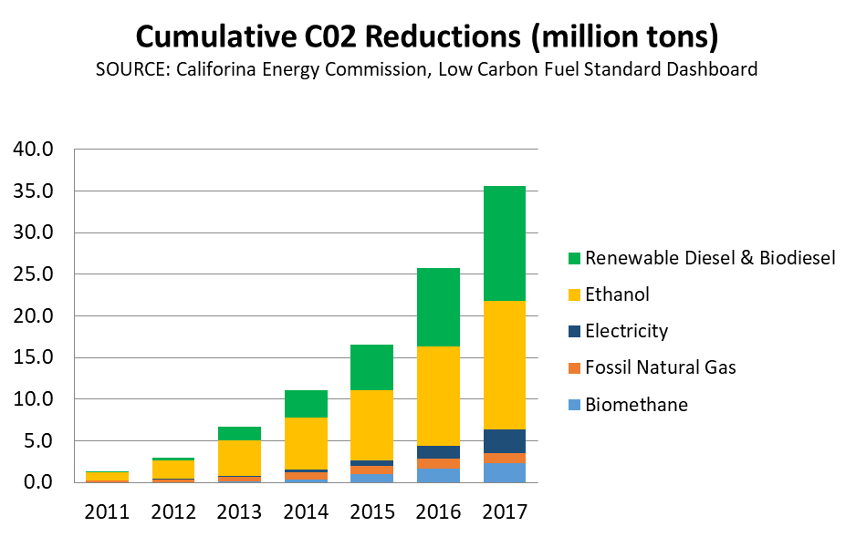
California Low Carbon Fuel Standard
Success of Renewable Fuels Reducing GHG
Diesel Technology Forum

Slide 8
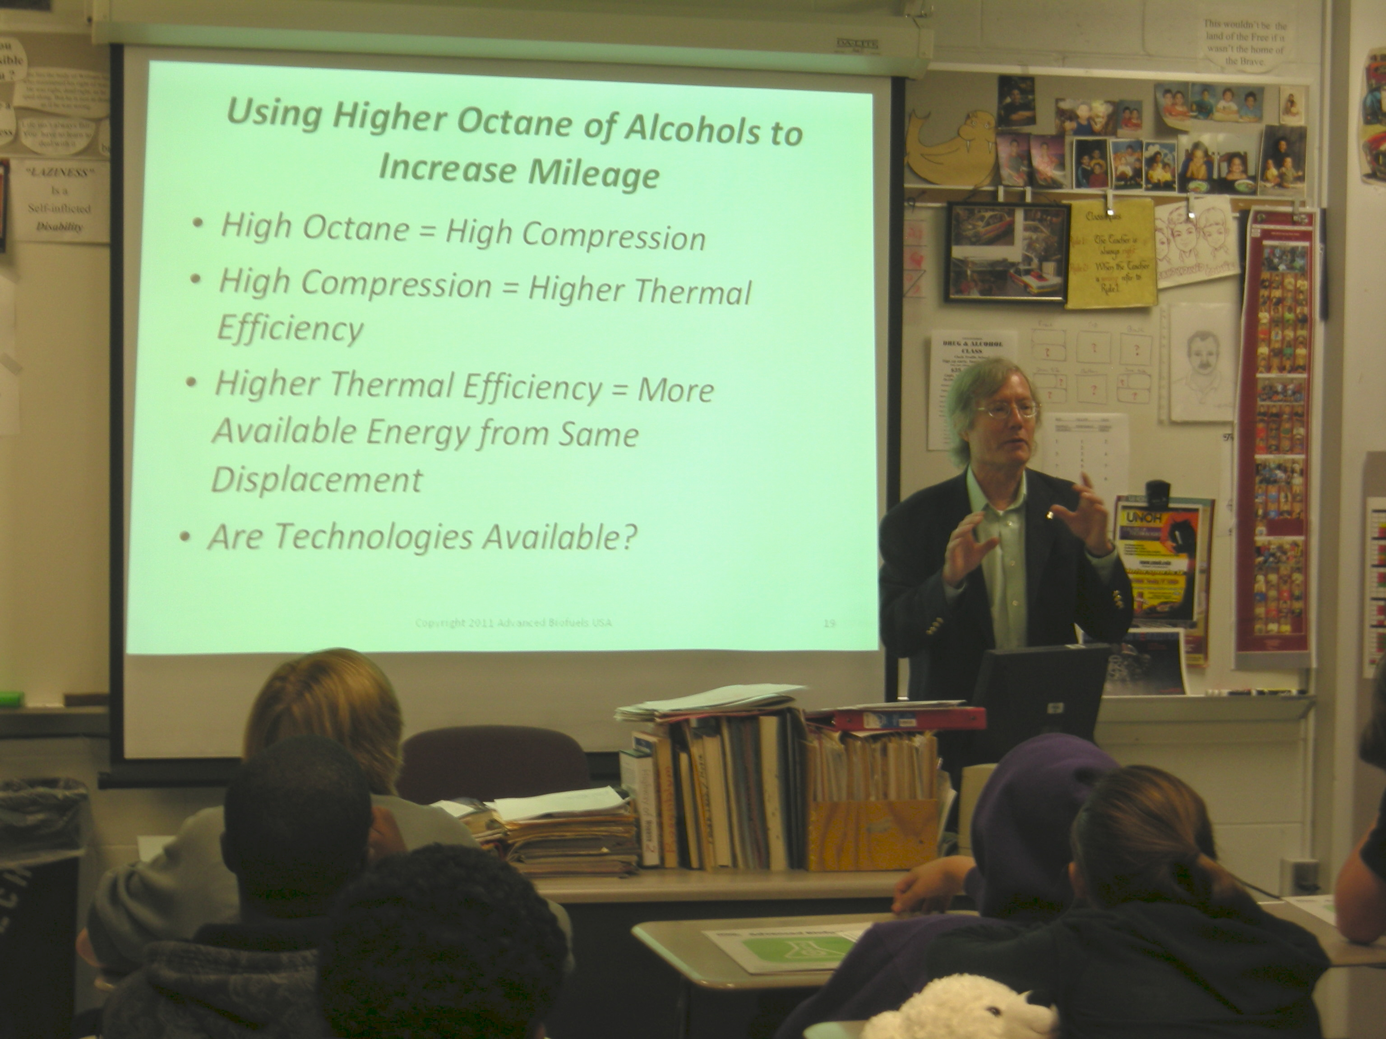
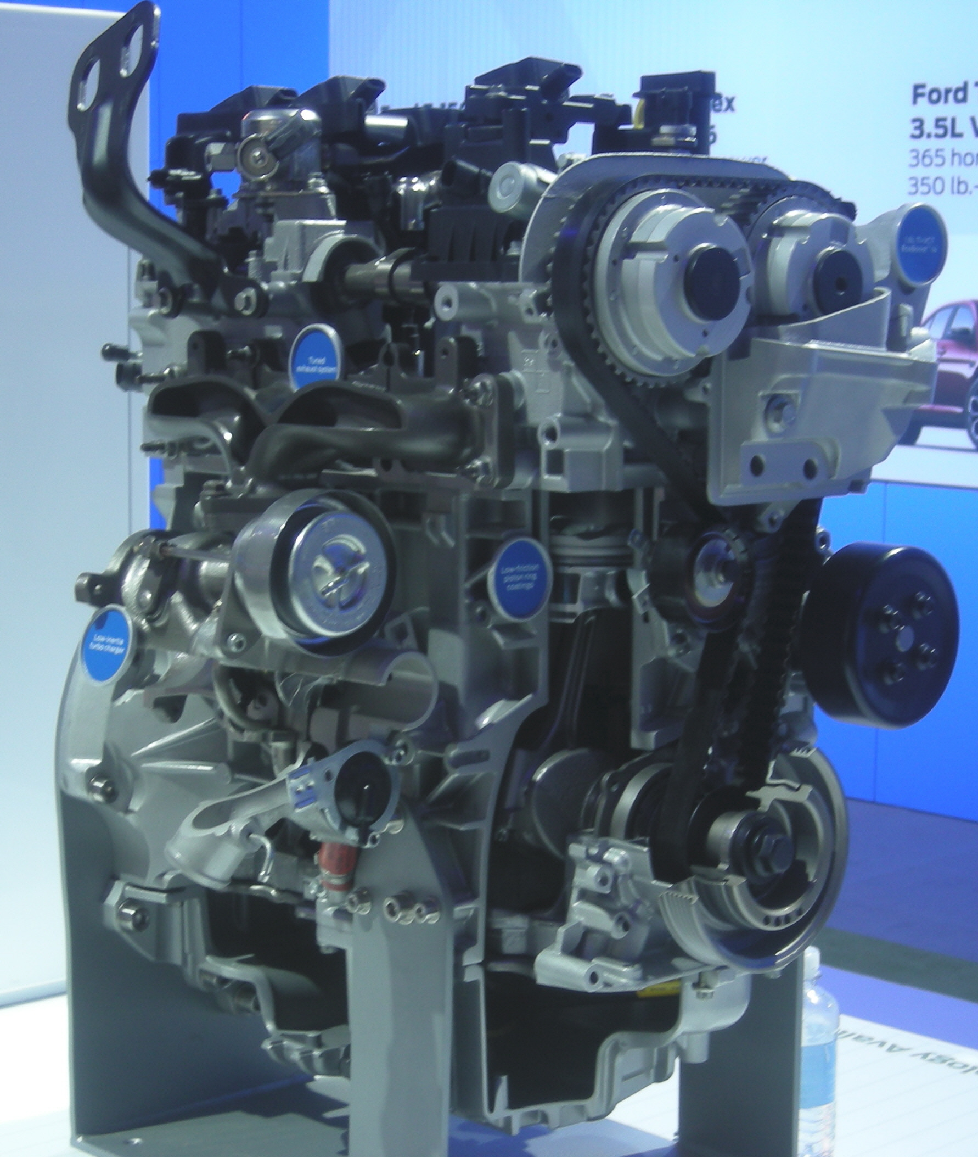
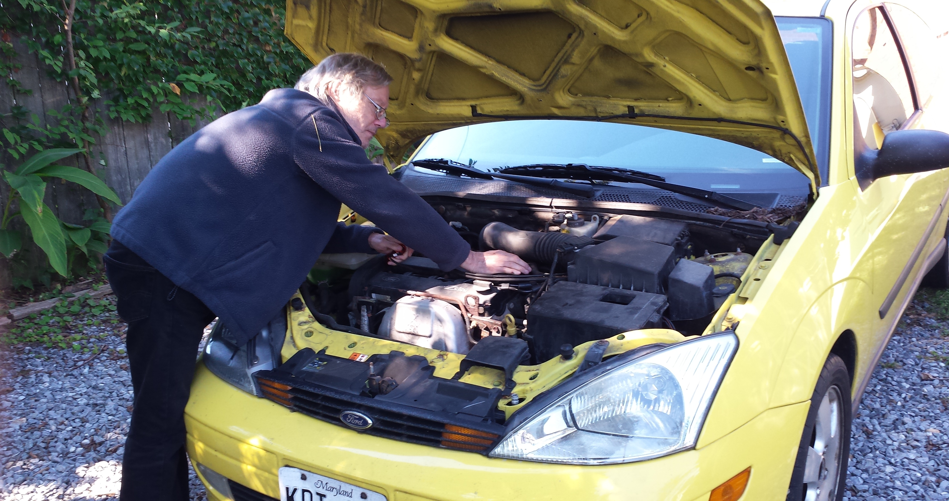
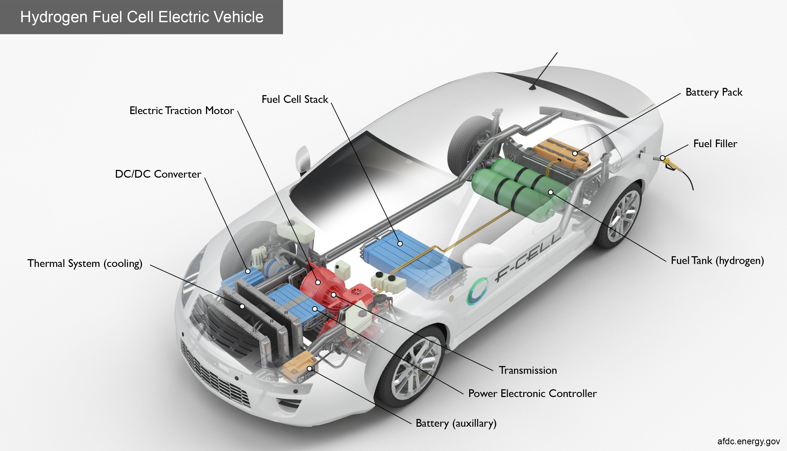
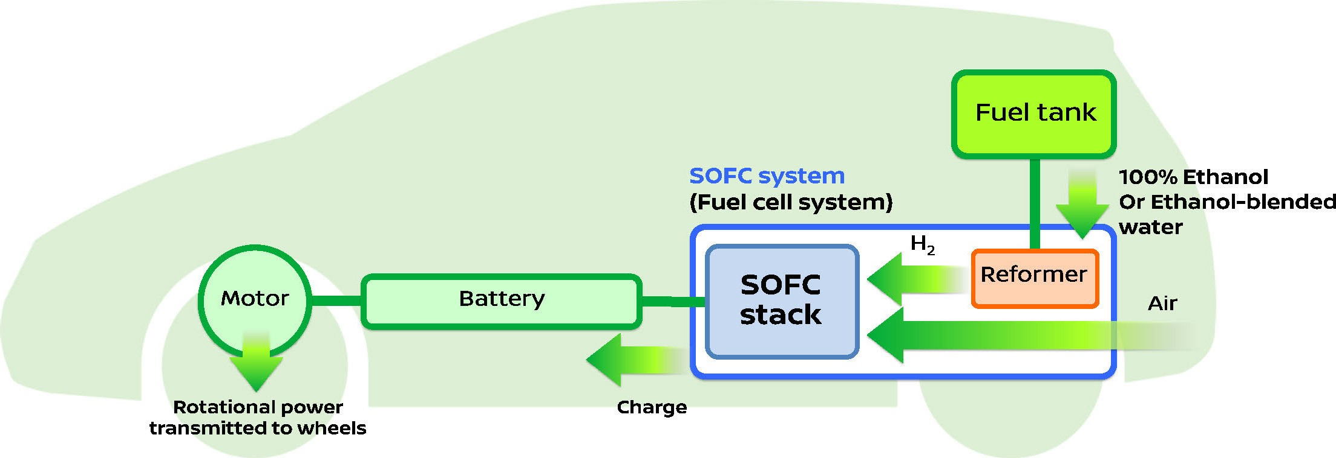
High octane fuels for high mileage vehicles
E30 Sweet Spot
Hydrogen or Ethanol for Fuel Cells
Notes:
MD Zero Emission Electric Vehicle Infrastructure Council (ZEEVIC) and broadened the focus of the Council to include hydrogen fueling stations and fuel cell vehicles. The law charged the Council with developing a plan to facilitate the integration of hydrogen fuel cell vehicles along with plug-in EVs into the State’s transportation network. Ethanol can also be fuel for fuel cells.
Ethanol is renewable. Most of hydrogen is fossil.
Gasoline substitutes
(Grassoline; Green Crude)
Biodiesel or renewable diesel from non-food feedstocks
Jet fuel made from biomass or algae
(JP-8; Commercial Aviation fuels)
“Designer” fuels tailored to obtain the most efficient, most powerful performance from specific engines
Hydrogen Carriers for Fuel Cells
Tier 3 and E30 certification fuels
3.5-liter V6 EcoBoost® racing engine to the 2014 TUDOR United SportsCar Championship series.
The new engine, which will debut at the 2014 Rolex 24 At Daytona on Jan. 25-26 and run the entire 12-race season, will power a new-look Daytona Prototype car, created with Ford corporate design influence. Michael Shank Racing is on board as the first team to put EcoBoost power behind its DP car.
“At Ford Racing, we really put great emphasis on racing production-based vehicles as well as production-based technologies,” says Jamie Allison, director, Ford Racing. “We’re proud to bring a direct-injected, twin-turbo 3.5-liter V6 EcoBoost engine to the United SportsCar Championship in a field of competitive V8-powered entries. We want to show Ford EcoBoost’s capabilities as an engine that provides both performance and fuel economy, on and off the track.”
“This engine is the future,” says Doug Yates, CEO, Roush Yates Racing Engines. “This Ford EcoBoost engine includes all the newest technologies – direct injection, turbocharging and high efficiency. We’re looking at taking it to the next level through this sports car racing program.”
A new Ford-inspired Riley Technologies Daytona Prototype car will accompany the 3.5-liter V6 EcoBoost in Daytona. The car’s body features enhanced Ford production vehicle design cues created by lead Ford production designer Garen Nicoghosian with aerodynamic support from Ford Racing chief aerodynamicist Bernie Marcus.
“Ford Motor Company has taken today’s Daytona Prototype and injected into it unique Ford attributes and unique Ford design characteristics,” says Allison. “This EcoBoost-powered car is obviously adapted for racing applications with racing controls, but ultimately we’re running what we’re selling and selling what we’re running.”
While the new engine will make its competitive racing debut at the highly anticipated 2014 Rolex 24 At Daytona, it will actually hit the Daytona track for the first time Oct. 9.
In a joint effort between Michael Shank Racing, Ford Racing and Continental Tire, the 2012 Rolex 24 At Daytona championship team will aim to set a new track record at the “World Center of Speed” by eclipsing the 210.364 mph lap laid down Feb. 9, 1987, by NASCAR champion Bill Elliott, who pushed his Ford Thunderbird to the top of the speed charts in qualifying for the Daytona 500.
“It’s really a privilege to have an opportunity to put your name in the record books like this,” says team owner Mike Shank. “It is almost inconceivable that this record has stood for such a long time, so it’s pretty special to be involved. We worked a long time to develop our relationship with Ford to be in a position to take on projects like this. Anytime you can get in the record books, it is a great opportunity and just builds on what this company has done.”
“Ford Motor Company stands for innovation and leading-edge technology, so having a chance to debut our Ford EcoBoost technology in a high-visibility setting such as this record run attempt, as well as the entire 2014 USCC schedule with its iconic races, is great,” says Allison. “Through USCC racing and its fan outreach, we want to showcase how EcoBoost technology presents the combined benefits of performance and fuel efficiency – something all consumers would want in their vehicles.”
Weather permitting, Michael Shank Racing will take to the track at 8 a.m. Oct. 9, to start building up speed for the record attempt.
To prepare for the record run and upcoming season, the EcoBoost engine has recently undergone endurance testing at Ford’s Dynamometer Lab in Dearborn, Mich., specifically at the specialized 17G cell. Production and racing engineers from Ford and specialists from Roush Yates Racing Engines have collaborated to ensure the engine is ready for the upcoming season.
http://www.imsa.com/articles/ford-debut-new-ecoboost-race-engine-rolex-24

Slide 9
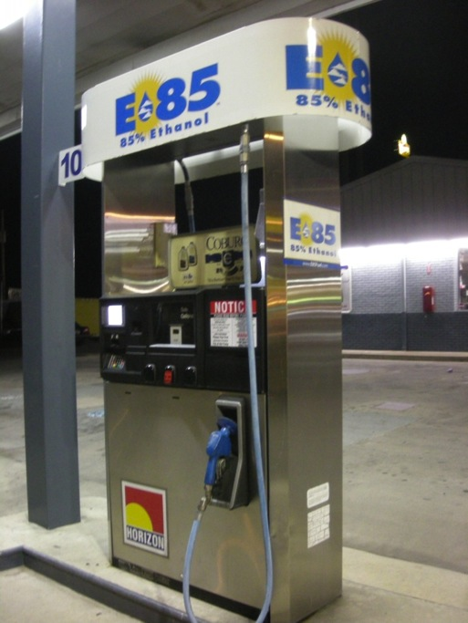
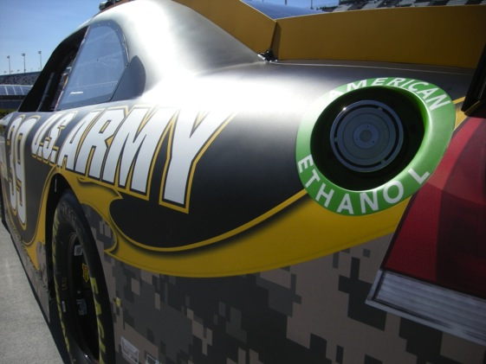
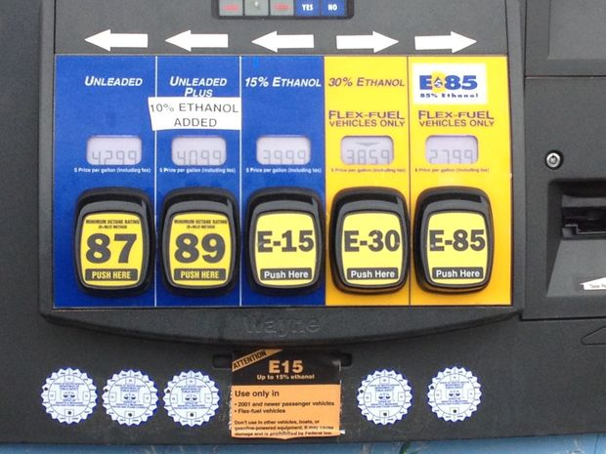
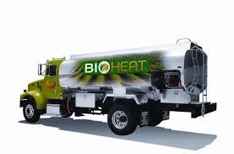
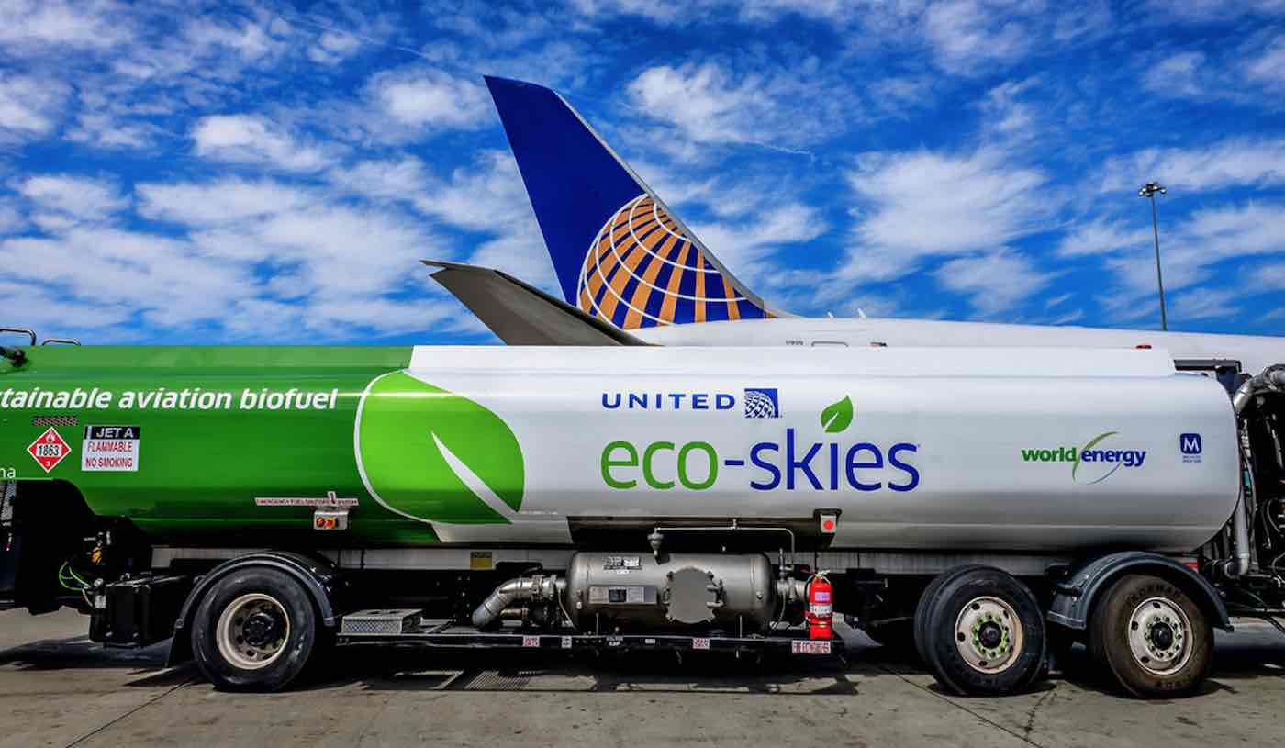
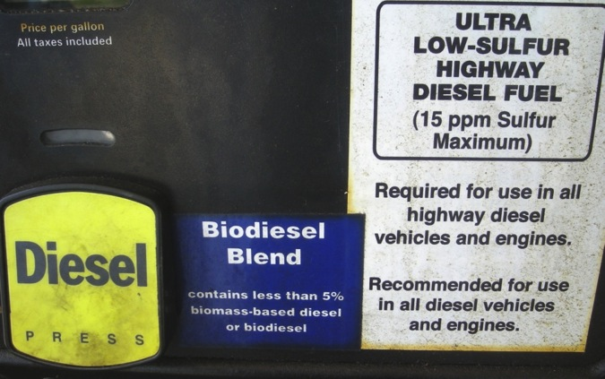
What Are Renewable Fuels Used for Today?
Fueling Cars and Trucks
Fueling Aircraft
Heating Fuel
Notes:
Today, biofuels are used in your cars and trucks. You can buy biofuels at the “gas” station. Around the Washington DC area, almost all the regular gasoline is E10—or 10% ethanol, a biofuel; so 10% biofuel. You can also buy biodiesel blends. Usually 2-5% is biodiesel; but some people use 100% biodiesel, sometimes in farm equipment or in specially adapted cars and trucks.
Race cars use biofuel—IndyCars use E98—almost 100% ethanol. Do you know why they can’t use 100%? Because someone might drink it; so they have to poison it with gasoline molecules so that it is used just for the cars; not for people. Next year IndyCar will use E85, to develop engines and fuels that are closer to what is used on the street.
NASCAR uses 15% ethanol this year. They may increase the amount of ethanol that they use in the future.
In the American Le Mans Series, some cars use bio-isobutanol (Butamax); some use E85; some use E10. Some use diesel; maybe they’ll use renewable diesel some day.
And some flights in Spain, Netherlands, Germany and Mexico use blends of biofuel and regular fuel; and commercial flights are starting in the US with Alaska Airlines and United/Continental being the first.
So, you do use biofuels today—just not so much advanced biofuels.

Slide 10
Renewable Fuels’ Role in GHG Reduction
    Most Cost Effective/ Greatest Amount of GHG Reduction/ Shortest Time
    Complement to EVs in the GHG Reduction Plan
          (Legacy, Long Haul, Aviation)
    Not just ethanol; Not just corn
    Benefits
    (Environmental Justice, Focus on High Pollution and Low Income Areas, Sustainability / Policy Considerations / Markets / Jobs)
    Our Proposals
Notes:
This is the as the most cost effective way to reduce the greatest amount of GHG in the shortest amount of time AND it will bring investments and jobs.

Slide 11
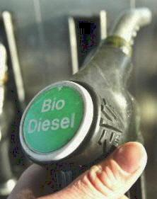
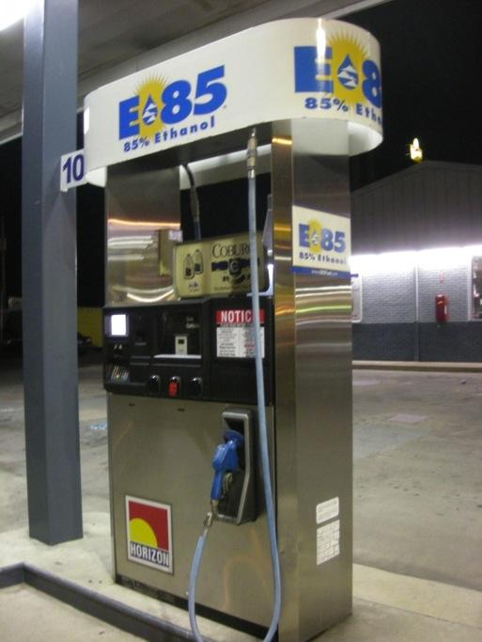
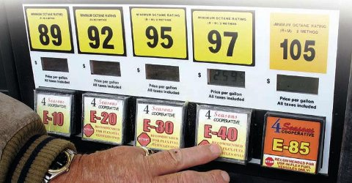

Biodiesel
Renewable Diesel
DME
Biogas/Renewable Natural Gas
Biojet (Sustainable Aviation Fuel (SAF))
Biobutanol
Renewable Hydrogen
Drop-in Hydrocarbons
BioHeat ®
Cooking Fuel
Rocket Fuel
Not just ethanol
Ethanol is a biofuel, not the only biofuel.

Slide 12
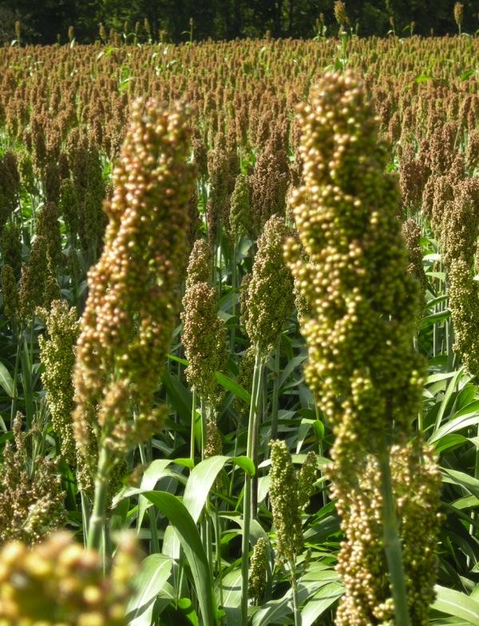
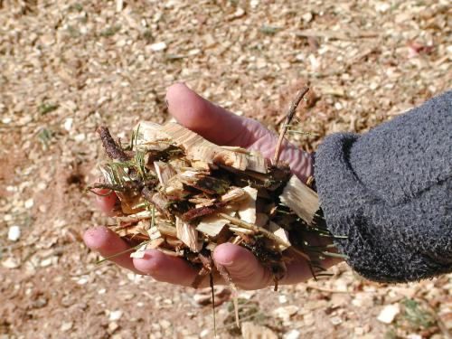

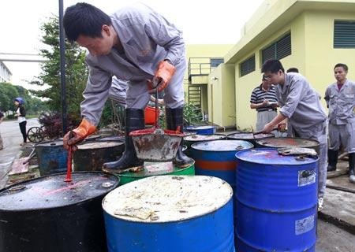
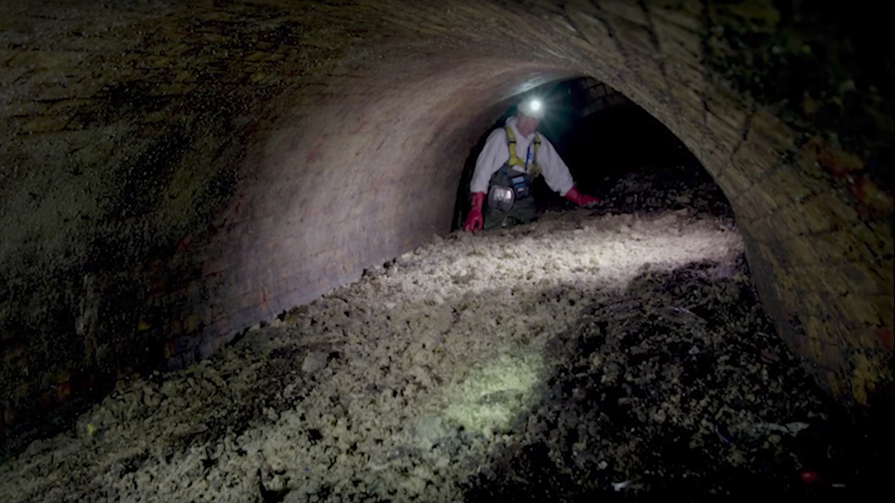
Feedstocks: Not Just Corn
Grasses such as
  Switchgrass
  Miscanthus
Sugar beets/ Energy Beets
Coffee grounds
Jatropha
Camelina, Carinata, Canola
Cassava
Paper/pulp mill waste
Used telephone poles
Oil seed crops
Thin air
Fatbergs
Halophytes…
Algae
Corn stover
Corn cobs
Energy cane
Sorghum
Forest waste, residues
Municipal waste
Sawdust
Chicken manure
Agricultural residues
Dairy Waste
Food Processing Waste
Notes:
University of Maryland Center for Environmental Science
($324,439) Feng Chen, associate professor, Institute of Marine & Environmental Technology, works with Dayton-based HY-TEK Bio LLC to develop a system for extracting nutrients from chicken manure to speed the growth of microalgae, which HY-TEK Bio uses in its photobioreactor-based systems to mitigate greenhouse gas emissions on an industrial scale, and develop a bacteria-based process that will separate algae from water that will make harvesting algae fast and inexpensive.
See more at: http://www.mtech.umd.edu/news/press_releases/mips_r52_release.html#sthash.1Zj3gA4S.dpuf
http://advancedbiofuelsusa.info/category/feedstocks/

Slide 13
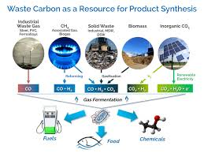
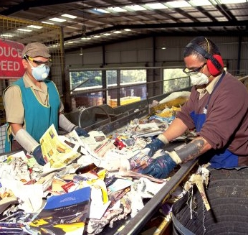
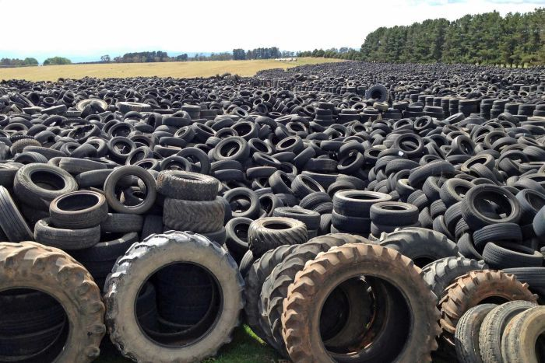
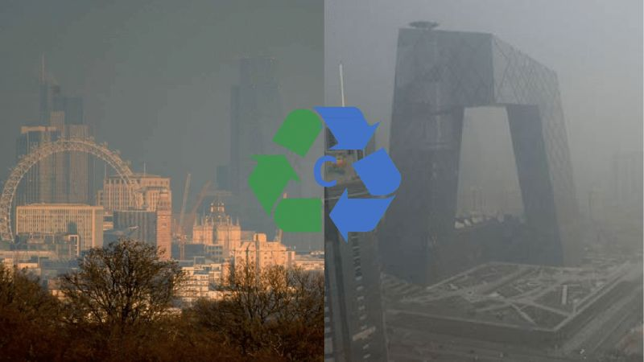
Renewable Fuels and Chemicals,
Not Just Bio-Based -- Recycling Carbon
Flue Gas/Industrial Waste Gas
Recycled Plastic, Tires
Municipal Waste
Carbon Capture and Reuse
Lanza Tech
Notes:
University of Maryland Center for Environmental Science
($324,439) Feng Chen, associate professor, Institute of Marine & Environmental Technology, works with Dayton-based HY-TEK Bio LLC to develop a system for extracting nutrients from chicken manure to speed the growth of microalgae, which HY-TEK Bio uses in its photobioreactor-based systems to mitigate greenhouse gas emissions on an industrial scale, and develop a bacteria-based process that will separate algae from water that will make harvesting algae fast and inexpensive.
See more at: http://www.mtech.umd.edu/news/press_releases/mips_r52_release.html#sthash.1Zj3gA4S.dpuf
http://advancedbiofuelsusa.info/category/feedstocks/

Slide 14
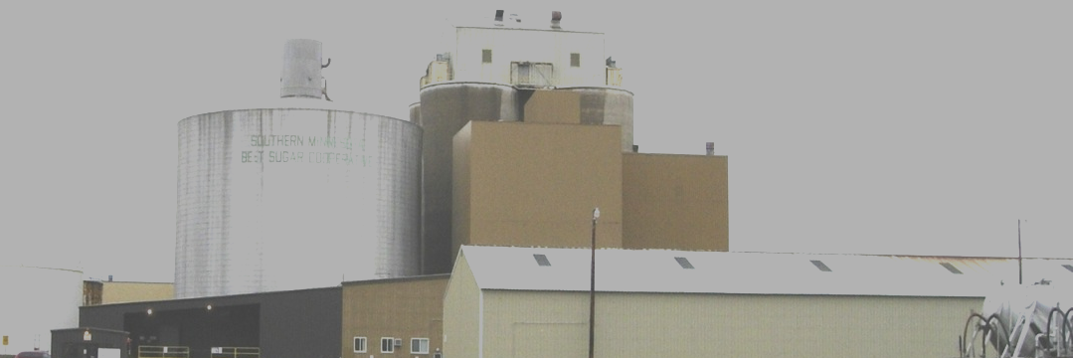
Some Feedstock Conversion Processes
Biochemical
Thermochemical
Fermentation
Anaerobic digestion
Plant extraction
Transesterification
Hydrolysis
Enzymatic catalysis
CO2-to-liquid bio-catalytic conversion
Gasification
Plasma arc gasification
Pyrolysis
Hydrothermal liquefaction
Thermochemical conversion of sugars
Notes:
Now we get to the technology piece.
These are names of processes that take the feedstock and make it into biofuels or the building blocks for biofuels.
Explain enzymes—like the saliva in your mouth
Explain fermentation—
Explain ethanol. Ask class—what is ethanol? What in everyday life has ethanol in it? You may need to prompt by using the word “alcohol.”
Make clear that the ethanol molecules in fuel are the same chemically as the ones in beer, wine, spirits. The process for converting sugars and starches into ethanol is fermentation. The process for getting the ethanol concentrated—getting the water out—is distillation.
Especially if local history includes production of moonshine, explain that corn ethanol is the same corn ethanol currently used commercially in fuel. If time permits, can introduce the idea of the difference in value and the difference in transportation costs between dried corn kernals and processed corn into whiskey/moonshine. If a history lesson is in order, refer to the Whiskey Rebellion dealt with by George Washington.
For more detail on process technologies, word search in Advanced Biofuels USA’s web site.

Slide 15

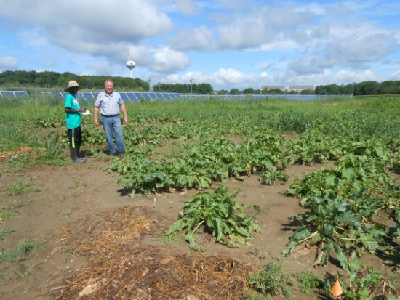
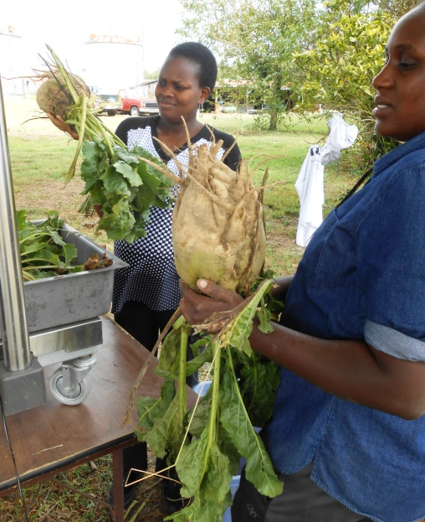
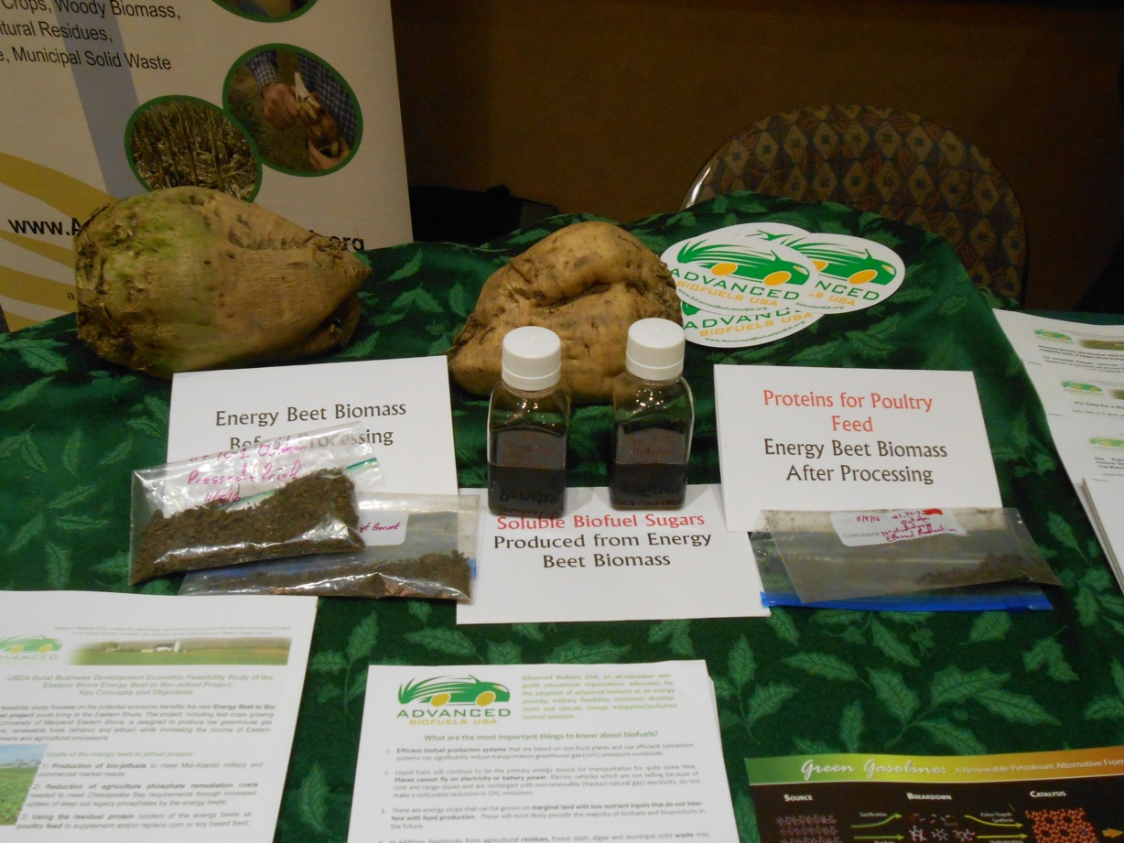
Energy Beet Projects in Maryland, Florida
Key concepts: NO lignin
High yield (2 times corn/acre)
Animal feed co-products

Slide 16
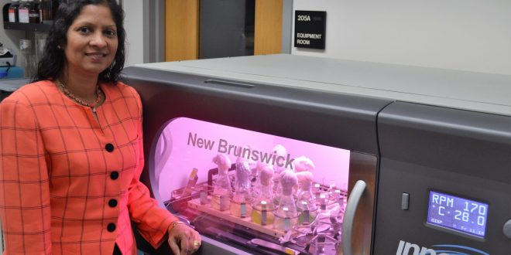
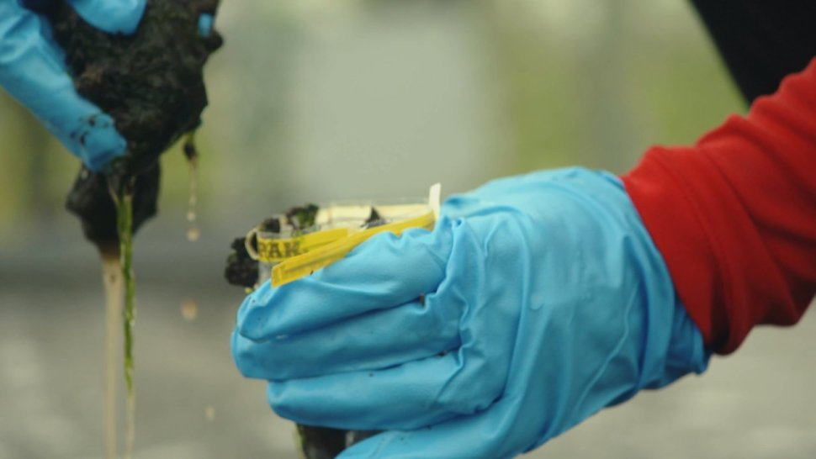
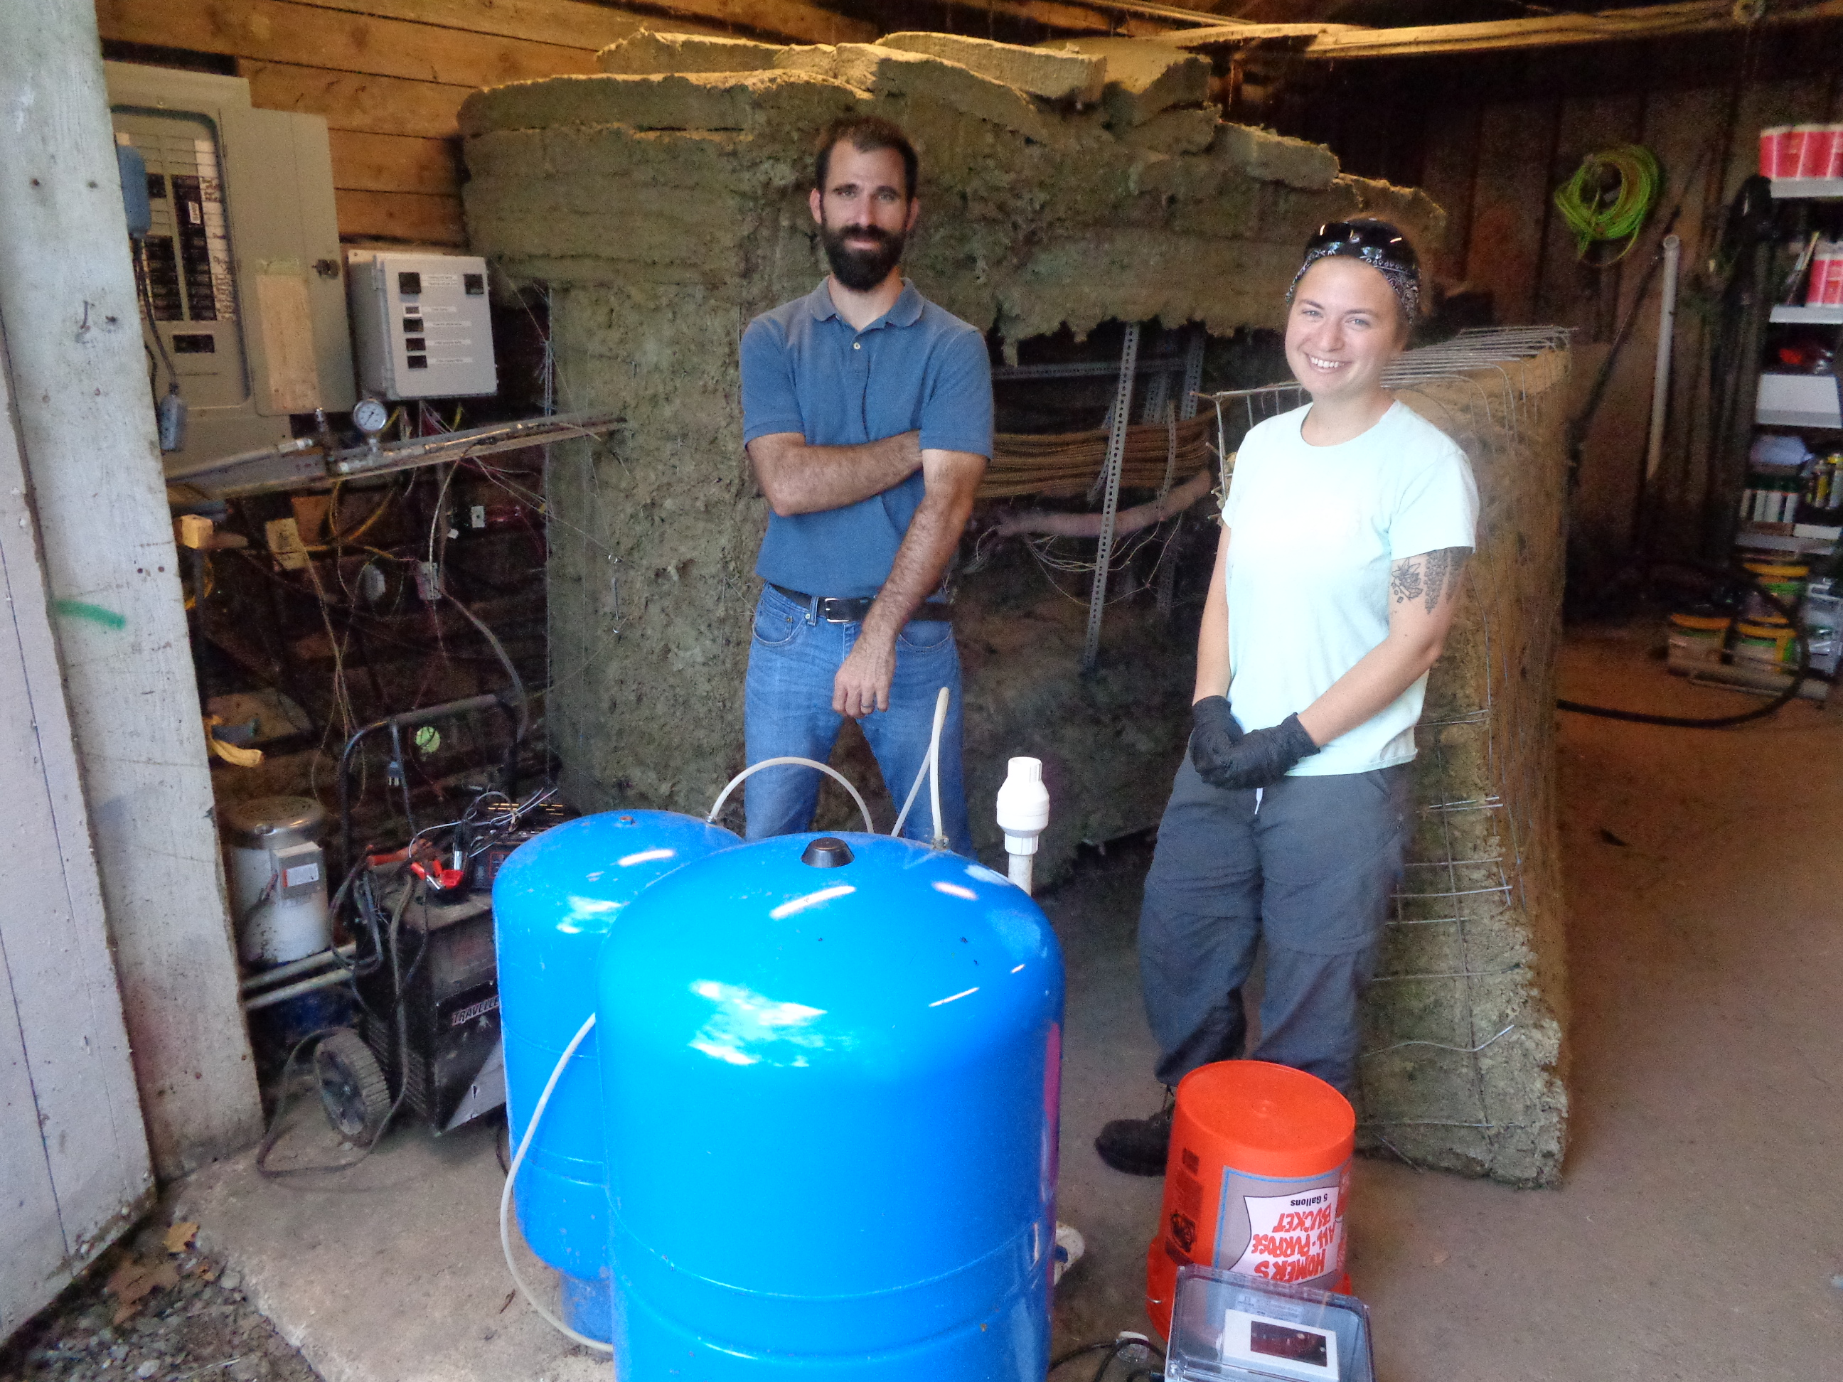
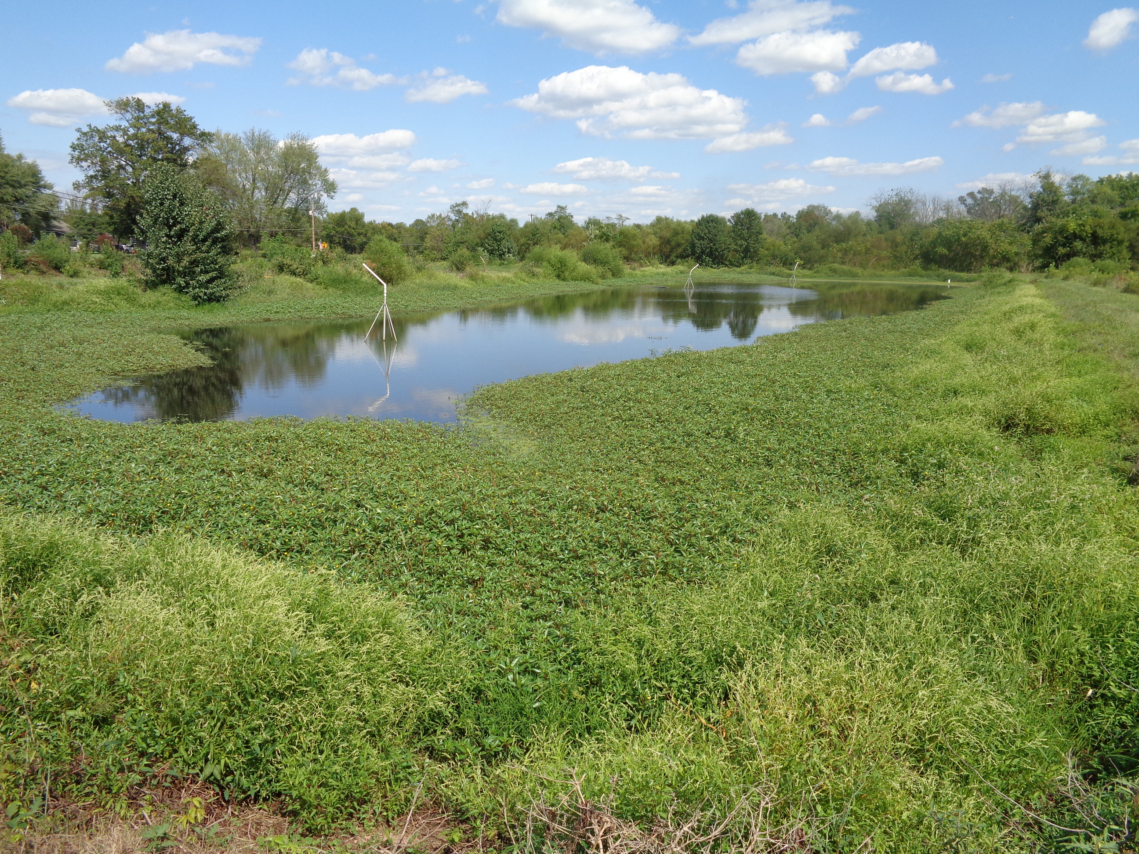
Algae Projects in Maryland
Cyanobacteria
Wastewater Treatment
Agricultural Algae
Dr. Stephanie Lansing, UMD College Park
Dr. Viji Sitther, Morgan State
Manta Biofuel, Dr. Ryan Powell

Slide 17
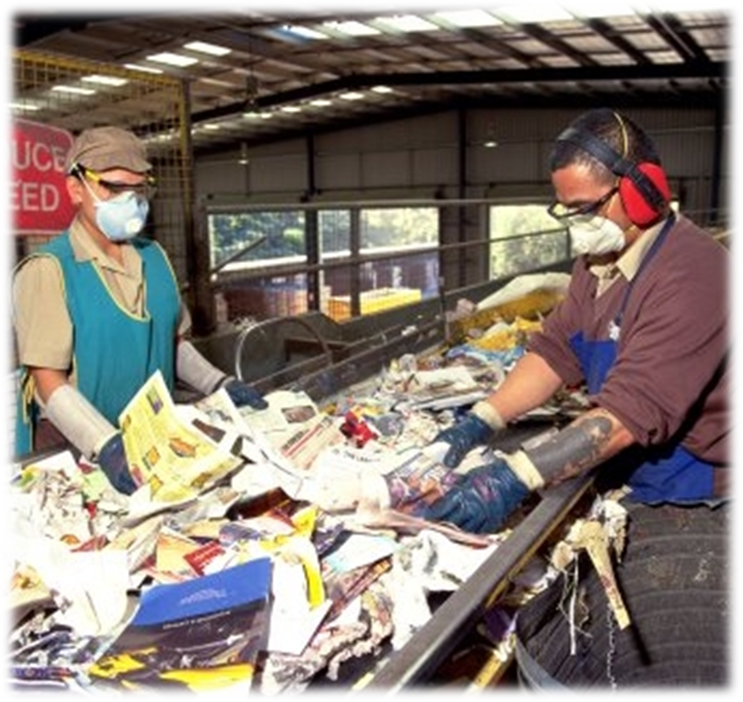
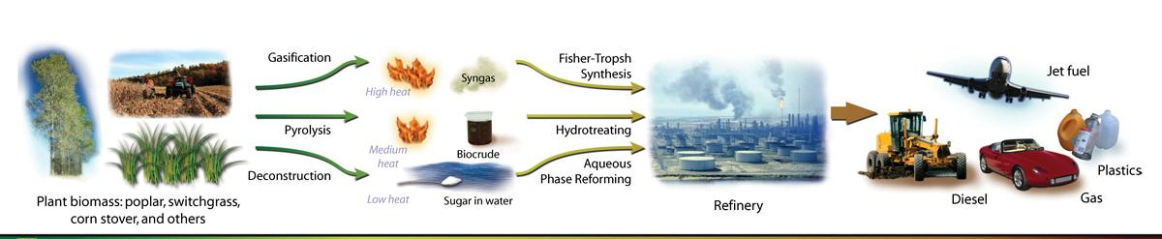
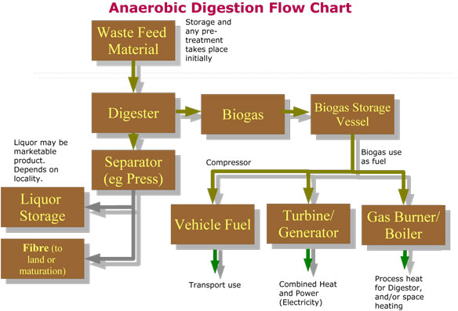
Process Path: Feedstock-to-Fuels and Products
Graphic by Zina Deretsky, National Science Foundation
Biogas to Renewable Natural Gas cleanup needed
Notes:
Spend some time on this slide. If you remember anything from this presentation, I hope you have in mind the stories and the photo of this page.
Tell York, PA Farm Show story.
Distributed (or decentralized)/Centralized production of precursors or intermediates at a location away from large scale integrated biorefineries.

Slide 18
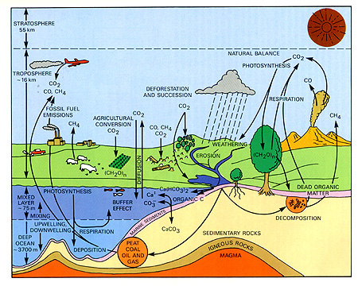
Sustainability: Recycling Carbon / Life Cycle Analysis
Notes:
Advanced Biofuels as part of a Climate Change mitigation solution
. Not only will oil run out some day, but in the meantime burning hydrocarbons that used to be buried deep in the Earth releases carbon dioxide into the air. More than we need to grow plants and to sustain life. So it stays for very long time in the atmosphere causing climate change. More about carbon cycle later.
Less pollution
Fuels like ethanol burn cleaner, don’t put as many pollutants into the air.
In this country, mostly for transportation; but in other countries ethanol and biodiesel can replace wood and dung which put lots of soot into the air which also causes climate change.
Carbon neutral: use does not contribute to an increase in greenhouse gases.
Suggestion: Point out location of oil on the chart. And arrows coming from oil surface, brining stored/sequestered carbon to the sruface and releasing it; compare that to re-using/recyling carbon that is already released.

Slide 19
Renewable Fuels’ Role in GHG Reduction
    Most Cost Effective/ Greatest Amount of GHG Reduction/ Shortest Time
    Complement to EVs in the GHG Reduction Plan
          (Legacy, Long Haul, Aviation)
    Not just ethanol; Not just corn
    Benefits
    (Environmental Justice, Focus on High Pollution and Low Income Areas, Sustainability / Policy Considerations / Markets / Jobs)
    Our Proposals
Notes:
This is the as the most cost effective way to reduce the greatest amount of GHG in the shortest amount of time AND it will bring investments and jobs.

Slide 20
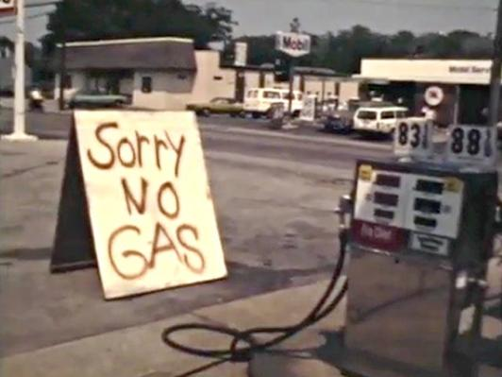
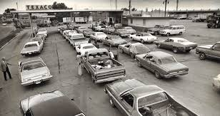
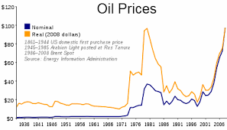
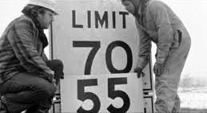
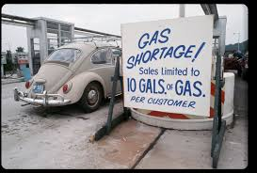
Oil Disruption--Geo-Political --1973 Oil Embargo Spurred Development of Home-Grown Fuel
Notes:
https://mpt.pbslearningmedia.org/resource/bln12.socst.ush.now.oilcrisis/the-oil-crisis-1979/#.W1TuTkjRU2w
Oil Embargo, 1973–1974. During the 1973 Arab-Israeli War, Arab members of the Organization of Petroleum Exporting Countries (OPEC) imposed an embargo against the United States in retaliation for the U.S. decision to re-supply the Israeli military and to gain leverage in the post-war peace negotiations.
The 1979 (or second) oil crisis or oil shock occurred in the world due to decreased oil output in the wake of the Iranian Revolution. ... The price of crude oil more than doubled to $39.50 per barrel over the next 12 months, and long lines once again appeared at gas stations, as they had in the 1973 oil crisis.

Slide 21
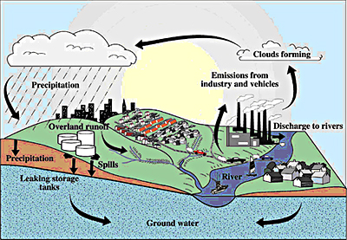
2006 Ethanol Replaces Carcinogenic MTBE as an oxygenate, serves as a source of octane.
MTBE Cycle—does not breakdown; litigation, banned in multiple states
Notes:
MTBE is believed to have entered the water supply from leaking underground storage tank systems including underground lines that contained gasoline and/or from surface spills at gas stations. Once in the ground, MTBE behaves differently from other gasoline constituents such as benzene . Unlike petroleum hydrocarbons, it is highly water soluble, not easily absorbed into soil, and is more resistant to biodegradation. Thus, with widespread use, MTBE has the potential to occur in high concentrations in groundwater, travel far from leak sources, and accumulate to become a concern for the entire region.
http://www.cvwd.com/Documents-MTBE-Project.aspx
http://www.epa.gov/mtbe/
National transition deadline: May 5, 2006
Switch to Ethanol-Based Fuel Causing Disruptions NYT https://www.nytimes.com/2006/04/21/us/21cnd-gas.html
MTBE in fuels EPA: https://archive.epa.gov/mtbe/web/html/gas.html
TIMELINE: A very short history of MTBE in the US https://www.icis.com/explore/resources/news/2006/07/05/1070674/timeline-a-very-short-history-of-mtbe-in-the-us/
MD litigation: http://www.marylandattorneygeneral.gov/press/2017/121317.pdf

Slide 22
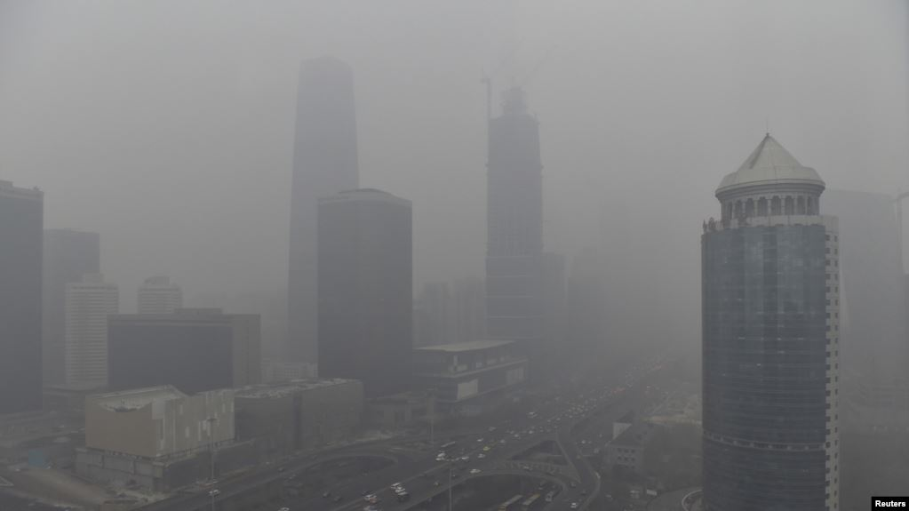

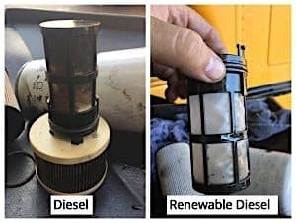
Ethanol
Substitute for Carcinogenic Aromatics
Replaces MTBE in Gasoline -- Urban Air Initiative
Less Expensive, Less Harmful Octane
Fuel for Fuel Cells
Biodiesel and Renewable Diesel
Low Sulfur
Cleaner Burning
Fewer Particulates
Less Maintenance

Slide 23
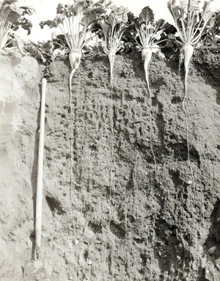
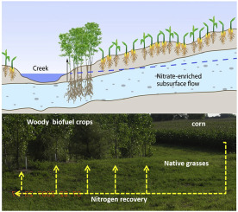
Solutions to Problems
Why Replacing Fossil-Fuel Oil With Advanced Transportation Biofuels is Important—
Reduce carbon footprints
Erosion control
Waste water treatment
Remediation of contaminated soil
Nutrient management
Carbon sequestration
Alternative to carcinogens / Air Quality
Overflowing landfill relief/plastic recycling
Burning agricultural waste in fields
Grease (fatbergs) in sewers
Contaminated black market used cooking oil

Slide 24
A Few Types of Jobs Available in Advanced Biofuels from Feedstock Development and Production through Fuel Sales
Agriculture/horticulture experts
Freight railroad operators, engineers, loaders, unloaders
Equipment operators, technicians
Farm product purchasers/traders
Agricultural Inspectors
Computer Software Engineers
Truck drivers
Equipment operators
Lawyers
Office Personnel
Investors
Others?
Agronomists
Farmers / Farm workers
Farm equipment designers
Biologists
Chemists/ Chemical engineers
Mechanical engineers
Electrical engineers
Researchers into bioenergy crop development
Lab Technicians
Industrial Engineers
Plant Operations Managers
Welders/Boilermakers
Accountants

Slide 25
Renewable Fuels Role in GHG Reduction
    Most Cost Effective/ Greatest Amount of GHG Reduction/ Shortest Time
    Complement to EVs in the GHG Reduction Plan
          (Legacy, Long Haul, Aviation)
    Not just ethanol; Not just corn
    Benefits
    (environmental justice, focus on high pollution and low income areas)
    Our Proposals
Notes:
This is the as the most cost effective way to reduce the greatest amount of GHG in the shortest amount of time AND it will bring investments and jobs.

Slide 26
Renewable Fuels’ Role in GHG Reduction
    Shortest Time
          Fuel for existing planes, trains, automobiles, equipment
          Fuel for non-EV vehicles that will continue to be bought, especially by:
                Lower income people
                Rural residents
                Those with long commutes (responsible for
                many vehicle miles traveled)
        Don’t have to wait for electricity to be renewable or batteries “fair trade”

Slide 27
Renewable Fuels’ Role in GHG Reduction
    Most Cost Effective
    People who can’t afford EVs can lower carbon footprint of current and future vehicles with less expensive fuel (November 1, 2019, in the US. Fossil gasoline with no ethanol was $3.09/gallon; with E15, more than 60 cents less ($2.45) and E85 nearly a dollar less ($2.14)
    Infrastructure change to existing fuel stations; can be part of scheduled equipment replacement

Slide 28
Renewable Fuels’ Role in GHG Reduction
Graphic: Diesel Technology Forum
    Greatest Amount of GHG Reduction
Notes:
Often the environmental harm from batteries is not considered it Evs, nor their life cycle carbon footprint. https://ideas.repec.org/a/eee/appene/v225y2018icp965-974.html
Kalghatgi, Gautam, 2018. "Is it really the end of internal combustion engines and petroleum in transport?," Applied Energy, Elsevier, vol. 225(C), pages 965-974.

Slide 29
Proposals
Include Renewable Fuels in GHG Reduction Plan
    Financing Infrastructure and R&D
    Promote Development and Use
Look at Low Carbon Fuel Standard models to address gaps
Incorporate into regional Transportation and Climate Initiative (TCI)
Disappearing Carbon User Fee
Prioritize funding for renewable fuel infrastructure and use for low income and high pollution areas

Slide 30

Find out more: www.AdvancedBiofuelsUSA.org
For a Truly Sustainable, Renewable Future
Joanne M. Ivancic, Executive Director
301-644-1395
Info@AdvancedBiofuelsUSA.org
30

Slide 31
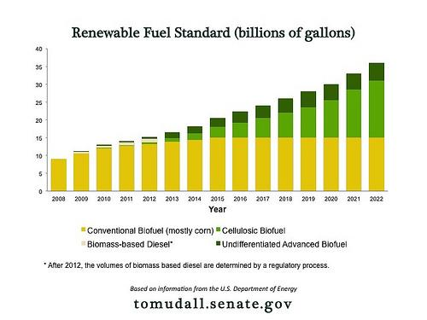
2007 Renewable Fuel Standard
Sec. 202 Energy Independence and Security Act of 2007
(Billion Gallons/Year)
History of Ethanol in US: Federal Policy
After 2022 EPA determines volumes based on six criteria
31
Notes:
The renewable fuel standard in the 2007 EISA mandated an amount of biofuels that oil companies were required to blend with gasoline for transportation fuel. This is an example illustrating the social aspects of sustainability. The society went through a political process to suggest, promote, discuss and then pass a law that put society’s desire, as President George W. Bush put it, to get off our addition to oil. This was one way society decided to work on that social goal that grows out of the values discussed in the initial slides of this presentation—energy security, for example.

