Slide 1
Advanced Biofuels A Truly Sustainable Renewable Future
Advanced Biofuels USA
www.AdvancedBiofuelsUSA.org
301-644-1395

Slide 2
Advocates for the adoption of advanced biofuels as an
energy security,
military flexibility,
economic development
climate change mitigation
pollution control
solution.
Advanced Biofuels USA
501(c)3 Nonprofit
Educational Organization
Founded April 2008
Website:
www.AdvancedBiofuelsUSA.org
Frederick, MD
Notes:
Advanced Biofuels USA, a nonprofit educational organization advocates for the adoption of advanced biofuels as an energy security, military flexibility, economic development and climate change mitigation/pollution control solution. Our key tool for accomplishing this is our web site, www.AdvancedBiofuelsUSA.org, a resource for everyone from opinion-leaders, decision-makers and legislators to industry professionals, investors, feedstock growers and researchers; as well as journalists, teachers and students.
In addition, we prepare technology assessments, present briefing documents to Congressional staff, participate in international conferences on renewable fuels, provide both background and attributed interviews for a wide range of journalists and broadcast reporters, consult with international conference organizers, conduct presentations and lectures for civic and school groups, and provide general assistance to those interested in any facet of the world of advanced biofuels.

Slide 3
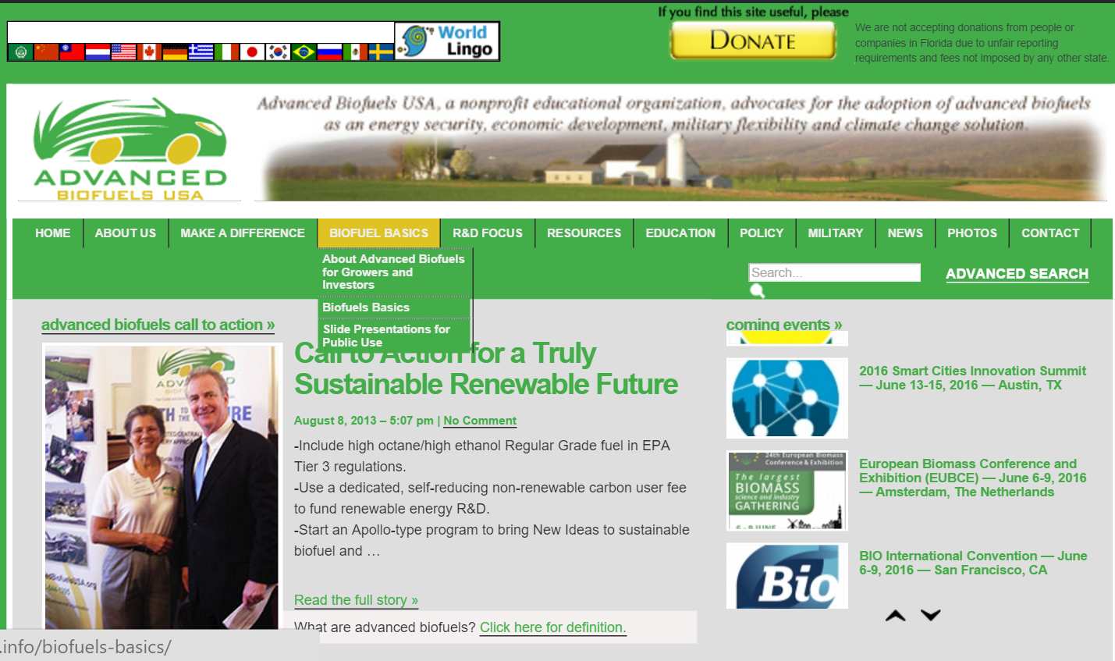
Access Presentation Step 1 www.AdvancedBiofuelsUSA.org
Notes:
Introduction
What do you think of when you hear the word “biofuel?”
This is what we are going to talk about
At the end of the presentation, you should be able to answer these questions. At least a little bit.
Before we do anything else, “What does the word ‘biofuel’ mean to you? What do you think of when you hear the word ‘biofuel’?”

Slide 4
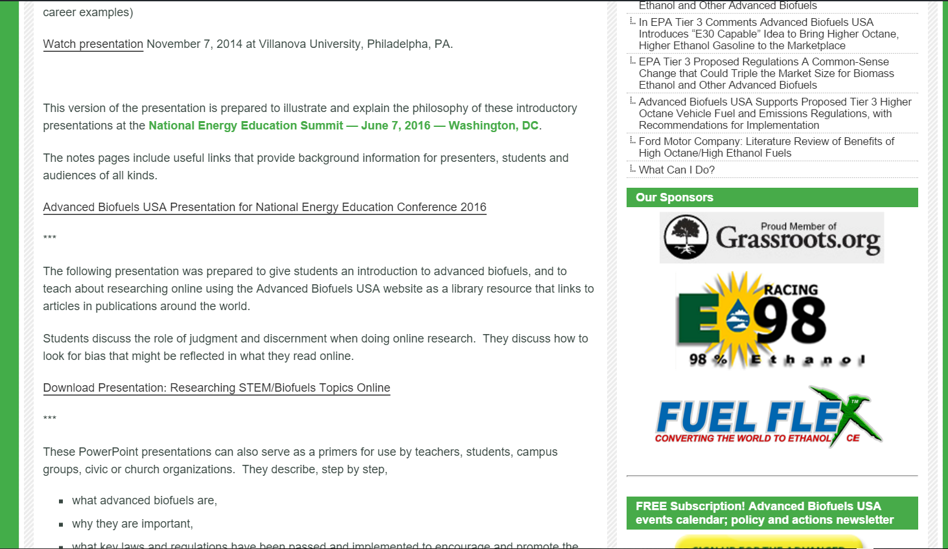
Access Presentation Step 2
Click on presentation
Notes:
Introduction
What do you think of when you hear the word “biofuel?”
This is what we are going to talk about
At the end of the presentation, you should be able to answer these questions. At least a little bit.
Before we do anything else, “What does the word ‘biofuel’ mean to you? What do you think of when you hear the word ‘biofuel’?”

Slide 5
Before we start: What do you think of when you hear “biofuel”?
Notes:
Introduction
What do you think of when you hear the word “biofuel?”
This is what we are going to talk about
At the end of the presentation, you should be able to answer these questions. At least a little bit.
Before we do anything else, “What does the word ‘biofuel’ mean to you? What do you think of when you hear the word ‘biofuel’?”

Slide 6
Overview Question to Assess Audience Quick Review of Basic Presentation Discuss Flexibility of Basic Presentation Sneak Peak at Extra Slides List of other resources
Notes:
Overview
Quick review of basic presentation, reasons for how it's organized
Start with a question to assess level of understanding, attitudes toward biofuels
Explanation of flexibility of basic presentation, geared to specific audience
Sneak peak at "extra" slides available for more in-depth exploration of specific areas
Engines/fuels
Conversion technologies
List of other resources
Anju Dahiya's book (Bioenergy) and Commercializing Bioproducts book

Slide 7
What Are Advanced Biofuels?
What are they?
Why do we need them?
What are they used for? (Yesterday, Today, Tomorrow)
How are they made?
Sustainability
Policy Considerations
Markets

Slide 8
What Are Advanced Biofuels?
What are they?
Why do we need them?
What are they used for? (Yesterday, Today, Tomorrow)
How are they made?
Sustainability
Policy Considerations
Markets

Slide 9
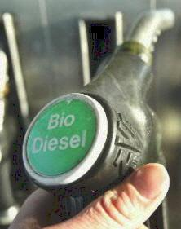
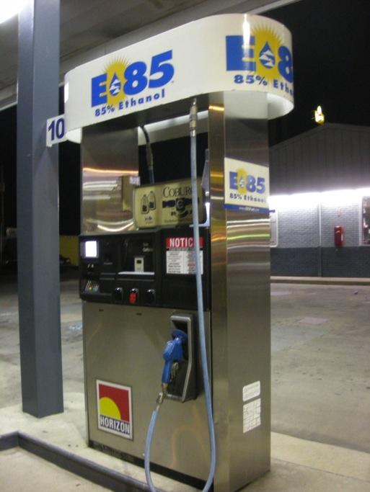
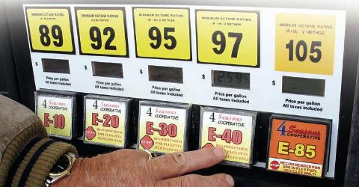
Ethanol is a biofuel, not the only biofuel. Biodiesel Renewable Diesel Biojet Biobutanol Drop-in Hydrocarbons Rocket Fuel BioHeat ®
What Are Advanced Biofuels?

Slide 10
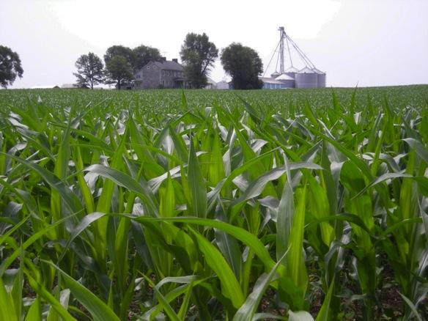
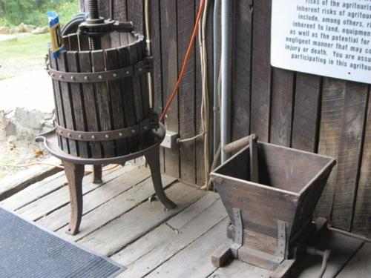
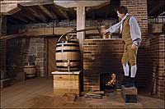
Corn-based ethanol (nearly 200 proof moonshine or 100% ethanol) is one of the few currently commercially available biofuels you can buy for vehicles in the US today.
And the ethanol molecule is part of many other things too.
Wine
Beer
Whiskey
AND, ethanol can be made from many things, not just corn. More on that later….
Notes:
Many people don’t realize that the ethanol that we talk about with regard to fuel is the same molecule as the ethanol or alcohol in wine, beer, whiskey—and that corn ethanol has long been nick-named moonshine.
Important note: as soon as the ethanol is distilled and ready for transport from a biorefinery, some gasoline is added to “poison” it so that it will not be drinkable, and will not be diverted to beverage purposes.
Photos are an old crusher and presser which might be used for grapes (similar ones for apples and other fruit); and the distillery at Mount Vernon, VA, a re-creation of the distillery operated by George Washington on his plantation.
If you want to add a history lesson, or integrate this with lessons in the history department, you can talk about how corn was converted to liquid (moonshine) to both increase its value and make it easier to move large volumes across the Appalachian mountains in the early days of the United States. The Whiskey Rebellion is also a relevant topic.
You can point out the parallels in the problems that people have today moving large volumes of raw biomass to biorefineries.
Ethanol for use as a transportation fuel must be highly distilled

Slide 11
What Are Advanced Biofuels?
What are they?
Why do we need them?
What are they used for? (Yesterday, Today, Tomorrow)
How are they made?
Sustainability
Policy Considerations
Markets
Notes:
Introduction
This is what we are going to talk about
At the end of the presentation, you should be able to answer these questions. At least a little bit.

Slide 12
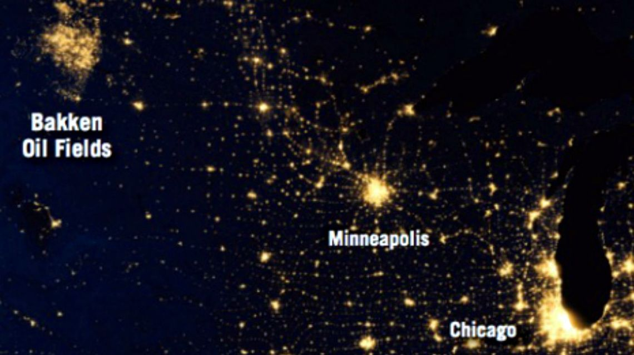
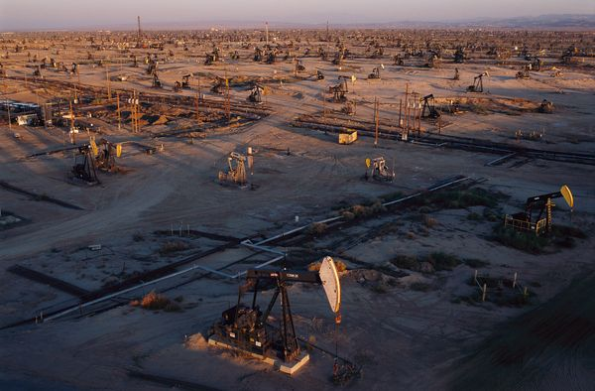
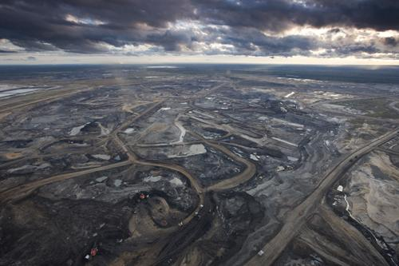
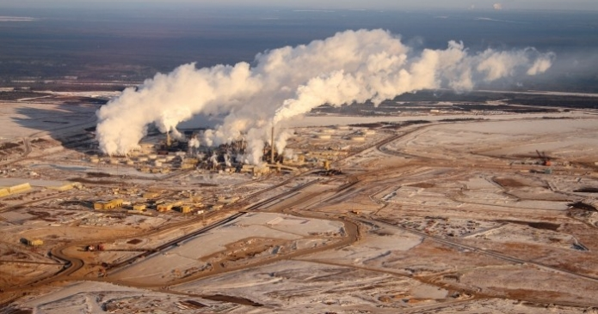
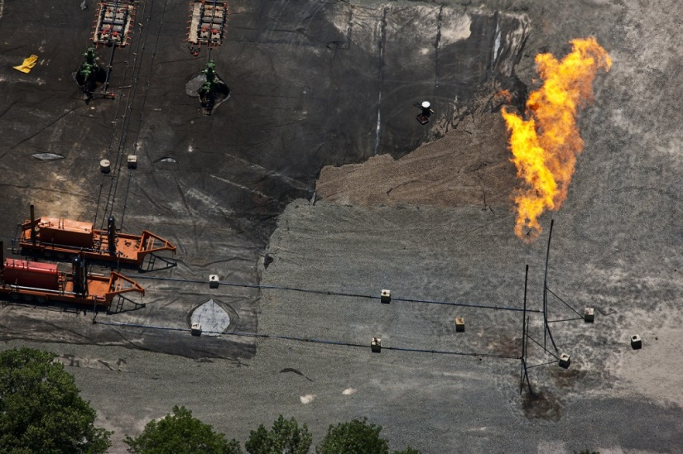
What We Have
Notes:
We are in the process of making choices about our energy resources.

Slide 13
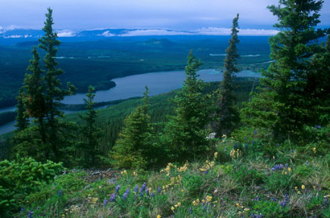
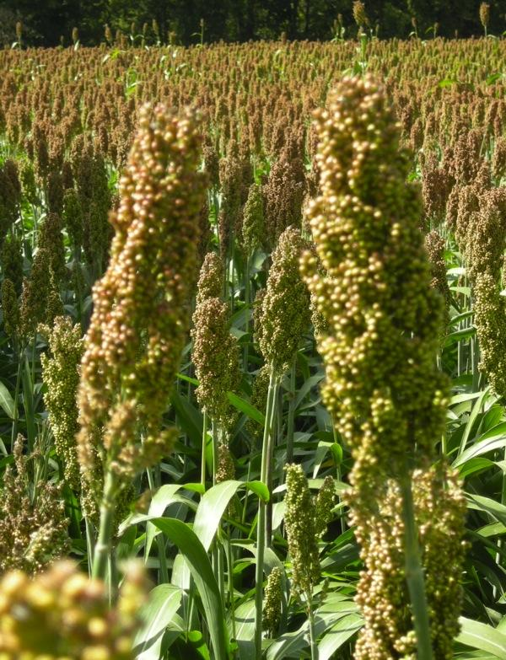
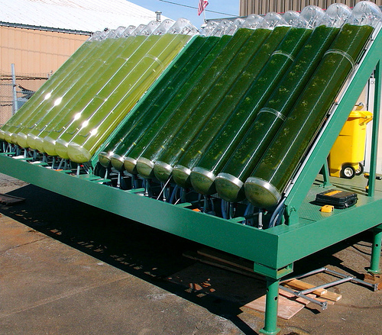
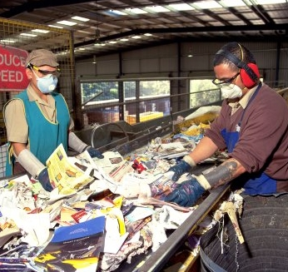
What We Can Have
Notes:
These two slides created by a Hood College student when asked to depict the choices we have.
What order would you put them in?
Is this what we have; and we are in the process of ruining it to create what we see on the previous slide?
Or, is the other slide a representative picture of what we have today; and these photos a depiction of what we could have if we change our ways?
How do you think about this?
Clearly, these are current photos. So we have both. Which do you prefer?

Slide 14
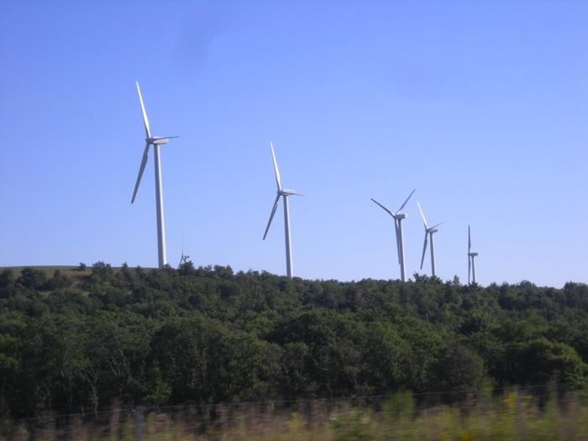
Why Replacing Fossil-Fuel Oil With Advanced Transportation Biofuels is Important—
Virtually no oil is used to produce electricity in the US– just 1%.
Windmills and solar
can produce electricity
but cannot power jet airplanes.
Notes:
Why focus on transportation instead of making electrical power? If our goal is to replace imported oil and petroleum-based fossil fuels, then transportation fuel is the way to go.

Slide 15
Why Replacing Fossil-Fuel Oil With Advanced Transportation Biofuels is Important—
18.9 Million Barrels
of oil used
each day by US
TODAY
71% Used as
Transportation Fuel
Rest to produce
plastics, fiber
film, chemicals
Information from US Energy Information Administration
Notes:
We are not just trying to put oil companies out of business. In addition to national energy security, the underlying reason for all of this is the crisis we face due to climate change.
RFS one was predicated on the idea that the oil companies would transition to become fuel companies; by forcing them to blend renewables into their product, some assumed that they would finance the development of these fuel products—diversify into renewables.
Instead, they fight tooth and nail to preserve their old market as they knew it rather than look to the future; see themselves as “oil men” rather than “fuel providers” or fuel and chemical precursor providers
All of the above; should be “all of the above ground”
Advanced Biofuels as part of an Energy Security solution.
1) Something as important to everyday life as the power to help you move from place to place.
If you put control of that power in the hands of other countries, you become vulnerable. If those other countries want to make you do something that you don’t want to do, they can just squeeze your supply of oil and make life difficult.
For examples, early 1970’s oil embargo lead to lines of cars at gas stations.
In your memory, then lines at gas stations after Hurricane Katrina knocked out a lot of gasoline production and distribution. That kind of disruption is a vulnerability. It’s better to make your fuel at home.
If we can replace a good portion of that oil that is used for transportation by making our own transportation fuels, we minimize that liability.
Energy Security
About two-thirds of U.S. petroleum demand is in the transportation sector. Approximately half of U.S. petroleum is imported. Depending heavily on foreign petroleum supplies puts the United States at risk for trade deficits, supply disruption, and price changes. The Renewable Fuels Association's 2012 Ethanol Industry Outlook(PDF) calculated that in 2011 the ethanol industry replaced the gasoline produced from more than 485 million barrels of imported oil. Ethanol represents 25% of domestically produced and refined motor fuel for gasoline engines.
http://www.afdc.energy.gov/fuels/ethanol_benefits.html US DOE Alternative Fuels Data Center
POLICY Discussion: Non-monitizable value of trying to first transition from petroleum transportation fuels: energy security, military flexibility, economic development, climate change mitigation, pollution control.
If we were not-policy directed, but rather marketing/financing directed; initial emphasis would have been on plastics, fiber, film. Greater margins, smaller scale for greater returns.
Problem has been that “fuels first” policy was articulated, but insufficiently funded.
In 2009: However, the majority of petroleum now extracted—
in the range of 85%—is used to produce fuels. Most of
these are transportation fuels such as gasoline, diesel
fuel, and jet fuel, while some, such as fuel oil, liquefied
petroleum gas, and propane, are used for heating
and power generation. Petroleum accounts for more
than 90% of transportation fuel, but only for 2% of
electricity generation. When refined, a 42-gallon barrel
of crude oil yields about 20 gallons of gasoline, 10
gallons of diesel fuel and heating oil, four gallons of
jet fuel, and smaller amounts of other products.
http://www.publichealthreports.org/userfiles/124_1/5-19.pdf
 5
Energy and Public Health:
The Challenge of Peak Petroleum
Howard Frumkin, MD, DrPHa
Jeremy Hess, MD, MPHa,b
Stephen Vindigni, MPHa,b
aNational Center for Environmental Health and Agency for Toxic Substances and Disease Registry, Centers for Disease Control and
Prevention, Atlanta, GA
bEmory Medical School, Atlanta, GA
Address correspondence to: Howard Frumkin, MD, DrPH, National Center for Environmental Health and Agency for Toxic Substances
and Disease Registry, Centers for Disease Control and Prevention, 4770 Buford Hwy., MS F-61, Atlanta, GA 30341-3717; tel. 770-488-0604;
fax 770-488-3385; e-mail <hfrumkin@cdc.gov>.
Consumption and Disposition
U.S. Petroleum Consumption18,835,000 barrels/day
U.S. Motor Gasoline Consumption8,736,000 barrels/day (377 million gallons/day)
Share of U.S. Oil Consumption for Transportation71% (2011)
U.S. Total Petroleum Exports2,924,000 barrels/day
http://www.eia.gov/energyexplained/index.cfm?page=oil_home#tab2
With the turmoil in the Middle East, it is more important than ever that, because the U.S. produced 13.9 billion gallons of ethanol last year, we used 485 million fewer barrels of imported oil. That is roughly equivalent to 13 percent of total U.S. crude oil imports, saving the American economy $49.7 billion. Without the RFS—and without ethanol production—the U.S. would have imported 52 percent of its oil last year. With the RFS—and with oil imports at 45 percent, their lowest level since 1996—the U.S. is less dependent on unstable or unfriendly regimes. http://www.ethanolproducer.com/articles/9185/the-rfs-itundefineds-not-broke-donundefinedt-fix-it
On the other hand:
Why opt look at the power of zoning. In the Digest we have written about strategic feedstock reserves. Why? Because without reserves and zoning, who is going to make $2 food or $3 fuel when one can make $7 chemicals, $12 nutraceuticals, or convert land for even more to parking lots. It is inevitable that the market will embrace the higher-value opportunities — and these markets are so titanic that it is not as easy as you think to saturate them and move down the cost curve to other products. You can build an awful lot of biorefineries before you have run out of markets for adipic acid, or ethylene.
…Regulate feedstock as the spectrum of scarce bandwidth that it is — and there will be feedstock for all products demanded by the market, and at fair prices. READ MORE

Slide 16
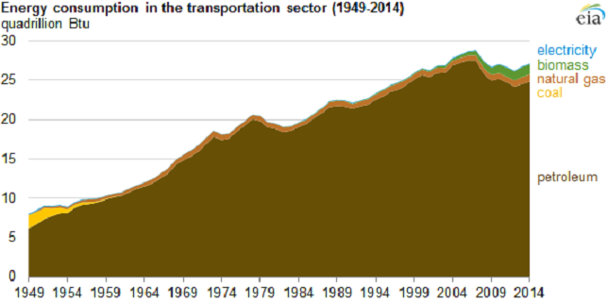
Why Replacing Fossil-Fuel Oil With Advanced Transportation Biofuels is Important—
Oil has held more than a 90% share of the transportation market for more than 60 years.
Information from US Energy Information Administration

Slide 17
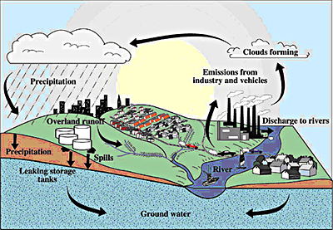
Why Replacing Fossil-Fuel Oil With Advanced Transportation Biofuels is Important—
Replaces MTBE as an octane enhancer.
Notes:
MTBE is believed to have entered the water supply from leaking underground storage tank systems including underground lines that contained gasoline and/or from surface spills at gas stations. Once in the ground, MTBE behaves differently from other gasoline constituents such as benzene . Unlike petroleum hydrocarbons, it is highly water soluble, not easily absorbed into soil, and is more resistant to biodegradation. Thus, with widespread use, MTBE has the potential to occur in high concentrations in groundwater, travel far from leak sources, and accumulate to become a concern for the entire region.
http://www.cvwd.com/Documents-MTBE-Project.aspx
http://www.epa.gov/mtbe/

Slide 18
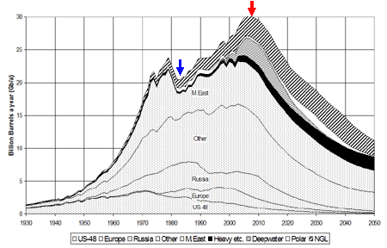
Peak Oil
Why Replacing Fossil-Fuel Oil With Advanced Transportation Biofuels is Important—
Notes:
This is a diagram of how production of oil has peaked in the US, while our need for petroleum fuels has increased, so we have to import oil that we can’t produce ourselves. This same dynamic of oil fields being used up is going on around the world. They don’t replenish, are not renewable. When the oil is gone, the well doesn’t grow more.

Slide 19
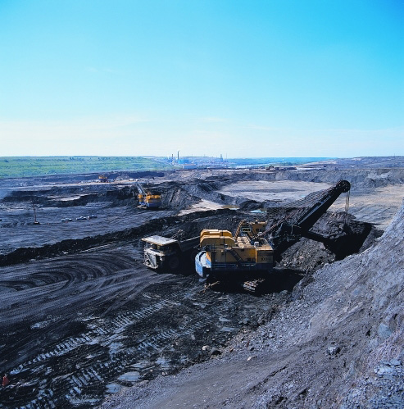
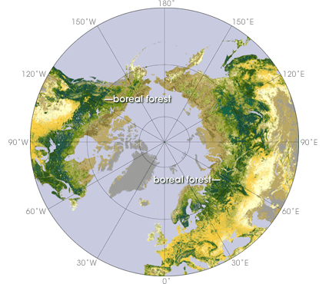
Why Replacing Fossil-Fuel Oil With Advanced Transportation Biofuels is Important—
Before oil runs out, it becomes more difficult and dangerous to extract.
Notes:
2) This oil is fossil fuel. It will run out some day. Before it runs out, it becomes very difficult, dangerous and expensive to find and to extract.
Remember the oil spill in the Gulf of Mexico in 2010—drilling for oil very, very deep wells
Also the tar sands in Canada
In Canada’s boreal forests, there are almost 3000 square miles of mineable oil sands. Getting to the oil sands means removing the forests. It means that large scale, heavy equipment moves into the landscape, removing the plants, impacting animal populations, and damaging soil, water and air. Shifting Sands documents the work in the oil sands with photos of the oil sands landscapes during and after this process. Some consider this to be a cost of oil production. Others consider this to be an environmental disaster.
http://www.decodedscience.com/the-tar-sands-fueling-controversy/4981 by Tricia Edgar is a science writer and educator from the beautiful, wet Pacific Northwest. She has a Master’s degree in Environmental Management.
Map: http://www.google.com/imgres?hl=en&sa=X&biw=1280&bih=685&tbm=isch&prmd=imvns&tbnid=YeF5QzLiRLZv9M:&imgrefurl=http://earthobservatory.nasa.gov/Study/BorealThreshold/&docid=omIRY8y0hG362M&imgurl=http://earthobservatory.nasa.gov/Features/BorealThreshold/Images/boreal_forest_map.gif&w=428&h=370&ei=CkO0TrbAJM-CsgKimNnmAw&zoom=1&iact=hc&vpx=607&vpy=226&dur=11401&hovh=209&hovw=241&tx=103&ty=113&sig=117376384788423915804&page=1&tbnh=141&tbnw=163&start=0&ndsp=18&ved=1t:429,r:8,s:0
http://www.platts.com/RSSFeedDetailedNews/RSSFeed/Oil/8662080?WT.mc_id=&WT.tsrc=Eloqua
"The challenge for producers such as the UAE is to continue producing oil and gas from existing reservoirs while, at the same time, developing new opportunities," he said. "It is no secret that the days of easy oil are coming to an end. Increasingly we are being forced to go down the route of enhanced oil recovery and developing ultra sour oil and gas from complex reservoirs." These challenges had turned the oil-rich region to become a center for development of new technologies and innovation, Hamli said, referring to the UAE's expansion into renewable energy and its decision to build the zero-carbon Masdar City in Abu Dhabi. "Our commitment to widening our domestic energy mix and promoting renewable energy does not mean that we have turned our backs to the oil industry," Hamli said. "Our growing population and fast-moving industrial developments have forced us to choose between continuing burning fossil fuels which would otherwise be exported and finding complementary energy solutions for use at home. We realized that by widening our domestic fuel mix, we could release more hydrocarbons for export," he added. The UAE has set a target of switching to nuclear power for 25% of its power generation requirements, Hamli said, adding that national peak demand for electricity was set to more than double by 2020 while demand for other forms of energy is growing. The UAE expects to have its first nuclear power station commissioned in 2017 while at the same time developing solar energy. Abu Dhabi has set a target of generating 7% of its energy needs from renewable sources including solar. "We believe that the best way of securing a sustainable economic future in a carbon constrained world is to develop a balanced portfolio of clean energy sources in which nuclear, renewable energy, oil and natural gas all have a role to play," Hamli said.

Slide 20
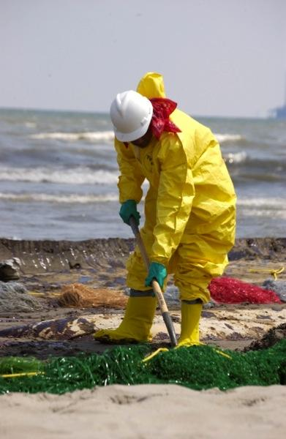
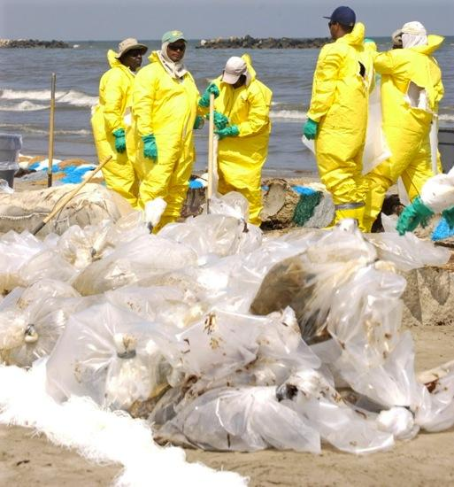
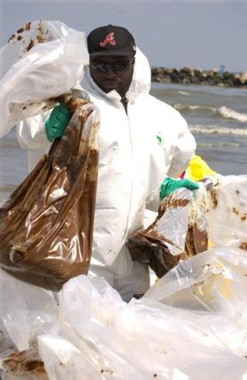
Why Replacing Fossil-Fuel Oil With Advanced Transportation Biofuels is Important—
Before oil runs out, it becomes more difficult and dangerous to extract.
Notes:
2) This oil is fossil fuel. It will run out some day. Before it runs out, it becomes very difficult, dangerous and expensive to find and to extract.
Remember the oil spill in the Gulf of Mexico in 2010—drilling for oil very, very deep wells
Also the tar sands in Canada
In Canada’s boreal forests, there are almost 3000 square miles of mineable oil sands. Getting to the oil sands means removing the forests. It means that large scale, heavy equipment moves into the landscape, removing the plants, impacting animal populations, and damaging soil, water and air. Shifting Sands documents the work in the oil sands with photos of the oil sands landscapes during and after this process. Some consider this to be a cost of oil production. Others consider this to be an environmental disaster.
http://www.decodedscience.com/the-tar-sands-fueling-controversy/4981 by Tricia Edgar is a science writer and educator from the beautiful, wet Pacific Northwest. She has a Master’s degree in Environmental Management.

Slide 21
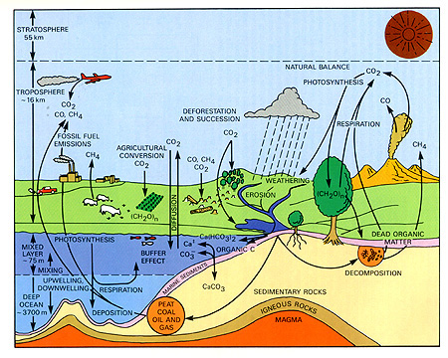
Why Replacing Fossil-Fuel Oil With Advanced Transportation Biofuels is Important—
Part of a low life cycle carbon emissions
climate change mitigation solution
Notes:
Advanced Biofuels as part of a Climate Change mitigation solution
. Not only will oil run out some day, but in the meantime burning hydrocarbons that used to be buried deep in the Earth releases carbon dioxide into the air. More than we need to grow plants and to sustain life. So it stays for very long time in the atmosphere causing climate change. More about carbon cycle later.
Less pollution
Fuels like ethanol burn cleaner, don’t put as many pollutants into the air.
In this country, mostly for transportation; but in other countries ethanol and biodiesel can replace wood and dung which put lots of soot into the air which also causes climate change.
Carbon neutral: use does not contribute to an increase in greenhouse gases.
Suggestion: Point out location of oil on the chart. And arrows coming from oil surface, brining stored/sequestered carbon to the sruface and releasing it; compare that to re-using/recyling carbon that is already released.

Slide 22
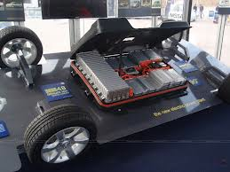
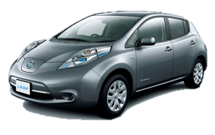
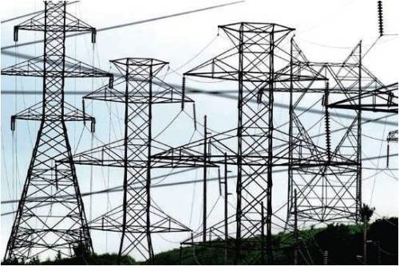
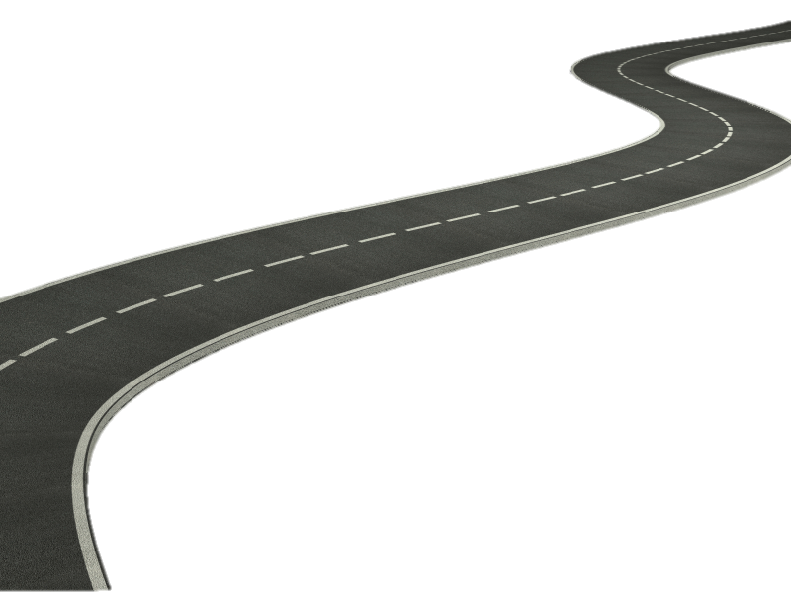
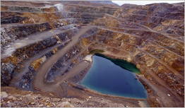
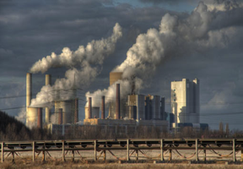
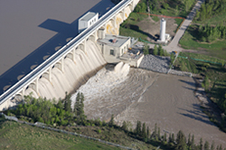
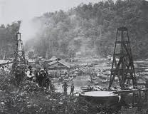
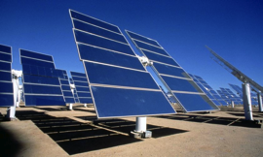
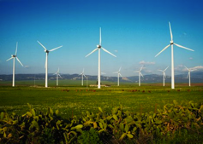
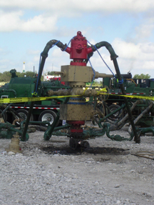
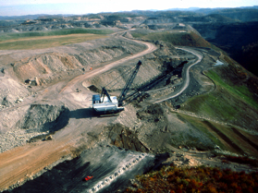
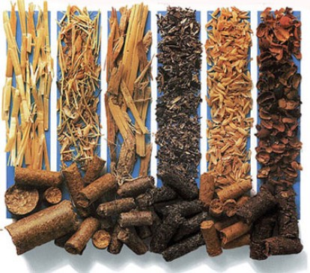
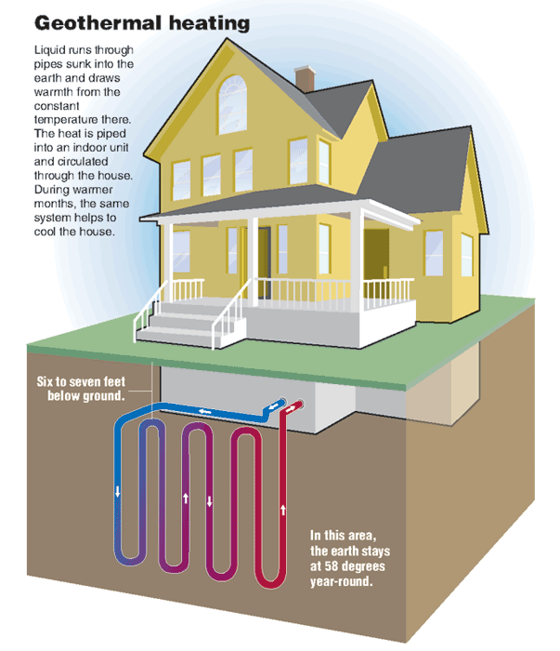
The Road to Electric Vehicles
Batteries
GHG Emissions
Rare Earth Metal Mining
Nuclear
Power Plant
0.4%
Hydro
GHG Emissions
Petroleum Oil
Solar
Wind
Biomass
Coal Mining
Natural Gas Fracking
Notes:
In 2014, the United States generated about 4,093 billion kilowatthours of electricity.¹ About 67% of the electricity generated was from fossil fuels (coal, natural gas, and petroleum).
Major energy sources and percent share of total U.S. electricity generation in 2014:
Coal = 39%
Natural gas = 27%
Nuclear = 19%
Hydropower = 6%
Other renewables = 7%
Biomass = 1.7%
Geothermal = 0.4%
Solar = 0.4%
Wind = 4.4%
Petroleum = 1%
Other gases < 1%
¹ Preliminary data.
Learn more:
Monthly Energy Review: Electricity
Last updated: March 31, 2015
http://www.eia.gov/tools/faqs/faq.cfm?id=427&t=3

Slide 23
The Road to Electric Vehicles
Batteries
GHG Emissions
Rare Earth Metal Mining
Nuclear
19%
Power Plant
6%
0.4%
1%
Hydro
GHG Emissions
0.4%
4.4%
Petroleum Oil
27%
Solar
Wind
39%
1.7%
Other gas: less than 1%
0.4%
Coal Mining
Natural Gas Fracking
Biomass
Notes:
In 2014, the United States generated about 4,093 billion kilowatthours of electricity.¹ About 67% of the electricity generated was from fossil fuels (coal, natural gas, and petroleum).
Major energy sources and percent share of total U.S. electricity generation in 2014:
Coal = 39%
Natural gas = 27%
Nuclear = 19%
Hydropower = 6%
Other renewables = 7%
Biomass = 1.7%
Geothermal = 0.4%
Solar = 0.4%
Wind = 4.4%
Petroleum = 1%
Other gases < 1%
¹ Preliminary data.
Learn more:
Monthly Energy Review: Electricity
Last updated: March 31, 2015
http://www.eia.gov/tools/faqs/faq.cfm?id=427&t=3

Slide 24
What Are Advanced Biofuels?
What are they?
Why do we need them?
What are they used for? (Yesterday, Today, Tomorrow)
How are they made?
Sustainability
Policy Considerations
Markets

Slide 25
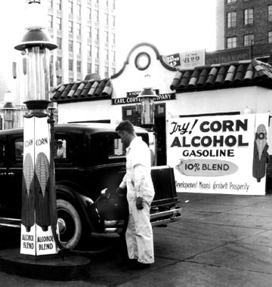
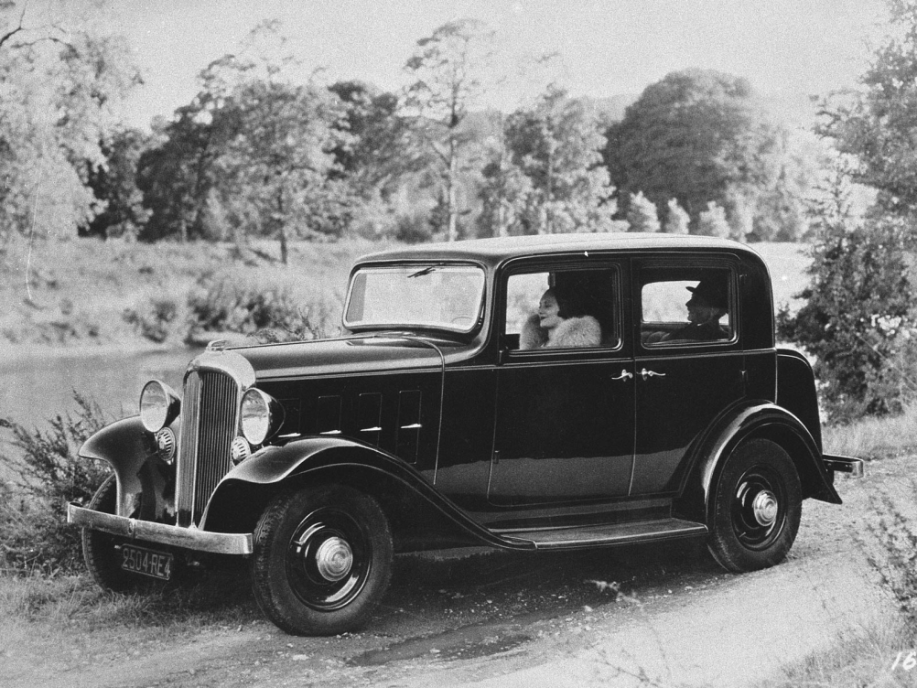
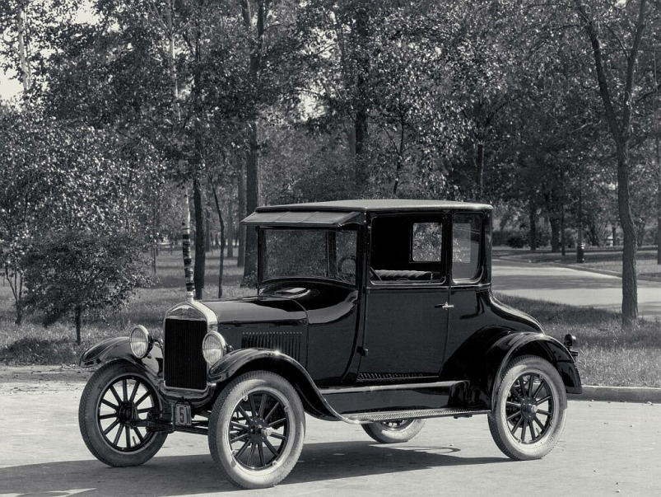
Yesterday: Early Automobiles
The Citröen Rosalie
Ford Model T
Notes:
cleanfuelforthought.wordpress.com
http://en.wikipedia.org/wiki/Citro%C3%ABn_Rosalie
http://www.fuel-testers.com/ethanol_fuel_history.html http://advancedbiofuelsusa.info/up-with-octane-and-down-with-aromatics-continuing-health-risks-with-petroleum-fuels-and-the-need-for-engine-efficiency/ good history
The Ford Model T was designed to run on corn ethanol.
In 1933, Citroën introduced the Rosalie, the first commercially available passenger car with a diesel engine, developed with Harry Ricardo. https://en.wikipedia.org/wiki/Citro%C3%ABn
Inspired by Sadi Carnot's writings to create a more efficient engine, he began working on his project in 1885, and eventually secured financial support from Maschinenfabrik Augsburg (forerunner of Maschinenfabrik Augsburg-Nürnberg and the present-day MAN Diesel) and Friedrich Krupp AG (now ThyssenKrupp). He received a patent for his heat-driven oil engine, now called the diesel engine, in 1892, and powered up the first working diesel engine — fueled by peanut oil — on 10 August 1893. After working out some problems with the design, he introduced a 25-horsepower, four-stroke, single cylinder compression engine in 1897, which gained widespread use after being displayed in the Munich Exhibition of 1898.
The diesel engine is an internal-combustion, compression-ignition mechanism which works by heating fuels (either petroleum-based or bio-derived) and causing the fuel to ignite. Driven solely by high compression in its cylinders, the diesel engine is generally more energy-efficient, quieter, and needs less maintenance and repairs than other internal combustion engines. As Diesel himself wrote, "It is the diesel's higher compression ratio that leads to its greater fuel efficiency. Because the air is compressed, the combustion temperature is higher, and the gases will expand more after combustion, applying more pressure to the piston and crankshaft".
http://www.nndb.com/people/906/000082660/

Slide 26
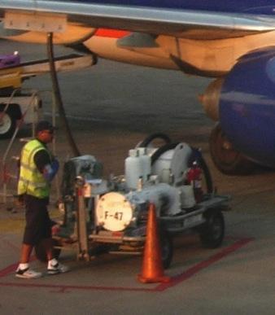
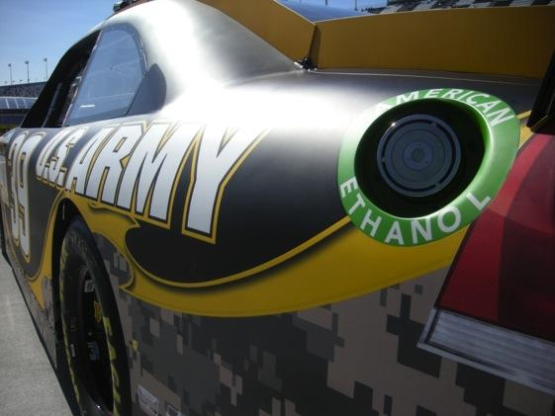
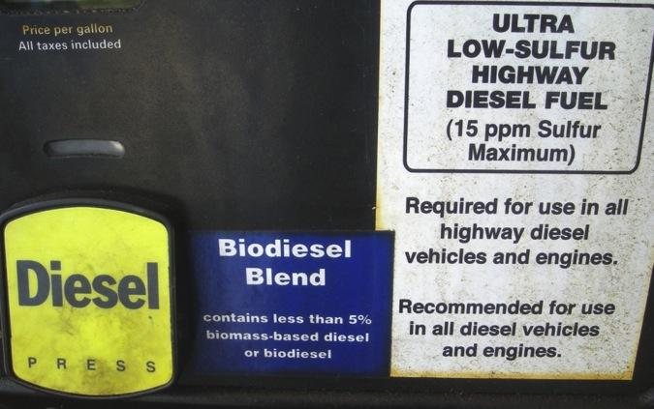
What Are Advanced Biofuels Used For? Today
Fueling Cars and Trucks
Fueling Aircraft
Notes:
Today, biofuels are used in your cars and trucks. You can buy biofuels at the “gas” station. Around the Washington DC area, almost all the regular gasoline is E10—or 10% ethanol, a biofuel; so 10% biofuel. You can also buy biodiesel blends. Usually 2-5% is biodiesel; but some people use 100% biodiesel, sometimes in farm equipment or in specially adapted cars and trucks.
Race cars use biofuel—IndyCars use E98—almost 100% ethanol. Do you know why they can’t use 100%? Because someone might drink it; so they have to poison it with gasoline molecules so that it is used just for the cars; not for people. Next year IndyCar will use E85, to develop engines and fuels that are closer to what is used on the street.
NASCAR uses 15% ethanol this year. They may increase the amount of ethanol that they use in the future.
In the American Le Mans Series, some cars used bio-isobutanol (Butamax); some used E85; some used E10. Some used diesel; Mazda’s SkyActiv engines used renewable diesel.
In 2016 the cars racing in the 24 hours at Le Mans use E20. 20% ethanol.
And some flights in Spain, Netherlands, Germany and Mexico use blends of biofuel and regular fuel; and commercial flights are starting in the US with Alaska Airlines and United/Continental being the first.
So, you do use biofuels today—just not so much advanced biofuels.

Slide 27
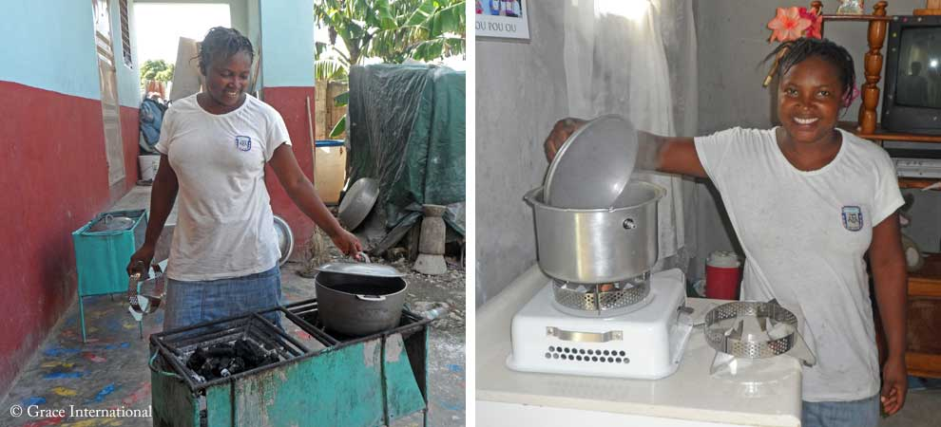
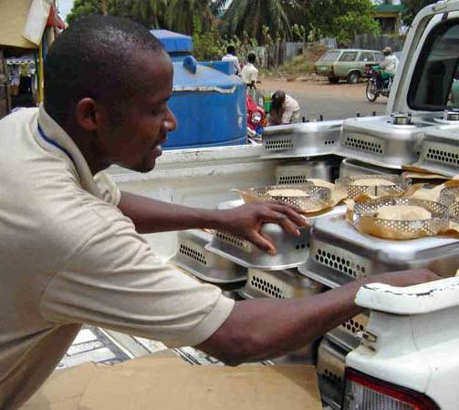
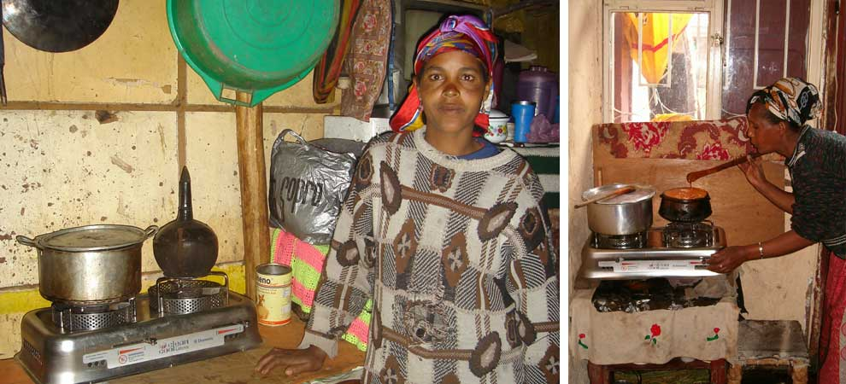
What Are Advanced Biofuels Used For? Today
Ethanol Cook Stoves
Project Gaia: Nigeria, Ethiopia, Haita, Brazil
Notes:
For more information: Project Gaia: https://projectgaia.com/

Slide 28
What Are Advanced Biofuels Used For? Today
Ethanol cook stoves
Notes:
https://projectgaia.com/about/

Slide 29
What Will Advanced Biofuels Be Used For Tomorrow?
High octane fuels for high mileage vehicles
Hydrogen Carriers for Fuel Cells
Notes:
Gasoline substitutes
(Grassoline; Green Crude)
Biodiesel or renewable diesel from non-food feedstocks
Jet fuel made from biomass or algae
(JP-8; Commercial Aviation fuels)
“Designer” fuels tailored to obtain the most efficient, most powerful performance from specific engines
Hydrogen Carriers for Fuel Cells
Tier 3 and E30 certification fuels
3.5-liter V6 EcoBoost® racing engine to the 2014 TUDOR United SportsCar Championship series.
The new engine, which will debut at the 2014 Rolex 24 At Daytona on Jan. 25-26 and run the entire 12-race season, will power a new-look Daytona Prototype car, created with Ford corporate design influence. Michael Shank Racing is on board as the first team to put EcoBoost power behind its DP car.
“At Ford Racing, we really put great emphasis on racing production-based vehicles as well as production-based technologies,” says Jamie Allison, director, Ford Racing. “We’re proud to bring a direct-injected, twin-turbo 3.5-liter V6 EcoBoost engine to the United SportsCar Championship in a field of competitive V8-powered entries. We want to show Ford EcoBoost’s capabilities as an engine that provides both performance and fuel economy, on and off the track.”
“This engine is the future,” says Doug Yates, CEO, Roush Yates Racing Engines. “This Ford EcoBoost engine includes all the newest technologies – direct injection, turbocharging and high efficiency. We’re looking at taking it to the next level through this sports car racing program.”
A new Ford-inspired Riley Technologies Daytona Prototype car will accompany the 3.5-liter V6 EcoBoost in Daytona. The car’s body features enhanced Ford production vehicle design cues created by lead Ford production designer Garen Nicoghosian with aerodynamic support from Ford Racing chief aerodynamicist Bernie Marcus.
“Ford Motor Company has taken today’s Daytona Prototype and injected into it unique Ford attributes and unique Ford design characteristics,” says Allison. “This EcoBoost-powered car is obviously adapted for racing applications with racing controls, but ultimately we’re running what we’re selling and selling what we’re running.”
While the new engine will make its competitive racing debut at the highly anticipated 2014 Rolex 24 At Daytona, it will actually hit the Daytona track for the first time Oct. 9.
In a joint effort between Michael Shank Racing, Ford Racing and Continental Tire, the 2012 Rolex 24 At Daytona championship team will aim to set a new track record at the “World Center of Speed” by eclipsing the 210.364 mph lap laid down Feb. 9, 1987, by NASCAR champion Bill Elliott, who pushed his Ford Thunderbird to the top of the speed charts in qualifying for the Daytona 500.
“It’s really a privilege to have an opportunity to put your name in the record books like this,” says team owner Mike Shank. “It is almost inconceivable that this record has stood for such a long time, so it’s pretty special to be involved. We worked a long time to develop our relationship with Ford to be in a position to take on projects like this. Anytime you can get in the record books, it is a great opportunity and just builds on what this company has done.”
“Ford Motor Company stands for innovation and leading-edge technology, so having a chance to debut our Ford EcoBoost technology in a high-visibility setting such as this record run attempt, as well as the entire 2014 USCC schedule with its iconic races, is great,” says Allison. “Through USCC racing and its fan outreach, we want to showcase how EcoBoost technology presents the combined benefits of performance and fuel efficiency – something all consumers would want in their vehicles.”
Weather permitting, Michael Shank Racing will take to the track at 8 a.m. Oct. 9, to start building up speed for the record attempt.
To prepare for the record run and upcoming season, the EcoBoost engine has recently undergone endurance testing at Ford’s Dynamometer Lab in Dearborn, Mich., specifically at the specialized 17G cell. Production and racing engineers from Ford and specialists from Roush Yates Racing Engines have collaborated to ensure the engine is ready for the upcoming season.
http://www.imsa.com/articles/ford-debut-new-ecoboost-race-engine-rolex-24

Slide 30
What Will Advanced Biofuels Be Used For Tomorrow?
Military Aviation Fuels
Military Marine Fuels
Notes:
On March 25, 2010, the Air Force successfully conducted
the first flight test of an aircraft powered by a 50-50
camelina-based biofuel blend. As of mid-2011, 99
percent of the Air Force fleet has been certified to fly on
biofuel blends.15 The Air Force expects to complete all
flight testing by February 2012 and all certifications by
December 2012.
The Navy also is actively engaged in testing and certifying
advanced biofuels for planes and ships—flying the
“Green Hornet” on a camelina-based jet fuel and floating
Riverine Command Boat-Experimental (RCB-X) on a
biofuel derived from algae.16
The Navy is planning to demonstrate a carrier strike group
powered solely by alternative fuels in 2012. Dubbed the
Great Green Fleet, the ships and planes are expected to
conduct an extended mission in 2016, and all energy
provided to operational platforms is to be 50 percent
alternative by 2020.

Slide 31
What Will Advanced Biofuels Be Used For Tomorrow?
The Great Green Fleet
2012 Pacific Rim Exercises
2016 Expanded Emphasis
Notes:
On March 25, 2010, the Air Force successfully conducted
the first flight test of an aircraft powered by a 50-50
camelina-based biofuel blend. As of mid-2011, 99
percent of the Air Force fleet has been certified to fly on
biofuel blends.15 The Air Force expects to complete all
flight testing by February 2012 and all certifications by
December 2012.
The Navy also is actively engaged in testing and certifying
advanced biofuels for planes and ships—flying the
“Green Hornet” on a camelina-based jet fuel and floating
Riverine Command Boat-Experimental (RCB-X) on a
biofuel derived from algae.16
The Navy demonstrated a carrier strike group
powered solely by alternative fuels in 2012. Dubbed the
Great Green Fleet, the ships and planes are expected to
conduct an extended mission in 2016, and all energy
provided to operational platforms is to be 50 percent
alternative by 2020.
2014 marks the first time the U.S. Navy is including biofuels in its annual procurement for bulk fuels.
More details can be found at https://www.fbo.gov, solicitation number SP060014R0061. READ MORE and MORE (Biofuels Digest; includes 10 backgrounders on the Navy’s biofuels’s program )
Washington, the Department of Defense has awarded $210 million under the Defense Production Act to Emerald Biofuels, Fulcrum BioEnergy and Red Rock Bio towards the construction of biorefineries that produce cost-competitive, drop-in military biofuels.
Under the grants, the companies will build biorefineries to produce military spec fuel that is expected to cost the US military, on a weighted average, less than $3.50 per gallon — or cost competitive with petroleum-based fuels, with availability expected as soon as 2016, and have a 50 percent of greater reduction of emissions compared to conventional fuels.
The biorefineries, once complete, will have a combined capacity for producing 100 million gallons of military-spec jet fuel and marine diesel. READ MORE and MORE (US Department of Energy)

Slide 32
What Will Advanced Biofuels Be Used For Tomorrow?
Rocket Fuel: Resupply Missions to the International Space Station
Notes:
Orbital Completes First Operational Cargo Mission to International Space Station for NASA-- Cygnus Cargo Logistics Spacecraft Reenters Earth’s Atmosphere Over Pacific Ocean --
-- Company’s Next CRS Mission to ISS to Take Place in Early May --
(Dulles, VA 19 February 2014) – Orbital Sciences Corporation (NYSE: ORB), one of the world’s leading space technology companies, today announced the successful completion of the first of eight CygnusTM operational cargo logistics spacecraft missions to the International Space Station (ISS) as part of the company’s $1.9 billion Commercial Resupply Services (CRS) contract with NASA. The Cygnus spacecraft unberthed from the ISS yesterday morning at 6:41 a.m. (EST), completing a 37-day stay at the orbiting laboratory. Today, Cygnus reentered Earth’s atmosphere over the Pacific Ocean east of New Zealand at approximately 1:20 p.m. (EST).
“We are very proud to have a second flawless cargo mission to the space station brought to a successful conclusion this afternoon,” said Mr. David W. Thompson, Orbital’s Chairman and Chief Executive Officer. “Following Cygnus’ successful demonstration mission in late 2013 conducted under our COTS research and development partnership with NASA, the picture-perfect execution of the first operational mission is a great way to start the CRS contract. We are looking forward to the next Antares launch and Cygnus cargo delivery mission currently scheduled for early May.”
The CRS-1 mission began on January 9, 2014 when Orbital’s AntaresTM rocket launched Cygnus into orbit from the Mid-Atlantic Regional Spaceport (MARS) located at NASA’s Wallops Flight Facility in eastern Virginia. Cygnus, which carried 2,780 lbs. (1,260 kg.) of cargo and science payloads, rendezvoused and berthed with the ISS three days later on January 12. Prior to its departure from the station, the astronauts loaded the cargo module with approximately 3,250 lbs. (1,477 kg.) of unneeded items for disposal.
Under the CRS contract with NASA, Orbital is using Antares and Cygnus to deliver up to 44,000 lbs. (20,000 kg.) of cargo to the ISS over eight missions, including the CRS-1 flight just completed, through late 2016. For these missions, NASA will manifest a variety of essential items based on ISS program needs, including food, clothing, crew supplies, spare parts and equipment, and scientific experiments.
Preparations are already well advanced for the next Cygnus cargo delivery flight, the CRS-2 mission, scheduled to take place in early May. The Antares rocket for the mission is now undergoing final assembly at Wallops Island, while the Cygnus spacecraft is being prepared for shipment to the Wallops launch site in mid-March. The CRS-2 flight is expected to deliver about 3,630 lbs. (1,650 kg.) of cargo to the Space Station.
About Antares The Antares medium-class launch vehicle represents a major increase in the payload launch capability that Orbital can provide to NASA, the U.S. Air Force and commercial customers compared to its heritage small-class space launch vehicles such as Pegasus, Taurus and Minotaur. The Antares rocket can launch spacecraft weighing up to 14,000 lbs. (6,400 kg.) into low-Earth orbit, as well as lighter-weight payloads into higher-energy orbits. Orbital’s newest launcher has completed three successful missions and is currently on-ramped to both the NASA Launch Services-2 and the U.S. Air Force’s Orbital/Suborbital Program-3 contracts, enabling the two largest U.S. government space launch customers to order Antares for “right-size and right-price” launch services for medium-class spacecraft. For more information on Antares, visit http://www.orbital.com/SpaceLaunch/Antares/.
About Cygnus Orbital developed the Cygnus cargo spacecraft as part of its Commercial Orbital Transportation Services (COTS) joint research and development initiative with NASA. Cygnus consists of a common Service Module (SM) designed and built by Orbital at its Dulles, VA manufacturing facilities, and a Pressurized Cargo Module (PCM), built by Thales Alenia Space under a subcontract from Orbital. The SM incorporates avionics, power and propulsion systems already successfully flown aboard dozens of Orbital’s LEOStar™ and GEOStar™ satellite products. The PCM is based on the Multi-Purpose Logistics Module (MPLM) used with the Space Shuttle. For more information on Cygnus, visit http://www.orbital.com/NewsInfo/Publications/Cygnus_fact.pdf.
About Orbital Orbital develops and manufactures small- and medium-class rockets and space systems for commercial, military and civil government customers. The company’s primary products are satellites and launch vehicles, including low-Earth orbit, geosynchronous-Earth orbit and planetary exploration spacecraft for communications, remote sensing, scientific and defense missions; human-rated space systems for Earth-orbit, lunar and other missions; ground- and air-launched rockets that deliver satellites into orbit; and missile defense systems that are used as interceptor and target vehicles. Orbital also provides satellite subsystems and space-related technical services to U.S. Government agencies and laboratories. More information about Orbital can be found at http://www.orbital.com. Follow the company on Twitter @OrbitalSciences.
# # # http://www.orbital.com/NewsInfo/release.asp?prid=1887

Slide 33
What Are Advanced Biofuels?
What are they?
Why do we need them?
What are they used for? (Yesterday, Today, Tomorrow)
How are they made?
Sustainability
Policy Considerations
Markets

Slide 34
What Are Advanced Biofuels?
How are they made?
Feedstock
Logistics
Technology
Notes:
There are three parts to making advanced biofuels: feedstock—the stuff that goes into the recipe; logistics—how do you get the feedstock from where it grows or is produced to the biorefinery; and the technology—how do you convert the feedstock into fuels.
For example, how do you release the energy of the sun that has been captured in plants so that it can be productively used to move a car, truck, train or plane?

Slide 35
Agriculture: The Foundation of the Bioeconomy
Feedstocks
Logistics
Technology
Notes:
There are three parts to making advanced biofuels: feedstock—the stuff that goes into the recipe; logistics—how do you get the feedstock from where it grows or is produced to the biorefinery; and the technology—how do you convert the feedstock into fuels.
For example, how do you release the energy of the sun that has been captured in plants so that it can be productively used to move a car, truck, train or plane?

Slide 36
Feedstocks:
Sugars, Starches
Oil seed crops
Grasses
Trees and Forest Waste
Agricultural Residues
Algae
Food/Animal Processing Residues
Energy Crops
Thin Air
Notes:
We’re just going to look at some pictures of the many things that could become advanced biofuels.
http://advancedbiofuelsusa.info/category/feedstocks/

Slide 37
Examples of Potential Feedstocks or Energy Crops
Algae
Corn stover
Corn cobs
Energy cane
Sorghum
Forestry waste
Municipal waste
Sawdust
Chicken manure
Agricultural residues
Grasses such as
Switchgrass
Miscanthus
Sugar beets
Coffee grounds
Jatropha
Camelina
Paper/pulp mill waste
Used telephone poles
Halophytes…
Notes:
University of Maryland Center for Environmental Science
($324,439) Feng Chen, associate professor, Institute of Marine & Environmental Technology, works with Dayton-based HY-TEK Bio LLC to develop a system for extracting nutrients from chicken manure to speed the growth of microalgae, which HY-TEK Bio uses in its photobioreactor-based systems to mitigate greenhouse gas emissions on an industrial scale, and develop a bacteria-based process that will separate algae from water that will make harvesting algae fast and inexpensive.
See more at: http://www.mtech.umd.edu/news/press_releases/mips_r52_release.html#sthash.1Zj3gA4S.dpuf
http://advancedbiofuelsusa.info/category/feedstocks/

Slide 38
Examples of potential crops/plants which can be used for production of biofuels
Sorghum
Notes:
http://advancedbiofuelsusa.info/tag/sorghum/

Slide 39
Examples of potential crops/plants which can be used for production of biofuels
Sunflower or Jerusalem Artichoke
Notes:
Photos from the Penn State Energy Crop Library fields
http://advancedbiofuelsusa.info/tag/sunflower/
http://advancedbiofuelsusa.info/tag/jerusalem-artichoke/

Slide 40
Examples of potential crops/plants which can be used for production of biofuels
Canola
Notes:
Canola/rapeseed
http://advancedbiofuelsusa.info/tag/canola/

Slide 41
Examples of potential crops/plants which can be used for production of biofuels
ENERGY GRASSES
Miscanthus
Arundo or Giant Reed
Notes:
Grasses that grow as high as houses.
Clarinet reeds are made out of giant reed plants.
In the US this is considered an invasive species. No federal funds are available to research using this as an energy crop in the US.
http://advancedbiofuelsusa.info/tag/arundo/
http://advancedbiofuelsusa.info/tag/miscanthus/

Slide 42
Examples of potential crops/plants which can be used for production of biofuels
ENERGY GRASSES
Phragmites
Notes:
Grasses that grow as high as houses.
http://advancedbiofuelsusa.info/tag/phragmites/
https://en.wikipedia.org/wiki/Phragmites

Slide 43
Examples of potential crops/plants which can be used for production of biofuels
AGRICULTURAL RESIDUES
Corn Stover, Cobs
Notes:
http://advancedbiofuelsusa.info/tag/corn-stover/

Slide 44
Examples of potential crops/plants which can be used for production of biofuels
Sugar Beet/Sugar Beet Pulp
Notes:
This is a small sugar beet. Many get as big as soccer balls. During harvest, people in the area know to drive far behind the trucks full of sugar beets as some bounce out of the truck and hit and break windshields.
http://advancedbiofuelsusa.info/tag/sugar-beet/

Slide 45
Examples of potential crops/plants which can be used for production of biofuels
Switchgrass
Notes:
Not only is the grass growing higher than the height of the man, but the root system of the grass grows even longer than that. So, when you talk about sustainability; places that need soil erosion control might be good candidates for growing switchgrass as an energy crop.
http://advancedbiofuelsusa.info/tag/switchgrass/

Slide 46
Examples of potential crops/plants which can be used for production of biofuels
Notes:
http://advancedbiofuelsusa.info/tag/sorghum/

Slide 47
Examples of potential crops/plants which can be used for production of biofuels
Kenaf
Notes:
https://hort.purdue.edu/newcrop/afcm/kenaf.html

Slide 48
Examples of potential other things which can be used for production of biofuels
Woody Biomass
Notes:
Wood chips might be left-overs or residues of other forest products processes. For example from sawmills. Or from slash and waste at forest harvest sites—materials that would otherwise be burned int the open. But then you have a logistics issue—getting the waste wood from the forest to the biorefinery for an economical price.
You might also have purpose-grown wood, just as you have for some pulp/paper mills; especially when those have gone out of business.
http://advancedbiofuelsusa.info/tag/woody-biomass/

Slide 49
Examples of potential crops/plants which can be used for production of biofuels
Short Rotation Coppice Willow
Poplar
Notes:
http://www.crops4energy.co.uk/short-rotation-coppice-src/
http://advancedbiofuelsusa.info/tag/willow/
http://advancedbiofuelsusa.info/tag/poplar/

Slide 50
Examples of potential other things which can be used for production of biofuels
Sorted Municipal Solid Waste
Copyright 2010Advanced Biofuels USA
Notes:
http://advancedbiofuelsusa.info/tag/msw-municipal-solid-waste/

Slide 51
Examples of potential other things which can be used for production of biofuels
Algae
Notes:
There are lots of different ways to grow algae.
http://advancedbiofuelsusa.info/tag/algae/
Also
http://advancedbiofuelsusa.info/tag/seaweed-macroalgae/
http://advancedbiofuelsusa.info/tag/cyanobacteria/

Slide 52
Leather “Fleshings”
Notes:
“Fleshings” (leftover subcutaneous ligament and fat) from leather production are a source of biofuel. The sludge would otherwise turn toxic and be burned, gTamil Nadu to Have World’s First Biorefinery Using Tannery Waste
Submitted by admin on June 26, 2012 – 7:00 pmNo Comment
by Kumar Chellappan (Daily News and Analysis India) Tamil Nadu will be home to the world’s first biorefinery which will use solid waste generated from tanneries in Vellore district.
The Central Leather Research Institute (CLRI) at Chennai, a unit of the Council for Scientific and Industrial Research (CSIR) has succeeded in developing a biorefinery which will produce biodiesel, bioethanol, biohydrogen and biomethane.
“With this bio refinery we will ensure that tanneries across the country do not discharge any kind of solid waste. There will not be any waste to be discharged because we will use it as raw materials,” Palani Shanmugam (42), the CLRI scientist who designed the refinery told DNA. READ MORE
http://www.dnaindia.com/india/report_tamil-nadu-to-have-worlds-first-biorefinery_1706301

Slide 53
Used cooking oils and grease
Notes:
http://advancedbiofuelsusa.info/tag/used-cooking-oil/

Slide 54
Landfill Refueling Stations
Notes:
http://www.greentechlead.com/news/clean-energy-opens-lng-fueling-station-in-seville-ohio-to-support-truck-fleet-operated-by-dillon-transport-serving-owens-corning-826
The opening
of this new Clean Energy LNG truck fueling station, the first in the industrial
heartland of America, is a major step toward realizing our program to create a
national LNG fueling infrastructure that will extend along major truck routes
nationwide.
http://www.quasarenergygroup.com/pages/cng.html

Slide 55
Process: 4th Generation
Direct-to-Fuel
Solar Fuels
Electrofuels
Joule Fuels (artist’s imagination)
Notes:
Joule Sunflow-E and Joule Sunflow-D are derived directly from sunlight and waste CO₂, without costly biomass intermediates or complex processing.
Scale: Our lack of feedstock constraints and our modular system allow rapid scale-up to meet global demand.
Efficiency: Our direct, continuous process maximizes areal efficiency, with ultimate productivity targets of 25,000 gallons of Sunflow-E and 15,000 gallons of Sunflow-D per acre annually.
Cost: At full-scale commercial production, we target costs as low as $1.28/gal Sunflow-E and $50/bbl Sunflow-D, excluding subsidies and including capital costs.
Infrastructure readiness: Our products are inherently compatible with existing fuel infrastructure without chemical processing.
Joule Sunflow-E will be commercially available in 2014, with Joule Sunflow-D to follow.
A similar example, a way to get to ethanol directly from algae—Algenol.
Direct solar fuel technologies utilize photosynthetic microorganisms to produce liquid fuels and fuel precursors directly from solar energy. In most cases, the microorganisms can work as biocatalysts to continuously produce fuels such as liquid hydrocarbons.
Direct Solar Fuels - Projects
Arizona State University: Turning Bacteria into Fuel
Iowa State University: A Genetically Tractable Microalgal Platform for Advanced Biofuel Production
Sun Catalytix: Energy from Water and Sunlight
University of Minnesota: Biofuel from Bacteria and Sunlight

Slide 56
Agriculture: The Foundation of the Bioeconomy
Feedstocks
Jobs Related to Feedstocks
Notes:
There are three parts to making advanced biofuels: feedstock—the stuff that goes into the recipe; logistics—how do you get the feedstock from where it grows or is produced to the biorefinery; and the technology—how do you convert the feedstock into fuels.
For example, how do you release the energy of the sun that has been captured in plants so that it can be productively used to move a car, truck, train or plane?

Slide 57
A Few Types of Jobs Available in Advanced Biofuels Feedstock Development and Production
Agriculture/horticulture experts
Freight railroad operators, engineers, loaders, unloaders
Equipment operators, technicians
Farm product purchasers/traders
Agricultural and Forestry Supervisors
Agricultural Inspectors
Computer Software Engineers
Others?
Agronomists
Farmers
Farm workers
Farm equipment designers
Biologists
Biologists specializing in genetic research
Biologists specializing in plant cells
Chemists
Chemical engineers
Researchers into bioenergy crop development

Slide 58
What Are Advanced Biofuels?
How are they made?
Feedstock
Logistics
Technology
Notes:
There are three parts to making advanced biofuels: feedstock—the stuff that goes into the recipe; logistics—how do you get the feedstock from where it grows or is produced to the biorefinery; and the technology—how do you convert the feedstock into fuels.
For example, how do you release the energy of the sun that has been captured in plants so that it can be productively used to move a car, truck, train or plane?

Slide 59
Logistics: Harvest, Storage, Transport
Notes:
http://www.energy.gov/eere/articles/five-harvesting-technologies-are-making-biofuels-more-competitive-marketplace

Slide 60
Logistics: Harvest, Storage, Transport
Notes:
http://www.energy.gov/eere/articles/five-harvesting-technologies-are-making-biofuels-more-competitive-marketplace

Slide 61
Logistics: Harvest, Storage, Transport

Slide 62
What Are Advanced Biofuels?
How are they made?
Feedstock
Logistics
Technology
Notes:
There are three parts to making advanced biofuels: feedstock—the stuff that goes into the recipe; logistics—how do you get the feedstock from where it grows or is produced to the biorefinery; and the technology—how do you convert the feedstock into fuels.
For example, how do you release the energy of the sun that has been captured in plants so that it can be productively used to move a car, truck, train or plane?

Slide 63
Processes
Biochemical
Thermochemical
Fermentation
Plant extraction
Transesterification
Hydrolysis
Enzymatic Catalysis
CO2-to-liquid bio-catalytic conversion
Gasification
Plasma arc gasification
Pyrolysis
Thermochemical conversion of sugars
Notes:
Now we get to the technology piece.
These are names of processes that take the feedstock and make it into biofuels or the building blocks for biofuels.
Explain enzymes—like the saliva in your mouth
Explain fermentation—
Explain ethanol. Ask class—what is ethanol? What in everyday life has ethanol in it? You may need to prompt by using the word “alcohol.”
Make clear that the ethanol molecules in fuel are the same chemically as the ones in beer, wine, spirits. The process for converting sugars and starches into ethanol is fermentation. The process for getting the ethanol concentrated—getting the water out—is distillation.
Especially if local history includes production of moonshine, explain that corn ethanol is the same corn ethanol currently used commercially in fuel. If time permits, can introduce the idea of the difference in value and the difference in transportation costs between dried corn kernals and processed corn into whiskey/moonshine. If a history lesson is in order, refer to the Whiskey Rebellion dealt with by George Washington.
For more detail on process technologies, word search in Advanced Biofuels USA’s web site.

Slide 64
Aviation Fuel Processes
Alcohol to Jet (ATJ)
Catalytic Conversion of Oil to Jet (CCOTJ)
Catalytic Conversion of Sugar to Jet (CCSTJ)
Catalytic Hydrothermolysis, Hydroprocessing to Jet (CH-HRJ)
Direct Fermentation of Sugar to Jet (DFSTJ)
Fischer-Tropsch Synthesized Paraffinic Kerosene (FT-SPK)
Hydrotreated Depolymerized Cellulosic Jet (HDCJ)
Hydroprocessed Esters & Fatty Acids (HEFA)
Synthesized Iso-Paraffinic Fuel (SIP)
Notes:
http://advancedbiofuelsusa.info/category/aviation/

Slide 65
Notes:
http://advancedbiofuelsusa.info/category/aviation/

Slide 66
Notes:
http://advancedbiofuelsusa.info/category/aviation/

Slide 67
Commercial Scale Cellulosic Ethanol Plants Producing NOW
Abengoa BioEnergy; corn stover, non-feed energy crops, wood waste, enzymatic process in Hugoton, KS
POET’s Project Liberty, Emmetsburg, IA corn stover, enzymatic process
Notes:
PARENT COMPANY NOW IN BANKRUPTCY FOR THIS FACILITY Fully owned (100%) by Abengoa Bioenergía.
Annual installed bioethanol production capacity of 25 Mgal.
Biomass consumption of 1,000 tons daily which includes the fuel for electricity co-generation.
Abengoa Bioenergy Biomass of Kansas is a project to build a plant for the production of 25 Mgal (100 ML) of cellulosic ethanol and 22 MW of renewable energy from biomass (mixture of agricultural waste, non-feed energy crops and wood waste). The plant will be located to the west of Hugoton, state of Kansas, and will create 65 permanent jobs.
The construction of the Hugoton plant began in July 2011. Grand opening scheduled for late 2014.
POET-DSM Advanced Biofuels intends to globally license an integrated technology package that converts corn crop residue to cellulosic bio-ethanol to third parties, as well as the other 26 existing corn ethanol plants in POET's network. - See more at: http://poetdsm.com/about#sthash.MCvHGz9l.dpuf Grand opening was early September 2014

Slide 68
Commercial Scale Cellulosic Ethanol Plants Producing NOW
DuPont Cellulosic Ethanol plant in Nevada, IA using corn stover, enzymatic process
INEOS Bio Cellulosic Ethanol plant in Indian River, FL using waste woody biomass in a thermochemical process.
Notes:
30 million gallons of cellulosic ethanol per year at Nevada, IA
INEOS Bio uses an advanced thermochemical and biochemical bioethanol technology, which can convert cellulose, hemi-cellulose and lignin efficiently to clean bioethanol. It delivers more than 90% Greenhouse gas savings compared to gasoline (petrol), is cost-competitive and is independent of food production. The INEOS Bio bioethanol is expected to make a significant contribution to the growth in the European and North American bioethanol market.
Central to the INEOS Bio technology platform is a highly selective, highly efficient, proprietary biochemical conversion of synthesis gas* to ethanol. The inspired use of a bacterial biocatalyst is the essential key to unlocking the value chains from a variety of low-cost, waste carbon materials through synthesis gas to:
Clean renewable advanced biofuel
Valuable chemical intermediates such as ethylene for polyethylene manufacture
A process of continuous innovation has transformed a simple concept into a world leading commercial technology. Our proprietary biocatalyst far out-performs any known, conventional catalyst for the transformation of synthesis gas to fuels.
September 2014: In a report filed by the State of Florida in recent months and obtained by The Digest, it was disclosed that “although the [INEOS Bio New Planet Energy] facility in Vero Beach, Florida is officially operating, very little fermentation or production of ethanol from the production fermentor has occurred, primarily because of the sensitivity of the bio-organisms in the fermentation process to high levels of [hydrogen cyanide] in the syngas.”
As a result, “installation of a HCN scrubber is essential for the fermentation process to be successful.”
According to INEOS Bio, the company remains highly committed to the project and sees the emergence of the problem with high HCN levels as the kind of challenge under at-scale operating conditions that exemplifies first-of-kind technology and that companies like INEOS have the team, technologies, and time to address. READ MORE and MORE and MORE (INEOS Bio)
Also Quad County Corn Processors produced ethanol from corn-kernel fiber at its bolt-on facility in Galva, Iowa. http://www.ethanolrfa.org/news/entry/rfa-lauds-quad-county-corn-processors-at-the-grand-opening-of-cellulosic/
Syngenta and Quad County Corn Processors (QCCP) are collaborating to produce cellulosic ethanol from corn kernels as well as to license the technology to other ethanol plants. The first-of-its-kind technology is known as Adding Cellulosic Ethanol and was developed by QCCP, who expects to produce one million gallons of cellulosic ethanol in 2014 and two million gallons in 2015.
This breakthrough was made possible through the integration of Adding Cellulosic Ethanol technology at QCCP, a 35 million gallon per year capacity ethanol production facility. The introduction of the technology will enable QCCP to increase ethanol yield per bushel by six percent, produce an additional two million gallons of cellulosic ethanol per year and realize a number of other important benefits including increased production of corn oil and distillers grains (DDGs). http://domesticfuel.com/2014/07/14/qccp-syngenta-collaboration-produces-cellulosic-ethanol/

Slide 69
Commercial Scale Cellulosic Ethanol Plants Producing NOW
GranBio, Brazil. First commercial-scale plant for second-generation ethanol in the Southern Hemisphere. Sugar cane straw and bagasse.
Beta Renewables, Crescentino, Italy. Wheat straw, rice straw and arundo donax.
Notes:
Situated in fields outside the city of Crescentino, it is the first plant in the world to be designed and built to produce bioethanol from agricultural residues and energy crops at commercial scale using enzymatic conversion Beta Renewables, a global leader in cellulosic biofuels and part of the M&G Group, and Novozymes, the world’s largest producer of industrial enzymes, marked on October 9 2013 the official opening in Northern Italy of the world’s largest advanced biofuels facility
http://biomassmagazine.com/articles/9540/commercial-scale-cellulosic-ethanol-refinery-opens-in-italy/
http://advancedbiofuelsusa.info/granbio-starts-cellulosic-ethanol-production-at-21-million-gallon-plant-in-alagoas-brazil
The 2G ethanol produced by GranBio is the cleanest fuel produced on a commercial scale in the world in carbon intensity – 7.55 gCO2/MJ, as confirmed by the Air Resources Board in California. No other fuel produced on a large scale is better for the environment and reversing climate change than that of GranBio, the first producer of 2G ethanol to have the carbon footprint approved by the American agency.
…
GranBio developed a system to harvest, store and process 400,000 metric tons of straw per year …
GranBio and Caeté, from the group Carlos Lyra, created a partnership for the integrated production of steam and electricity. Installed next to Bioflex 1, the co-generation system is fed by sugarcane bagasse and lignin – a byproduct of producing second-generation ethanol. This is an unprecedented bioenergy solution in Brazil, the first time lignin is being used to this purpose in the sugar-based alcohol industry.

Slide 70
Commercial Scale Advanced Biofuel / Biochemical Plants Producing NOW Chronology
October 9, 2013: Beta Renewables’ 20 million gallon cellulosic ethanol plant opens in Crescentino, Italy. At the time, the world’s largest.
...
May 29, 2014: Solazyme’s 100,000 metric ton tailored renewable oils plant opens in Moema, Brazil.
...
June 4, 2014: Enerkem’s 10 million gallon waste-to-methanol/ethanol biorefinery opens in Edmonton, Alberta— the world’s largest biorefinery converting municipal solid waste into liquid fuels and chemicals.
...
September 3, 2014: POET-DSM’s 20 million gallon cellulosic ethanol biorefinery opens in Emmetsburg, Iowa — at the time, tied for world’s largest.
...
September 24, 2014: GranBio’s 21 million gallon cellulosic ethanol biorefinery opens in Alagoas state, Brazil — at the time, the world’s largest.
...
October 17, 2014: Abengoa Bioenergy’s 25 million gallon cellulosic ethanol biorefinery opens in Hugoton, Kansas — for a while was the world’s largest. Now parent company is in bankruptcy.
...
Q4 2014: Raizen’s 22 million gallon cellulosic ethanol biorefinery opens in Piricicaba, Brazil.
...
October 30, 2015: DuPont’s 30 million gallon cellulosic ethanol biorefinery opens in Nevada, Iowa--the world’s largest.
Notes:
http://www.biofuelsdigest.com/bdigest/2014/10/21/industrial-biotechnologys-2014-in-pictures-the-year-of-steel/ for photos of each of these projects
http://www.dupont.com/corporate-functions/media-center/press-releases/dupont-celebrates-opening-of-worlds-largest-cellulosic-ethanol-plant.html

Slide 71
Conversion Processes: Turning biomass and renewables into building blocks for fuels, chemicals and products
Jobs Related to Conversion Processes

Slide 72
A Few Types of Jobs Available in Advanced Biofuels Production
Biologists
Biologists specializing in genetic research
Biologists specializing in plant cells
Chemists
Chemical engineers
Systems engineers
Research assistants
Process Technicians
Lab technicians
Industrial engineers
Industrial architects
Construction workers, Managers
Truck drivers
Plant operations managers
Equipment operators, technicians
Computer Software Engineers
Refinery Equipment Manufacturers
Welders
Boilermakers
Pipe Fitters
Others?
Notes:
And construction and startup of new advanced biofuel biorefineries are creating thousands of new jobs, many of them also union jobs, for others in different regions of the country. One new cellulosic biorefinery has had as many as 1,000 workers on site as it nears the start of production this year. That means welders, boilermakers, pipe fitters and more are finding new jobs.
With construction of our commercial-scale cellulosic ethanol facility nearing completion, we stand by our commitment to this industry and to helping the United States lead the world in the production of advanced renewable transportation fuel. Commercialization of the cellulosic biofuels industry is not only supporting farmers - it's also adding jobs right here in the state of Iowa. Be a part of one of the first and largest commercial-scale biorefineries by joining the DuPont cellulosic ethanol facility in Nevada, Iowa!
We're currently looking for self-motivated candidates to join us for this unique career opportunity:
Process Technician
Maintenance Technician
Lab Technician
Material Handler

Slide 73
Process Path: Biomass-to-Fuels and Products
Graphic by Zina Deretsky, National Science Foundation
Notes:
Spend some time on this slide. If you remember anything from this presentation, I hope you have in mind the stories and the photo of this page.
Tell York, PA Farm Show story.
Distributed (or decentralized)/Centralized production of precursors or intermediates at a location away from large scale integrated biorefineries.

Slide 74
Heat
Syngas
Fischer-Tropsch
Synthesis or Fermentation
Gasification
Pyrolysis
Heat
Biocrude
Hydro treating
Deconstruction
Aqueous
phase
forming
Low heat
sugar in water
Plant Biomass: poplar,switchgrass, corn stover, woody biomass; sorted municipal solid waste and others
Catalytic Process
Jet fuel
Diesel
Process Path: Biomass-to-Fuels and Products
Transportation Fuel
Plastics
Notes:
Here’s generally where those processes or technologies fall into the steps of getting from feedstock to fuel or other product.

Slide 75
What Are Advanced Biofuels?
What are they?
Why do we need them?
What are they used for? (Yesterday, Today, Tomorrow)
How are they made?
Sustainability
Policy Considerations
Markets

Slide 76
Principles of Sustainability
Economic Environmental Social
Notes:
So, those are the reasons of why BIOFUELS in general are important; why Advanced Biofuels?
That has to do with sustainability. We’ll talk about this in more detail later and you’ll do an exercise too.
For now, what does sustainable mean?
Endurance
Lasts for a long time. Or, you can keep doing something over and over without it degrading. Or, in a way, it has continued life or existence
So, when we talk about sustainability and biofuels, we mean that they have to have economic viability over a long term; have to allow or enable the environment to be unharmed or helped; and have to have social acceptance, fit into the fabric of a culture. We’ll talk about some examples later. Just tuck that in the back of your mind for now.
Advanced biofuels are the ones that are more sustainable, do less damage to the environment, while still being economical to produce and that meet the demands of the society for social values such as the ones we talked about before—energy security, for example.
Sustainability is the capacity to endure. For humans, sustainability is the long-term maintenance of well being, which has environmental, economic, and social dimensions, and encompasses the concept of stewardship, the responsible management of resource use. In ecology, sustainability describes how biological systems remain diverse and productive over time, a necessary precondition for human well-being. Long-lived and healthy wetlands and forests are examples of sustainable biological systems (from Wikipedia)

Slide 77
Principles of Sustainability
Economic Environmental Social
Everyone in the value chain needs to make a living
The operation must be financially stable
The price of the product must be competitive in its market
Notes:
Here are some concepts that might be considered when talking about economic aspects of sustainability. You might not have used these words, but probably included at least one of these ideas in your discussion.
The inflection point
Credit worthy feedstock supplier, 15 year terms US $50/tonne
Demonstration of technology at scale
Credit worthy offtake partner 10-15 years (tough for airlines, although they say they will buy whatever can be produce and although they seem stable, they don’t have good balance sheets from the perspective of financiers)
Parity with $80 oil, unsubsidizied on comparable BTUs
(Jim Lane, Biofuels Digest 11 1006)

Slide 78
Principles of Sustainability
Economic Environmental Social
18.8 Million Barrels
of oil used
each day by US
TODAY
71% Used as
Transportation Fuel
Rest to produce
plastics, fiber
film, chemicals
78
Copyright 2010Advanced Biofuels USA
Notes:
We are not just trying to put oil companies out of business. In addition to national energy security, the underlying reason for all of this is the crisis we face due to climate change.
RFS one was predicated on the idea that the oil companies would transition to become fuel companies; by forcing them to blend renewables into their product, some assumed that they would finance the development of these fuel products—diversify into renewables.
Instead, they fight tooth and nail to preserve their old market as they knew it rather than look to the future; see themselves as “oil men” rather than “fuel providers” or fuel and chemical precursor providers
All of the above; should be “all of the above ground”
Advanced Biofuels as part of an Energy Security solution.
1) Something as important to everyday life as the power to help you move from place to place.
If you put control of that power in the hands of other countries, you become vulnerable. If those other countries want to make you do something that you don’t want to do, they can just squeeze your supply of oil and make life difficult.
For examples, early 1970’s oil embargo lead to lines of cars at gas stations.
In your memory, then lines at gas stations after Hurricane Katrina knocked out a lot of gasoline production and distribution. That kind of disruption is a vulnerability. It’s better to make your fuel at home.
If we can replace a good portion of that oil that is used for transportation by making our own transportation fuels, we minimize that liability.
Energy Security
About two-thirds of U.S. petroleum demand is in the transportation sector. Approximately half of U.S. petroleum is imported. Depending heavily on foreign petroleum supplies puts the United States at risk for trade deficits, supply disruption, and price changes. The Renewable Fuels Association's 2012 Ethanol Industry Outlook(PDF) calculated that in 2011 the ethanol industry replaced the gasoline produced from more than 485 million barrels of imported oil. Ethanol represents 25% of domestically produced and refined motor fuel for gasoline engines.
http://www.afdc.energy.gov/fuels/ethanol_benefits.html US DOE Alternative Fuels Data Center
POLICY Discussion: Non-monitizable value of trying to first transition from petroleum transportation fuels: energy security, military flexibility, economic development, climate change mitigation, pollution control.
If we were not-policy directed, but rather marketing/financing directed; initial emphasis would have been on plastics, fiber, film. Greater margins, smaller scale for greater returns.
Problem has been that “fuels first” policy was articulated, but insufficiently funded.
In 2009: However, the majority of petroleum now extracted—
in the range of 85%—is used to produce fuels. Most of
these are transportation fuels such as gasoline, diesel
fuel, and jet fuel, while some, such as fuel oil, liquefied
petroleum gas, and propane, are used for heating
and power generation. Petroleum accounts for more
than 90% of transportation fuel, but only for 2% of
electricity generation. When refined, a 42-gallon barrel
of crude oil yields about 20 gallons of gasoline, 10
gallons of diesel fuel and heating oil, four gallons of
jet fuel, and smaller amounts of other products.
http://www.publichealthreports.org/userfiles/124_1/5-19.pdf
 5
Energy and Public Health:
The Challenge of Peak Petroleum
Howard Frumkin, MD, DrPHa
Jeremy Hess, MD, MPHa,b
Stephen Vindigni, MPHa,b
aNational Center for Environmental Health and Agency for Toxic Substances and Disease Registry, Centers for Disease Control and
Prevention, Atlanta, GA
bEmory Medical School, Atlanta, GA
Address correspondence to: Howard Frumkin, MD, DrPH, National Center for Environmental Health and Agency for Toxic Substances
and Disease Registry, Centers for Disease Control and Prevention, 4770 Buford Hwy., MS F-61, Atlanta, GA 30341-3717; tel. 770-488-0604;
fax 770-488-3385; e-mail <hfrumkin@cdc.gov>.
Consumption and Disposition
U.S. Petroleum Consumption18,835,000 barrels/day
U.S. Motor Gasoline Consumption8,736,000 barrels/day (377 million gallons/day)
Share of U.S. Oil Consumption for Transportation71% (2011)
U.S. Total Petroleum Exports2,924,000 barrels/day
http://www.eia.gov/energyexplained/index.cfm?page=oil_home#tab2
With the turmoil in the Middle East, it is more important than ever that, because the U.S. produced 13.9 billion gallons of ethanol last year, we used 485 million fewer barrels of imported oil. That is roughly equivalent to 13 percent of total U.S. crude oil imports, saving the American economy $49.7 billion. Without the RFS—and without ethanol production—the U.S. would have imported 52 percent of its oil last year. With the RFS—and with oil imports at 45 percent, their lowest level since 1996—the U.S. is less dependent on unstable or unfriendly regimes. http://www.ethanolproducer.com/articles/9185/the-rfs-itundefineds-not-broke-donundefinedt-fix-it

Slide 79
Minimizing the Cost of Biomass Transportation The Transport Conundrum
Principles of Sustainability
Economic Environmental Social
How can we gather enough Biomass
to support a
Cost-Efficient Biorefinery?
79
Notes:
This is the logistics part of the economic question. This is where thinking about changing the biomass closer to the original location becomes an important consideration.
Then biorefineries can be built at larger scale which makes them more economical to operate (and think of social aspects of having many biorefineries in many towns—people might say—not in my backyard).
Right now, research continues into conversion to intermediaries or precursors that can be transported easier and cheaper. See next slide.

Slide 80
As a prospective grower, how do you find out what bioenergy crops might sustainably grow where you live?
Principles of Sustainability
Economic Environmental Social
Ask your
local Agricultural Extension Service
local Farm Bureau members
State Land Grant University
Contact your local Agricultural Economic Development Office
Need for online grower decision-making tool
80
Notes:
Biofuel/Bioproduct Biomass Grower Decision Tool Box
Need for the Tool Box
In order to meet expanding national needs for the production of non-food crop biofuels, biomass production will have to be substantially increased without decreasing food or forest product production. In large part, this increase in biomass will have to come from perennial grasses, energy crops, and non-forest product managed stands. Specific programs proposed for increasing bioenergy biomass production include:
Intercropping,
Prairie Recovery,
Pastureland Preservation,
Grass Land Cropping, and
Forest Harvesting
Since the economic margins of growing biomass for commodity biofuels are thin, it is of prime importance that growers have a reliable source of information on the best species/strains to grow and what their expected yields would be. In most cases, yields are not only a product of macroclimate conditions, but also of microenvironmental conditions including rain fall, soil conditions, and runoff. Questions that growers need to have answered would include:
What species/strains are suitable for their land?
What is the minimum tonnage/acre needed for profitable cropping?
What is the ratio of yield to nutrient inputs?
What is the minimum acreage needed to be profitable?
Tool Box Design
Answers to these questions could be provided by a grower-oriented decision making tool box. The decision making model would be statistically based and would use a database composed of: in-field production data, USDA and state soil condition data, NOAA climatological information, and demand and price information from biofuel/bioproducts markets and technologies. Information would be presented to the grower using maps and charts. Users would have the ability to enter data for specific parameters and could choose output types. Output options would include graphs depicting ranges and what/if solutions.
Objective/Work Program for Phase 1Funding
The objective of Phase 1 funding would be to determine the data needs and the programming requirements for the Biomass Grower Decision Tool Box. In order to reduce production and maintenance costs and to maximize existing resources, the starting point for this project could be the knowledge base already existing in University of Minnesota, College of Food, Agricultural and National Resources FINBIN Farm Financial Database. On the successful completion of a Phase 1 design study, a pilot program would be developed and tested on a state or regional basis. Once that has been accomplished the program would expand to a national scope.

Slide 81
Principles of Sustainability
Economic Environmental Social
Carbon Cycle/Climate Change
Reduce Green House Gases in
the atmosphere
Reduce our “carbon footprint”
Reduce Black carbon from
cooking fires
Reduce use of fertilizer
Reduce use of water
Grow crops that sequester carbon
81

Slide 82
82
Notes:
Carbon neutral: use does not contribute to an increase in greenhouse gases.

Slide 83
Principles of Sustainability
Economic Environmental Social
Government
Land ownership
Transportation
Infrastructure
Education
Copyright 2010Advanced Biofuels USA
83

Slide 84
Principles of Sustainability
Economic Environmental Social
Land Use Practices
Decision-Making
Form of Government
Cultural Values and Traditions
Economic System
Market-Based
Level of Government Influence
Prestige and Aspirations
84

Slide 85
Principles of Sustainability
Economic Environmental Social
Small Group Discussions
Notes:
So, those are the reasons of why BIOFUELS in general are important; why Advanced Biofuels?
That has to do with sustainability. We’ll talk about this in more detail later and you’ll do an exercise too.
For now, what does sustainable mean?
Endurance
Lasts for a long time. Or, you can keep doing something over and over without it degrading. Or, in a way, it has continued life or existence
So, when we talk about sustainability and biofuels, we mean that they have to have economic viability over a long term; have to allow or enable the environment to be unharmed or helped; and have to have social acceptance, fit into the fabric of a culture. We’ll talk about some examples later. Just tuck that in the back of your mind for now.
Advanced biofuels are the ones that are more sustainable, do less damage to the environment, while still being economical to produce and that meet the demands of the society for social values such as the ones we talked about before—energy security, for example.
Sustainability is the capacity to endure. For humans, sustainability is the long-term maintenance of well being, which has environmental, economic, and social dimensions, and encompasses the concept of stewardship, the responsible management of resource use. In ecology, sustainability describes how biological systems remain diverse and productive over time, a necessary precondition for human well-being. Long-lived and healthy wetlands and forests are examples of sustainable biological systems (from Wikipedia)

Slide 86
Sample Question: Environmental
How can
Growing crops,
Using forest products,
Growing algae, or
Using waste from food processing or municipal waste
Help or Hurt the Environment?
86
Notes:
These are some of the questions that come up when thinking about sustainability from an environmental point of view.
Take each question one at a time.
First, how can growing crops help the environment? Think about the switchgrass.
How can growing crops hurt the environment? What have you heard about fertilizers and the dead zones in the Chesapeake Bay or Gulf of Mexico?
How can using forest products help the environment?
Think about preventing forest fires through good forest management
How can it hurt the environment? You may have heard of harming the rainforests by cutting them down for agriculture purposes.
Same kind of questions and thoughts for the other topics. Or you can talk about others, too.

Slide 87
Sample Question: Social
How do we use land for Food/Fuel/Feed/Fiber and Fun?
Who gets to decide how land is used?
Locally, Nationally, Internationally
Notes:
This group gets to discuss a question dealing with social sustainability. How do advanced biofuels fit into the culture?
First, think about the ways we use land in this culture. What do we use land for?
Then think about who gets to decide how that land is used?
What about the residues from an industry? Like food processing? Who decides how those are used—or not used and thrown away?
What if you as a community wanted to change that? What would you do?
If your community has a landfill problem—the landfill is getting full and the community is discussing what to do with the waste—what might you recommend that they consider? How does that process of recommending what is considered happen?
Think about public hearings, zoning, planning commissions, protest marches, petition drives, what else? Running for office?

Slide 88
Group Discussion Myths, Misconceptions, Mysteries
Session 1 Frederick County Public Library

Slide 89
Sample Question:
What are some changes you can imagine in your community that would lower carbon emissions? In the state? In the region? In the country? In the world?
Notes:
Break up into small groups to discuss this issue related to economic sustainability.
Remember, sustainability means endurance, long lasting; of, relating to, or being a method of harvesting or using a resource so that the resource is not depleted or permanently damaged
As well as: Sustainability is a way of working and living that balances immediate needs for commerce, living, habitation, food, transportation, energy and entertainment with future needs for these resources and systems as well as the liveliness and support of nature, natural resources and future generations.
When considering this question, think about the residues from sugar production from sugar beets; think about getting the slash from forests; the large bales of grass or corn stover and corn cobs from the field to the biorefinery.
What will you use?
What kind of costs are involved in the transportation?
Do you have to move it in the condition it is in in the field or processing plant?
If you could change it, what do you think would help make answering this question easier?
What ways is fuel moved from the refinery to the place where people put it into cars and trucks?
Any problems with that that you have heard of?

Slide 90
Sample Question:
Who are the Policy Makers who would have the biggest impact on changing/enforcing policies in your town, county, state, region, country, world?
Notes:
Break up into small groups to discuss this issue related to economic sustainability.
Remember, sustainability means endurance, long lasting; of, relating to, or being a method of harvesting or using a resource so that the resource is not depleted or permanently damaged
As well as: Sustainability is a way of working and living that balances immediate needs for commerce, living, habitation, food, transportation, energy and entertainment with future needs for these resources and systems as well as the liveliness and support of nature, natural resources and future generations.
When considering this question, think about the residues from sugar production from sugar beets; think about getting the slash from forests; the large bales of grass or corn stover and corn cobs from the field to the biorefinery.
What will you use?
What kind of costs are involved in the transportation?
Do you have to move it in the condition it is in in the field or processing plant?
If you could change it, what do you think would help make answering this question easier?
What ways is fuel moved from the refinery to the place where people put it into cars and trucks?
Any problems with that that you have heard of?

Slide 91
Group Discussion Where do we go from here? Do we want to make change happen? If yes, what kind? Where? How? If no, discuss.
Session 3 Frederick County Public Library

Slide 92
Sample Question: Economic
What are Applications for Biofuels in the Near Future? How do we integrate them into daily life?
Copyright 2010Advanced Biofuels USA
92
Notes:
Break up into small groups to discuss this issue related to economic sustainability.
Remember, sustainability means endurance, long lasting; of, relating to, or being a method of harvesting or using a resource so that the resource is not depleted or permanently damaged
As well as: Sustainability is a way of working and living that balances immediate needs for commerce, living, habitation, food, transportation, energy and entertainment with future needs for these resources and systems as well as the liveliness and support of nature, natural resources and future generations.
When considering this question, think about the residues from sugar production from sugar beets; think about getting the slash from forests; the large bales of grass or corn stover and corn cobs from the field to the biorefinery.
What will you use?
What kind of costs are involved in the transportation?
Do you have to move it in the condition it is in in the field or processing plant?
If you could change it, what do you think would help make answering this question easier?
What ways is fuel moved from the refinery to the place where people put it into cars and trucks?
Any problems with that that you have heard of?

Slide 93
Sample Question: Economic
How Will We Economically Produce and Transport Feedstock to Biorefineries? And Fuel to Customers?
Copyright 2010Advanced Biofuels USA
93
Notes:
Break up into small groups to discuss this issue related to economic sustainability.
Remember, sustainability means endurance, long lasting; of, relating to, or being a method of harvesting or using a resource so that the resource is not depleted or permanently damaged
As well as: Sustainability is a way of working and living that balances immediate needs for commerce, living, habitation, food, transportation, energy and entertainment with future needs for these resources and systems as well as the liveliness and support of nature, natural resources and future generations.
When considering this question, think about the residues from sugar production from sugar beets; think about getting the slash from forests; the large bales of grass or corn stover and corn cobs from the field to the biorefinery.
What will you use?
What kind of costs are involved in the transportation?
Do you have to move it in the condition it is in in the field or processing plant?
If you could change it, what do you think would help make answering this question easier?
What ways is fuel moved from the refinery to the place where people put it into cars and trucks?
Any problems with that that you have heard of?

Slide 94
Group Discussion Optimizing Social, Economic and Moral Values
Session 2 Frederick County Public Library

Slide 95
How do we transition to a truly renewable, sustainable transportation future?
Review:
Advanced biofuels what are they?
Why do we need them?
What are they used for?
How are they made?
Sustainability
New: Barriers and Challenges
Feedstocks
Technical Challenges

Slide 96
How do we transition to a truly renewable, sustainable transportation future?
Barriers and Challenges
Feedstock Characteristics
Conversion Technology Challenges
Engine/Fuel Optimization
Financing
Policy Issues/Controversies

Slide 97
How do we transition to a truly renewable, sustainable transportation future?
Barriers and Challenges
Feedstock Characteristics
Conversion Technology Challenges
Engine/Fuel Optimization

Slide 98
Overcoming the Technical Roadblocks to Low-Cost Advanced Biofuel Production
Make all components of biomass available for biofuel and co-product production (Use the appropriate parts of specific plants)
Improve the efficiency of biomass to biofuel conversion (Do it faster, cheaper, sustainably)
Minimize the cost of biomass transportation (Move more for less)
98

Slide 99
“Why aren’t we there yet?” Biomass Recalcitrance
Lignin
(“You can make anything you want from lignin except money”)
Cellulose
Hemicellulose
Pectin
Notes:
Look back at feedstocks we have discussed. Think of their characteristics. Describe.

Slide 100
Making Plant Biomass Available for Biofuel Production Sugar Availability in Plant Cell Walls
Additional “simple” sugars are available in plant and tree cell walls, but are in more complex forms that are not readily available for biofuel production
Plant cell walls are composed primarily of three components: cellulose, hemicellulose, and pectin
100

Slide 101
Making Plant Biomass Available for Biofuel Production Sugar Availability in Plant Cell Walls
Tree and grass cell walls have an additional component, lignin.
This is the “woody” material that gives trees great tensile strength
Cellulose, hemicellulose, and pectin are composed of monosaccharides strung together, they are called polysaccharides
Lignin is composed of polysaccharides and alcohols
101

Slide 102
Making Plant Biomass Available for Biofuel Production Biomass Recalcitrance
Cellulose, hemicellulose, pectin, & lignin intertwine to create complex cell wall matrices
This complex structure protects plants and trees from disease, moves nutrients, and provides for growth
These complex structures also restrict access to the “simple sugar” components
Current technologies to break up biomass: acid, ammonia, steam, or pressure are energy and cost intensive
102

Slide 103
Making Plant Biomass Available for Biofuel Production Overcoming Biomass Recalcitrance
Researchers are pursuing at least four different approaches to overcome biomass recalcitrance
Reverse engineer plant cell wall genetics to discover enzymes that will “deconstruct” cell wall matrices
Adapt microbial “rotting” enzymes to dissolve cell wall sugars
103

Slide 104
Making Plant Biomass Available for Biofuel Production Overcoming Biomass Recalcitrance
Breed plants and trees with cell wall structures more amenable to chemical or enzyme solubility
Reduce costs and energy requirements of chemical processes
104

Slide 105
Making Plant Biomass Available for Biofuel Production Overcoming Biomass Recalcitrance
Discover enzymes that will “deconstruct” cell wall matrices
Examples: Leaf Cutter Ants,
Termites, Horse Feces
105
Notes:
https://www.glbrc.org/news/gina-lewin-explores-how-ants-break-down-cellulose?utm_source=Spring+Education+%26+Outreach+Newsletter+2015&utm_campaign=Feb-2015-GLBRC-E-O-Newsletter&utm_medium=email leaf cutter ants at Great Lakes Bioenergy Research Center
http://www.sciencedaily.com/releases/2013/04/130411194641.htm
scientists have described the discovery of a potential treasure-trove of candidate enzymes in fungi thriving in the feces and intestinal tracts of horses.
They reported on these enzymes -- the key to economical production of biofuels from non-food plant material -- at the 245th National Meeting & Exposition of the American Chemical Society (ACS) currently going on in New Orleans.
Michelle A. O'Malley, Ph.D., explained that cellulose is the raw material for making biofuels from non-food plant materials. Cellulose, however, is sealed away inside a tough network of lignin within the cell walls of plants. To produce biofuels from these materials, lignin must be removed through an expensive pretreatment process. Then, a collection of enzymes breaks cellulose down into sugars. Finally, in a process much like production of beer or wine, those sugars become food for microbes to ferment into alcohol for fuel, ingredients for plastics and other materials.

Slide 106
Processes
Biochemical
Thermochemical
Fermentation
Plant extraction
Transesterification
Hydrolysis
Enzymatic Catalysis
CO2-to-liquid bio-catalytic conversion
Gasification
Plasma arc gasification
Pyrolysis
Thermochemical conversion of sugars
Notes:
Now we get to the technology piece.
These are names of processes that take the feedstock and make it into biofuels or the building blocks for biofuels.
Explain enzymes—like the saliva in your mouth
Explain fermentation—
Explain ethanol. Ask class—what is ethanol? What in everyday life has ethanol in it? You may need to prompt by using the word “alcohol.”
Make clear that the ethanol molecules in fuel are the same chemically as the ones in beer, wine, spirits. The process for converting sugars and starches into ethanol is fermentation. The process for getting the ethanol concentrated—getting the water out—is distillation.
Especially if local history includes production of moonshine, explain that corn ethanol is the same corn ethanol currently used commercially in fuel. If time permits, can introduce the idea of the difference in value and the difference in transportation costs between dried corn kernals and processed corn into whiskey/moonshine. If a history lesson is in order, refer to the Whiskey Rebellion dealt with by George Washington.
For more detail on process technologies, word search in Advanced Biofuels USA’s web site.

Slide 107
Minimizing the Cost of Biomass Transportation The Transport Conundrum
The size of current generation of ethanol production plants is limited by the amount of crop that can be economically trucked to the plant
Production plants can not take advantage of economies of scale
Production plants may not operate year-round because of harvest patterns
Production plants may not be able to switch crops to reduce costs because of longer transport distances
107
Notes:
See: The Distributed/Centralized BioProduction Approach: Sustainable Biofuels and Bioproducts Are Possible Through the Significant Reduction of Biomass Transportation Costs
by Robert Kozak (Advanced Biofuels USA) Problem Definition: The production of biofuels in the US is at a substantial roadblock. Due to the high cost of transporting large quantities of low density, low value biomass to biorefineries, the economies of scale that allow the US petroleum industry to minimize production and transportation costs are not available to the biofuel industry.
The current biofuel production paradigm is based on the “Midwestern Model” of building relatively small, 50-100 mgy (million gallons per year) biorefineries that are supplied by a single type of crop grown within the economic transport range for freshly harvested crops. The maximum range for cost-effectively transporting these crops is about 50-75 miles.
There are two significant problems with this approach.
First, in most agricultural areas east of the Mississippi there is not enough contiguous non-food producing land within the 50-75 mile zones suitable for biorefinery siting to “feed” a biorefinery of even the small 50-100 mgy size.
Second, and even more important, the current biofuel production system cannot economically sustain the 2-5 billion gallons/year biorefineries needed to cost-effectively meet US transportation fuel demands. (The average US petroleum refinery capacity is 1.7 billion gallons/year (146 refineries) and the ten largest petroleum refineries that supply 23% of all capacity average 5.5 billion gallons/year. US DOE/EIA 2008 data.)
Solution Definition: The solution to this problem is to efficiently convert harvested field crops, slash timber, and agricultural residues at their point of production into biofuel and bioproducts precursors with sufficient value so they may be economically transported in excess of 500 miles. At the end of their journey, these precursors would arrive at large-scale biorefineries that would be designed to produce a variety of market driven bioproducts ranging from automotive fuel alcohols to structural polymers. In many cases, these large facilities would be co-located with existing petroleum refineries or would utilize mothballed industrial facilities.
The most efficient precursors that should be produced are soluble sugars or pyrolysis hydrocarbons. These slurry liquids can be transported by tank trucks, rail cars, or barges. Additionally, the composition and concentration of these slurries produce a product with enough value to justify medium to long-range transport.
Design Principles: The Decentralized/Centralized concept embraces two general concepts: Follow-the-Crop and Depot systems.
Follow-the-Crop: Developed by Atlantic Biomass Conversions, this portable system is based on the model of combines that follow the harvest season, “Follow-the-Crop” modules would be deployed nationwide as energy grasses and crops are harvested. These modules would convert the biomass into medium density soluble biofuel sugars, C-5 and C-6, using a fast, low-cost combined pretreatment and saccharification enzyme system. A byproduct would be high protein animal feed from the plant proteins. These systems would be especially beneficial to regions with non-contiguous stands, converted pasture lands, lands with regulated cropping patterns (conservation lands), or regions lacking in railheads equipped with grain elevators.
Depot: The Depot system, developed by Bruce Dale of Michigan State University, envisions a series of multi-precursor production systems co-located with existing agricultural collection points such as grain elevators. These systems would be able to produce pyrolysis hydrocarbons, as well as high protein animal feeds. These multiple crop input systems would be especially suited to regions with existing networks of agricultural collecting points with railheads since the Depots would be able to collect and process large quantities of biomass.
In either case, the benefits to overall bioproducts would be the same.
Decentralized/Centralized System Benefits: By splitting precursor production from the integrated biorefinery and placing it close to the grower, the transportation conundrum can be overcome. The result would be a sustainable biofuel and bioproducts industry. Benefits would include:
For Growers and Agricultural Communities
Multiple crops and agricultural residues could be used as biofuel feedstocks giving growers multiple economically driven options.
With biofuel feedstocks becoming non-crop specific, “energy” crops can be selected on the basis of specific environmental and agronomic factors rather than suitability for the local biofuel plant.
Farmers will be able to utilize their marginal lands and expand their selection of crops for biofuel use without the necessity of planting hundreds of contiguous acres.
Significant quantities of total energy biomass could be grown outside the Midwestern “grain-belt.”
Nationwide deployment of the Depot and Follow-the-Crop systems would provide new, year-round employment in technical and equipment maintenance jobs needed to staff the biofuel intermediate production modules.
Rural communities could retain significant biomass economic benefits from precursor production without having industrial biorefinery installations in their towns.
For the Bioproducts Industry
The Decentralized/Centralized concept would transform the American advanced biofuels and bioproducts industry into one coherent system that could respond to supply and demand market forces. Benefits to the industry would include:
Changing the feedstock of biofuel refineries from individual specialized crops into common commodities would make input pricing stable.
Providing common precursors on a year-round basis would increase the number of days of biorefinery operation. This would greatly improve the economics of biofuel production and make the industry a better investment.
Providing common precursors would reduce and simplify refinery conversion operations leading to reduced production costs.
Providing a reliable and sustainable biorefinery feedstock would encourage investments in new advanced biofuels and bioproducts.
Download “Quick Brief” PDF READ MORE (US Department of Energy) and MORE (Bruce Dale, Michigan State University)

Slide 108
Minimizing the Cost of Biomass Transportation Distributed/Centralized Precursor Processing
Separating biorefinery functions is an answer to the conundrum
Conversion of biomass to high density liquid sugars or other intermediate compounds would occur at a network of decentralized, low-capital facilities, often co-located with grain elevators
Intermediate liquids or “precursors” would be transported by truck or rail to existing refineries
108
Notes:
http://advancedbiofuelsusa.info/tag/distributedcentralized/

Slide 109
Minimizing the Cost of Biomass Transportation Distributed/Centralized Precursor Processing
Existing petroleum refineries or biorefineries could be retrofitted to utilize intermediates or precursors as a feedstock alternative to crude oil
Biofuel production would be year-round, utilizing a variety of different biomass sources harvested at different times of year
Multiple biofuels and other bio-chemicals would be produced at one facility, provides market response flexibility
Copyright 2010Advanced Biofuels USA
109
Notes:
http://advancedbiofuelsusa.info/tag/distributedcentralized/

Slide 110
How do we transition to a truly renewable, sustainable transportation future?
Barriers and Challenges
Feedstock Characteristics
Conversion Technology Challenges
Engine/Fuel Optimization

Slide 111
What Will Advanced Biofuels Be Used For Tomorrow—Or maybe today?
Optimized Flex-Fuel Vehicles
E85
E30
Drop-In Petroleum Fuel Replacements
Renewable Diesel
Jetfuel (ASTM standards)
The Rest of the Gallon (Aromatics, Butanol, Biogasoline Blendstock)
Notes:
http://advancedbiofuelsusa.info/tag/e30/
http://advancedbiofuelsusa.info/tag/e85/

Slide 112
Engine and Fuel Design Collaboration
Goals: Performance
Energy Efficiency
Extract the maximum amount of energy contained in the fuel.
Thermal efficiency.
Restricted by two realities:
Economics and technology of engine construction, and
Characteristics of the fuel being used.
Notes:
We are talking design here—economics, efficient use of resources, policy and regulation are additional factors that must also be considered.
http://advancedbiofuelsusa.info/tag/enginefuel-co-optimization/

Slide 113
Comparison of Fuel Energy Values (In British Thermal Units: BTU) BTU information from US EIA/DOE
Fuel | BTUs/Gallon | Percent
Gasoline | 124,000 | 100%
E-10 | 120,280 | 97%
E-85 | 94,190 | 76%
Automotive Technology Challenge:
How Do We Recover Mileage Loss?
Notes:
Just focusing on performance:
Use familiar issues related to ethanol—less Btus, so must not be as good as gasoline.
BTUs aren’t the only relevant characteristic or measure.
Biodiesel, renewable diesel and jetfuel have their own issues and benefits.

Slide 114
Fuel Characteristics Beside Energy Content
Octane: Higher Compression Needed for Combustion
Benefits?
More Power
Higher Thermal Efficiency
High Octane = High Compression
High Compression = Higher Thermal Efficiency
Higher Thermal Efficiency = More Available Energy from Same Displacement
Notes:
“So our model, what we are here to do is to compete with these products on price and performance.
“And when we do that, there’s no objection: ‘Now you are on the list with everybody else and you’re just like everybody else: hey, give me a call. Your stuff worked for me.’” Golden Leaf Energy’s Troy A. Clark
Pay premium prices for higher octane when it is made with petroleum feedstock; but ethanol from corn is less expensive—and cellulosic ethanol, once birth pains are passed, and commercial scales are achieved, is likely to be even less expensive; certainly leaves a smaller carbon footprint.

Slide 115
Maximizing Thermal Efficiency: The Atkinson Cycle
James Atkinson, 19th Century English engineer.
To maximize thermal efficiency in an IC engine the power stroke had to have more time for combustion than for compression.
Used in Ford and Toyota hybrids.
Delay the closing of the intake valves to create a shorter compression stroke as compared to the power stroke.
Increases thermal efficiency through a longer period of combustion, but decreases power.
Decreasing the compression stroke, the size of the engine is actually smaller than if Otto Cycle valve timing was used.
Notes:
http://advancedbiofuelsusa.info/tag/enginefuel-co-optimization/
http://advancedbiofuelsusa.info/wp-content/uploads/2012/08/New-Ethanol-Engine-Tech-Revised-Aug-2012-Formatted.pdf

Slide 116
Gaining Back Power: The Miller Cycle
1920s: American racing engine builder/designer Ralph Miller overcame power deficiencies of the Atkinson cycle engine by adding a supercharger to the intake system.
Supercharger increased the pressure of the air/fuel mixture coming into the cylinder during the shortened Atkinson compression stroke to several times atmospheric pressure.
Raised the amount of fuel and air available for combustion thereby increasing power and thermal efficiency.
Miller controlled all this mechanically (including the valve timing). Maintaining peak efficiency was virtually impossible.
Miller engines were very successful and won several Indy 500s, they were not suited to production cars.
Notes:
http://advancedbiofuelsusa.info/wp-content/uploads/2012/08/New-Ethanol-Engine-Tech-Revised-Aug-2012-Formatted.pdf

Slide 117
Can Current Technologies Maximize Thermal Efficiency and Mileage?
Ford and GM Ecoboost/Ecotech technology
Variable Valve Timing Atkinson Cycle
Direct Fuel Injection Atkinson Cycle
Turbocharging Miller Cycle
Computer Controlled
Can be used for Flex-Fuel
87 or 100+ Octane
Optimized E30 engines
See Ford Motor Co and Advanced Biofuels USA comments to EPA proposed Tier 3 regulations 2013
Notes:
For more details, see Robert Kozak’s paper on ethanol and engines. http://advancedbiofuelsusa.info/advanced-biofuels-usa-updates-next-generation-engines-white-paper and our Tier 3 comments:
In EPA Tier 3 Comments Advanced Biofuels USA Introduces “E30 Capable” Idea to Bring Higher Octane, Higher Ethanol Gasoline to the Marketplace (31.4)
EPA Tier 3 Proposed Regulations A Common-Sense Change that Could Triple the Market Size for Biomass Ethanol and Other Advanced Biofuels (30.7)
Advanced Biofuels USA Supports Proposed Tier 3 Higher Octane Vehicle Fuel and Emissions Regulations, with Recommendations for Implementation (27)
others from this list: http://advancedbiofuelsusa.info/?s=%22Tier+3%22&x=8&y=3
These address the problem of having a long-term solution to getting higher mileage per the new CAFÉ standards (54.5 mpg) and transitioning to more renewables in our fuel. And, thus, to creating markets for cellulosic ethanol greater than the E10 blend wall without loss of mileage that results from using high ethanol blends in engines optimized for low octane gasoline blendstock.

Slide 118
Sample Question: Economic
How Will We Economically Produce and Transport Feedstock to Biorefineries? And Fuel to Customers?
Copyright 2010Advanced Biofuels USA
118
Notes:
Break up into small groups to discuss this issue related to economic sustainability.
Remember, sustainability means endurance, long lasting; of, relating to, or being a method of harvesting or using a resource so that the resource is not depleted or permanently damaged
As well as: Sustainability is a way of working and living that balances immediate needs for commerce, living, habitation, food, transportation, energy and entertainment with future needs for these resources and systems as well as the liveliness and support of nature, natural resources and future generations.
When considering this question, think about the residues from sugar production from sugar beets; think about getting the slash from forests; the large bales of grass or corn stover and corn cobs from the field to the biorefinery.
What will you use?
What kind of costs are involved in the transportation?
Do you have to move it in the condition it is in in the field or processing plant?
If you could change it, what do you think would help make answering this question easier?
What ways is fuel moved from the refinery to the place where people put it into cars and trucks?
Any problems with that that you have heard of?

Slide 119
Sample Question: Economic
What are Applications for Biofuels in the Near Future? How do we integrate them into daily life?
Copyright 2010Advanced Biofuels USA
119
Notes:
Break up into small groups to discuss this issue related to economic sustainability.
Remember, sustainability means endurance, long lasting; of, relating to, or being a method of harvesting or using a resource so that the resource is not depleted or permanently damaged
As well as: Sustainability is a way of working and living that balances immediate needs for commerce, living, habitation, food, transportation, energy and entertainment with future needs for these resources and systems as well as the liveliness and support of nature, natural resources and future generations.
When considering this question, think about the residues from sugar production from sugar beets; think about getting the slash from forests; the large bales of grass or corn stover and corn cobs from the field to the biorefinery.
What will you use?
What kind of costs are involved in the transportation?
Do you have to move it in the condition it is in in the field or processing plant?
If you could change it, what do you think would help make answering this question easier?
What ways is fuel moved from the refinery to the place where people put it into cars and trucks?
Any problems with that that you have heard of?

Slide 120
Group Discussion Optimizing Social, Economic and Moral Values
Session 2 Frederick County Public Library

Slide 121
How do we transition to a truly renewable, sustainable transportation future?
Barriers and Challenges
Financing
“New”, “Never Been Done Before”
Markets
Policy Issues/Controversies

Slide 122
Funding of “new” and “never been
done before” technologies
Private
Investors
Government
Long-term
Personal
Passion
Credit
Markets/
Banks
Federal
States
Venture
Capital
Valley
of Death
Exit Strategy
2-3 years;
20% ROI
New Ideas?
Copyright 2010Advanced Biofuels USA
122
Notes:
This illustrates a merger of the economic and social aspects of sustainability. Unless new ideas that are developed to achieve the social goals (energy security, for example) can get funded, they have no life, no endurance, no sustainability.
All of the legs of the sustainability analysis stool must be strong or the project will not survive.
The inflection point
Credit worthy feedstock supplier, 15 year terms US $50/tonne
Demonstration of technology at scale
Credit worthy offtake partner 10-15 years (tough for airlines, although they say they will buy whatever can be produce and although they seem stable, they don’t have good balance sheets from the perspective of financiers)
Parity with $80 oil, unsubsidizied on comparable BTUs
(Jim Lane, Biofuels Digest 11 1006)
1859—first oil well in US in Titusville, PA

Slide 123
Private Financing/Investing
IPOs
Green Bonds
Master Limited Partnerships
Only fossil fuel; Legislation pending for renewables
Venture Capital
Loans
Loan Guarantees

Slide 124
Private Financing/Investing
Comparison to IT/Comparison to Pharma
Bricks/Mortar, Permits
Competing options for investment
Natural Gas, LNG exports, Shale Oil, Oil Sands
Solar, Wind, Geothermal, Anaerobic Digestion
Policy Uncertainty

Slide 125
Markets for bio-based, renewable fuels, chemicals and products
18.8 Million Barrels
of oil used
each day by US
TODAY
71% Used as
Transportation Fuel
Rest to produce
plastics, fiber
film, chemicals
125
Copyright 2010Advanced Biofuels USA
Notes:
We are not just trying to put oil companies out of business. In addition to national energy security, the underlying reason for all of this is the crisis we face due to climate change.
RFS one was predicated on the idea that the oil companies would transition to become fuel companies; by forcing them to blend renewables into their product, some assumed that they would finance the development of these fuel products—diversify into renewables.
Instead, they fight tooth and nail to preserve their old market as they knew it rather than look to the future; see themselves as “oil men” rather than “fuel providers” or fuel and chemical precursor providers
All of the above; should be “all of the above ground”
Advanced Biofuels as part of an Energy Security solution.
1) Something as important to everyday life as the power to help you move from place to place.
If you put control of that power in the hands of other countries, you become vulnerable. If those other countries want to make you do something that you don’t want to do, they can just squeeze your supply of oil and make life difficult.
For examples, early 1970’s oil embargo lead to lines of cars at gas stations.
In your memory, then lines at gas stations after Hurricane Katrina knocked out a lot of gasoline production and distribution. That kind of disruption is a vulnerability. It’s better to make your fuel at home.
If we can replace a good portion of that oil that is used for transportation by making our own transportation fuels, we minimize that liability.
Energy Security
About two-thirds of U.S. petroleum demand is in the transportation sector. Approximately half of U.S. petroleum is imported. Depending heavily on foreign petroleum supplies puts the United States at risk for trade deficits, supply disruption, and price changes. The Renewable Fuels Association's 2012 Ethanol Industry Outlook(PDF) calculated that in 2011 the ethanol industry replaced the gasoline produced from more than 485 million barrels of imported oil. Ethanol represents 25% of domestically produced and refined motor fuel for gasoline engines.
http://www.afdc.energy.gov/fuels/ethanol_benefits.html US DOE Alternative Fuels Data Center
POLICY Discussion: Non-monitizable value of trying to first transition from petroleum transportation fuels: energy security, military flexibility, economic development, climate change mitigation, pollution control.
If we were not-policy directed, but rather marketing/financing directed; initial emphasis would have been on plastics, fiber, film. Greater margins, smaller scale for greater returns.
Problem has been that “fuels first” policy was articulated, but insufficiently funded.
In 2009: However, the majority of petroleum now extracted—
in the range of 85%—is used to produce fuels. Most of
these are transportation fuels such as gasoline, diesel
fuel, and jet fuel, while some, such as fuel oil, liquefied
petroleum gas, and propane, are used for heating
and power generation. Petroleum accounts for more
than 90% of transportation fuel, but only for 2% of
electricity generation. When refined, a 42-gallon barrel
of crude oil yields about 20 gallons of gasoline, 10
gallons of diesel fuel and heating oil, four gallons of
jet fuel, and smaller amounts of other products.
http://www.publichealthreports.org/userfiles/124_1/5-19.pdf
 5
Energy and Public Health:
The Challenge of Peak Petroleum
Howard Frumkin, MD, DrPHa
Jeremy Hess, MD, MPHa,b
Stephen Vindigni, MPHa,b
aNational Center for Environmental Health and Agency for Toxic Substances and Disease Registry, Centers for Disease Control and
Prevention, Atlanta, GA
bEmory Medical School, Atlanta, GA
Address correspondence to: Howard Frumkin, MD, DrPH, National Center for Environmental Health and Agency for Toxic Substances
and Disease Registry, Centers for Disease Control and Prevention, 4770 Buford Hwy., MS F-61, Atlanta, GA 30341-3717; tel. 770-488-0604;
fax 770-488-3385; e-mail <hfrumkin@cdc.gov>.
Consumption and Disposition
U.S. Petroleum Consumption18,835,000 barrels/day
U.S. Motor Gasoline Consumption8,736,000 barrels/day (377 million gallons/day)
Share of U.S. Oil Consumption for Transportation71% (2011)
U.S. Total Petroleum Exports2,924,000 barrels/day
http://www.eia.gov/energyexplained/index.cfm?page=oil_home#tab2
With the turmoil in the Middle East, it is more important than ever that, because the U.S. produced 13.9 billion gallons of ethanol last year, we used 485 million fewer barrels of imported oil. That is roughly equivalent to 13 percent of total U.S. crude oil imports, saving the American economy $49.7 billion. Without the RFS—and without ethanol production—the U.S. would have imported 52 percent of its oil last year. With the RFS—and with oil imports at 45 percent, their lowest level since 1996—the U.S. is less dependent on unstable or unfriendly regimes. http://www.ethanolproducer.com/articles/9185/the-rfs-itundefineds-not-broke-donundefinedt-fix-it

Slide 126
Market Competition/Opportunity for Transportation Fuels
Market Competition/Opportunity for Chemicals and Products
Petroleum-based
Gasoline
Diesel
Jetfuel
Rocket fuel
Distribution/Sales of Petroleum-based Fuels
Gas Stations—Major Oil Companies
Gas Stations---Independent Owners
Gas Stations--Franchises
Petroleum-based
Plastics
Fibers for clothes and other products
Chemicals
Steel or aluminum-based
Structural components of vehicles

Slide 127
Value Chain Markets Selling raw materials, intermediates, precursors, and final products

Slide 128
Markets
Commercial Aviation
European Emissions Trading System
The EU ETS covers CO₂ emissions from flights within and between countries participating in the EU ETS. International flights to and from non-ETS countries are also covered.
In October 2013 the International Civil Aviation Organization (ICAO) Assembly agreed to develop a global market-based mechanism to address international aviation emissions by 2016, and to apply it by 2020. In response, the EU has decided to limit the scope of the EU ETS to flights within Europe until 2016. Exemptions for operators with low emissions have also been introduced.
Q: Will calculations include life cycle or just tail pipe emissions?
Notes:
DLA will purchase the biofuel blends only if they are cost competitive with their conventionally-derived counterparts. However, $27.2 million in US Department of Agriculture (USDA) Commodity Credit Corporation (CCC) funds, capped at 71 cents or less per neat biofuel gallon, are available to defray any additional costs that may exist for fuels derived from domestic feedstocks on a USDA-approved list.

Slide 129
Markets
Chemicals
Why sell a $2 fuel when you can sell a $5 chemical?
Toxic Chemicals and Substances Act
Notes:
Thought Leadership: The Toxic Substances Control Act and the Bioeconomy: Part 1, The Impact of Nomenclature on the Commercialization of Biobased Chemicals; Part 2, Reportable Substances across the Manufacturing Process; Part 3, Call to Action
http://advancedbiofuelsusa.info/thought-leadership-the-toxic-substances-control-act-and-the-bioeconomy-part-1-the-impact-of-nomenclature-on-the-commercialization-of-biobased-chemicals/

Slide 130
Markets
Defense Logistics Agency/Navy
DLA will purchase the biofuel blends only if they are cost competitive with their conventionally-derived counterparts.
Help from USDA
However, $27.2 million in US Department of Agriculture (USDA) Commodity Credit Corporation (CCC) funds, capped at 71 cents or less per neat biofuel gallon, are available to defray any additional costs that may exist for fuels derived from domestic feedstocks on a USDA-approved list.
Notes:
DLA will purchase the biofuel blends only if they are cost competitive with their conventionally-derived counterparts. However, $27.2 million in US Department of Agriculture (USDA) Commodity Credit Corporation (CCC) funds, capped at 71 cents or less per neat biofuel gallon, are available to defray any additional costs that may exist for fuels derived from domestic feedstocks on a USDA-approved list.

Slide 131
A Few Types of Jobs in Marketing and Transporting Renewable Fuels, Chemicals and Products
Investors
Market researchers
Lawyers
Accountants
Commodities traders
Truck drivers
Fueling station operators
Freight railroad operators, engineers, loaders, unloaders
Equipment operators, technicians
Farm product purchasers/traders
Marketing Software Engineers
Sales professionals: wholesale and retail
And many others
131

Slide 132
How do we transition to a truly renewable, sustainable transportation future?
Barriers and Challenges
Financing
“New”, “Never Been Done Before”
Markets
Policy Issues/Controversies

Slide 133
http://on.cc.com/O3QfhU
http://thedailyshow.cc.com/videos/n5dnf3/an-energy-independent-future
Notes:
http://thedailyshow.cc.com/videos/n5dnf3/an-energy-independent-future
Presidents for many years have promised to get off fossil fuel, especially “foreign oil.”

Slide 134
Policy Objectives
Energy Security
Economic Development (Urban and Rural)
Military Flexibility
Climate Change Mitigation, Adaptation
Pollution Control
Notes:
Obama Administration actions that hinder achieving this goal

Slide 135
Policy Objective
Produce and use cars and trucks that go farthest using the least amount of life cycle carbon
How to harmonize policies so they complement rather than hinder each other
Corporate Average Fleet Economy/CAFE
Engine efficiency
E30 (EPA Tier 3 Regulations)
Renewable Fuel Standard RVO discretion
Notes:
Obama Administration actions that hinder achieving this goal

Slide 136
2007 Renewable Fuels Standard Sec. 202 Energy Independence and Security Act of 2007 (Billion Gallons/Year)
136
Notes:
The renewable fuel standard in the 2007 EISA mandated an amount of biofuels that oil companies were required to blend with gasoline for transportation fuel. This is an example illustrating the social aspects of sustainability. The society went through a political process to suggest, promote, discuss and then pass a law that put society’s desire, as President George W. Bush put it, to get off our addition to oil. This was one way society decided to work on that social goal that grows out of the values discussed in the initial slides of this presentation—energy security, for example.

Slide 137
Policy Issues/Controversies: Renewable Fuel Standard

Slide 138
Controversies
Food/Fiber/Feed/Fuel/Fun/Residential, Commercial, Industrial Development
International Indirect Land Use Change Analysis
Direct Land Use Change Analysis
Direct and Indirect Emissions Analysis
Land Use Competition
Distribution Systems
End Users
138

Slide 139
Sustainability Certification
139
Notes:
These are symbols of organizations that have “Good Housekeeping Seals of Approval” for the sustainability of biofuels feedstock. Shouldn’t these same criteria be applied to food, fiber, feed, fun, shelter, etc.?

Slide 140
Pros and Cons Look at different types of biofuels productions. Identify the strong points and weaknesses of each process. Some questions to ask:
What challenges are being
worked on to improve this process? For example:
How easily does the process fit into existing agricultural processing systems?
Can the product be transported to users in existing systems?
Can existing refineries or moth-balled industrial facilities be retro-fitted for this new process?
How efficient is the process
Can feedstock be obtained at a fair price to the grower/producer?
What is good about this process?
Is it sustainable?
Does it use high yield, low input crops?
Can it be used to sustainably produce the most efficient (i.e., powerful) liquid transportation fuels?
Is it easy to transport?
Feedstocks to processing plant
Final fuel product to consumers
140

Slide 141
If Climate Change Mitigation Was REALLY Important... Wouldn’t we treat it as important? Three Questions for any country…
Is the money your government puts into research to develop sustainable advanced biofuels on the same level as money spent for other national security priorities?
US: No
Annual budget for USDA and DOE
biofuel and biocrop research
about ½ the cost of one fully developed and equipped F-35 jet fighter/bomber.
=
The US military plans to buy hundreds of these aircraft each year for the next decade.
141
Copyright 2010Advanced Biofuels USA
Notes:
Is the money your government puts into research to develop sustainable advanced biofuels on the same level as money spent for other national security priorities?
US Commitment: Currently the US’s annual budget for USDA and DOE biofuel and biocrop research is about ½ the cost of one fully developed and equipped F-35 jet fighter/bomber. The US military plans to buy hundreds of these aircraft each year for the next decade.
Answer: No

Slide 142
If Climate Change Mitigation Was REALLY Important... Wouldn’t we treat it as important? 3 Questions for any country…
2. Do the economic and taxation policies of your government properly include the cost of climate change adaption, environmental restoration, and national defense in the price of non-renewable hydrocarbon fuel sources?
US : No
The US does not charge or tax for externalities--
Damages caused by mountain top removal and fracking,
Adaptation of American coast lines to rising sea levels, or for
Military protection of oil producing countries and shipping lanes.
142
Copyright 2010Advanced Biofuels USA
Notes:
Do the economic and taxation policies of your government properly include the cost of climate change adaption, environmental restoration, and national defense in the price of non-renewable hydrocarbon fuel sources?
US Commitment: The US has not enacted any “carbon tax” policies to pay for restoration of damages caused by mountain top removal and fracking, the adaption of American coast lines to rising sea levels, or for the US military’s protection of oil producing countries and shipping lanes.
Answer: No

Slide 143
If Climate Change Mitigation Was REALLY Important... Wouldn’t we treat it as important? 3 Questions for any country…
3. Does your government apply uniform environmental and sustainable production rules, including international Indirect Land Use Change analysis (ILUC), to both advanced biofuels and emerging extractive hydrocarbon technologies?
US : No
Renewable Fuel Standard (RFS2) regulations require environmental and sustainability studies, including Indirect Land Use Change, before commercial production of an advanced biofuel can be included in the RFS program
Wide-scale commercial production of natural gas fracking allowed without studying potential geological effects and other environmental damage.
vs
143
Copyright 2010Advanced Biofuels USA
Notes:
Does your government apply uniform environmental and sustainable production rules, including Indirect International Land Use (IILU), to both advanced biofuels and emerging extractive hydrocarbon technologies?
US Commitment: The US government allowed wide-scale commercial production of natural gas fracking without studying what the geological effects would be. In contrast, US EPA Renewable Fuel Standard (RFS) regulations for the production of advanced biofuels require environmental and sustainable production studies, including Indirect International Land Use (IILU), before commercial production can included in the RFS program.
Answer: No

Slide 144
A Few Types of Jobs in Communicating Importance of Advanced Biofuels
Public Relations
Economic Development
Marketing/Sales
Elected Official
Federal Agency Staff
State Agency Staff
County/Local Administrative Staff
Journalists
Writers
Photographers
Broadcast Media Professionals
Teachers
Teaching Assistants
Nonprofit Organization Staff
Advocates
Lawyers
Office Administrative Staff
Book Publishers
Event Organizers
Fundraisers
Others?

Slide 145
Sample Question:
Who are the Policy Makers who would have the biggest impact on changing/enforcing policies in your town, county, state, region, country, world?
Notes:
Break up into small groups to discuss this issue related to economic sustainability.
Remember, sustainability means endurance, long lasting; of, relating to, or being a method of harvesting or using a resource so that the resource is not depleted or permanently damaged
As well as: Sustainability is a way of working and living that balances immediate needs for commerce, living, habitation, food, transportation, energy and entertainment with future needs for these resources and systems as well as the liveliness and support of nature, natural resources and future generations.
When considering this question, think about the residues from sugar production from sugar beets; think about getting the slash from forests; the large bales of grass or corn stover and corn cobs from the field to the biorefinery.
What will you use?
What kind of costs are involved in the transportation?
Do you have to move it in the condition it is in in the field or processing plant?
If you could change it, what do you think would help make answering this question easier?
What ways is fuel moved from the refinery to the place where people put it into cars and trucks?
Any problems with that that you have heard of?

Slide 146
Sample Question:
What are some changes you can imagine in your community that would lower carbon emissions? In the state? In the region? In the country? In the world?
Notes:
Break up into small groups to discuss this issue related to economic sustainability.
Remember, sustainability means endurance, long lasting; of, relating to, or being a method of harvesting or using a resource so that the resource is not depleted or permanently damaged
As well as: Sustainability is a way of working and living that balances immediate needs for commerce, living, habitation, food, transportation, energy and entertainment with future needs for these resources and systems as well as the liveliness and support of nature, natural resources and future generations.
When considering this question, think about the residues from sugar production from sugar beets; think about getting the slash from forests; the large bales of grass or corn stover and corn cobs from the field to the biorefinery.
What will you use?
What kind of costs are involved in the transportation?
Do you have to move it in the condition it is in in the field or processing plant?
If you could change it, what do you think would help make answering this question easier?
What ways is fuel moved from the refinery to the place where people put it into cars and trucks?
Any problems with that that you have heard of?

Slide 147
Group Discussion Where do we go from here? Do we want to make change happen? If yes, what kind? Where? How? If no, discuss.
Session 3 Frederick County Public Library

Slide 148
In depth analysis of our current fuel options shows that there must be a better way to achieve fossil fuel independence, to transform much of the US transportation fuels to sustainable, renewable power.
Advanced biofuels is one part of the answer.
The Promise of Advanced Biofuels
148

Slide 149
List of other resources
Biofuels Digest
Trade organizations (National)
Renewable Fuels Association
Growth Energy
National Biodiesel Board
Diesel Technology Forum
State-level trade groups
Iowa Renewable Fuels Association
Minnesota Bio-Fuels Association
Growers associations (Corn, Grains, Soybeans, etc.)
Advanced BioFeedstocks Council (still being formed)
University-based programs
Great Lakes Bioenergy Research Center
NewBIO
Southeast Partnership for Integrated Biomass Supply Systems (IBSS)
Notes:
Biofuels Digest biofuelsdigest.com
Trade organizations (National)
Renewable Fuels Association http://www.ethanolrfa.org/
Growth Energy http://www.growthenergy.org/
National Biodiesel Board http://biodiesel.org/
Diesel Technology Forum http://www.dieselforum.org/
State-level trade groups
Iowa Renewable Fuels Association http://iowarfa.org/
Minnesota Bio-Fuels Association https://www.mnbiofuels.org/
Growers associations (Corn, Grains)
University-based programs
Great Lakes Bioenergy Research Center
https://www.glbrc.org/
NewBIO
http://www.newbio.psu.edu/
Southeast Partnership for Integrated Biomass Supply Systems (IBSS) http://www.se-ibss.org/
Advanced Biofuels USA www.AdvancedBiofuelsUSA.org

Slide 150
What’s so Advanced about Advanced Biofuels?
Find out more: www.AdvancedBiofuelsUSA.org
For a Truly Sustainable, Renewable Future
Joanne M. Ivancic, Executive Director
301-644-1395
JIvancic@AdvancedBiofuelsUSA.org
150

