Slide 1

Advanced Biofuels
A Truly Sustainable Renewable Future
Advanced Biofuels USA
www.AdvancedBiofuelsUSA.org
301-644-1395

Slide 2
Advocates for the adoption of advanced biofuels as an
energy security,
military flexibility,
economic development
climate change mitigation
pollution control
solution.
Advanced Biofuels USA
501(c)3 Nonprofit
Educational Organization
Founded April 2008
Website:
www.AdvancedBiofuelsUSA.org
Frederick, MD
Notes:
Advanced Biofuels USA, a nonprofit educational organization advocates for the adoption of advanced biofuels as an energy security, military flexibility, economic development and climate change mitigation/pollution control solution. Our key tool for accomplishing this is our web site, www.AdvancedBiofuelsUSA.org, a resource for everyone from opinion-leaders, decision-makers and legislators to industry professionals, investors, feedstock growers and researchers; as well as journalists, teachers and students.
In addition, we prepare technology assessments, present briefing documents to Congressional staff, participate in international conferences on renewable fuels, provide both background and attributed interviews for a wide range of journalists and broadcast reporters, consult with international conference organizers, conduct presentations and lectures for civic and school groups, and provide general assistance to those interested in any facet of the world of advanced biofuels.

Slide 3
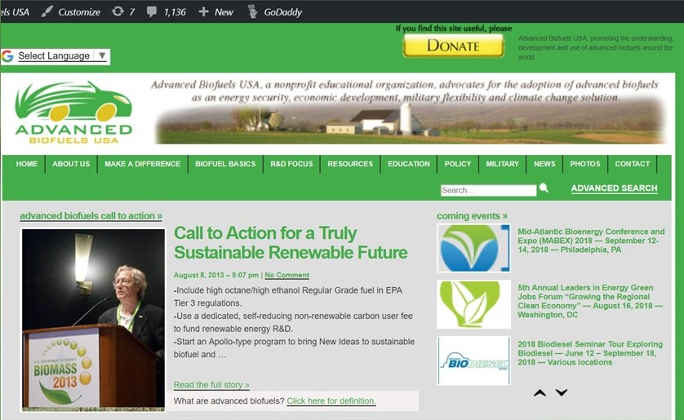

Slide 4
Before we start:
What do you think of when you hear “biofuel”?
Notes:
Introduction
What do you think of when you hear the word “biofuel?”
This is what we are going to talk about
At the end of the presentation, you should be able to answer these questions. At least a little bit.
Before we do anything else, “What does the word ‘biofuel’ mean to you? What do you think of when you hear the word ‘biofuel’?”

Slide 5
“Advanced Biofuels: Transportation, Cooking and Energy Storage”
Overview
      Advanced Biofuels Basics
      Renewable Cooking Fuel
      New Research on Liquid Energy Storage
      Q&A throughout
Notes:
Overview
Quick review of basic presentation, reasons for how it's organized
Start with a question to assess level of understanding, attitudes toward biofuels
Explanation of flexibility of basic presentation, geared to specific audience
Sneak peak at "extra" slides available for more in-depth exploration of specific areas
Engines/fuels
Conversion technologies
List of other resources
Anju Dahiya's book (Bioenergy) and Commercializing Bioproducts book

Slide 6
Advanced Biofuels Basics
What are they?
Why do we need them?
What are they used for? (Yesterday, Today, Tomorrow)
How are they made?
Sustainability
Policy Considerations
Markets

Slide 7
Advanced Biofuels Basics
What are they?
Why do we need them?
What are they used for? (Yesterday, Today, Tomorrow)
How are they made?

Slide 8
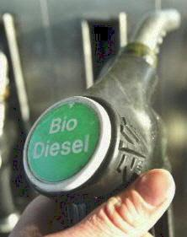
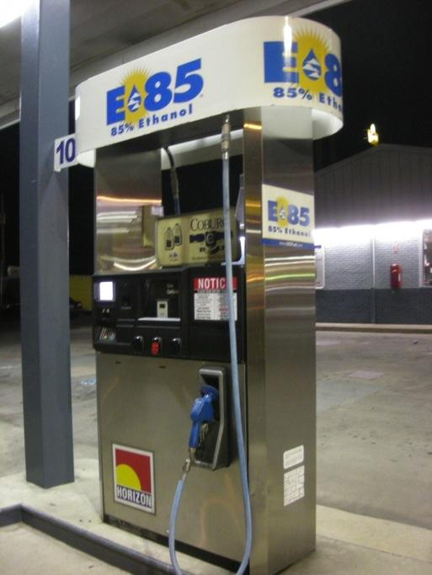
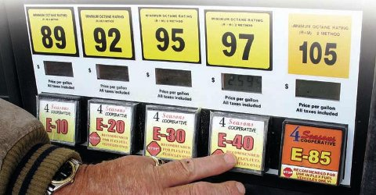
Ethanol is a biofuel, not the only biofuel.
Biodiesel
Renewable Diesel
Biojet
Biobutanol
Drop-in Hydrocarbons
Rocket Fuel
BioHeat ®
What Are Advanced Biofuels?

Slide 9
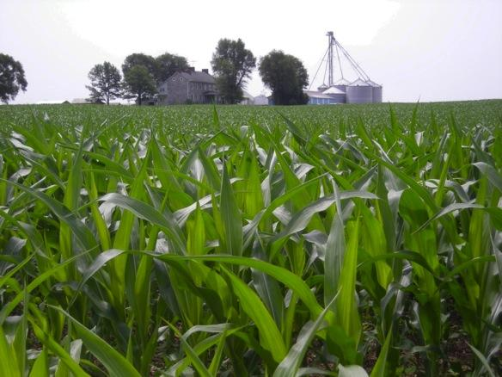
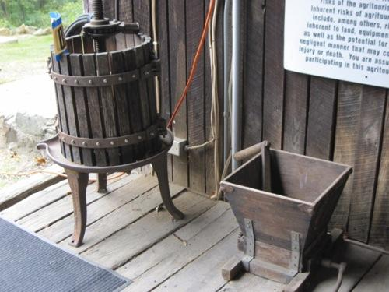
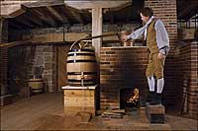
Corn-based ethanol (nearly 200 proof moonshine or 100% ethanol) is one of the few currently commercially available biofuels you can buy for vehicles in the US today.
And the ethanol molecule is part of many other things too.
Wine
Beer
Whiskey
AND, ethanol can be made from many things, not just corn. More on that later….
Notes:
Many people don’t realize that the ethanol that we talk about with regard to fuel is the same molecule as the ethanol or alcohol in wine, beer, whiskey—and that corn ethanol has long been nick-named moonshine.
Important note: as soon as the ethanol is distilled and ready for transport from a biorefinery, some gasoline is added to “poison” it so that it will not be drinkable, and will not be diverted to beverage purposes.
Photos are an old crusher and presser which might be used for grapes (similar ones for apples and other fruit); and the distillery at Mount Vernon, VA, a re-creation of the distillery operated by George Washington on his plantation.
If you want to add a history lesson, or integrate this with lessons in the history department, you can talk about how corn was converted to liquid (moonshine) to both increase its value and make it easier to move large volumes across the Appalachian mountains in the early days of the United States. The Whiskey Rebellion is also a relevant topic.
You can point out the parallels in the problems that people have today moving large volumes of raw biomass to biorefineries.
Ethanol for use as a transportation fuel must be highly distilled

Slide 10
Advanced Biofuels Basics
What are they?
Why do we need them?
What are they used for? (Yesterday, Today, Tomorrow)
How are they made?
Sustainability
Policy Considerations
Markets
Notes:
Introduction
This is what we are going to talk about
At the end of the presentation, you should be able to answer these questions. At least a little bit.

Slide 11
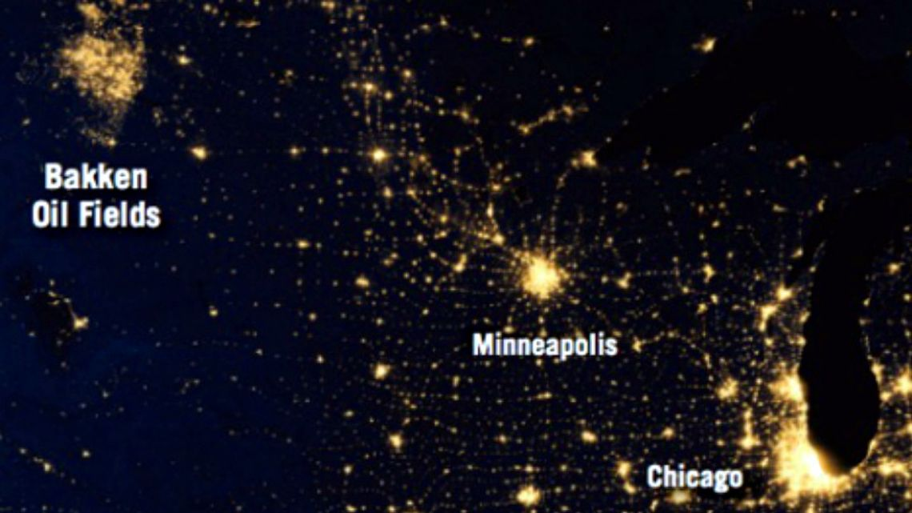
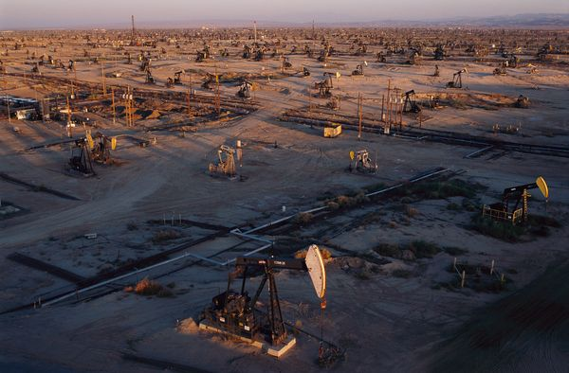
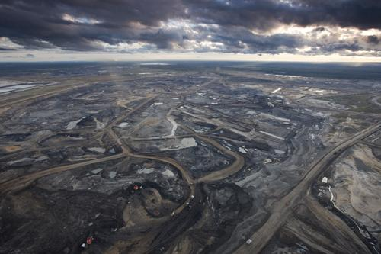
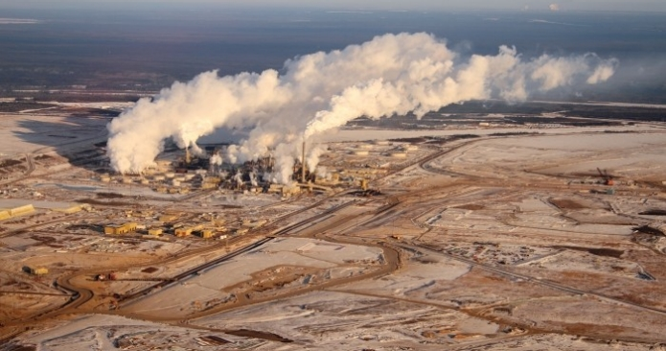
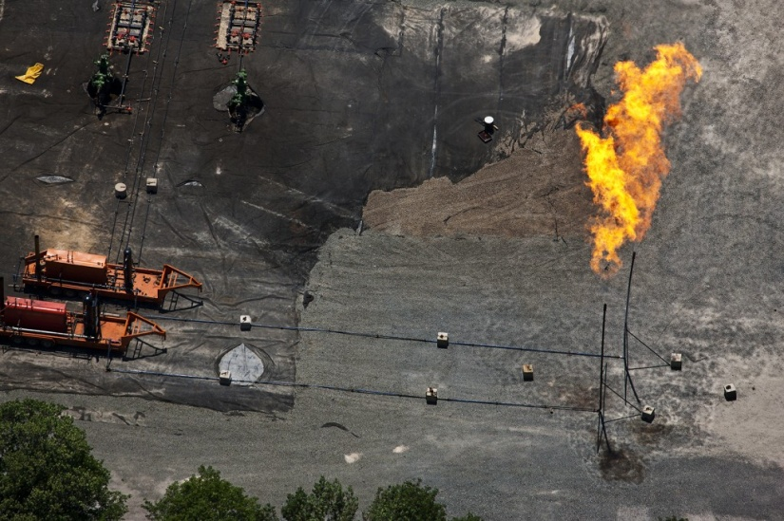
What We Have
Notes:
We are in the process of making choices about our energy resources.

Slide 12

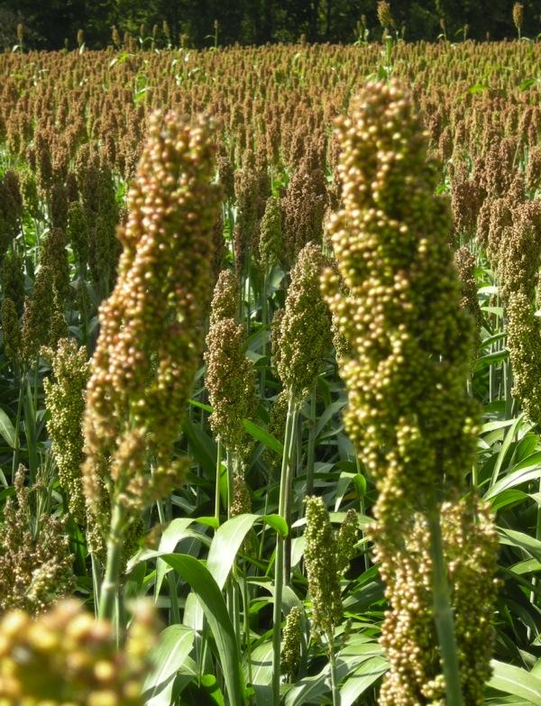
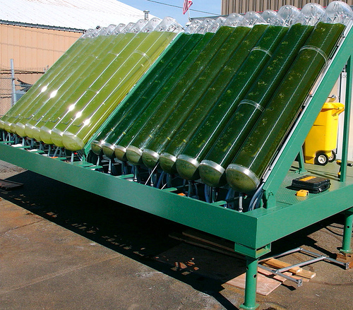
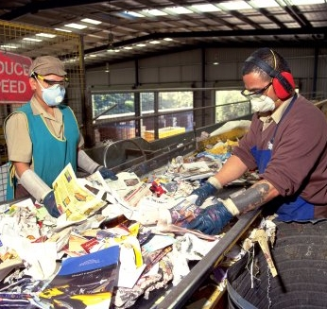
What We Can Have
Notes:
These two slides created by a Hood College student when asked to depict the choices we have.
What order would you put them in?
Is this what we have; and we are in the process of ruining it to create what we see on the previous slide?
Or, is the other slide a representative picture of what we have today; and these photos a depiction of what we could have if we change our ways?
How do you think about this?
Clearly, these are current photos. So we have both. Which do you prefer?

Slide 13
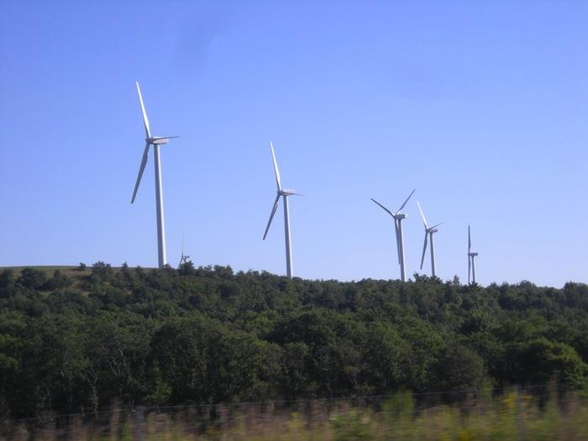


Why Replacing Fossil-Fuel Oil With Advanced Transportation Biofuels is Important—
Virtually no oil is used to produce electricity in the US– just 1%.
Windmills and solar
can produce electricity
but cannot power jet airplanes.
Notes:
Why focus on transportation instead of making electrical power? If our goal is to replace imported oil and petroleum-based fossil fuels, then transportation fuel is the way to go.

Slide 14
Why Replacing Fossil-Fuel Oil With Advanced Transportation Biofuels is Important—
18.9 Million Barrels
of oil used
each day by US
TODAY
71% Used as
Transportation Fuel
Rest to produce
plastics, fiber
film, chemicals
Information from US Energy Information Administration
Notes:
We are not just trying to put oil companies out of business. In addition to national energy security, the underlying reason for all of this is the crisis we face due to climate change.
RFS one was predicated on the idea that the oil companies would transition to become fuel companies; by forcing them to blend renewables into their product, some assumed that they would finance the development of these fuel products—diversify into renewables.
Instead, they fight tooth and nail to preserve their old market as they knew it rather than look to the future; see themselves as “oil men” rather than “fuel providers” or fuel and chemical precursor providers
All of the above; should be “all of the above ground”
Advanced Biofuels as part of an Energy Security solution.
1) Something as important to everyday life as the power to help you move from place to place.
If you put control of that power in the hands of other countries, you become vulnerable. If those other countries want to make you do something that you don’t want to do, they can just squeeze your supply of oil and make life difficult.
For examples, early 1970’s oil embargo lead to lines of cars at gas stations.
In your memory, then lines at gas stations after Hurricane Katrina knocked out a lot of gasoline production and distribution. That kind of disruption is a vulnerability. It’s better to make your fuel at home.
If we can replace a good portion of that oil that is used for transportation by making our own transportation fuels, we minimize that liability.
Energy Security
About two-thirds of U.S. petroleum demand is in the transportation sector. Approximately half of U.S. petroleum is imported. Depending heavily on foreign petroleum supplies puts the United States at risk for trade deficits, supply disruption, and price changes. The Renewable Fuels Association's 2012 Ethanol Industry Outlook(PDF) calculated that in 2011 the ethanol industry replaced the gasoline produced from more than 485 million barrels of imported oil. Ethanol represents 25% of domestically produced and refined motor fuel for gasoline engines.
http://www.afdc.energy.gov/fuels/ethanol_benefits.html US DOE Alternative Fuels Data Center
POLICY Discussion: Non-monitizable value of trying to first transition from petroleum transportation fuels: energy security, military flexibility, economic development, climate change mitigation, pollution control.
If we were not-policy directed, but rather marketing/financing directed; initial emphasis would have been on plastics, fiber, film. Greater margins, smaller scale for greater returns.
Problem has been that “fuels first” policy was articulated, but insufficiently funded.
In 2009: However, the majority of petroleum now extracted—
in the range of 85%—is used to produce fuels. Most of
these are transportation fuels such as gasoline, diesel
fuel, and jet fuel, while some, such as fuel oil, liquefied
petroleum gas, and propane, are used for heating
and power generation. Petroleum accounts for more
than 90% of transportation fuel, but only for 2% of
electricity generation. When refined, a 42-gallon barrel
of crude oil yields about 20 gallons of gasoline, 10
gallons of diesel fuel and heating oil, four gallons of
jet fuel, and smaller amounts of other products.
http://www.publichealthreports.org/userfiles/124_1/5-19.pdf
 5
Energy and Public Health:
The Challenge of Peak Petroleum
Howard Frumkin, MD, DrPHa
Jeremy Hess, MD, MPHa,b
Stephen Vindigni, MPHa,b
aNational Center for Environmental Health and Agency for Toxic Substances and Disease Registry, Centers for Disease Control and
Prevention, Atlanta, GA
bEmory Medical School, Atlanta, GA
Address correspondence to: Howard Frumkin, MD, DrPH, National Center for Environmental Health and Agency for Toxic Substances
and Disease Registry, Centers for Disease Control and Prevention, 4770 Buford Hwy., MS F-61, Atlanta, GA 30341-3717; tel. 770-488-0604;
fax 770-488-3385; e-mail <hfrumkin@cdc.gov>.
Consumption and Disposition
U.S. Petroleum Consumption18,835,000 barrels/day
U.S. Motor Gasoline Consumption8,736,000 barrels/day (377 million gallons/day)
Share of U.S. Oil Consumption for Transportation71% (2011)
U.S. Total Petroleum Exports2,924,000 barrels/day
http://www.eia.gov/energyexplained/index.cfm?page=oil_home#tab2
With the turmoil in the Middle East, it is more important than ever that, because the U.S. produced 13.9 billion gallons of ethanol last year, we used 485 million fewer barrels of imported oil. That is roughly equivalent to 13 percent of total U.S. crude oil imports, saving the American economy $49.7 billion. Without the RFS—and without ethanol production—the U.S. would have imported 52 percent of its oil last year. With the RFS—and with oil imports at 45 percent, their lowest level since 1996—the U.S. is less dependent on unstable or unfriendly regimes. http://www.ethanolproducer.com/articles/9185/the-rfs-itundefineds-not-broke-donundefinedt-fix-it
On the other hand:
Why opt look at the power of zoning. In the Digest we have written about strategic feedstock reserves. Why? Because without reserves and zoning, who is going to make $2 food or $3 fuel when one can make $7 chemicals, $12 nutraceuticals, or convert land for even more to parking lots. It is inevitable that the market will embrace the higher-value opportunities — and these markets are so titanic that it is not as easy as you think to saturate them and move down the cost curve to other products. You can build an awful lot of biorefineries before you have run out of markets for adipic acid, or ethylene.
…Regulate feedstock as the spectrum of scarce bandwidth that it is — and there will be feedstock for all products demanded by the market, and at fair prices. READ MORE

Slide 15
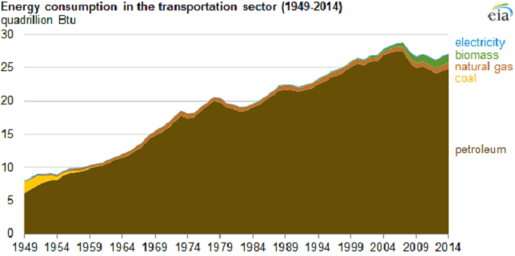
Why Replacing Fossil-Fuel Oil With Advanced Transportation Biofuels is Important—
Oil has held more than a 90% share of the transportation market for more than 60 years.
Information from US Energy Information Administration

Slide 16
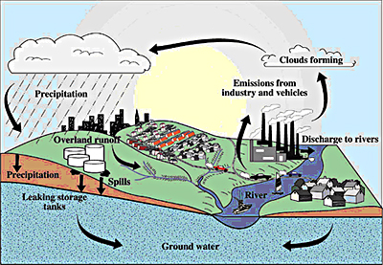
Why Replacing Fossil-Fuel Oil With Advanced Transportation Biofuels is Important—
Replaces MTBE as an oxygenate.
Notes:
MTBE is believed to have entered the water supply from leaking underground storage tank systems including underground lines that contained gasoline and/or from surface spills at gas stations. Once in the ground, MTBE behaves differently from other gasoline constituents such as benzene . Unlike petroleum hydrocarbons, it is highly water soluble, not easily absorbed into soil, and is more resistant to biodegradation. Thus, with widespread use, MTBE has the potential to occur in high concentrations in groundwater, travel far from leak sources, and accumulate to become a concern for the entire region.
http://www.cvwd.com/Documents-MTBE-Project.aspx
http://www.epa.gov/mtbe/

Slide 17
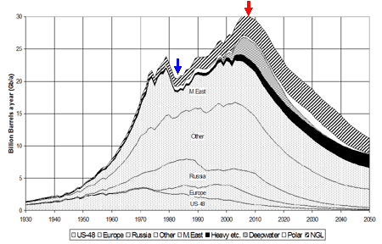
Peak Oil
Why Replacing Fossil-Fuel Oil With Advanced Transportation Biofuels is Important—
Notes:
This is a diagram of how production of oil has peaked in the US, while our need for petroleum fuels has increased, so we have to import oil that we can’t produce ourselves. This same dynamic of oil fields being used up is going on around the world. They don’t replenish, are not renewable. When the oil is gone, the well doesn’t grow more.

Slide 18
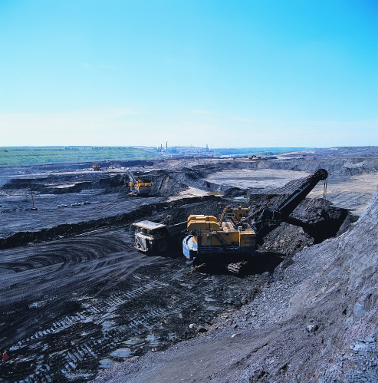

Why Replacing Fossil-Fuel Oil With Advanced Transportation Biofuels is Important—
Before oil runs out, it becomes more difficult and dangerous to extract.
Notes:
2) This oil is fossil fuel. It will run out some day. Before it runs out, it becomes very difficult, dangerous and expensive to find and to extract.
Remember the oil spill in the Gulf of Mexico in 2010—drilling for oil very, very deep wells
Also the tar sands in Canada
In Canada’s boreal forests, there are almost 3000 square miles of mineable oil sands. Getting to the oil sands means removing the forests. It means that large scale, heavy equipment moves into the landscape, removing the plants, impacting animal populations, and damaging soil, water and air. Shifting Sands documents the work in the oil sands with photos of the oil sands landscapes during and after this process. Some consider this to be a cost of oil production. Others consider this to be an environmental disaster.
http://www.decodedscience.com/the-tar-sands-fueling-controversy/4981 by Tricia Edgar is a science writer and educator from the beautiful, wet Pacific Northwest. She has a Master’s degree in Environmental Management.
Map: http://www.google.com/imgres?hl=en&sa=X&biw=1280&bih=685&tbm=isch&prmd=imvns&tbnid=YeF5QzLiRLZv9M:&imgrefurl=http://earthobservatory.nasa.gov/Study/BorealThreshold/&docid=omIRY8y0hG362M&imgurl=http://earthobservatory.nasa.gov/Features/BorealThreshold/Images/boreal_forest_map.gif&w=428&h=370&ei=CkO0TrbAJM-CsgKimNnmAw&zoom=1&iact=hc&vpx=607&vpy=226&dur=11401&hovh=209&hovw=241&tx=103&ty=113&sig=117376384788423915804&page=1&tbnh=141&tbnw=163&start=0&ndsp=18&ved=1t:429,r:8,s:0
http://www.platts.com/RSSFeedDetailedNews/RSSFeed/Oil/8662080?WT.mc_id=&WT.tsrc=Eloqua
"The challenge for producers such as the UAE is to continue producing oil and gas from existing reservoirs while, at the same time, developing new opportunities," he said. "It is no secret that the days of easy oil are coming to an end. Increasingly we are being forced to go down the route of enhanced oil recovery and developing ultra sour oil and gas from complex reservoirs."
These challenges had turned the oil-rich region to become a center for development of new technologies and innovation, Hamli said, referring to the UAE's expansion into renewable energy and its decision to build the zero-carbon Masdar City in Abu Dhabi.
"Our commitment to widening our domestic energy mix and promoting renewable energy does not mean that we have turned our backs to the oil industry," Hamli said.
"Our growing population and fast-moving industrial developments have forced us to choose between continuing burning fossil fuels which would otherwise be exported and finding complementary energy solutions for use at home. We realized that by widening our domestic fuel mix, we could release more hydrocarbons for export," he added.
The UAE has set a target of switching to nuclear power for 25% of its power generation requirements, Hamli said, adding that national peak demand for electricity was set to more than double by 2020 while demand for other forms of energy is growing.
The UAE expects to have its first nuclear power station commissioned in 2017 while at the same time developing solar energy. Abu Dhabi has set a target of generating 7% of its energy needs from renewable sources including solar.
"We believe that the best way of securing a sustainable economic future in a carbon constrained world is to develop a balanced portfolio of clean energy sources in which nuclear, renewable energy, oil and natural gas all have a role to play," Hamli said.

Slide 19


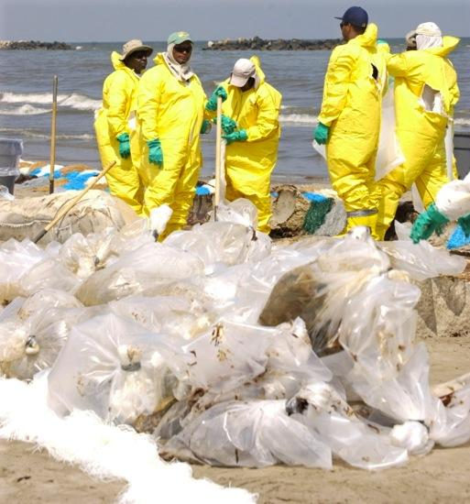

Why Replacing Fossil-Fuel Oil With Advanced Transportation Biofuels is Important—
Before oil runs out, it becomes more difficult and dangerous to extract.
Notes:
2) This oil is fossil fuel. It will run out some day. Before it runs out, it becomes very difficult, dangerous and expensive to find and to extract.
Remember the oil spill in the Gulf of Mexico in 2010—drilling for oil very, very deep wells
Also the tar sands in Canada
In Canada’s boreal forests, there are almost 3000 square miles of mineable oil sands. Getting to the oil sands means removing the forests. It means that large scale, heavy equipment moves into the landscape, removing the plants, impacting animal populations, and damaging soil, water and air. Shifting Sands documents the work in the oil sands with photos of the oil sands landscapes during and after this process. Some consider this to be a cost of oil production. Others consider this to be an environmental disaster.
http://www.decodedscience.com/the-tar-sands-fueling-controversy/4981 by Tricia Edgar is a science writer and educator from the beautiful, wet Pacific Northwest. She has a Master’s degree in Environmental Management.

Slide 20
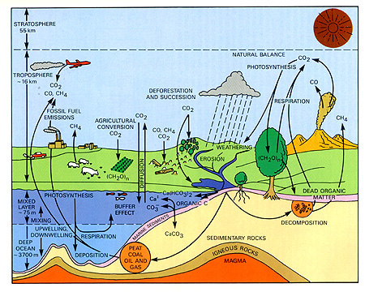
Why Replacing Fossil-Fuel Oil With Advanced Transportation Biofuels is Important—
Part of a low life cycle carbon emissions
climate change mitigation solution
Notes:
Advanced Biofuels as part of a Climate Change mitigation solution
. Not only will oil run out some day, but in the meantime burning hydrocarbons that used to be buried deep in the Earth releases carbon dioxide into the air. More than we need to grow plants and to sustain life. So it stays for very long time in the atmosphere causing climate change. More about carbon cycle later.
Less pollution
Fuels like ethanol burn cleaner, don’t put as many pollutants into the air.
In this country, mostly for transportation; but in other countries ethanol and biodiesel can replace wood and dung which put lots of soot into the air which also causes climate change.
Carbon neutral: use does not contribute to an increase in greenhouse gases.
Suggestion: Point out location of oil on the chart. And arrows coming from oil surface, brining stored/sequestered carbon to the sruface and releasing it; compare that to re-using/recyling carbon that is already released.

Slide 21
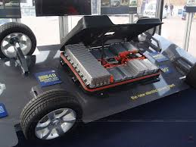

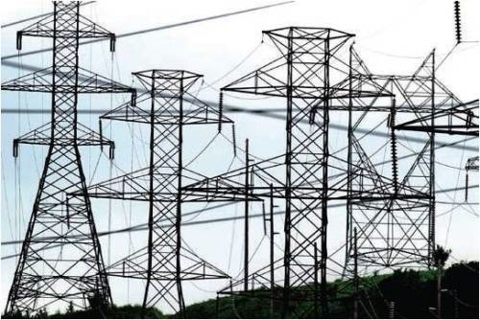

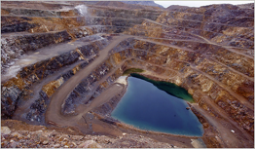

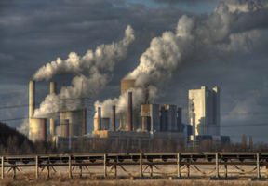
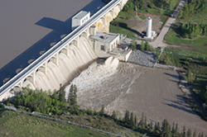
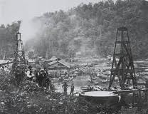

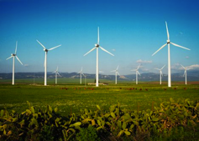
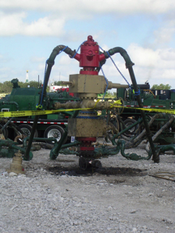
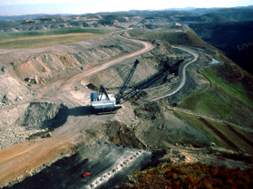
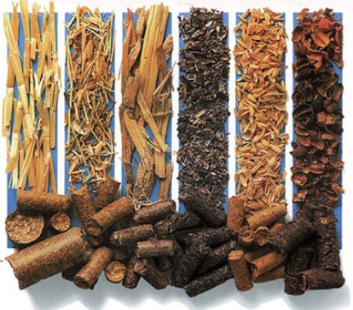
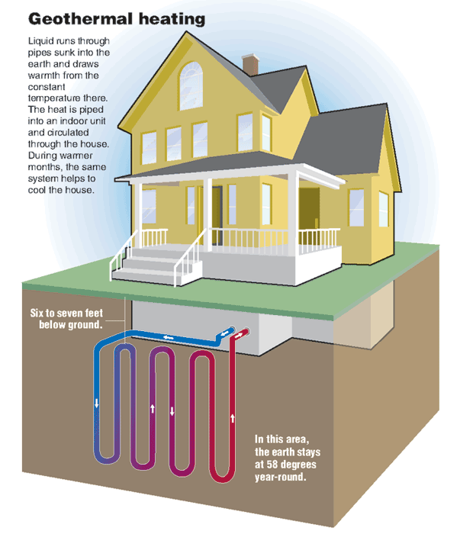
The Road to Electric Vehicles
Batteries
GHG Emissions
Rare Earth Metal Mining
Nuclear
Power Plant
Hydro
GHG Emissions
Petroleum Oil
Solar
Wind
Biomass
Coal Mining
Natural Gas Fracking
Notes:
In 2014, the United States generated about 4,093 billion kilowatthours of electricity.¹ About 67% of the electricity generated was from fossil fuels (coal, natural gas, and petroleum).
Major energy sources and percent share of total U.S. electricity generation in 2014:
Coal = 39%
Natural gas = 27%
Nuclear = 19%
Hydropower = 6%
Other renewables = 7%
Biomass = 1.7%
Geothermal = 0.4%
Solar = 0.4%
Wind = 4.4%
Petroleum = 1%
Other gases < 1%
¹ Preliminary data.
Learn more:
Monthly Energy Review: Electricity
Last updated: March 31, 2015
http://www.eia.gov/tools/faqs/faq.cfm?id=427&t=3

Slide 22
The Road to Electric Vehicles
Batteries
GHG Emissions
Rare Earth Metal Mining
Nuclear
19%
Power Plant
6%
1%
Hydro
GHG Emissions
0.4%
4.4%
Petroleum Oil
27%
Solar
Wind
39%
1.7%
Other gas: less than 1%
0.4%
Coal Mining
Natural Gas Fracking
Biomass
Notes:
In 2014, the United States generated about 4,093 billion kilowatthours of electricity.¹ About 67% of the electricity generated was from fossil fuels (coal, natural gas, and petroleum).
Major energy sources and percent share of total U.S. electricity generation in 2014:
Coal = 39%
Natural gas = 27%
Nuclear = 19%
Hydropower = 6%
Other renewables = 7%
Biomass = 1.7%
Geothermal = 0.4%
Solar = 0.4%
Wind = 4.4%
Petroleum = 1%
Other gases < 1%
¹ Preliminary data.
Learn more:
Monthly Energy Review: Electricity
Last updated: March 31, 2015
http://www.eia.gov/tools/faqs/faq.cfm?id=427&t=3

Slide 23
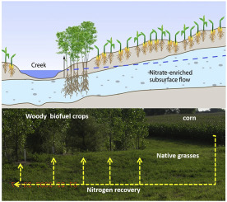

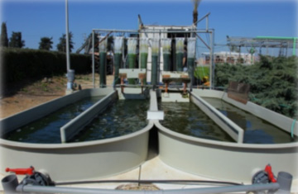
Solutions
Reduce carbon footprints
Erosion control
Waste water treatment
Remediation of contaminated soil
Nutrient management
Carbon Sequestration
Alternative to Carcinogens / Air Quality
Landfill Relief

Slide 24
What Are Advanced Biofuels?
What are they?
Why do we need them?
What are they used for? (Yesterday, Today, Tomorrow)
How are they made?
Sustainability
Policy Considerations
Markets

Slide 25
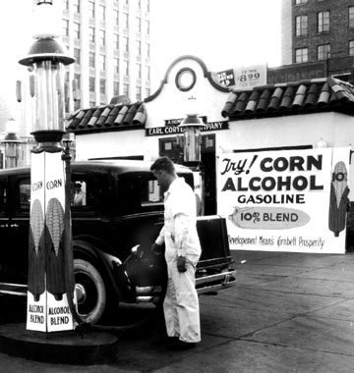
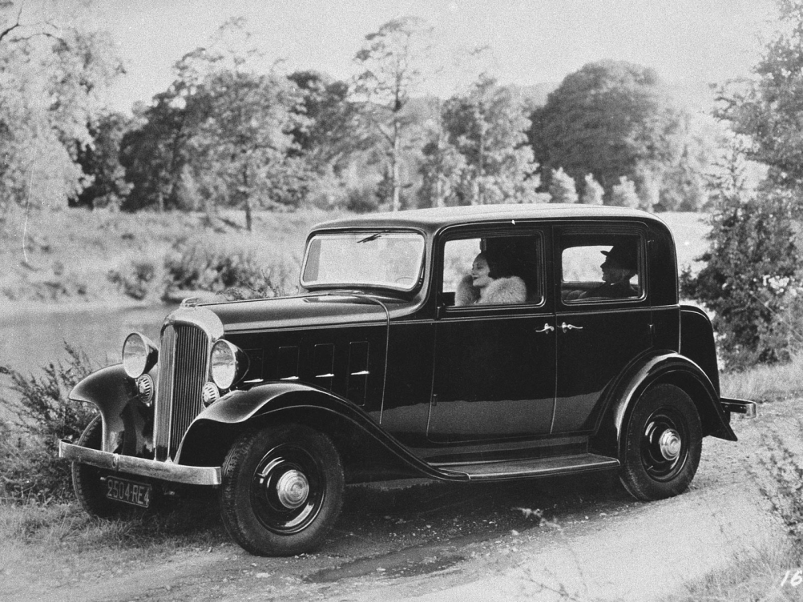
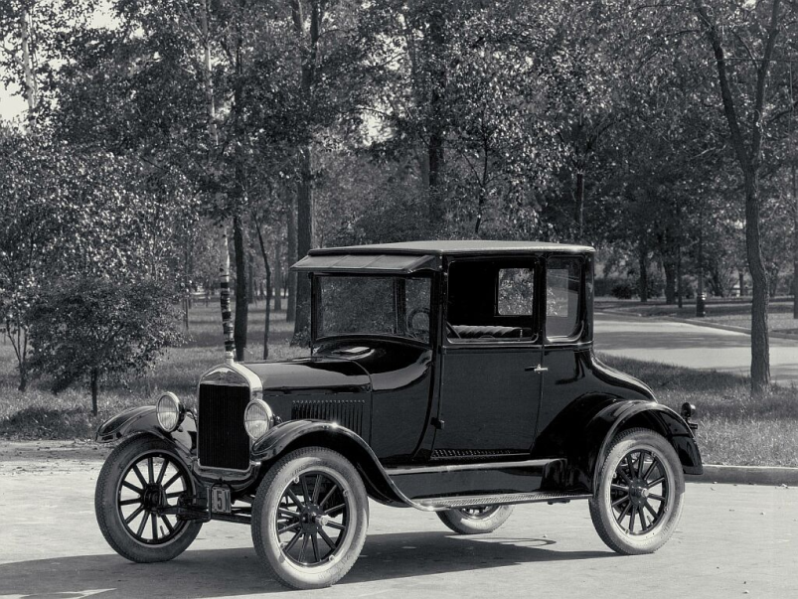
Yesterday: Early Automobiles
The Citröen Rosalie
Ford Model T
Notes:
cleanfuelforthought.wordpress.com
http://en.wikipedia.org/wiki/Citro%C3%ABn_Rosalie
http://www.fuel-testers.com/ethanol_fuel_history.html http://advancedbiofuelsusa.info/up-with-octane-and-down-with-aromatics-continuing-health-risks-with-petroleum-fuels-and-the-need-for-engine-efficiency/ good history
The Ford Model T was designed to run on corn ethanol.
In 1933, Citroën introduced the Rosalie, the first commercially available passenger car with a diesel engine, developed with Harry Ricardo. https://en.wikipedia.org/wiki/Citro%C3%ABn
Inspired by Sadi Carnot's writings to create a more efficient engine, he began working on his project in 1885, and eventually secured financial support from Maschinenfabrik Augsburg (forerunner of Maschinenfabrik Augsburg-Nürnberg and the present-day MAN Diesel) and Friedrich Krupp AG (now ThyssenKrupp). He received a patent for his heat-driven oil engine, now called the diesel engine, in 1892, and powered up the first working diesel engine — fueled by peanut oil — on 10 August 1893. After working out some problems with the design, he introduced a 25-horsepower, four-stroke, single cylinder compression engine in 1897, which gained widespread use after being displayed in the Munich Exhibition of 1898.
The diesel engine is an internal-combustion, compression-ignition mechanism which works by heating fuels (either petroleum-based or bio-derived) and causing the fuel to ignite. Driven solely by high compression in its cylinders, the diesel engine is generally more energy-efficient, quieter, and needs less maintenance and repairs than other internal combustion engines. As Diesel himself wrote, "It is the diesel's higher compression ratio that leads to its greater fuel efficiency. Because the air is compressed, the combustion temperature is higher, and the gases will expand more after combustion, applying more pressure to the piston and crankshaft".
http://www.nndb.com/people/906/000082660/

Slide 26

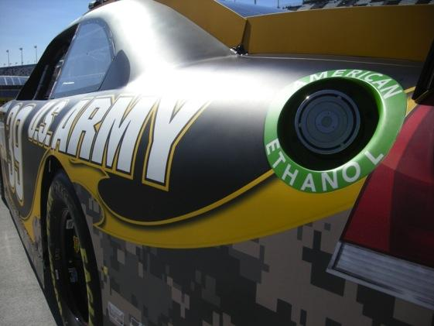
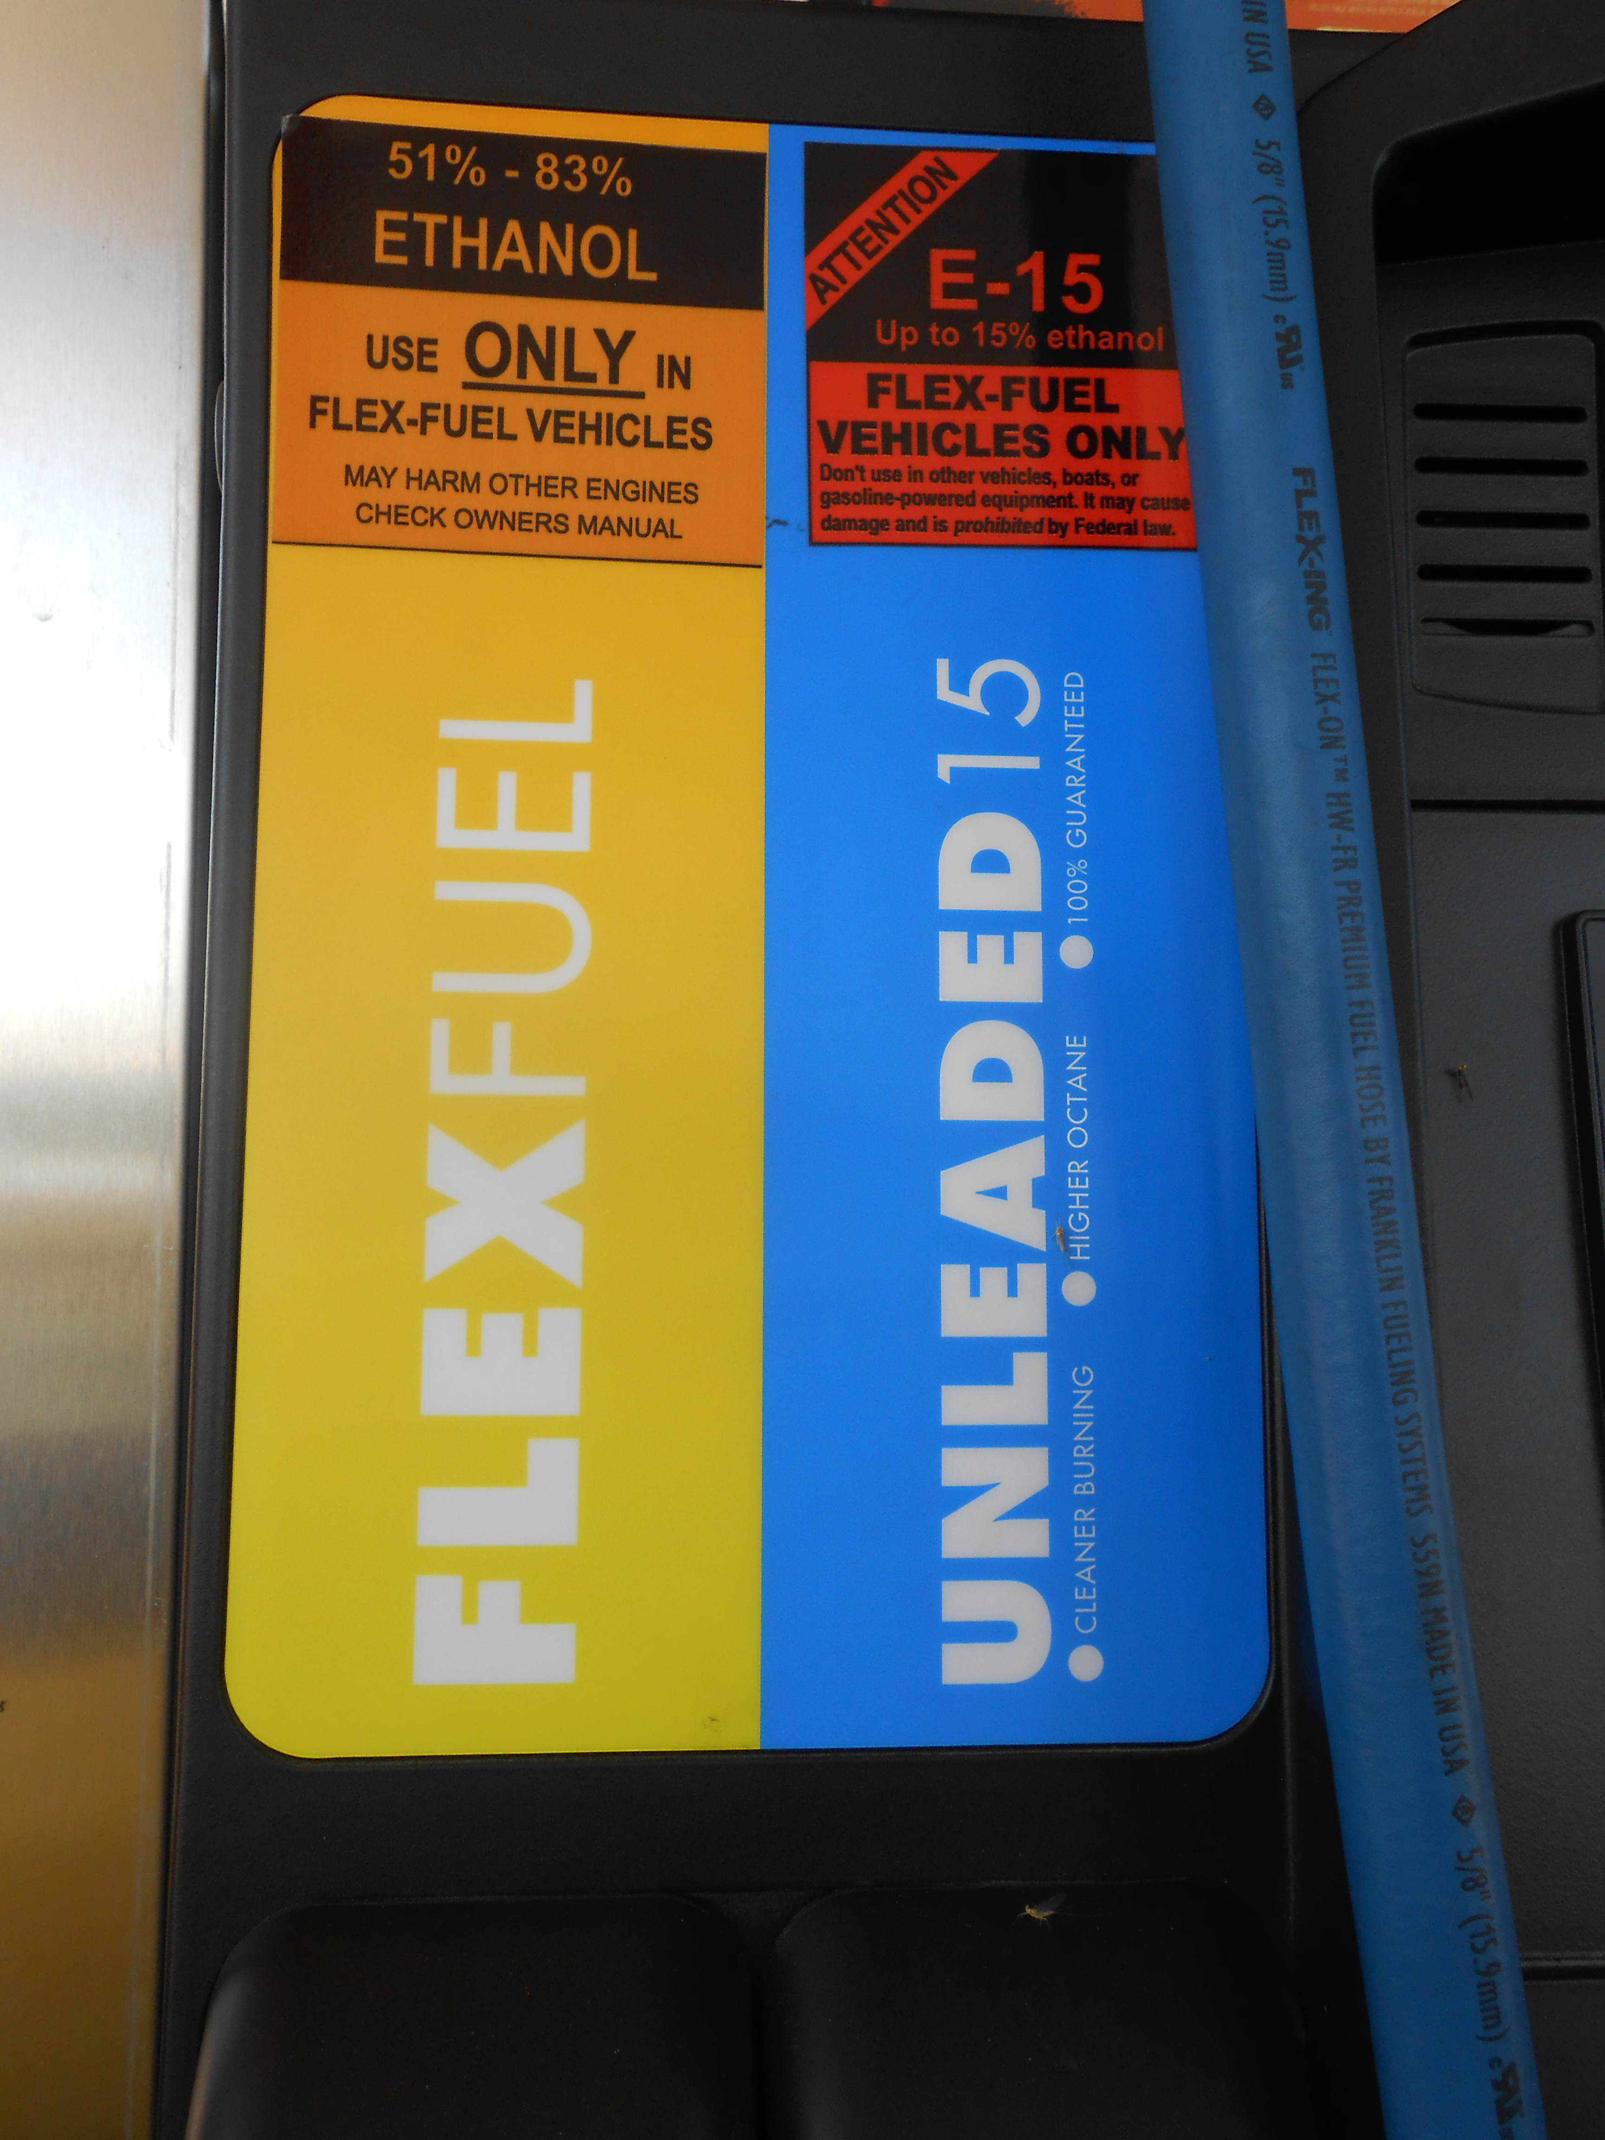

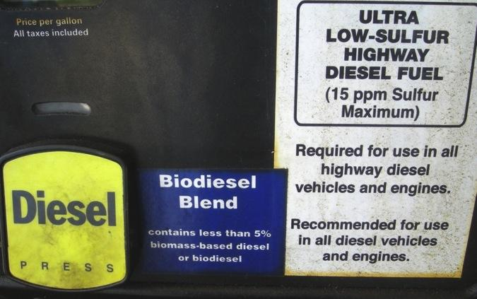
What Are Advanced Biofuels Used For?
Today
Fueling Cars and Trucks
Fueling Aircraft
Notes:
Today, biofuels are used in your cars and trucks. You can buy biofuels at the “gas” station. Around the Washington DC area, almost all the regular gasoline is E10—or 10% ethanol, a biofuel; so 10% biofuel. You can also buy biodiesel blends. Usually 2-5% is biodiesel; but some people use 100% biodiesel, sometimes in farm equipment or in specially adapted cars and trucks.
Race cars use biofuel—IndyCars use E98—almost 100% ethanol. Do you know why they can’t use 100%? Because someone might drink it; so they have to poison it with gasoline molecules so that it is used just for the cars; not for people. Next year IndyCar will use E85, to develop engines and fuels that are closer to what is used on the street.
NASCAR uses 15% ethanol this year. They may increase the amount of ethanol that they use in the future.
In the American Le Mans Series, some cars used bio-isobutanol (Butamax); some used E85; some used E10. Some used diesel; Mazda’s SkyActiv engines used renewable diesel.
In 2016 the cars racing in the 24 hours at Le Mans use E20. 20% ethanol.
And some flights in Spain, Netherlands, Germany and Mexico use blends of biofuel and regular fuel; and commercial flights are starting in the US with Alaska Airlines and United/Continental being the first.
So, you do use biofuels today—just not so much advanced biofuels.

Slide 27
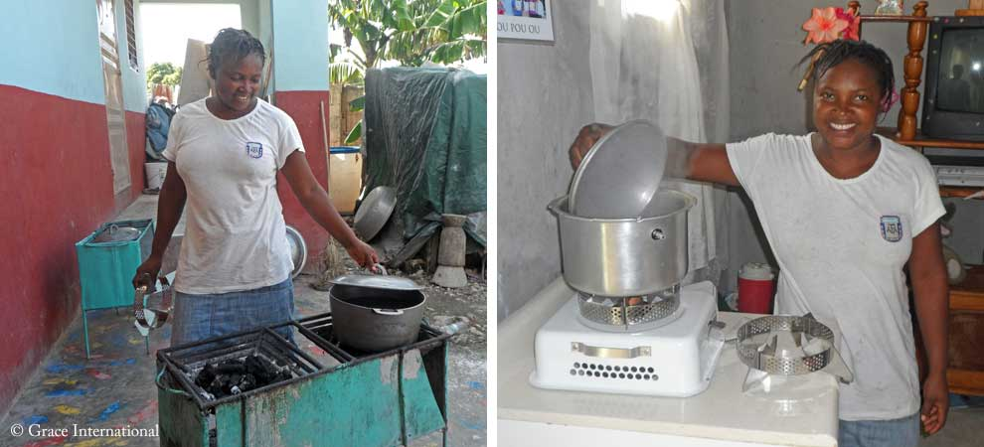
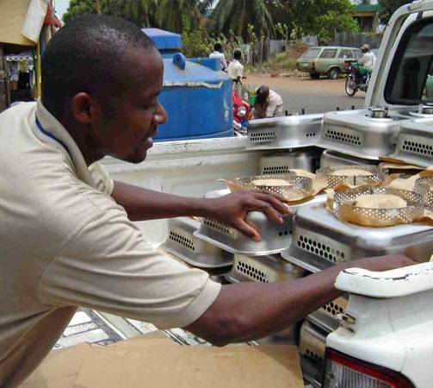
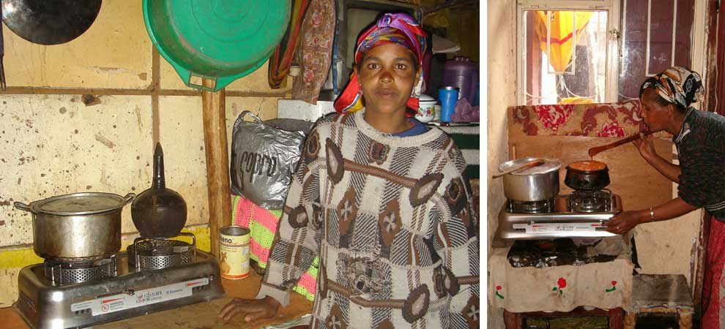
What Are Advanced Biofuels Used For?
Today
Ethanol Cook Stoves
Project Gaia: Nigeria, Ethiopia, Haita, Brazil
Notes:
For more information: Project Gaia: https://projectgaia.com/

Slide 28
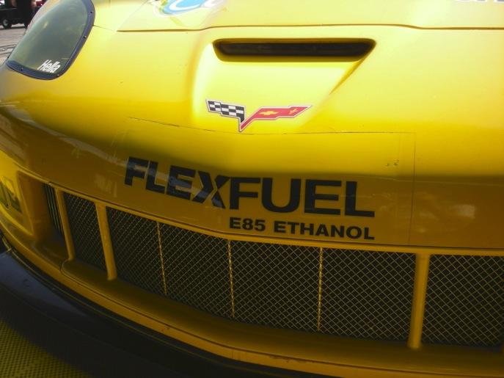
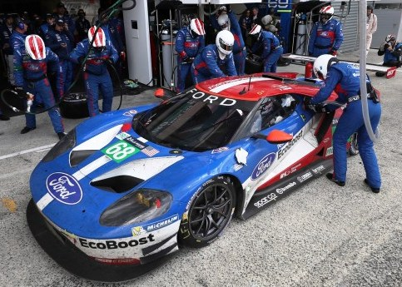
What Will Advanced Biofuels Be Used For Tomorrow?
High octane fuels for high mileage vehicles
Hydrogen Carriers for Fuel Cells
Notes:
Gasoline substitutes
(Grassoline; Green Crude)
Biodiesel or renewable diesel from non-food feedstocks
Jet fuel made from biomass or algae
(JP-8; Commercial Aviation fuels)
“Designer” fuels tailored to obtain the most efficient, most powerful performance from specific engines
Hydrogen Carriers for Fuel Cells
Tier 3 and E30 certification fuels
3.5-liter V6 EcoBoost® racing engine to the 2014 TUDOR United SportsCar Championship series.
The new engine, which will debut at the 2014 Rolex 24 At Daytona on Jan. 25-26 and run the entire 12-race season, will power a new-look Daytona Prototype car, created with Ford corporate design influence. Michael Shank Racing is on board as the first team to put EcoBoost power behind its DP car.
“At Ford Racing, we really put great emphasis on racing production-based vehicles as well as production-based technologies,” says Jamie Allison, director, Ford Racing. “We’re proud to bring a direct-injected, twin-turbo 3.5-liter V6 EcoBoost engine to the United SportsCar Championship in a field of competitive V8-powered entries. We want to show Ford EcoBoost’s capabilities as an engine that provides both performance and fuel economy, on and off the track.”
“This engine is the future,” says Doug Yates, CEO, Roush Yates Racing Engines. “This Ford EcoBoost engine includes all the newest technologies – direct injection, turbocharging and high efficiency. We’re looking at taking it to the next level through this sports car racing program.”
A new Ford-inspired Riley Technologies Daytona Prototype car will accompany the 3.5-liter V6 EcoBoost in Daytona. The car’s body features enhanced Ford production vehicle design cues created by lead Ford production designer Garen Nicoghosian with aerodynamic support from Ford Racing chief aerodynamicist Bernie Marcus.
“Ford Motor Company has taken today’s Daytona Prototype and injected into it unique Ford attributes and unique Ford design characteristics,” says Allison. “This EcoBoost-powered car is obviously adapted for racing applications with racing controls, but ultimately we’re running what we’re selling and selling what we’re running.”
While the new engine will make its competitive racing debut at the highly anticipated 2014 Rolex 24 At Daytona, it will actually hit the Daytona track for the first time Oct. 9.
In a joint effort between Michael Shank Racing, Ford Racing and Continental Tire, the 2012 Rolex 24 At Daytona championship team will aim to set a new track record at the “World Center of Speed” by eclipsing the 210.364 mph lap laid down Feb. 9, 1987, by NASCAR champion Bill Elliott, who pushed his Ford Thunderbird to the top of the speed charts in qualifying for the Daytona 500.
“It’s really a privilege to have an opportunity to put your name in the record books like this,” says team owner Mike Shank. “It is almost inconceivable that this record has stood for such a long time, so it’s pretty special to be involved. We worked a long time to develop our relationship with Ford to be in a position to take on projects like this. Anytime you can get in the record books, it is a great opportunity and just builds on what this company has done.”
“Ford Motor Company stands for innovation and leading-edge technology, so having a chance to debut our Ford EcoBoost technology in a high-visibility setting such as this record run attempt, as well as the entire 2014 USCC schedule with its iconic races, is great,” says Allison. “Through USCC racing and its fan outreach, we want to showcase how EcoBoost technology presents the combined benefits of performance and fuel efficiency – something all consumers would want in their vehicles.”
Weather permitting, Michael Shank Racing will take to the track at 8 a.m. Oct. 9, to start building up speed for the record attempt.
To prepare for the record run and upcoming season, the EcoBoost engine has recently undergone endurance testing at Ford’s Dynamometer Lab in Dearborn, Mich., specifically at the specialized 17G cell. Production and racing engineers from Ford and specialists from Roush Yates Racing Engines have collaborated to ensure the engine is ready for the upcoming season.
http://www.imsa.com/articles/ford-debut-new-ecoboost-race-engine-rolex-24

Slide 29


What Will Advanced Biofuels Be Used For Tomorrow?
Military Aviation Fuels
Military Marine Fuels
Notes:
On March 25, 2010, the Air Force successfully conducted
the first flight test of an aircraft powered by a 50-50
camelina-based biofuel blend. As of mid-2011, 99
percent of the Air Force fleet has been certified to fly on
biofuel blends.15 The Air Force expects to complete all
flight testing by February 2012 and all certifications by
December 2012.
The Navy also is actively engaged in testing and certifying
advanced biofuels for planes and ships—flying the
“Green Hornet” on a camelina-based jet fuel and floating
Riverine Command Boat-Experimental (RCB-X) on a
biofuel derived from algae.16
The Navy is planning to demonstrate a carrier strike group
powered solely by alternative fuels in 2012. Dubbed the
Great Green Fleet, the ships and planes are expected to
conduct an extended mission in 2016, and all energy
provided to operational platforms is to be 50 percent
alternative by 2020.

Slide 30

What Will Advanced Biofuels Be Used For Tomorrow?
The Great Green Fleet
2012 Pacific Rim Exercises
2016 Expanded Emphasis
Notes:
On March 25, 2010, the Air Force successfully conducted
the first flight test of an aircraft powered by a 50-50
camelina-based biofuel blend. As of mid-2011, 99
percent of the Air Force fleet has been certified to fly on
biofuel blends.15 The Air Force expects to complete all
flight testing by February 2012 and all certifications by
December 2012.
The Navy also is actively engaged in testing and certifying
advanced biofuels for planes and ships—flying the
“Green Hornet” on a camelina-based jet fuel and floating
Riverine Command Boat-Experimental (RCB-X) on a
biofuel derived from algae.16
The Navy demonstrated a carrier strike group
powered solely by alternative fuels in 2012. Dubbed the
Great Green Fleet, the ships and planes are expected to
conduct an extended mission in 2016, and all energy
provided to operational platforms is to be 50 percent
alternative by 2020.
2014 marks the first time the U.S. Navy is including biofuels in its annual procurement for bulk fuels.
More details can be found at https://www.fbo.gov, solicitation number SP060014R0061. READ MORE and MORE (Biofuels Digest; includes 10 backgrounders on the Navy’s biofuels’s program )
Washington, the Department of Defense has awarded $210 million under the Defense Production Act to Emerald Biofuels, Fulcrum BioEnergy and Red Rock Bio towards the construction of biorefineries that produce cost-competitive, drop-in military biofuels.
Under the grants, the companies will build biorefineries to produce military spec fuel that is expected to cost the US military, on a weighted average, less than $3.50 per gallon — or cost competitive with petroleum-based fuels, with availability expected as soon as 2016, and have a 50 percent of greater reduction of emissions compared to conventional fuels.
The biorefineries, once complete, will have a combined capacity for producing 100 million gallons of military-spec jet fuel and marine diesel. READ MORE and MORE (US Department of Energy)

Slide 31

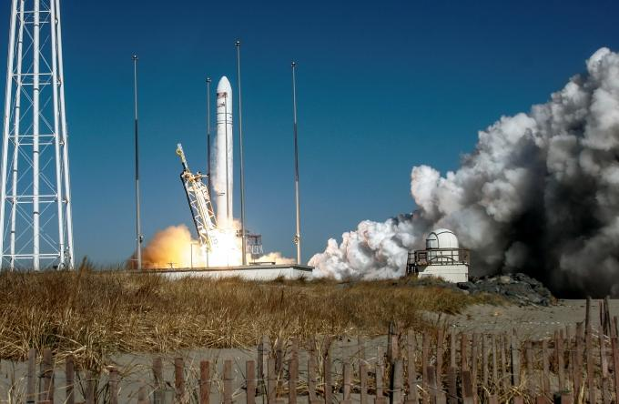
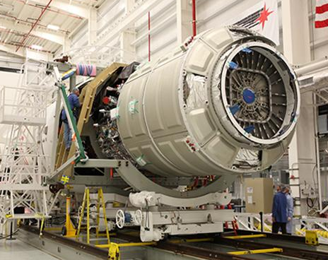
What Will Advanced Biofuels Be Used For Tomorrow?
Rocket Fuel: Resupply Missions to the International Space Station
Notes:
Orbital Completes First Operational Cargo Mission to International Space Station for NASA-- Cygnus Cargo Logistics Spacecraft Reenters Earth’s Atmosphere Over Pacific Ocean --
-- Company’s Next CRS Mission to ISS to Take Place in Early May --
(Dulles, VA 19 February 2014) – Orbital Sciences Corporation (NYSE: ORB), one of the world’s leading space technology companies, today announced the successful completion of the first of eight CygnusTM operational cargo logistics spacecraft missions to the International Space Station (ISS) as part of the company’s $1.9 billion Commercial Resupply Services (CRS) contract with NASA. The Cygnus spacecraft unberthed from the ISS yesterday morning at 6:41 a.m. (EST), completing a 37-day stay at the orbiting laboratory. Today, Cygnus reentered Earth’s atmosphere over the Pacific Ocean east of New Zealand at approximately 1:20 p.m. (EST).
“We are very proud to have a second flawless cargo mission to the space station brought to a successful conclusion this afternoon,” said Mr. David W. Thompson, Orbital’s Chairman and Chief Executive Officer. “Following Cygnus’ successful demonstration mission in late 2013 conducted under our COTS research and development partnership with NASA, the picture-perfect execution of the first operational mission is a great way to start the CRS contract. We are looking forward to the next Antares launch and Cygnus cargo delivery mission currently scheduled for early May.”
The CRS-1 mission began on January 9, 2014 when Orbital’s AntaresTM rocket launched Cygnus into orbit from the Mid-Atlantic Regional Spaceport (MARS) located at NASA’s Wallops Flight Facility in eastern Virginia. Cygnus, which carried 2,780 lbs. (1,260 kg.) of cargo and science payloads, rendezvoused and berthed with the ISS three days later on January 12. Prior to its departure from the station, the astronauts loaded the cargo module with approximately 3,250 lbs. (1,477 kg.) of unneeded items for disposal.
Under the CRS contract with NASA, Orbital is using Antares and Cygnus to deliver up to 44,000 lbs. (20,000 kg.) of cargo to the ISS over eight missions, including the CRS-1 flight just completed, through late 2016. For these missions, NASA will manifest a variety of essential items based on ISS program needs, including food, clothing, crew supplies, spare parts and equipment, and scientific experiments.
Preparations are already well advanced for the next Cygnus cargo delivery flight, the CRS-2 mission, scheduled to take place in early May. The Antares rocket for the mission is now undergoing final assembly at Wallops Island, while the Cygnus spacecraft is being prepared for shipment to the Wallops launch site in mid-March. The CRS-2 flight is expected to deliver about 3,630 lbs. (1,650 kg.) of cargo to the Space Station.
About Antares
The Antares medium-class launch vehicle represents a major increase in the payload launch capability that Orbital can provide to NASA, the U.S. Air Force and commercial customers compared to its heritage small-class space launch vehicles such as Pegasus, Taurus and Minotaur. The Antares rocket can launch spacecraft weighing up to 14,000 lbs. (6,400 kg.) into low-Earth orbit, as well as lighter-weight payloads into higher-energy orbits. Orbital’s newest launcher has completed three successful missions and is currently on-ramped to both the NASA Launch Services-2 and the U.S. Air Force’s Orbital/Suborbital Program-3 contracts, enabling the two largest U.S. government space launch customers to order Antares for “right-size and right-price” launch services for medium-class spacecraft. For more information on Antares, visit http://www.orbital.com/SpaceLaunch/Antares/.
About Cygnus
Orbital developed the Cygnus cargo spacecraft as part of its Commercial Orbital Transportation Services (COTS) joint research and development initiative with NASA. Cygnus consists of a common Service Module (SM) designed and built by Orbital at its Dulles, VA manufacturing facilities, and a Pressurized Cargo Module (PCM), built by Thales Alenia Space under a subcontract from Orbital. The SM incorporates avionics, power and propulsion systems already successfully flown aboard dozens of Orbital’s LEOStar™ and GEOStar™ satellite products. The PCM is based on the Multi-Purpose Logistics Module (MPLM) used with the Space Shuttle. For more information on Cygnus, visit http://www.orbital.com/NewsInfo/Publications/Cygnus_fact.pdf.
About Orbital
Orbital develops and manufactures small- and medium-class rockets and space systems for commercial, military and civil government customers. The company’s primary products are satellites and launch vehicles, including low-Earth orbit, geosynchronous-Earth orbit and planetary exploration spacecraft for communications, remote sensing, scientific and defense missions; human-rated space systems for Earth-orbit, lunar and other missions; ground- and air-launched rockets that deliver satellites into orbit; and missile defense systems that are used as interceptor and target vehicles. Orbital also provides satellite subsystems and space-related technical services to U.S. Government agencies and laboratories. More information about Orbital can be found at http://www.orbital.com. Follow the company on Twitter @OrbitalSciences.
# # # http://www.orbital.com/NewsInfo/release.asp?prid=1887

Slide 32
What Are Advanced Biofuels?
What are they?
Why do we need them?
What are they used for? (Yesterday, Today, Tomorrow)
How are they made?
Sustainability
Policy Considerations
Markets

Slide 33
What Are Advanced Biofuels?
How are they made?
Feedstock
Logistics
Technology
Notes:
There are three parts to making advanced biofuels: feedstock—the stuff that goes into the recipe; logistics—how do you get the feedstock from where it grows or is produced to the biorefinery; and the technology—how do you convert the feedstock into fuels.
For example, how do you release the energy of the sun that has been captured in plants so that it can be productively used to move a car, truck, train or plane?

Slide 34
Agriculture and Forestry:
The Foundations of the Bioeconomy
Feedstocks
Logistics
Technology
Notes:
There are three parts to making advanced biofuels: feedstock—the stuff that goes into the recipe; logistics—how do you get the feedstock from where it grows or is produced to the biorefinery; and the technology—how do you convert the feedstock into fuels.
For example, how do you release the energy of the sun that has been captured in plants so that it can be productively used to move a car, truck, train or plane?

Slide 35
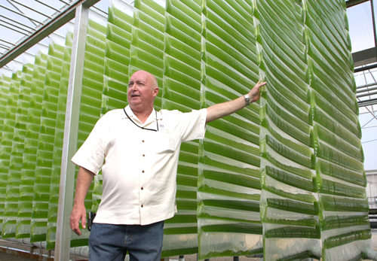
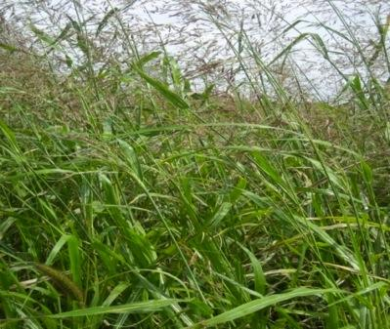






Feedstocks:
Sugars, Starches
Oil seed crops
Grasses
Trees and Forest Waste
Agricultural Residues
Algae
Food/Animal Processing Residues
Energy Crops
Thin Air
Notes:
We’re just going to look at some pictures of the many things that could become advanced biofuels.
http://advancedbiofuelsusa.info/category/feedstocks/

Slide 36
Advanced Biofuels USA Online Library Articles in Category: Atmosphere
From Water to Hydrogen Biofuel – ASU Uses Light-Driven Energy ExtractionJuly 9, 2018 –by Helena Tavares Kennedy (Biofuels Digest) In Arizona, Arizona State University researcher Kevin Redding is working on biological, light-driven energy extraction. Redding, a biochemist who leads the Center for Bioenergy and Photosynthesis at ASU, is producing hydrogen …
Can Climate Change Be Stopped by Turning Air into Gasoline?June 20, 2018 –by David Fridley and Richard Heinberg (Renewable Energy World) The headline of this article was composed simply by rephrasing the title of a popular recent piece in The Atlantic — “Climate Change Can Be Stopped by Turning Air into …
Solar Fuels Come Nearer: Direct-from-Air CO2 Capture Cost Drops below $100/Ton ThresholdJune 8, 2018 –by Jim Lane (Biofuels Digest) A technology for direct air capture of carbon dioxide from the atmosphere, with a cost that “fully burdened with interest on capital, ranges from 94 to 232 $/t-CO2 depending on financial …
Bio-CCS and Bio-CCUS in Climate Change Mitigation–Market and Regulatory Issues Related to Bio-CCUSFebruary 27, 2018 (International Energy Agency Bioenergy Task 41) The fourth IEA Bioenergy Task 41 workshop on Bio-CC(U)S was organized in Brussels 16 January 2018. The topic of the workshop was Market and regulatory issues related to Bio-CCUS. The workshop was …
Solar-to-Fuel System Recycles CO2 to Make Ethanol and EthyleneSeptember 21, 2017 – (Lawrence Berkeley National Laboratory) Solar-to-Fuel System Recycles CO2 to Make Ethanol and Ethylene — Scientists at the Department of Energy’s Lawrence Berkeley National Laboratory (Berkeley Lab) have harnessed the power of photosynthesis to convert carbon …
A Smart, Faster Path to Zero Lifecycle Emission: Advances from the EU in Direct Carbon Capture from AirAugust 8, 2017 –
by Jim Lane (Biofuels Digest) … The most scalable solution is liquid fuels that use water, captured CO2 and renewable electricity.
… Thinkers have been coming around to the realization that this might be the most sustainable …

Slide 37

Process: 4th Generation
Direct-to-Fuel
Solar Fuels
Electrofuels
Algenol’s cyanobacteria
Notes:
Bankrupt.
Joule Sunflow-E and Joule Sunflow-D are derived directly from sunlight and waste CO₂, without costly biomass intermediates or complex processing.
Scale: Our lack of feedstock constraints and our modular system allow rapid scale-up to meet global demand.
Efficiency: Our direct, continuous process maximizes areal efficiency, with ultimate productivity targets of 25,000 gallons of Sunflow-E and 15,000 gallons of Sunflow-D per acre annually.
Cost: At full-scale commercial production, we target costs as low as $1.28/gal Sunflow-E and $50/bbl Sunflow-D, excluding subsidies and including capital costs.
Infrastructure readiness: Our products are inherently compatible with existing fuel infrastructure without chemical processing.
Joule Sunflow-E will be commercially available in 2014, with Joule Sunflow-D to follow.
A similar example, a way to get to ethanol directly from algae—Algenol.
Direct solar fuel technologies utilize photosynthetic microorganisms to produce liquid fuels and fuel precursors directly from solar energy. In most cases, the microorganisms can work as biocatalysts to continuously produce fuels such as liquid hydrocarbons.
Direct Solar Fuels - Projects
Arizona State University: Turning Bacteria into Fuel
Iowa State University: A Genetically Tractable Microalgal Platform for Advanced Biofuel Production
Sun Catalytix: Energy from Water and Sunlight
University of Minnesota: Biofuel from Bacteria and Sunlight

Slide 38



Examples of Potential Feedstocks or Energy Crops
Algae
Corn stover
Corn cobs
Energy cane
Sorghum
Forestry waste
Municipal waste
Sawdust
Chicken manure
Agricultural residues
Grasses such as
  Switchgrass
  Miscanthus
Sugar beets
Coffee grounds
Jatropha
Camelina
Paper/pulp mill waste
Used telephone poles
Halophytes…
Notes:
University of Maryland Center for Environmental Science
($324,439) Feng Chen, associate professor, Institute of Marine & Environmental Technology, works with Dayton-based HY-TEK Bio LLC to develop a system for extracting nutrients from chicken manure to speed the growth of microalgae, which HY-TEK Bio uses in its photobioreactor-based systems to mitigate greenhouse gas emissions on an industrial scale, and develop a bacteria-based process that will separate algae from water that will make harvesting algae fast and inexpensive.
See more at: http://www.mtech.umd.edu/news/press_releases/mips_r52_release.html#sthash.1Zj3gA4S.dpuf
http://advancedbiofuelsusa.info/category/feedstocks/

Slide 39
Examples of potential crops/plants which can be used for production of biofuels
Sorghum
Notes:
http://advancedbiofuelsusa.info/tag/sorghum/

Slide 40

Examples of potential crops/plants which can be used for production of biofuels
Sunflower or Jerusalem Artichoke
Notes:
Photos from the Penn State Energy Crop Library fields
http://advancedbiofuelsusa.info/tag/sunflower/
http://advancedbiofuelsusa.info/tag/jerusalem-artichoke/

Slide 41




Examples of potential crops/plants which can be used for production of biofuels
Canola
Notes:
Canola/rapeseed
http://advancedbiofuelsusa.info/tag/canola/

Slide 42



Examples of potential crops/plants which can be used for production of biofuels
ENERGY GRASSES
Phragmites
Arundo or Giant Reed
Miscanthus
Notes:
Grasses that grow as high as houses.
Clarinet reeds are made out of giant reed plants.
In the US this is considered an invasive species. No federal funds are available to research using this as an energy crop in the US.
http://advancedbiofuelsusa.info/tag/arundo/
http://advancedbiofuelsusa.info/tag/miscanthus/

Slide 43


Examples of potential crops/plants which can be used for production of biofuels
ENERGY GRASSES
Switchgrass
Notes:
Not only is the grass growing higher than the height of the man, but the root system of the grass grows even longer than that. So, when you talk about sustainability; places that need soil erosion control might be good candidates for growing switchgrass as an energy crop.
http://advancedbiofuelsusa.info/tag/switchgrass/

Slide 44

Examples of potential crops/plants which can be used for production of biofuels
ENERGY GRASSES
Notes:
http://advancedbiofuelsusa.info/tag/sorghum/

Slide 45


Examples of potential crops/plants which can be used for production of biofuels
AGRICULTURAL RESIDUES
Corn Stover, Cobs
Notes:
http://advancedbiofuelsusa.info/tag/corn-stover/

Slide 46




Examples of potential crops/plants which can be used for production of biofuels
Sugar Beet/Sugar Beet Pulp
Energy Beets
Notes:
This is a small sugar beet. Many get as big as soccer balls. During harvest, people in the area know to drive far behind the trucks full of sugar beets as some bounce out of the truck and hit and break windshields.
http://advancedbiofuelsusa.info/tag/sugar-beet/

Slide 47



Examples of potential crops/plants which can be used for production of biofuels
Short Rotation Coppice Willow
Poplar
Notes:
http://www.crops4energy.co.uk/short-rotation-coppice-src/
http://advancedbiofuelsusa.info/tag/willow/
http://advancedbiofuelsusa.info/tag/poplar/

Slide 48

Examples of potential crops/plants which can be used for production of biofuels
Kenaf
Notes:
https://hort.purdue.edu/newcrop/afcm/kenaf.html

Slide 49

Examples of potential other things which can be used for production of biofuels
Woody Biomass
Notes:
Wood chips might be left-overs or residues of other forest products processes. For example from sawmills. Or from slash and waste at forest harvest sites—materials that would otherwise be burned int the open. But then you have a logistics issue—getting the waste wood from the forest to the biorefinery for an economical price.
You might also have purpose-grown wood, just as you have for some pulp/paper mills; especially when those have gone out of business.
http://advancedbiofuelsusa.info/tag/woody-biomass/

Slide 50
Examples of potential other things which can be used for production of biofuels
Sorted Municipal Solid Waste
Copyright 2010Advanced Biofuels USA
Notes:
http://advancedbiofuelsusa.info/tag/msw-municipal-solid-waste/

Slide 51

Examples of potential other things which can be used for production of biofuels
Algae
Notes:
There are lots of different ways to grow algae.
http://advancedbiofuelsusa.info/tag/algae/
Also
http://advancedbiofuelsusa.info/tag/seaweed-macroalgae/
http://advancedbiofuelsusa.info/tag/cyanobacteria/

Slide 52



Leather “Fleshings”
Notes:
“Fleshings” (leftover subcutaneous ligament and fat) from leather production are a source of biofuel. The sludge would otherwise turn toxic and be burned, gTamil Nadu to Have World’s First Biorefinery Using Tannery Waste
Submitted by admin on June 26, 2012 – 7:00 pmNo Comment
by Kumar Chellappan (Daily News and Analysis India) Tamil Nadu will be home to the world’s first biorefinery which will use solid waste generated from tanneries in Vellore district.
The Central Leather Research Institute (CLRI) at Chennai, a unit of the Council for Scientific and Industrial Research (CSIR) has succeeded in developing a biorefinery which will produce biodiesel, bioethanol, biohydrogen and biomethane.
“With this bio refinery we will ensure that tanneries across the country do not discharge any kind of solid waste. There will not be any waste to be discharged because we will use it as raw materials,” Palani Shanmugam (42), the CLRI scientist who designed the refinery told DNA. READ MORE
http://www.dnaindia.com/india/report_tamil-nadu-to-have-worlds-first-biorefinery_1706301

Slide 53




Used cooking oils and grease
Notes:
http://advancedbiofuelsusa.info/tag/used-cooking-oil/

Slide 54




Landfill Refueling Stations
Notes:
http://www.greentechlead.com/news/clean-energy-opens-lng-fueling-station-in-seville-ohio-to-support-truck-fleet-operated-by-dillon-transport-serving-owens-corning-826
The opening
of this new Clean Energy LNG truck fueling station, the first in the industrial
heartland of America, is a major step toward realizing our program to create a
national LNG fueling infrastructure that will extend along major truck routes
nationwide.
http://www.quasarenergygroup.com/pages/cng.html

Slide 55
Agriculture:
The Foundation of the Bioeconomy
Feedstocks
Jobs Related to Feedstocks
Notes:
There are three parts to making advanced biofuels: feedstock—the stuff that goes into the recipe; logistics—how do you get the feedstock from where it grows or is produced to the biorefinery; and the technology—how do you convert the feedstock into fuels.
For example, how do you release the energy of the sun that has been captured in plants so that it can be productively used to move a car, truck, train or plane?

Slide 56
A Few Types of Jobs Available in Advanced Biofuels Feedstock Development and Production
Agronomists
Farmers
Farm workers
Farm equipment designers
Biologists
Biologists specializing in genetic research
Biologists specializing in plant cells
Chemists
Chemical engineers
Researchers into bioenergy crop development
Agriculture/horticulture experts
Freight railroad operators, engineers, loaders, unloaders
Equipment operators, technicians
Farm product purchasers/traders
Agricultural and Forestry Supervisors
Agricultural Inspectors
Computer Software Engineers
Others?

Slide 57
What Are Advanced Biofuels?
How are they made?
Feedstock
Logistics
Technology
Notes:
There are three parts to making advanced biofuels: feedstock—the stuff that goes into the recipe; logistics—how do you get the feedstock from where it grows or is produced to the biorefinery; and the technology—how do you convert the feedstock into fuels.
For example, how do you release the energy of the sun that has been captured in plants so that it can be productively used to move a car, truck, train or plane?

Slide 58




Logistics: Harvest, Storage, Transport
Notes:
http://www.energy.gov/eere/articles/five-harvesting-technologies-are-making-biofuels-more-competitive-marketplace

Slide 59




Logistics: Harvest, Storage, Transport
Notes:
http://www.energy.gov/eere/articles/five-harvesting-technologies-are-making-biofuels-more-competitive-marketplace

Slide 60


Logistics: Harvest, Storage, Transport

Slide 61
What Are Advanced Biofuels?
How are they made?
Feedstock
Logistics
Technology
Notes:
There are three parts to making advanced biofuels: feedstock—the stuff that goes into the recipe; logistics—how do you get the feedstock from where it grows or is produced to the biorefinery; and the technology—how do you convert the feedstock into fuels.
For example, how do you release the energy of the sun that has been captured in plants so that it can be productively used to move a car, truck, train or plane?

Slide 62

Processes
Biochemical
Thermochemical
Fermentation
Plant extraction
Transesterification
Hydrolysis
Enzymatic Catalysis
CO2-to-liquid bio-catalytic conversion
Gasification
Plasma arc gasification
Pyrolysis
Thermochemical conversion of sugars
Notes:
Now we get to the technology piece.
These are names of processes that take the feedstock and make it into biofuels or the building blocks for biofuels.
Explain enzymes—like the saliva in your mouth
Explain fermentation—
Explain ethanol. Ask class—what is ethanol? What in everyday life has ethanol in it? You may need to prompt by using the word “alcohol.”
Make clear that the ethanol molecules in fuel are the same chemically as the ones in beer, wine, spirits. The process for converting sugars and starches into ethanol is fermentation. The process for getting the ethanol concentrated—getting the water out—is distillation.
Especially if local history includes production of moonshine, explain that corn ethanol is the same corn ethanol currently used commercially in fuel. If time permits, can introduce the idea of the difference in value and the difference in transportation costs between dried corn kernals and processed corn into whiskey/moonshine. If a history lesson is in order, refer to the Whiskey Rebellion dealt with by George Washington.
For more detail on process technologies, word search in Advanced Biofuels USA’s web site.

Slide 63
Aviation Fuel Processes
Alcohol to Jet (ATJ)
Catalytic Conversion of Oil to Jet (CCOTJ)
Catalytic Conversion of Sugar to Jet (CCSTJ)
Catalytic Hydrothermolysis, Hydroprocessing to Jet (CH-HRJ)
Direct Fermentation of Sugar to Jet (DFSTJ)
Fischer-Tropsch Synthesized Paraffinic Kerosene (FT-SPK)
Hydrotreated Depolymerized Cellulosic Jet (HDCJ)
Hydroprocessed Esters & Fatty Acids (HEFA)
Synthesized Iso-Paraffinic Fuel (SIP)
Notes:
http://advancedbiofuelsusa.info/category/aviation/

Slide 64

Notes:
http://advancedbiofuelsusa.info/category/aviation/

Slide 66
A Few Types of Jobs Available in Advanced Biofuels Production
Biologists
Biologists specializing in genetic research
Biologists specializing in plant cells
Chemists
Chemical engineers
Systems engineers
Research assistants
Process Technicians
Lab technicians
Industrial engineers
Industrial architects
Construction workers, Managers
Truck drivers
Plant operations managers
Equipment operators, technicians
Computer Software Engineers
Refinery Equipment Manufacturers
Welders
Boilermakers
Pipe Fitters
Others?
Notes:
And construction and startup of new advanced biofuel biorefineries are creating thousands of new jobs, many of them also union jobs, for others in different regions of the country. One new cellulosic biorefinery has had as many as 1,000 workers on site as it nears the start of production this year. That means welders, boilermakers, pipe fitters and more are finding new jobs.
With construction of our commercial-scale cellulosic ethanol facility nearing completion, we stand by our commitment to this industry and to helping the United States lead the world in the production of advanced renewable transportation fuel. Commercialization of the cellulosic biofuels industry is not only supporting farmers - it's also adding jobs right here in the state of Iowa. Be a part of one of the first and largest commercial-scale biorefineries by joining the DuPont cellulosic ethanol facility in Nevada, Iowa!
We're currently looking for self-motivated candidates to join us for this unique career opportunity:
Process Technician
Maintenance Technician
Lab Technician
Material Handler

Slide 67
“Advanced Biofuels: Transportation, Cooking and Energy Storage”
Overview
      Advanced Biofuels Basics
      Renewable Cooking Fuel
      New Research on Liquid Energy Storage
      Q&A throughout
Notes:
Overview
Quick review of basic presentation, reasons for how it's organized
Start with a question to assess level of understanding, attitudes toward biofuels
Explanation of flexibility of basic presentation, geared to specific audience
Sneak peak at "extra" slides available for more in-depth exploration of specific areas
Engines/fuels
Conversion technologies
List of other resources
Anju Dahiya's book (Bioenergy) and Commercializing Bioproducts book

Slide 68
Project Gaia---based in Gettysburg, PA
Ethanol Cook Stoves
Project Gaia: Nigeria, Ethiopia, Haita, Brazil
Notes:
For more information: Project Gaia: https://projectgaia.com/

Slide 69



Eradicating Energy Poverty by Increasing Access to Sustainable Cooking Fuels
Ethanol cook stoves
Notes:
https://projectgaia.com/about/

Slide 70
Articles in Category: Cooking Fuel
Vivo Energy Kenya and Koko Networks Form Ethanol Cooking Fuel PartnershipJuly 3, 2018 – (Koko Networks) Vivo Energy becomes first multinational fuels company to enter Kenyan market for ethanol cooking fuel, using KOKO technology to enable affordable mass-market access.
Vivo Energy Kenya today announces a partnership with KOKO Networks (“KOKO”) that …
Cenergy Launches Global Biogas Capture and Utilization ProgramJune 15, 2018 – (Cenergy Solutions/NGV Journal) Cenergy Solutions has a Biogas Capture and Utilization System (BCU System) to help farms and communities around the world economically store and use their biogas instead of venting or flaring it. It is …
‘Biogas Backpack’ Successfully Tested in UgandaMay 15, 2018 – (Bioenergy Insight) A Ugandan and German team called ‘Agali Awamu’ has developed an ‘innovative and feasible’ solution for electricity and biogas supply in Uganda.
The project was facilitated by the lab of tomorrow, an organisation run by the …
Burning of Biofuels, Suspended Dust Emit 48% of Total Pollution in MumbaiMay 7, 2018 by Virat A Singh (Daily News and Analysis India) … “The sector-wise figures would not have changed substantially though its a 2016 study and one has to understand that apart from industries, the main contributor …
New Research Shows the Health Benefits of Ethanol-Fueled CookstovesMay 7, 2018 –by Jieyi Lu (Environmental and Energy Study Institute) Today, about three billion people still cook and heat their homes with traditional stoves and solid fuels worldwide. These fuels and stoves are major contributors to household air …
New Fuels Project in China Targets Cooking in the Commercial SectorMay 3, 2018 – 3:54 pm (Global Alliance for Clean Cookstoves) The Alliance partnered with China’s Ministry of Agriculture, Shell, local governments, and SSM to develop and launch a new clean cooking project in Zhejiang province of China. The project aims to …

Slide 71

Project Gaia---based in Gettysburg, PA
Humanitarian Assistance, Refugee Camps
Families living in refugee camps suffer from energy poverty at its most extreme. Already high levels of environmental degradation are exacerbated by fuelwood collection. Increasing deforestation forces refugee women and girls to travel greater and greater distances in search of already scarce resources, leaving them vulnerable to violence and injury.
Project Gaia became an official implementing partner of the United Nations High Commissioner for Refugees (UNHCR) in 2005 and administers the organization’s Safe and Clean Household Energy Program.
Notes:
Families living in the Jijiga refugee camps suffer from energy poverty at its most extreme. Already high levels of environmental degradation are exacerbated by fuelwood collection. Increasing deforestation forces refugee women and girls to travel greater and greater distances in search of already scarce resources, leaving them vulnerable to violence and injury.
Gaia became an official implementing partner of the United Nations High Commissioner for Refugees (UNHCR) in 2005 and administers the organization’s Safe and Clean Household Energy Program. Gaia’s commitment to bring modern stoves and fuels to households in the camps provides clean energy to thousands of refugee households each year. Today, Gaia covers 100% of families in Eastern Ethiopia’s Jijiga camps (Awberre, Kebribeyah, and Sheder) with clean stoves and fuel. To date, the humanitarian program has distributed more than 7,000 clean cookstoves and over three million liters of ethanol.

Slide 72

Project Gaia---based in Gettysburg, PA
refugee camp project
Other projects:

Slide 73

Project Gaia---based in Gettysburg, PA
Less than 2% of Haiti’s forest cover remains — but Haitians continue to depend on charcoal and firewood, both polluting fuels that have devastated the environment of both Haiti and the Dominican Republic. Haiti is a case of extreme energy poverty – one which calls for sustainable & domestic fuel solutions.

Slide 74

Haiti was once a leading alcohol-producing nation but currently produces only a fraction of its potential. Project Gaia believes that sugarcane mills and alcohol distilleries represent a ready infrastructure for a clean energy future.
Project Gaia and partners are working to commercialize the stove and fuel, revitalize local agriculture, diversify crops, build industry, and lay the groundwork for a sustainable supply of fuel production both internationally and locally. We are working closely with the Haitian company Novogaz, as our local partner on the ground, for the dissemination of clean ethanol stoves and fuel. The US ethanol producer, POET, one of the world’s largest ethanol producers has helped to catalyze the Haitian market with the first batch of donated ethanol. POET is continuing to provide technical support to all partners and actively engage in seeing the market for clean fuel in Haiti become a commercial success. The first rollout of stoves and fuel began in early 2015.
Notes:
Haiti was once a leading alcohol-producing nation but currently produces only a fraction of its potential. Project Gaia believes that sugarcane mills and alcohol distilleries represent a ready infrastructure for a clean energy future.
Project Gaia and partners are working to commercialize the stove and fuel, revitalize local agriculture, diversify crops, build industry, and lay the groundwork for a sustainable supply of fuel production both internationally and locally. We are working closely with the Haitian company Novogaz, as our local partner on the ground, for the dissemination of clean ethanol stoves and fuel. The US ethanol producer, POET, one of the world’s largest ethanol producers has helped to catalyze the Haitian market with the first batch of donated ethanol. POET is continuing to provide technical support to all partners and actively engage in seeing the market for clean fuel in Haiti become a commercial success. The first rollout of stoves and fuel began in early 2015.

Slide 75


Project Gaia---based in Gettysburg, PA -- INDIA Project
A Gendered Problem
Approximately 400 million people in India are exposed to indoor air pollution from cooking fires and subsequently suffer from a number of directly-related ailments, including respiratory and pulmonary disease, cataracts, and premature death. As is the case around the world, women are disproportionately affected. Being the primary preparers of food, women comprise nearly 90% of those most extensively exposed in India. Beyond exposure to indoor air pollution, Indian women must spend five to eight hours each day on cooking-related activities when using traditional solid fuels, with 20% of that time spent on fuel collection.
Beyond the Household Level: Effect of Cookstove Smoke on the Himalayas
The negative effects of solid fuel use are not confined to the household level; indeed, they have a much larger impact. The incomplete combustion of biomass produces black carbon, the second most heat-trapping pollutant in our atmosphere after CO2. This black carbon settles on Himalayan glaciers, accelerating the melting process and consequently threatening India’s water supply.

Slide 76

Renewable Cooking Fuel—India Study

Slide 77
“Advanced Biofuels: Transportation, Cooking and Energy Storage”
Overview
      Advanced Biofuels Basics
      Renewable Cooking Fuel
      New Research on Liquid Energy Storage
      Q&A throughout
Notes:
Overview
Quick review of basic presentation, reasons for how it's organized
Start with a question to assess level of understanding, attitudes toward biofuels
Explanation of flexibility of basic presentation, geared to specific audience
Sneak peak at "extra" slides available for more in-depth exploration of specific areas
Engines/fuels
Conversion technologies
List of other resources
Anju Dahiya's book (Bioenergy) and Commercializing Bioproducts book

Slide 78
Articles tagged with: energy storage
Compound Could Transform Energy Storage for Large GridsFebruary 7, 2018 (Phys.Org/University of Rochester) In order to power entire communities with clean energy, such as solar and wind power, a reliable backup storage system is needed to provide energy when the sun isn’t shining and the …
Ethanol’s Next Breakthrough? Turning Greenhouse Gas into Fuel.February 5, 2018 by Kevin Hardy (Des Moines Register) … Scientists at Oak Ridge National Laboratory unintentionally uncovered a process that uses tiny bits of carbon and copper to convert the greenhouse gas carbon dioxide into ethanol fuel.
While the research remains in …
What is Renewable Methane?December 14, 2017 –by Cliff Gladstein (ACT News) … Attitudes toward the utility of natural gas as the environmentally preferred fuel began to change when technologies to effectively extract natural gas from local shale formations—a process called hydraulic fracturing, or …
SoCalGas Model Energy Design Includes RNG FocusDecember 14, 2017 –by Betsy Lillian (NGT News) Southern California Gas Co. (SoCalGas) is partnering with the University of California-Irvine’s Advanced Power & Energy Program to design an “Advanced Energy Community” in an underserved neighborhood in Huntington Beach.
The community …
Turning Brewery Wastewater into Battery PowerOctober 12, 2016 – (University of Colorado Boulder) CU Boulder engineers have developed an innovative bio-manufacturing process that uses a biological organism cultivated in brewery wastewater to create the carbon-based materials needed to make energy storage cells.

Slide 79


Ethanol and Methanol derived compounds as energy storage for Redox Flow Battery
Ellen Matson, left, assistant professor of chemistry, and PhD student Lauren VanGelder at work in Matson's lab. VanGelder is lead author on a paper describing modifications to a redox flow battery that make it nearly twice as effective for electrochemical energy storage.
Credit: University of Rochester photo / Matson Lab
The key to this technology, called a redox flow battery, is finding chemicals that can not only "carry" sufficient charge, but also be stored without degrading for long periods, thereby maximizing power generation and minimizing the costs of replenishing the system.
Replacing the compound's methanol-derived methoxide groups with ethanol-based ethoxide ligands—the team was able to expand the potential window during which the cluster was stable, doubling the amount of electrical energy that could be stored in the battery.
Notes:
Read more at: https://phys.org/news/2018-02-compound-energy-storage-large-grids.html#jCp
Matson stressed the "crucial role" played by VanGelder, who conducted the initial testing and experiments on the clusters while Matson was on maternity leave. "As a third-year graduate student, she did an incredible job of starting this project. She's played an important role in driving this research effort in the lab," Matson says.
Explore further: Chemists improve batteries for renewable energy storage
More information: L. E. VanGelder et al. Polyoxovanadate-alkoxide clusters as multi-electron charge carriers for symmetric non-aqueous redox flow batteries, Chemical Science (2018). DOI: 10.1039/C7SC05295B
http://dx.doi.org/10.1039/C7SC05295B
Read more at: https://phys.org/news/2018-02-compound-energy-storage-large-grids.html#jCp

Slide 80

Nano-spike catalysts convert carbon dioxide directly into ethanol
Oak Ridge National Laboratory have developed an electrochemical process that uses tiny spikes of carbon and copper to turn carbon dioxide, a greenhouse gas, into ethanol.
The team used a catalyst made of carbon, copper and nitrogen and applied voltage to trigger a complicated chemical reaction that essentially reverses the combustion process.
The solution of carbon dioxide dissolved in water turned into ethanol with a yield of 63 percent.
Notes:
https://youtu.be/t7EYQLOlwDM
Given the technique’s reliance on low-cost materials and an ability to operate at room temperature in water, the researchers believe the approach could be scaled up for industrially relevant applications. For instance, the process could be used to store excess electricity generated from variable power sources such as wind and solar.
“A process like this would allow you to consume extra electricity when it’s available to make and store as ethanol,” Rondinone said. “This could help to balance a grid supplied by intermittent renewable sources.”
https://www.ornl.gov/news/nano-spike-catalysts-convert-carbon-dioxide-directly-ethanol

Slide 81

Energy Storage in Renewable Methane via Power-to-Gas
By running an electric current through water, the water molecule decomposes into hydrogen and oxygen. The hydrogen is then captured and is either used directly or mixed with carbon dioxide to create methane.
The methane can be injected into existing natural gas infrastructure where it can be stored indefinitely, or used for power production, vehicle fuel, residential heating and cooking, manufacturing or as an industrial feedstock.
Power-to-Gas, provides a solution to renewable energy storage, helps communities decarbonize their gas supply and can supply potentially endless volumes of clean hydrogen and renewable methane to power transportation.
Natural gas engines can replace diesel engines. To ensure that we can both enjoy the air quality and climate protection benefits of near zero emission natural gas engines, they should be fueled by renewable methane.
Notes:
https://www.act-news.com/news/what-is-renewable-methane/

Slide 82

1930’s Huntington Beach, CA
post 1920’s oil boom
Southern California Gas Co. (SoCalGas) is partnering with the University of California-Irvine’s Advanced Power & Energy Program to design an “Advanced Energy Community” in an underserved neighborhood in Huntington Beach.
Energy options: solar, wind and renewable natural gas (RNG) and storing wind- and solar-generated energy with power-to-gas technology.

Slide 83


In 2016, the University of California-Irvine demonstrated the use of power-to-gas technology to use excess solar-generated electricity on the university’s campus.
Installation of a novel bioreactor system that will be used to test power-to-gas technology at the U.S. Department of Energy’s National Renewable Energy Laboratory in Golden, Colo.
By 2025, between 3,300 and 7,800 GWh of excess solar and wind energy will be curtailed in California.
If all that excess solar and wind energy were converted to methane through the biomethanation process and stored as RNG, it would provide enough renewable energy to heat 158,000 to 370,000 homes or provide renewable electricity to 80,000 to 187,000 homes, according to the utility.
1950’s Oil gusher in Huntington Beach, CA

Slide 84


Huntington Beach, California, USA. 20th Jan, 2018. Offshore oil rig platforms off the coast of Huntington Beach in Orange county. The Trump administration recently proposed the largest expansion of offshore oil and gas drilling in U.S. history, releasing a plan to allow new drilling off the coasts of Northern, Central and Southern California.'Today we're embarking on a new path for energy dominance in America, ' U.S. Interior Secretary Zinke said. Credit: ZUMA Press, Inc./Alamy Live News
What we have now
What we could have

Slide 85


University of Colorado Boulder engineers have developed an innovative bio-manufacturing process that uses a biological organism cultivated in brewery wastewater to create the carbon-based materials needed to make energy storage cells.
They can’t just dump it into the sewer because it requires extra filtration.
A fast-growing fungus, Neurospora crassa, cultivated in the sugar-rich brewery wastewater
One of the most efficient naturally-derived lithium-ion battery electrodes known to date while cleaning the wastewater in the process.
The findings were published recently in the American Chemical Society journal Applied Materials & Interfaces.
If the process were applied on a large scale, breweries could potentially reduce their municipal wastewater costs significantly while manufacturers would gain access to a cost-effective incubating medium for advanced battery technology components.
Notes:
https://www.colorado.edu/today/2016/10/07/turning-brewery-wastewater-battery-power

Slide 86

Find out more: www.AdvancedBiofuelsUSA.org
For a Truly Sustainable, Renewable Future
Joanne M. Ivancic, Executive Director
301-644-1395
JIvancic@AdvancedBiofuelsUSA.org
86

